Slide 1
Pacific Regional
Navigation
Initiative
Keleni Raqisia
Pacific GIS/RS Conference
Date: December 2016

Slide 2
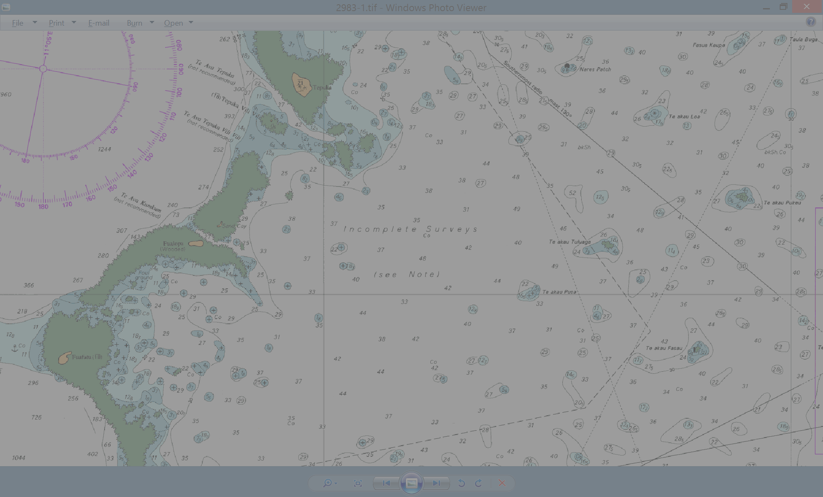
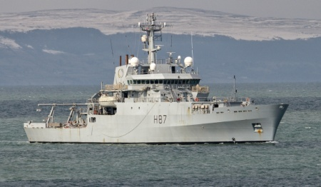
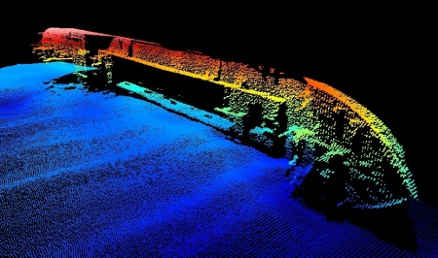
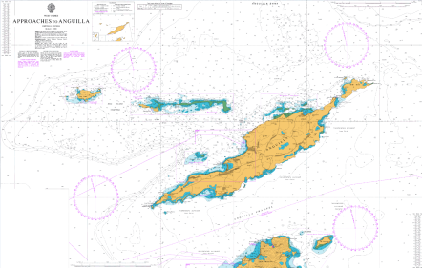
Outline:
Introduction
Pacific Wide Data Discovery Activity & Access
Outputs
Concluding Statements
Notes:
Good morning.
Keleni Raqisia and I work as a Geospatial Administrator at the SPC-Geoscience , Geoinformatics for Development Section.
My work mainly focuses on Geospatial Metadata Content Management.
And this afternoon I will be talking about a project that my section has been working on.
So to start of I will introduce the Project.
Specifically focus on the how we assisting this project.
Provide some outputs currently completed.
And I will conclude with how we’d like to move forward from the current status of the project.

Slide 3
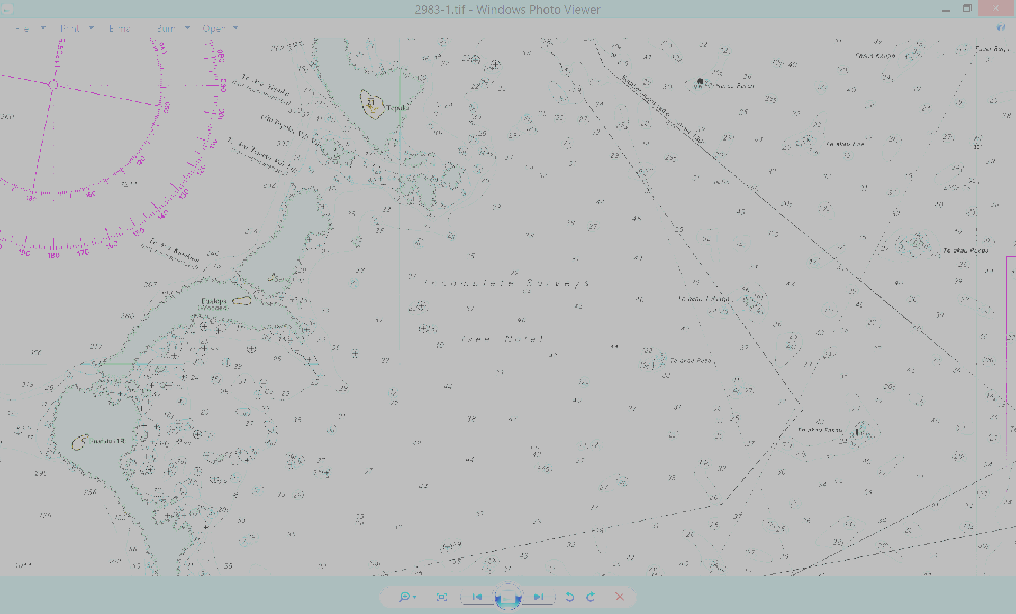
Introduction: PRNI
Pacific Regional Navigation Initiative
South West Regional Pacific Hydrography Programme.
Aims
A safer maritime environment for the transport of people & goods
Improve maritime charts and electronic navigation information to enable economic development opportunities for PICs, such as increased tourism through cruise ship visits
Provide independent data to PICs about areas of greatest maritime risk and possible mitigations (Risk Assessments)
Improvements to Aids to Navigation
Comply with IMO regulations for SOLAS ships to use Electronic Navigation Charts
Notes:
To start , PRNI which stands for the Pacific Regional Navigation Initiative.
This project Builds on the successes and lessons learned from the South West Regional Pacific Hydrography Programme , particularly in relation to charting and risk assessment work.
The aims of the Initiative is provide safer maritime environment for the transport of people and goods.
Improve maritime charts and electronic navigation information .
Provide independent data to PICs about areas of greatest maritime.
Improvements to aids to navigation
Comply with IMO ( International M……. O....…..) regulations for SOLAS ships to use electronic Navigation Charts

Slide 4
Introduction: Pacific Wide Data Discovery & Access
5 Years
5 Countries – Niue, Cook Islands, Tonga, Samoa, Tokelau
PRNI action to address Data Discovery and access
Collate and Analyse all bathymetry and related data held by SPC on behalf of member PICT
Gain agreements with PICT’s for release of data to Primary Charting Authority (PCA)
Catalogue metadata and make available to PICT’s and PCA’s
PCA use appropriate data to update charts
Notes:
We’re involved with the “Pacific wide data discovery activity” which is a component of the PRNI
Into the 2nd year of the activity at SPC
Because we’re working in partnership, within this LINZ have 5 priority countries mainly primarily due to its Primary Charting Authority in this countries Niue, CK, Tonga, WS, Tokelau. But in fact SPC in the current activity is looking at compiling for all its member countries.
Because SPC is known as a repository for a range of maritime information from satellite , military and other sources. Under this output SPC will with initial assistance and planning input from LINZ , undertake the pacific wide data discovery activities in relation to all PICs for which it holds data.
SPC analyse all the data SPC holds across in the Pacific. In addition to information it may hold through undertaking applied scientific research. Some of this information included includes bathymetric and other scientific work that may be relevant to hydrography.
Facilitate the provision of agreements with our member countries for approval of release of data to responsible PCAs.
Catalogue this information in its most appropriate metadata standard or schema.

Slide 5
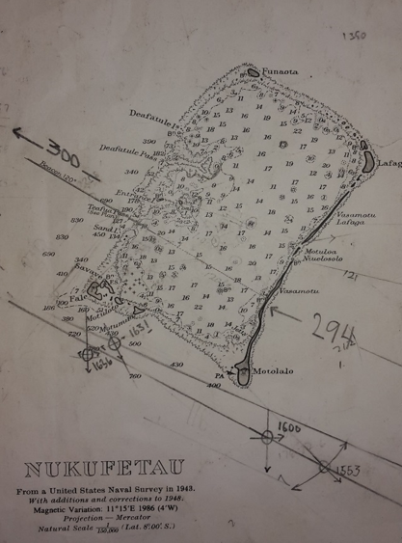
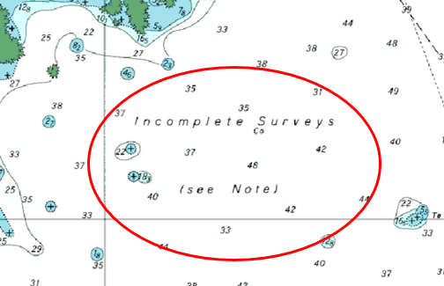
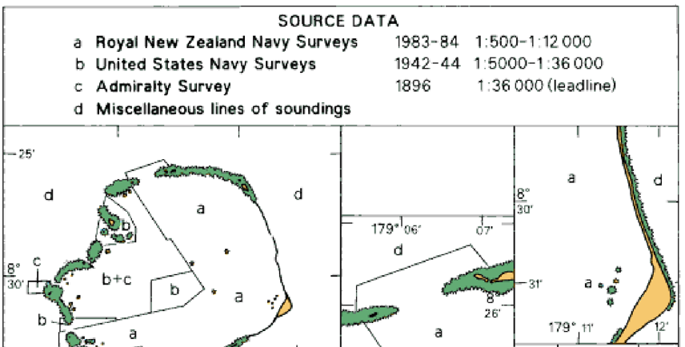
Pacific Wide Data Discovery Need for Data:
Notes:
To be able to meet this aims of the PRNI we recognise the fundamental issue faced in our region is the lack of data to enable the updating of existing charts and production of new ones to improve safety of navigation and better support the needs of maritime users.
Here is an example of for a need for data.
This Niutao in Tuvalu
As we can see here the existing nautical chart does not provide enough information for safe navigation.
The data held by SPC can be used to update the existing nautical chart, or in the example shown, provide enough data to possible produce a larger scale chart of Niutao.

Slide 6
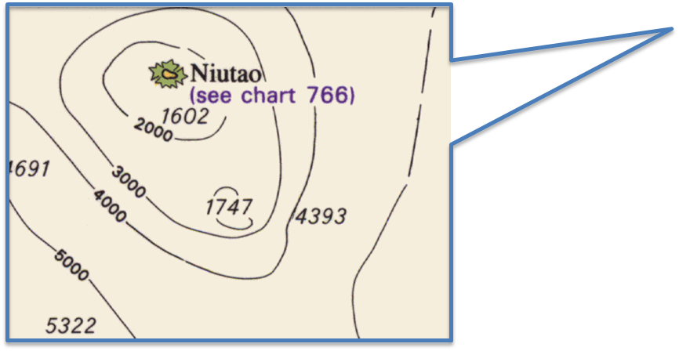
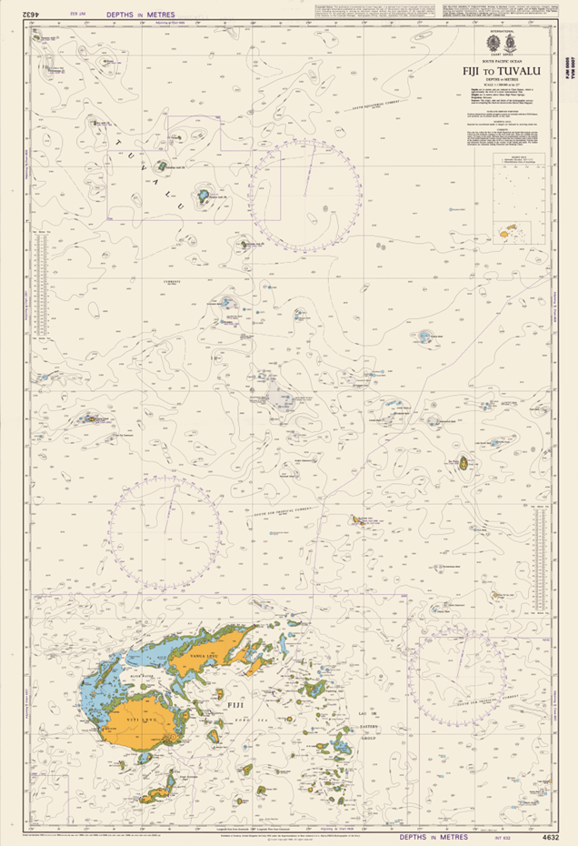
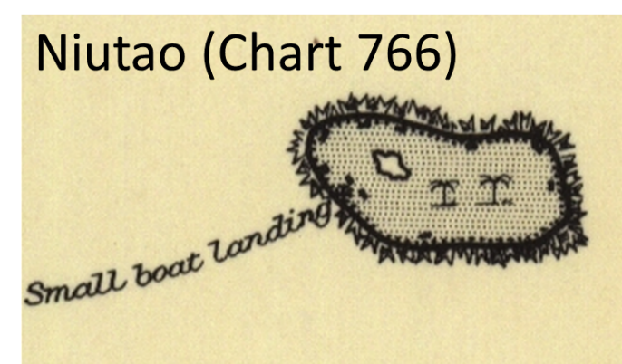
Pacific Wide Data Discovery Need for Data:
Notes:
To be able to meet this aims of the PRNI we recognise the fundamental issue faced in our region is the lack of data to enable the updating of existing charts and production of new ones to improve safety of navigation and better support the needs of maritime users.
Here is an example of for a need for data.
This Niutao in Tuvalu
As we can see here the existing nautical chart does not provide enough information for safe navigation.
The data held by SPC can be used to update the existing nautical chart, or in the example shown, provide enough data to possible produce a larger scale chart of Niutao.

Slide 7
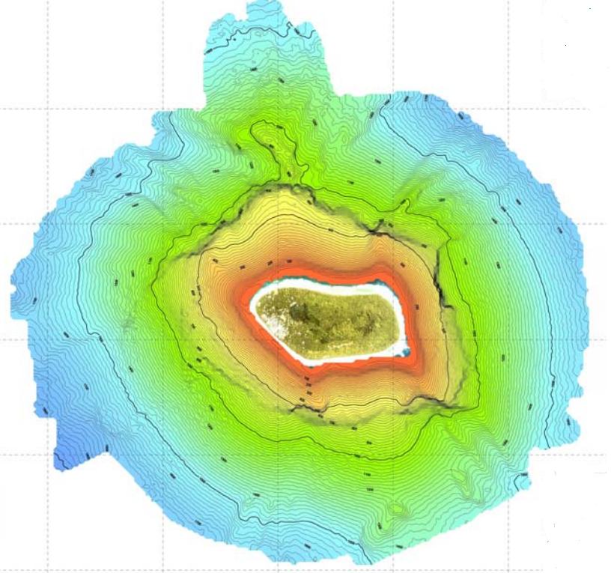
Pacific Wide Data Discovery Need for Data:
Notes:
Data Gap
As you can see the data held by SPC can be used to update the existing nautical chart, or in the example shown, provide enough data to possible produce a larger scale chart of Niutao.

Slide 8
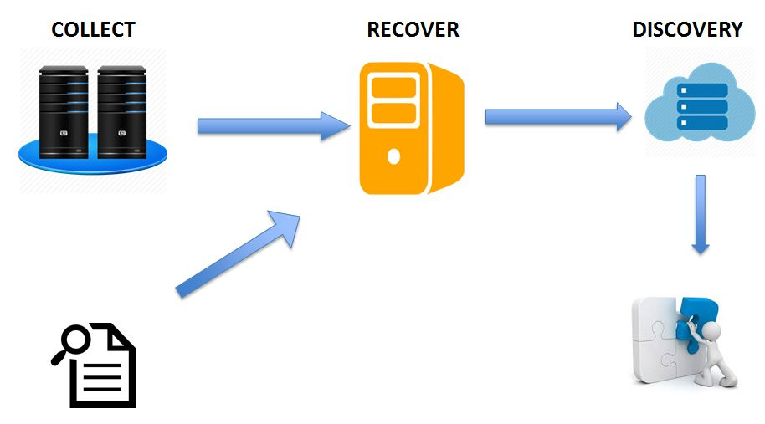
Pacific Wide Data Discovery Workflow:
Notes:
So bringing all this information into a server. Anything from reports, atlases, charts, bathymetry collected by SPC Geoscience surveyors and those collected by external organisations ( from Scientific cruise ships). Tedious work as after we collect this information , we need to consult with surveyors , researching reading through reports .Organised by country and we try converting all this information into WGS 84 and we try preparing them for exposure by converting them to readily read formats such as .shp

Slide 9
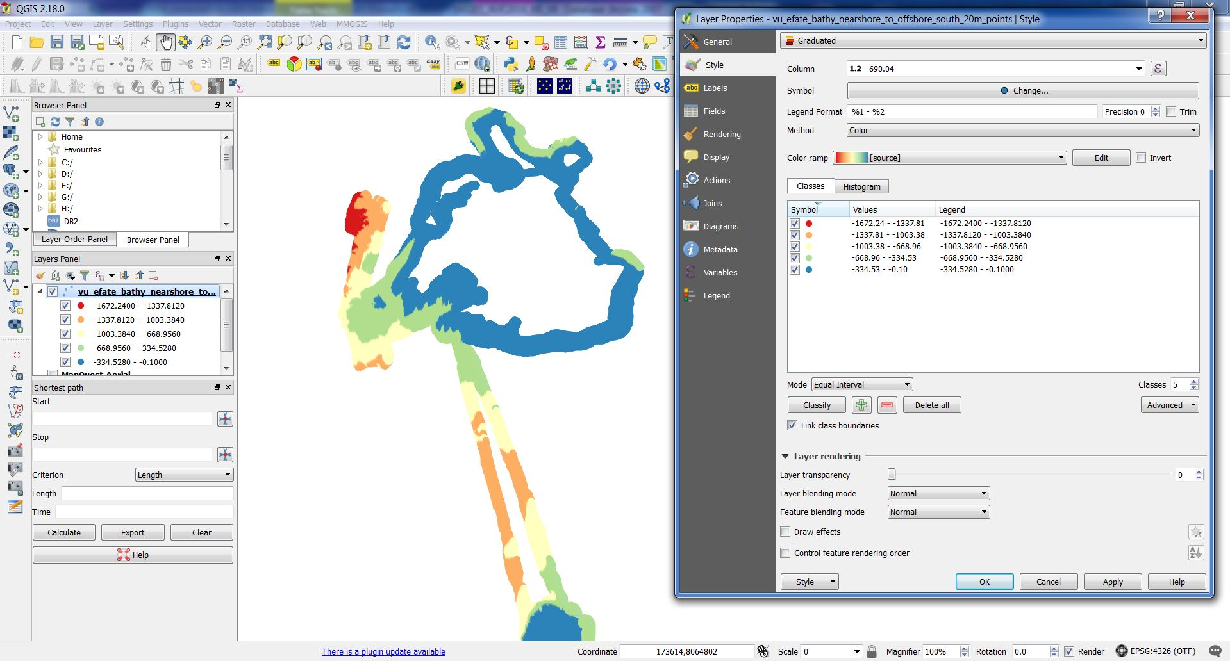
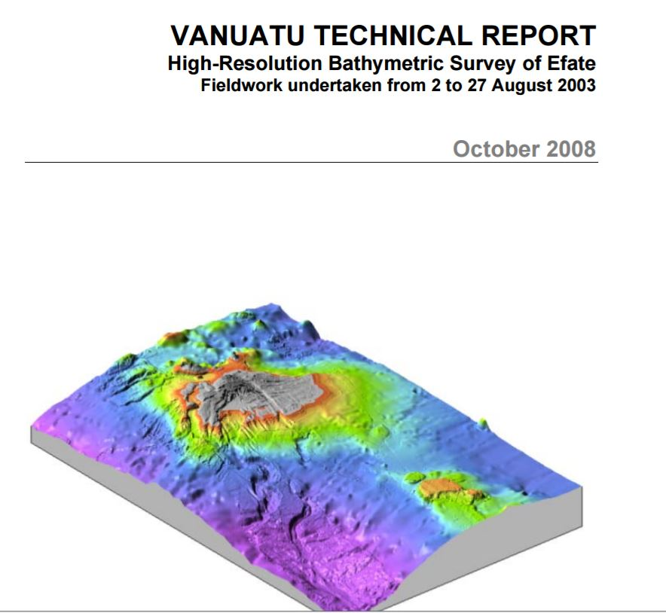
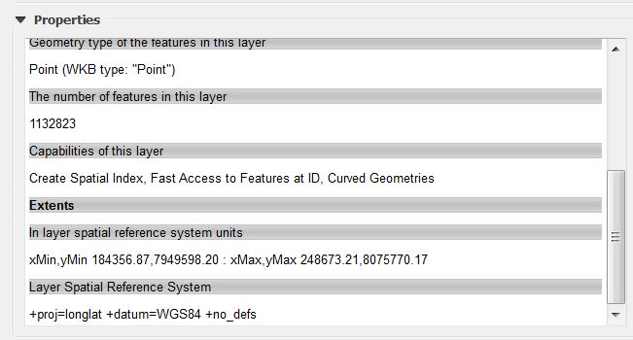
Pacific Wide Data Discovery : Workflows

Slide 10
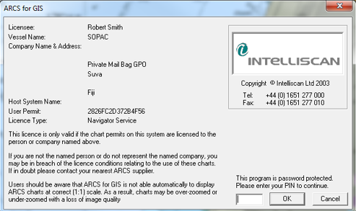
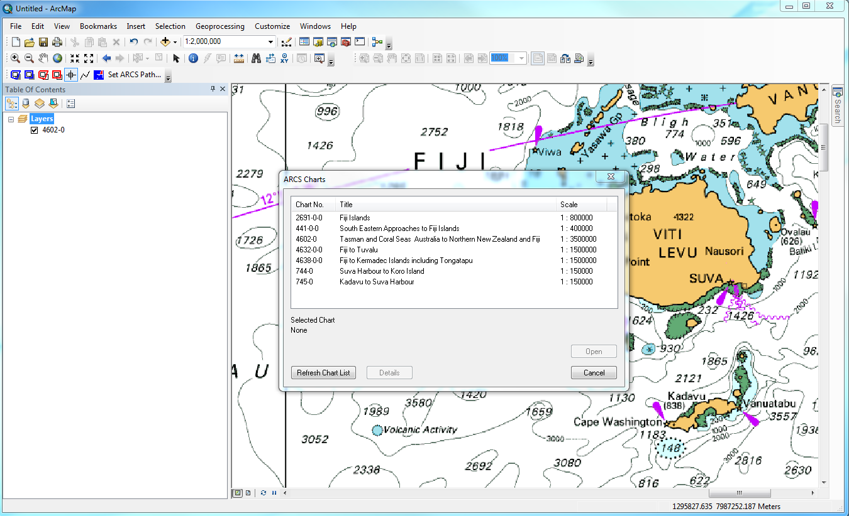
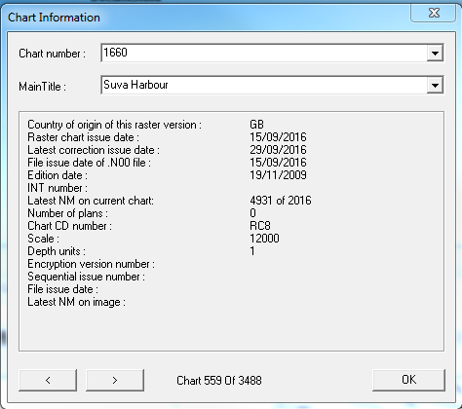
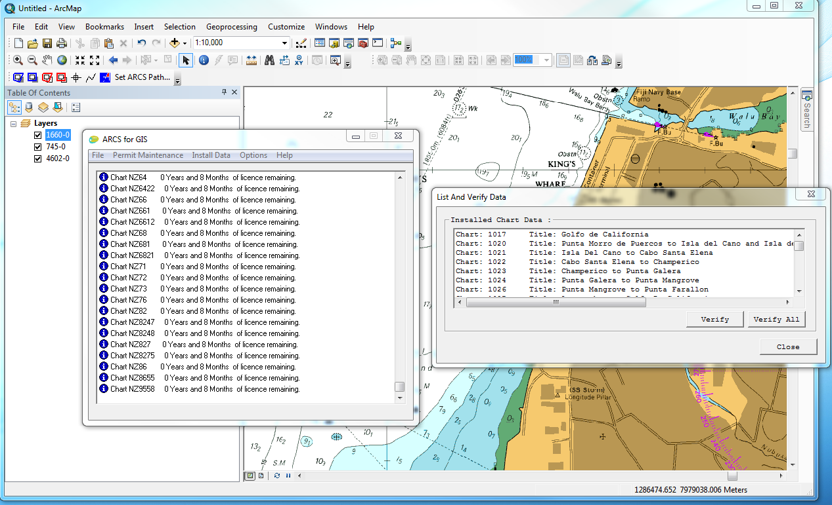
Pacific Wide Data Discovery : Workflows

Slide 11
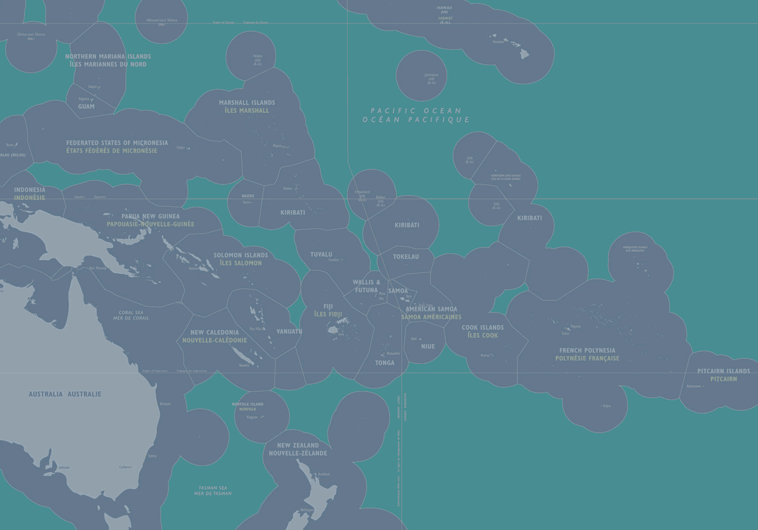
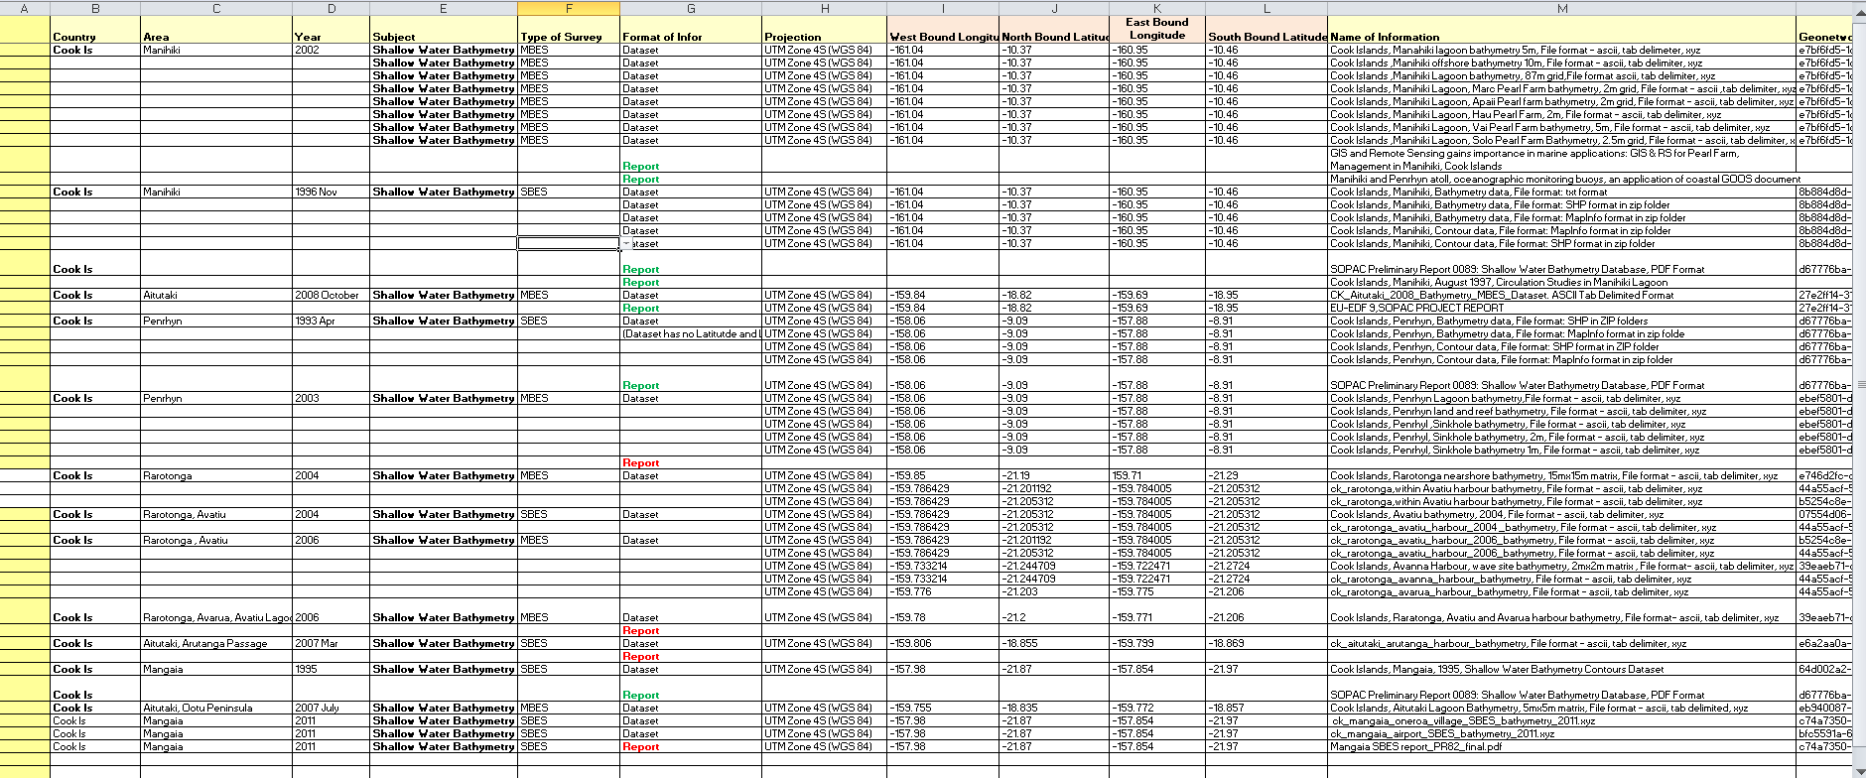
Pacific Wide Data Discovery Outputs:
-
Metadata compilation in Excel spreadsheet

Slide 12
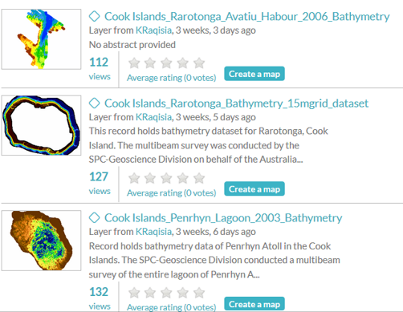
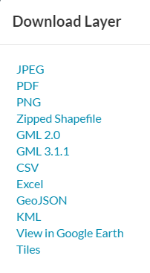
Pacific Wide Data Discovery Outputs
PACGEO
http://www.pacgeo.org/

Slide 13
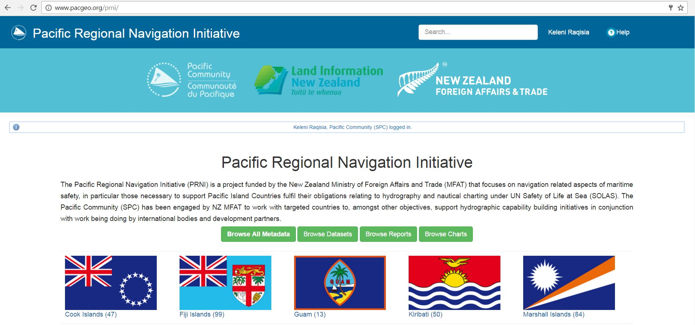
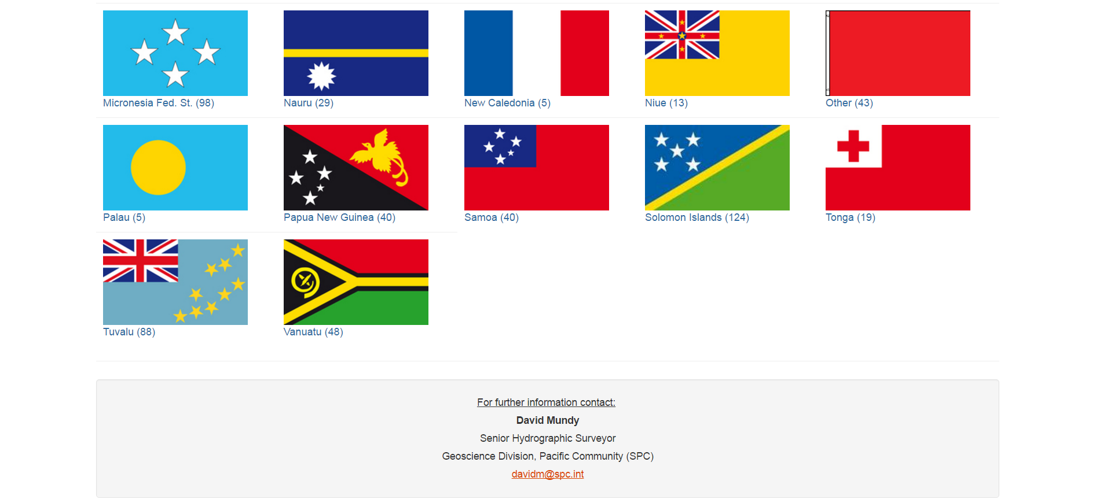
Pacific Wide Data Discovery Outputs
Add
Notes:
SPC is involved with the “Pacific wide data discovery activity” which is a component of the PRNI
Into the 2nd year of the activity at SPC
Because we’re working in partnership, within this LINZ have 5 priority countries mainly primarily due to its Primary Charting Authority in this countries Niue, CK, Tonga, WS, Tokelau. But in fact SPC in the current activity is looking at compiling for all its member countries.
Because SPC is known as a repository for a range of maritime information from satellite , military and other sources. Under this output SPC will with initial assistance and planning input from LINZ , undertake the pacific wide data discovery activities in relation to all PICs for which it holds data.
- SPC analyse all the data SPC holds across in the Pacific. In addition to information it may hol.d through undertaking applied scientific research. Some of this information included includes bathymetric and other scientific work that may be relevant to hydrography.

Slide 14
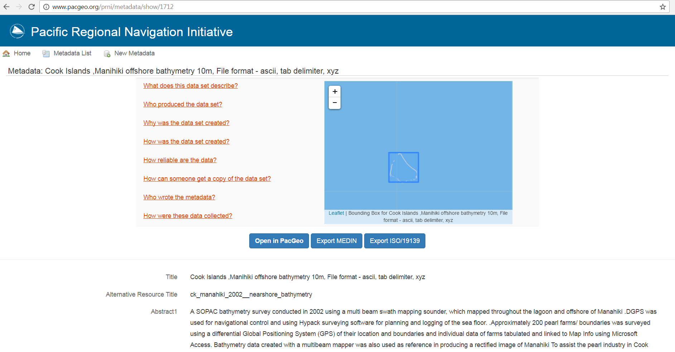
Pacific Wide Data Discovery Outputs
PRNI-SPC Portal
Support PCA Decision Making
User defined FAQ (NOAA example)
Mapped to relevant entry component in MEDIN
Facilitate checks against required criteria

Slide 15
NEXT STEPS
Progress data release agreements
Discuss with SHOM and USA
SPC-PRNI Portal
Complete implementation of MEDIN profile
Progress high level analysis and pop PACGEO
Retrospective capture of detailed metadata
Continue to liaise with LINZ (eg PCA FAQ)
Timeframe
Completion Q4 2017

Slide 16
Thanks
David Mundy - davidm@spc.int
Salesh Kumar saleshk@spc.int
Sachindra Singh sachindras@spc.int
Keleni Raqisia kelenir@spc.int

