Slide 1
Applications of the
Pacific Ocean Portal
Molly Powers-Tora
SPC Geoscience Division
GIS/RS User Conference
1 December 2016

Slide 2
Introducing the Pacific Ocean Portal
Building capacity in understanding and applying ocean data
Early outcomes

Slide 3
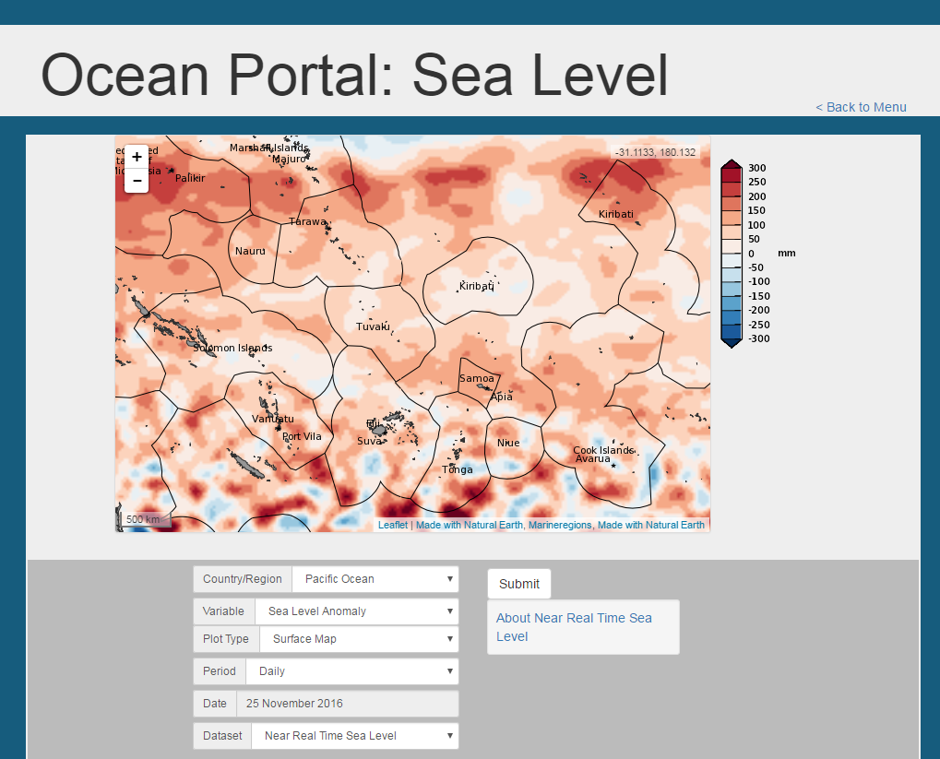
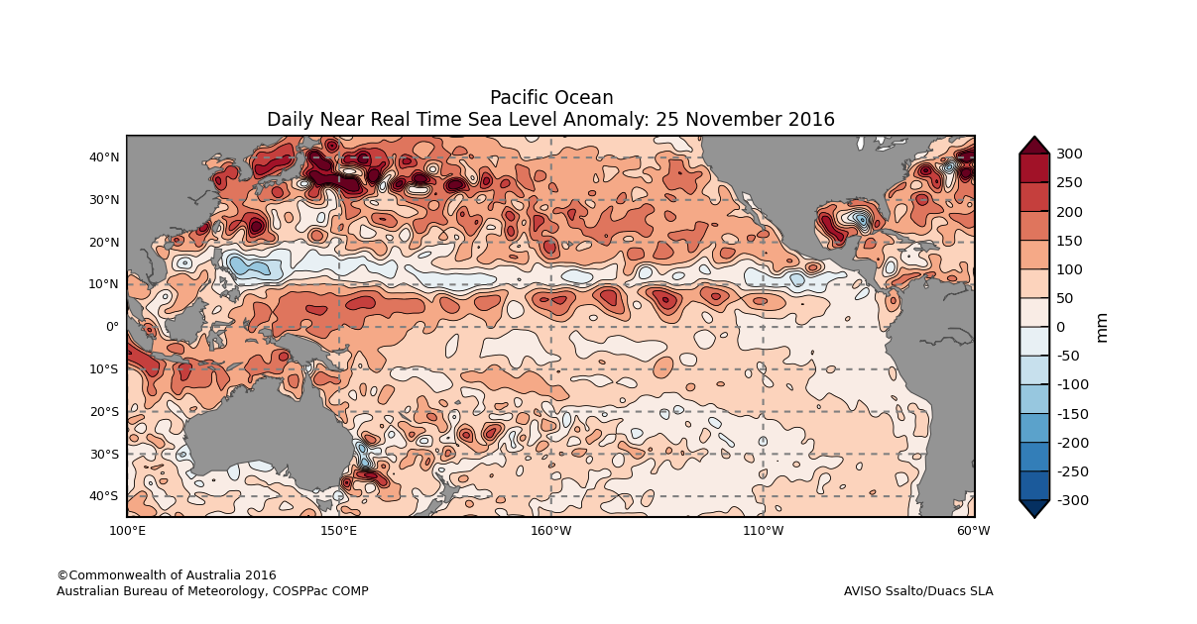
What is the Pacific Ocean Portal?
Designed by Australian Bureau of Meteorology
Open-access website
Uses model data and remote sensing data
Display gridded datasets as maps
Intuitive map functions with zooming and scrolling
Notes:
The bureau has a long history of designing and providing climate science training, tools and support to the Pacific- this was one of their first forays into ocean science.
Based on needs of NMSs and relevant stakeholders
The website is accessible to anyone with an internet connection.
Datasets available are both historical and forecast. Remote sensing data from satellites are in near-real time (e.g. SST and chlorophyll). Forecast data is based on various computer models.
Mainly displays gridded datasets as maps. Also displays some data as a time series (e.g. sea level). Maps can be used as a data resource, or used in the communication of information to stakeholders.
Functionality is logical and intuitive - Scrolling & Zooming.

Slide 4
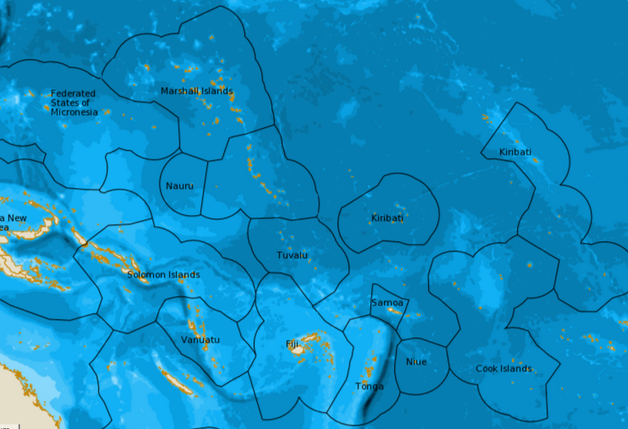
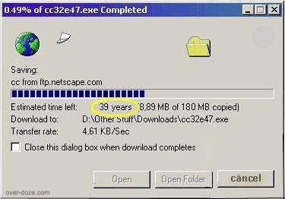
Why create this portal?
Capacity Building: Safety, sustainability, well being, prosperity
One-Stop-Shop: Compilation of datasets with directly identified applications and benefits
Custom maps for each country – simple yet critical feature
Low bandwidth design: Only picture files are sent thru the portal
Notes:
During the design phase of COSPPac, there were many requests for products that could be delivered in an ocean service component.
As many requests as possible have been compiled into this version of the ocean portal.
Ability to see an individual nation’s EEZ, important for information surrounding small islands. High resolution datasets were utilised to better resolve data around small islands.
Portal can produce local maps for communications in-country based on country EEZs. Larger country EEZ (like Kiribati) also have the option to create custom maps for each group of Islands (e.g. Line Islands, Gilbert Islands, Phoenix Islands).
Low bandwidth to cope with wide range of internet speeds in the Pacific. Data are processed at the Bureau and only picture files are sent through the portal.

Slide 5
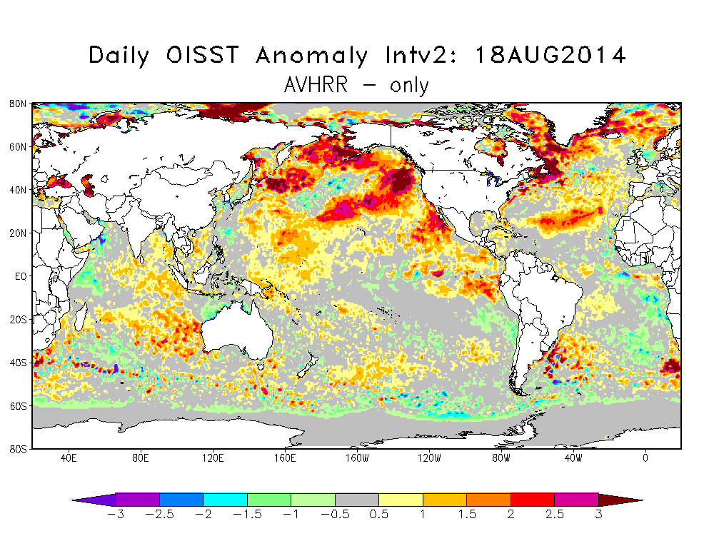
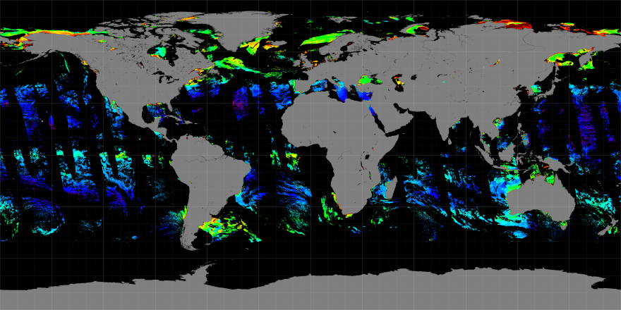
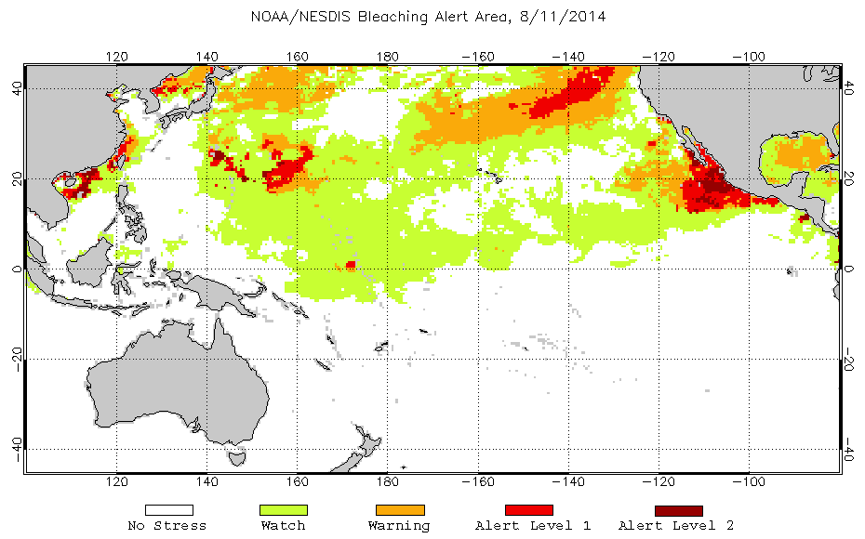
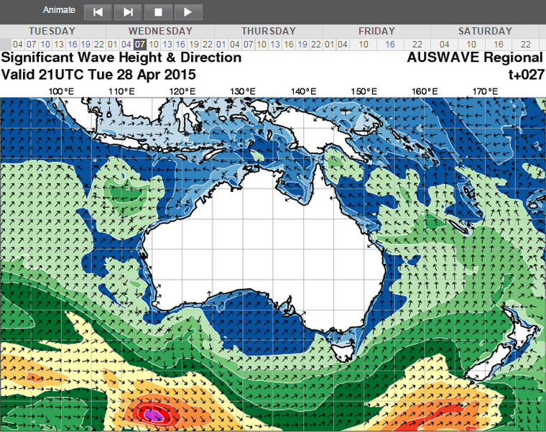
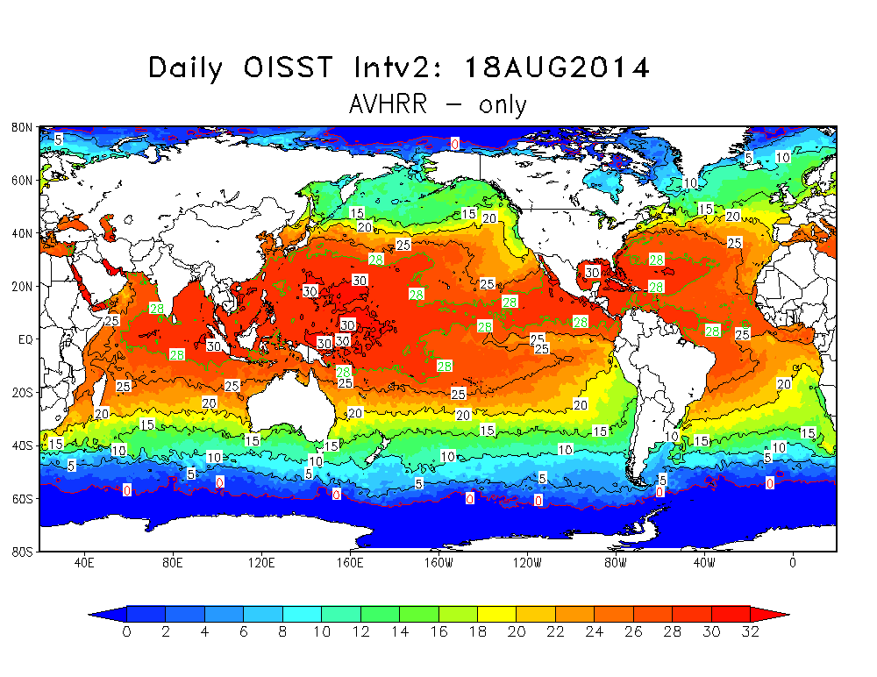
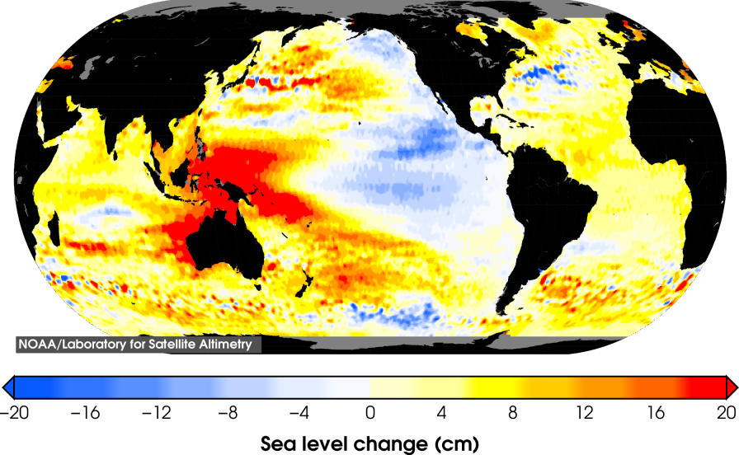
Compilation of existing ocean datasets with added value
Notes:
Datasets come from various sources:
NOAA
Bureau of Meteorology
CSIRO- BLUELink Current
Pacific Sea Level Monitoring Project
ReefBase
SPC
Collaboration for Australian Weather and Climate Research (CAWCR)
Information selected all as a direct application and benefit to Pacific Island Communities.

Slide 6
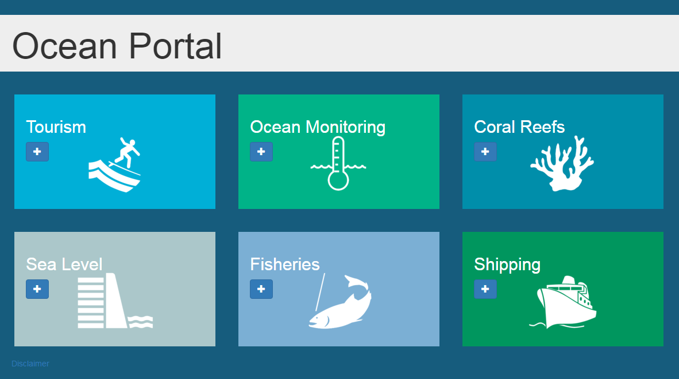
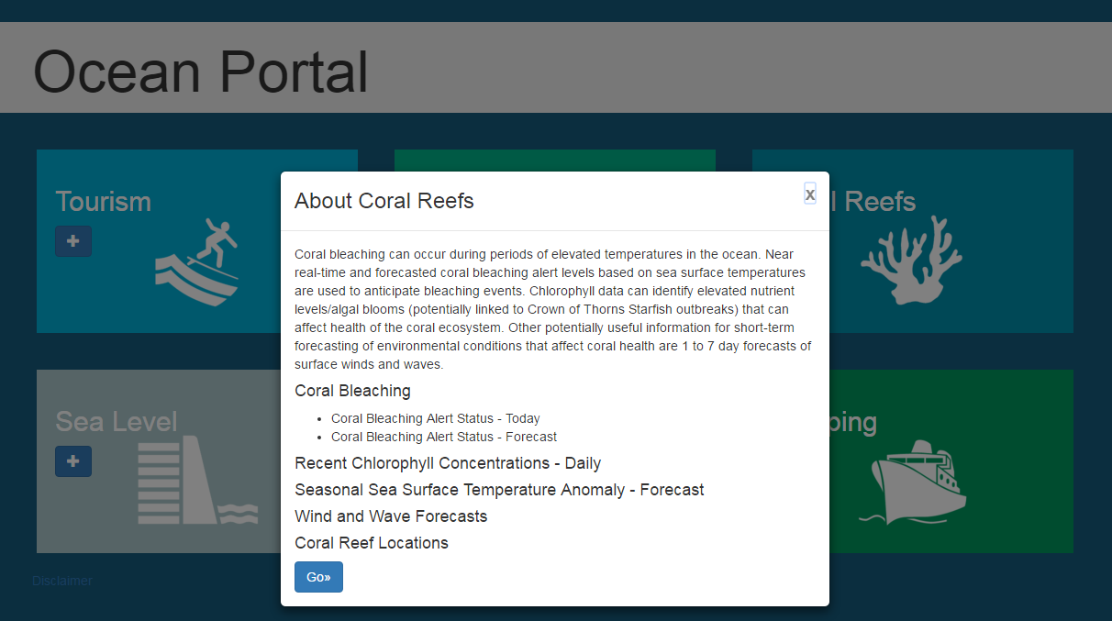
Ocean Portal - Home Page
http://oceanportal.spc.int
6
Notes:
Interface based on Ocean Applications that have been identified as important through consultation with PICs
Datasets have been selected and tailored specifically to the needs of Pacific Island Nations
In the identification of useful datasets, COSPPAC has development of partnerships between NOAA, CSIRO, Academics, and Pacific Met Services

Slide 7
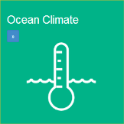
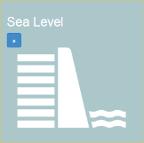
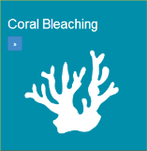
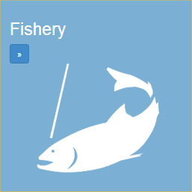
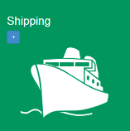
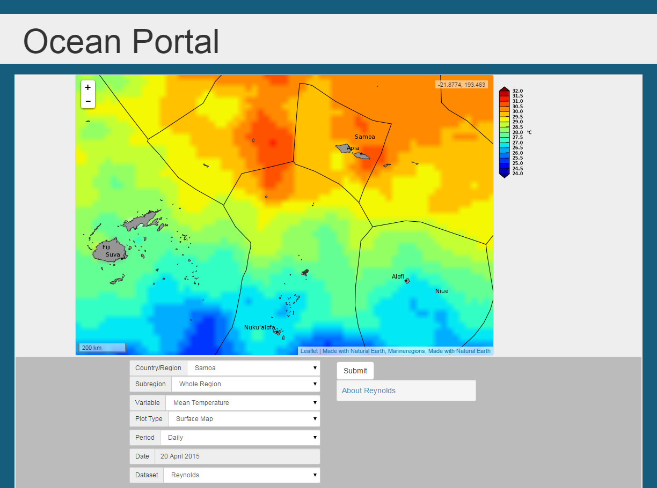
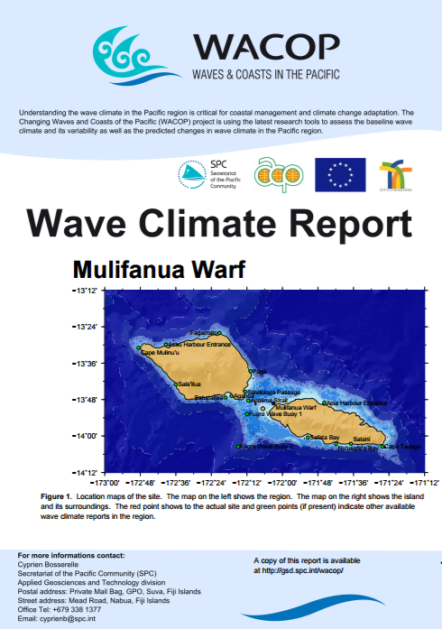
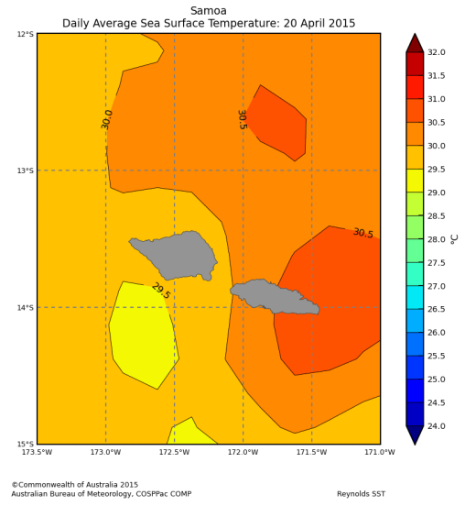
Ocean Monitoring
Near real time sea surface temperature updated daily
Sea surface temperature statistical averages and anomalies for various time periods
Historical sub-surface temperature
Wave Climatology from the past 30-years
Monthly chlorophyll data
7
Notes:
Ocean Monitoring data includes both historical data and near-real time.
The SST data has fantastic averaging techniques that allows viewing of average SST over various periods. Weekly, monthly, monthly, six-monthly, and 12-monthly averages available.

Slide 8
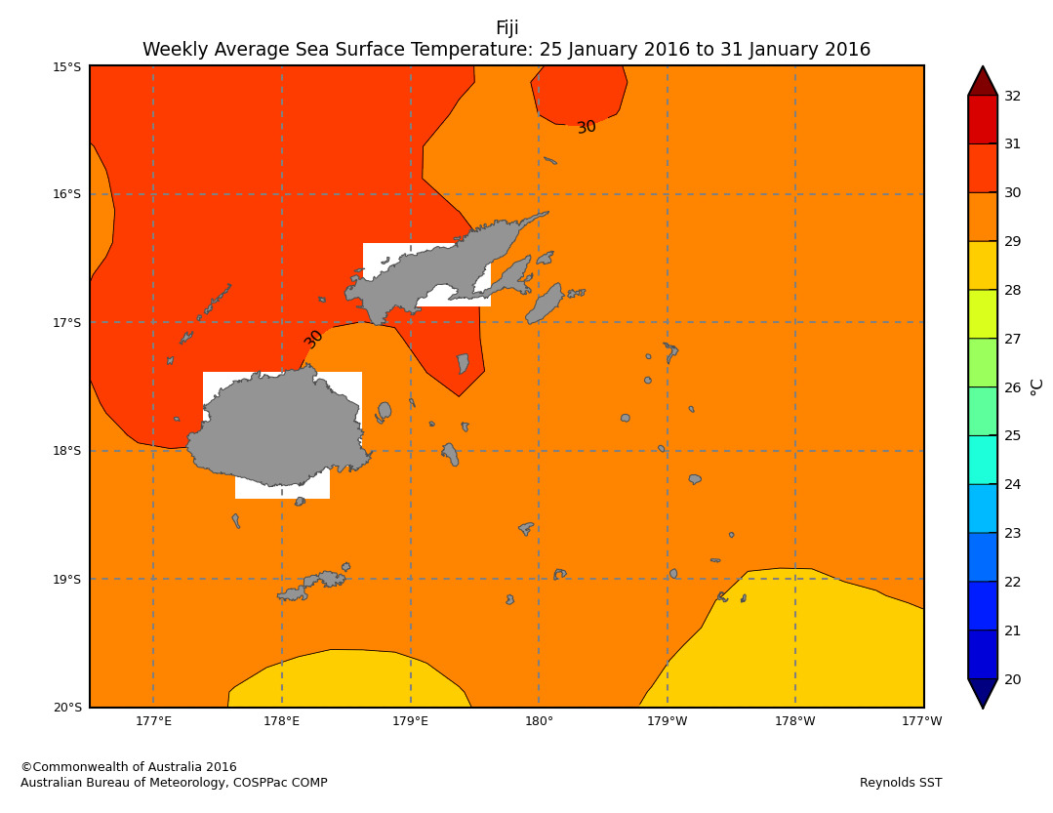
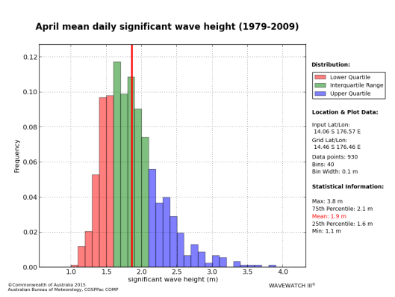
Ocean Monitoring
Climate Monitoring: ENSO and cyclones
Risk Management: Wave Climatology
8
Notes:
EXAMPLE APPLICATIONS:
Climate applications:
Monitoring ENSO: Sea surface temperature is used as one of the indicators of the El Niño Southern Oscillation. Past events can be diagnosed by looking at average SST maps over various periods of time. The thermocline depth gives an indication of sub-surface warming or cooling during past ENSO events.
Cyclones: The formation of tropical cyclones requires SSTs higher than 26.5 degrees Celsius, although major storms require higher temperatures. Monitoring warm patches of ocean gives insight into the potential for cyclone formation, and the possible start or finish of the cyclone season.
Risk Management: Construction works, naval architecture, equipment maintenance, and any other development occurring near the ocean require knowledge of the typical wave climate that a region is likely to experience.

Slide 9
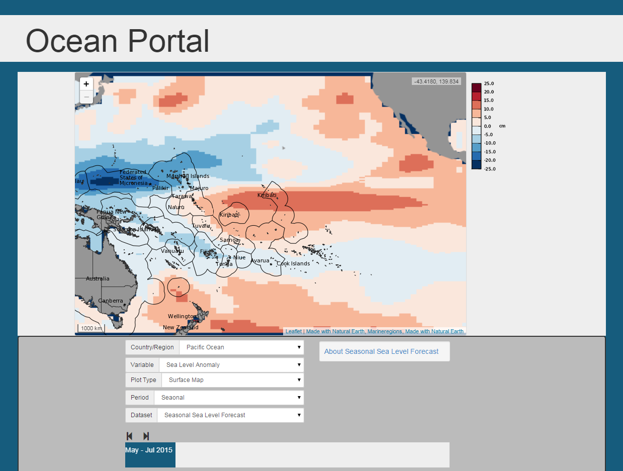
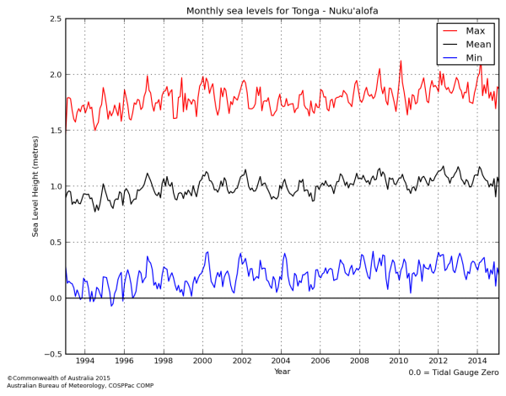
Sea Level
Altimetry maps dating back to 1993
Reconstruction maps dating back to 1950
Time series statistics for Pacific tide gauge network
Wave forecasts from AUSWAVE model – for predicting inundation events
Sea Level Forecasts (POAMA)
9
Notes:
Reconstruction can be used to monitor sea level rise over long periods of time (60 years). Tide gauge network shows similar trends over shorter period (20 years)
Wave forecasts to aid in inundation prediction
Wave forecasts are available 7-days in advance from the Bureau of Meteorology Wave Model.
Large wave events can cause inundation when they coincide with high tide events.
Knowing this in advance can prepare emergency services for the possibility of evacuation.
Portal also links back to the Real Time Data Display

Slide 10
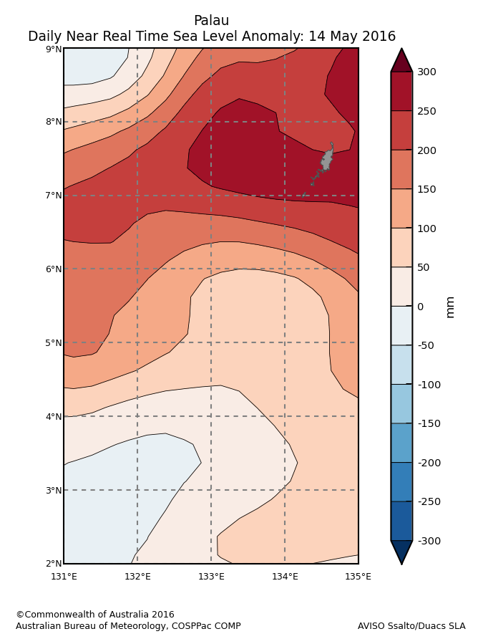
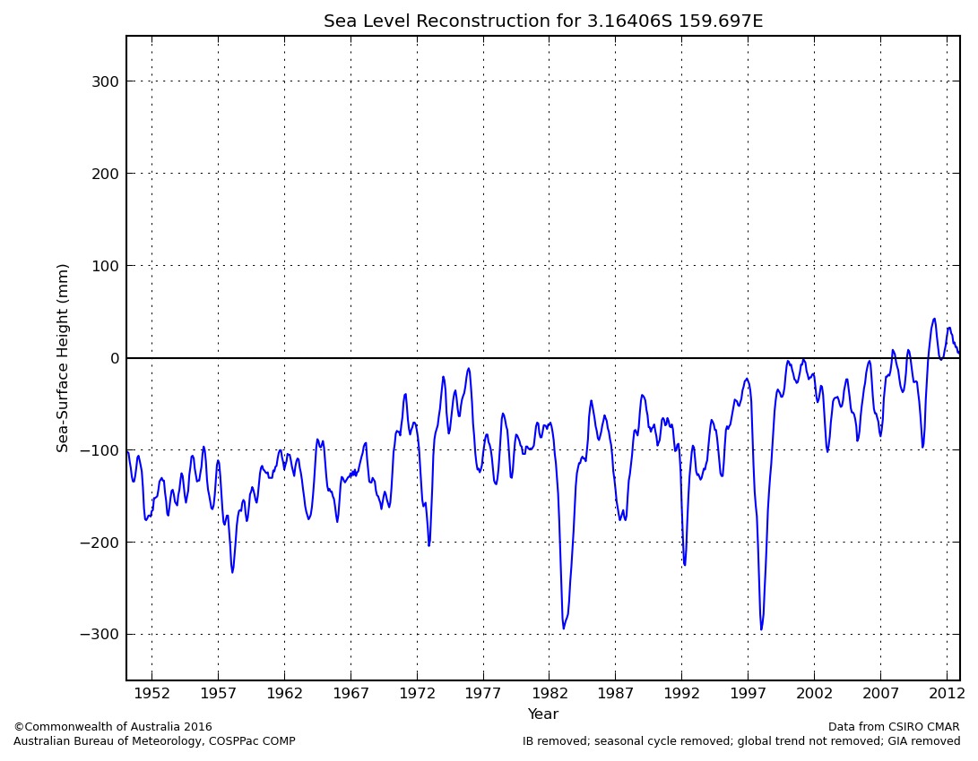
Sea Level
Risk Mitigation: Inundation
Climate Change: Sea Level Rise
10
Notes:
EXAMPLE APPLICATIONS:
Risk Management: Stakeholders can use forecasts of extreme sea level to make decisions aimed at the protection of communities and infrastructure
SLR: There is a strong interest in sea level rise amongst low lying nations that are susceptible to inundation and coastal erosion. The reconstruction data covers a large enough time period to capture sea level rise due to climate change.

Slide 11
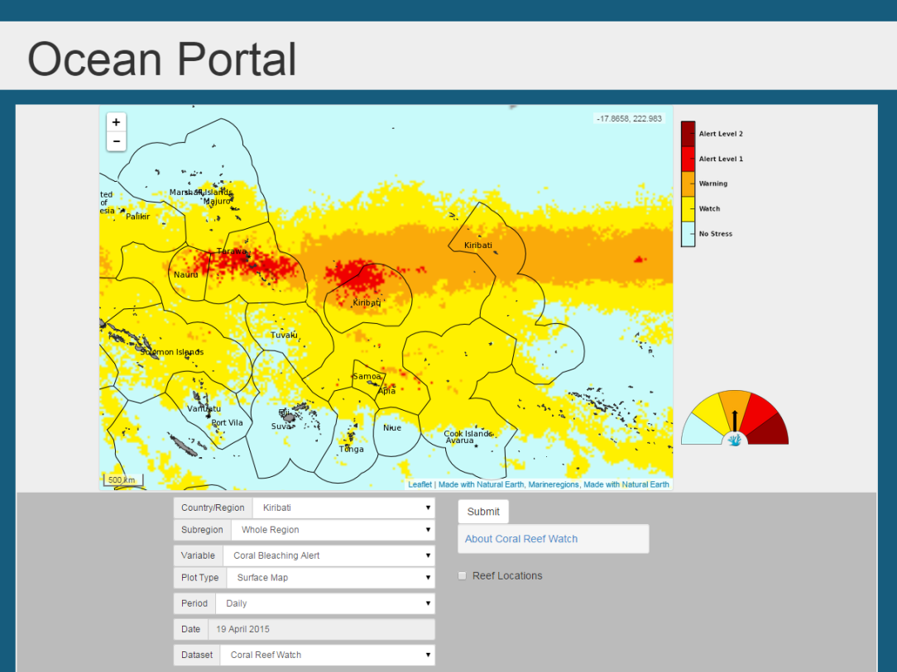
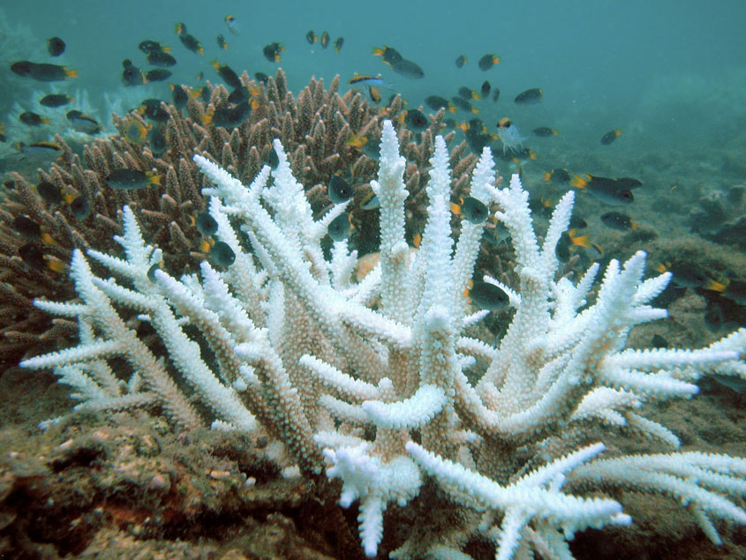
Coral Reefs
Collaboration with NOAA Coral Reef Watch Project
Forecast sea surface temperature anomalies also available out to 9 months ahead (POAMA)
Daily chlorophyll data
11
Notes:
Warmer water temperatures can result in coral bleaching. When water is too warm, corals will expel the algae living within them causing the coral to turn completely white. This is called coral bleaching.
NOAA has developed a coral bleaching alert dataset, derived from sea surface temperature data, that provides daily maps with forecasts for 4, 8, and 12-weeks in advance.
POAMA is the Bureau of Meteorology seasonal model. It provides seasonal sea surface temperature forecast anomalies out to nine months ahead.

Slide 12
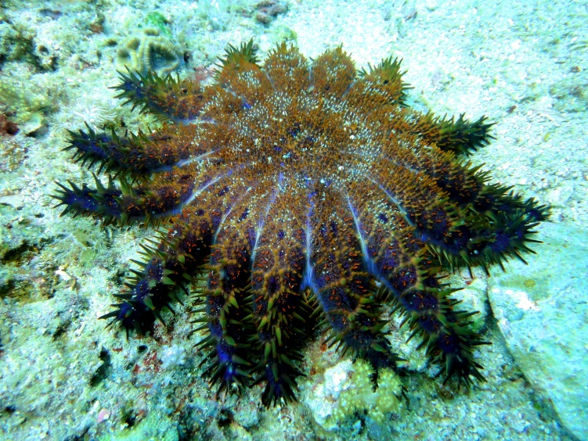
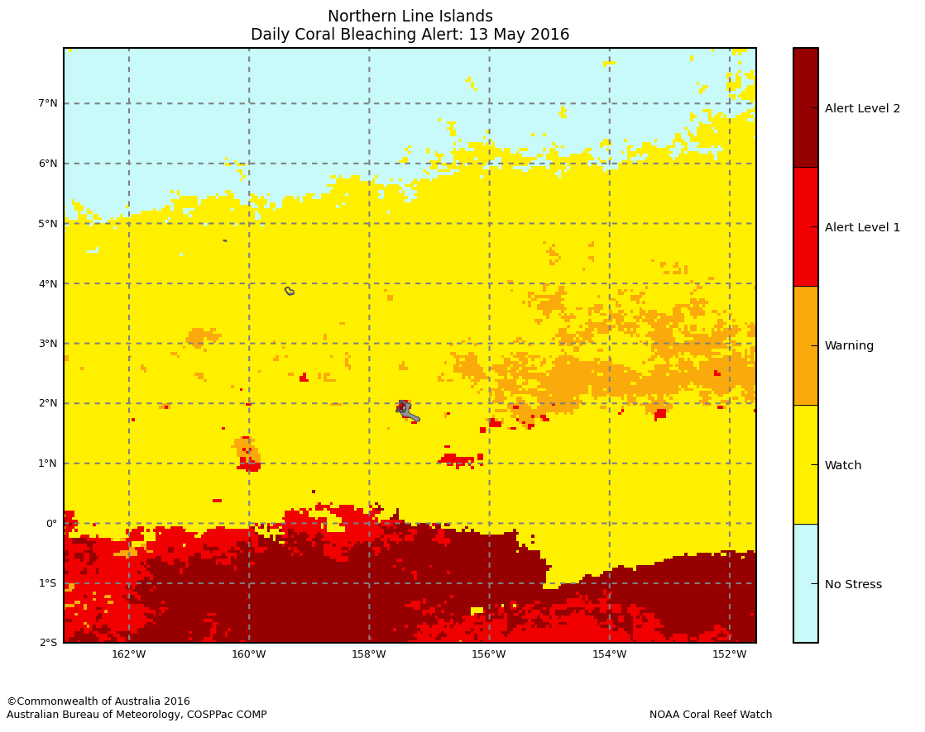
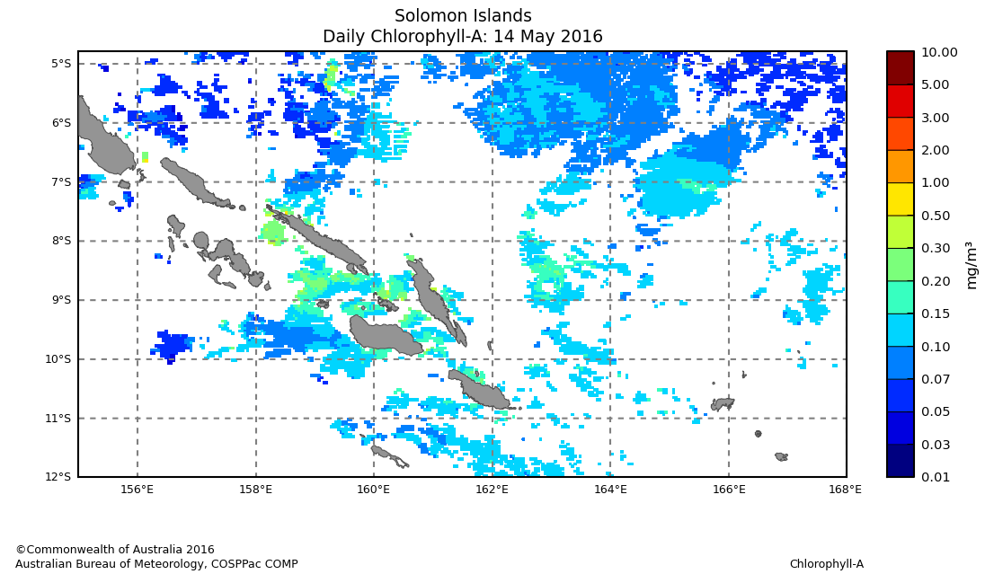
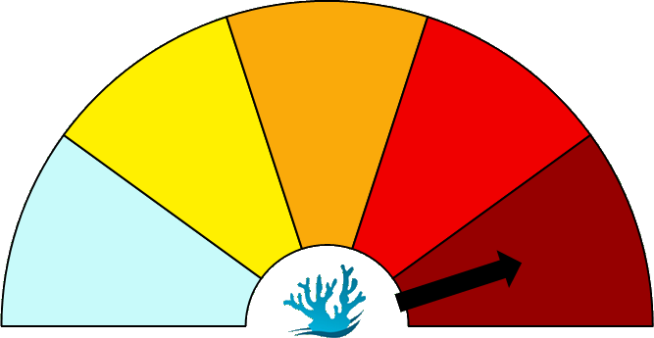
Coral Reefs
Environmental Management: Coral Bleaching
Management of the Crown of Thorns Starfish
12
Notes:
EXAMPLE APPLICATIONS:
The coral bleaching alert can indicate the possibility of a coral bleaching event occurring now or soon. This tool can be used by environmental management divisions to know when they should be monitoring of the reef more closely, and to implement management strategies to mitigate the damage in the event of coral bleaching. For example, limiting fishing activities during coral bleaching events can improve reef resilience and help the corals to recover.
Seasonal Forecast SST Anomalies are available and provide an indication of warming in the Pacific further into the future (out to 9 months)
In some parts of the Pacific, the Crown of Thorns starfish, a natural predator of corals, is the largest contributor to coral reef destruction (more than cyclones and bleaching in some regions).
There have been many correlations of COTS outbreaks with high chlorophyll concentrations, such as the starfish occurrence of January-February of 2009 in Vanuatu. Chlorophyll fronts in Hawaii and at Palau have also been linked to COTS outbreaks. Chlorophyll, as a proxy for phytoplankton abundance, can be used to monitor potentially fertile areas where COTS spawning is likely to be more successful.

Slide 13
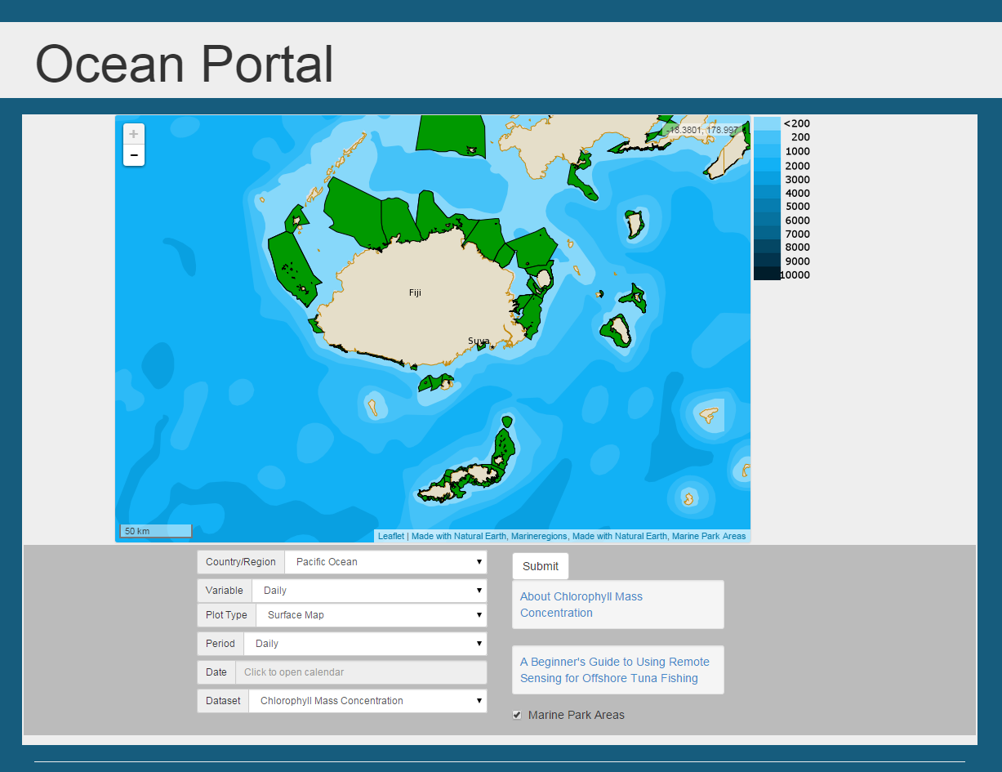
Fisheries
Sea surface temperatures (near real time and forecasts)
Daily chlorophyll maps indicate areas of high biological activity
Marine Protected Areas available as an overlay to indicate potential restricted zones
Link to SPC "Guide to Using Remote Sensing for Offshore Tuna Fishing"
13

Slide 14
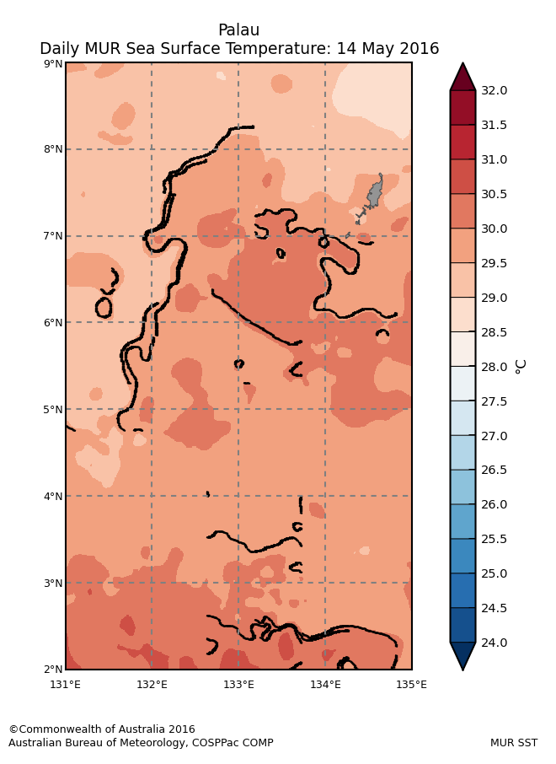
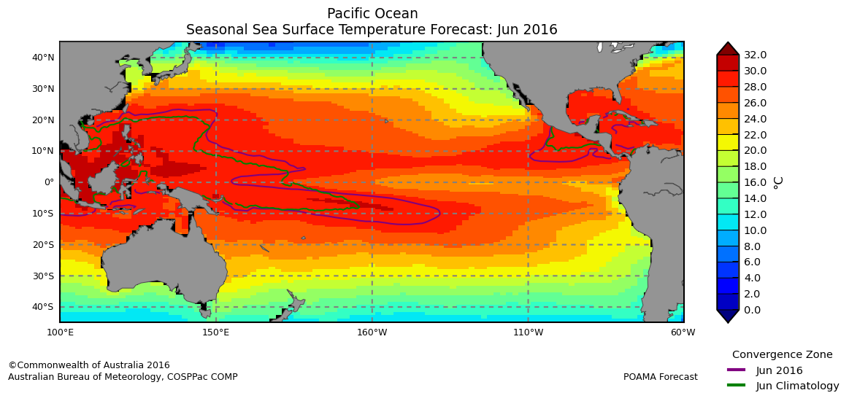
Fisheries
Local fishing
Fisheries Management
14
Notes:
EXAMPLE APPLICATIONS:
Local Fishing: Near real time high resolution SST maps, along with near real time chlorophyll maps, can assist in locating good offshore fishing spots for pelagic species (like tuna). Promoting fishing of pelagic fish has environmental benefits as it can reduce stress on coastal lagoons.
SPC's "Beginner's Guide to Using Remote Sensing for Offshore Tuna Fishing" is a document that gives advice on using SST and chlorophyll aid tuna fishing activities. This document is linked to in the portal.
Fisheries Management; POAMA seasonal SST forecasts can assist in indicating where tuna will likely be migrating to in the upcoming months by monitoring the edge of the warm pool. This is useful for managing fishing license to international companies, and setting prices and bag limits.

Slide 15
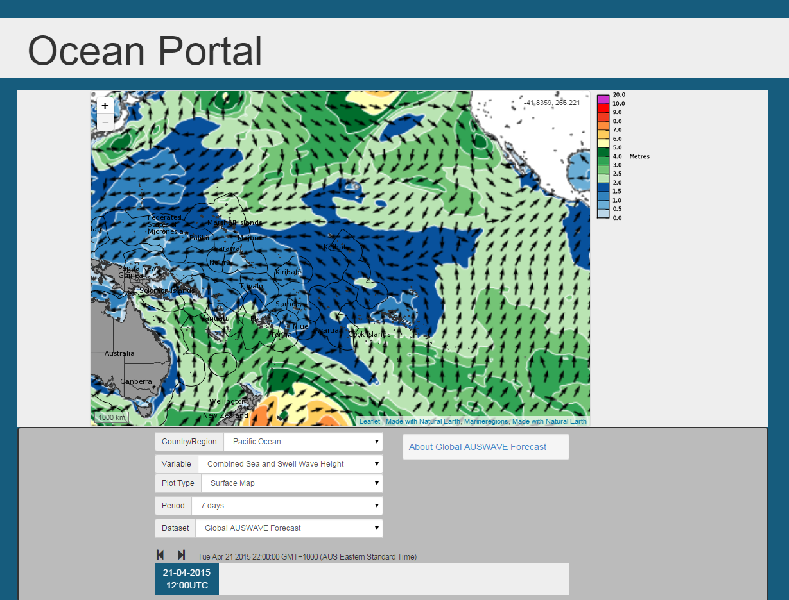
Tourism
Wave forecast information from AUSWAVE up to seven days in advance
Wind forecast information also available
Useful for planning recreational activities
15
Notes:
AUSWAVE is the Bureau of Meteorology's global wave forecast model

Slide 16
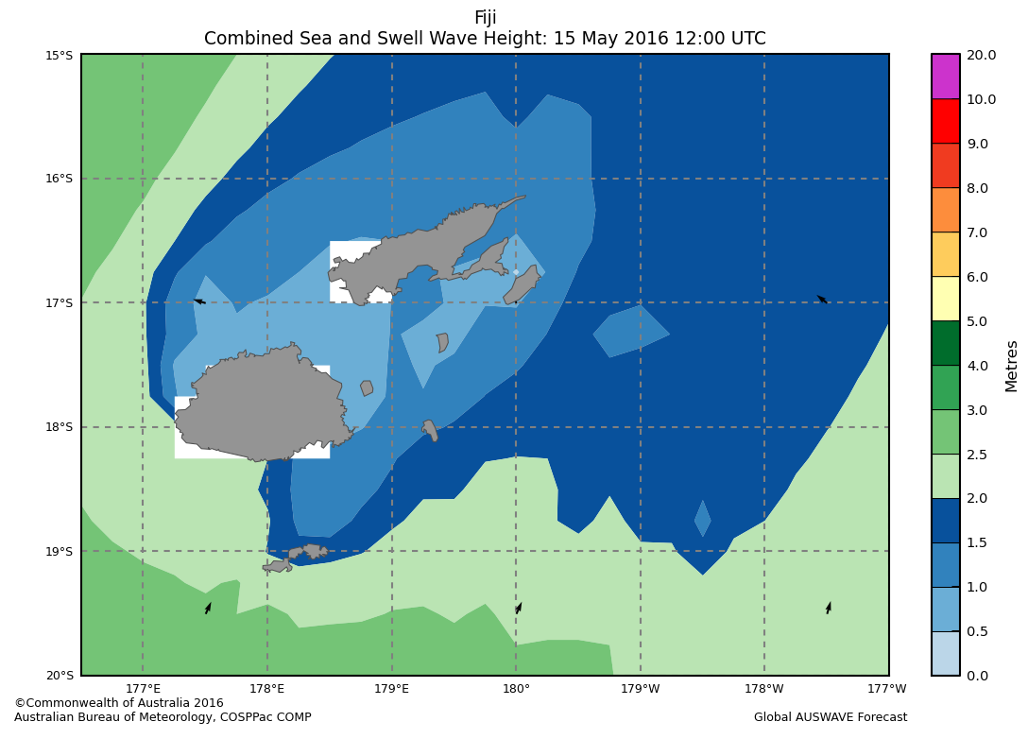
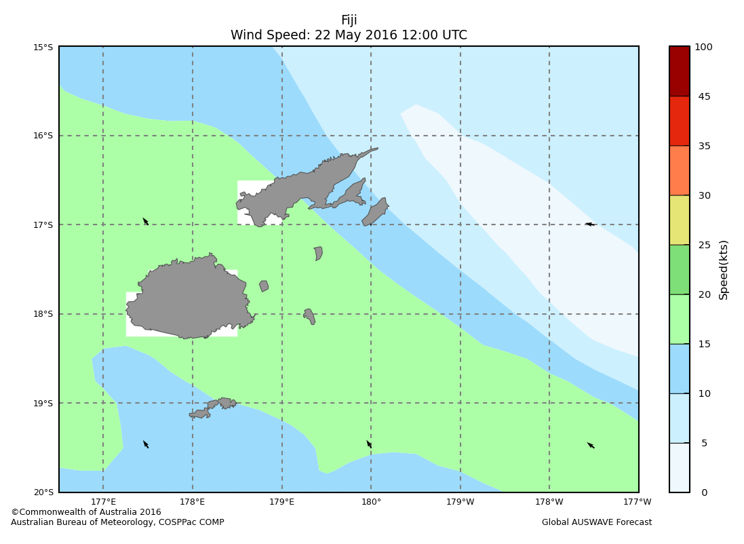
Tourism
Wave forecast
Wind forecast
16
Notes:
EXAMPLE APPLICATIONS:
There are many activities that rely on wind and waves for maximum enjoyment and safety of the participants. Some examples of these are surfing, windsurfing, kitesurfing, fishing, scuba diving, snorkeling, boating, and any other recreational activities occurring in (or near) the ocean.

Slide 17
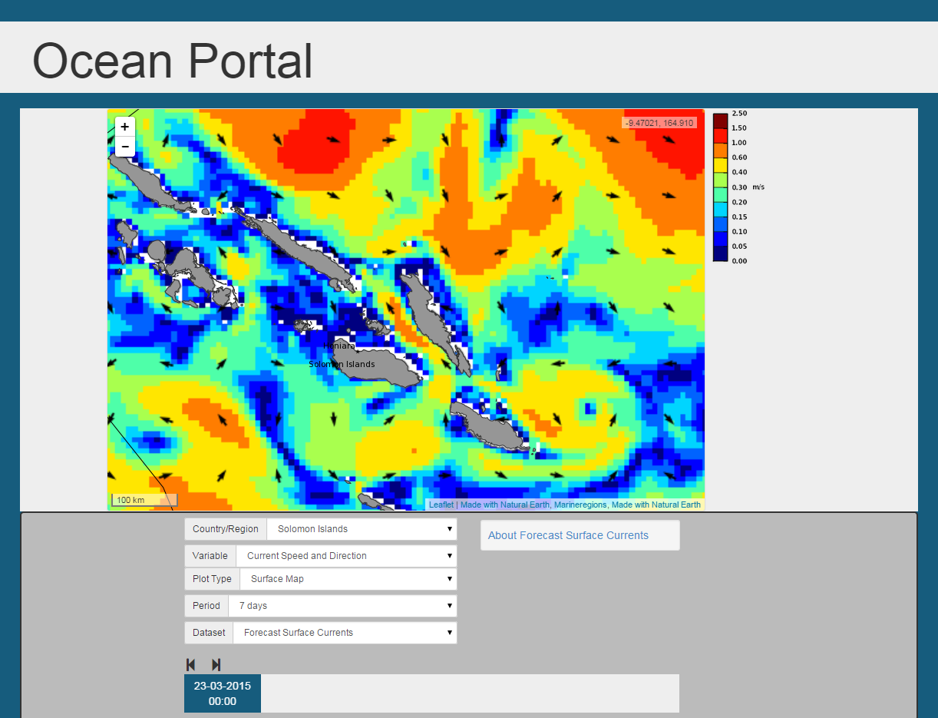
Shipping
Wave forecast
Wind forecast
Current forecast
17

Slide 18
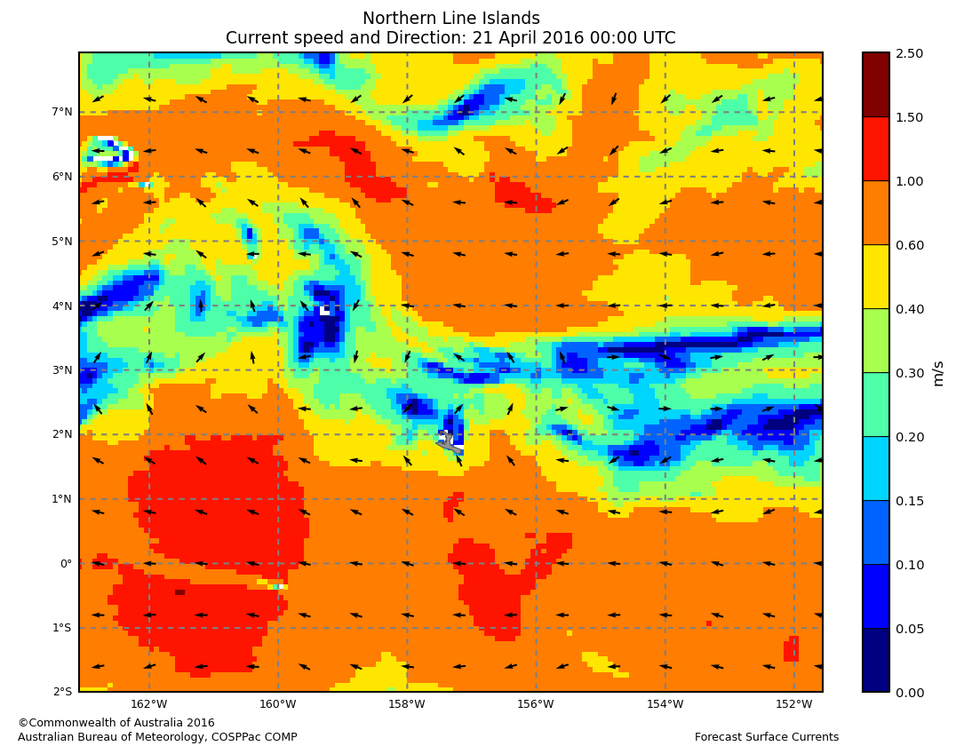
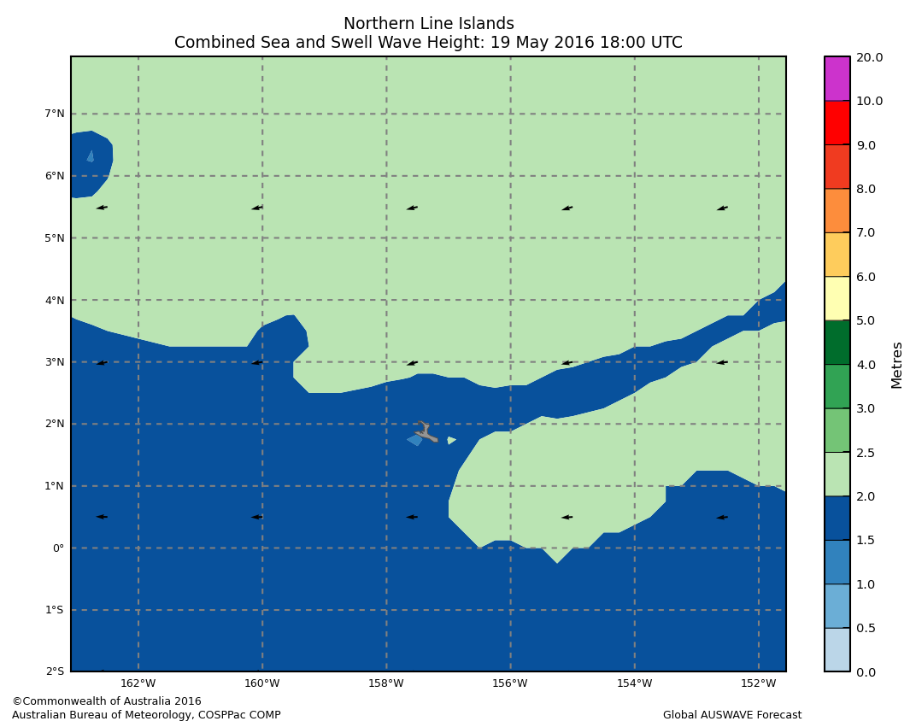
Shipping
Navigation Applications: route planning
18
Notes:
EXAMPLE APPLICATIONS:
Large swell wave events have been known to cause shipping disasters in the Pacific. Knowing the location and severity of high sea events via the seven day wind and wave forecast give sea-going vessels an insight into what they can expect to encounter.
Experienced small boat operators often know how to use wind speed information to know how choppy the conditions will be.
Forecast speed and directions of ocean current are great for planning efficient shipping routes that can save on time and fuel. Also useful for search and rescue applications for vessels lost at sea.

Slide 19
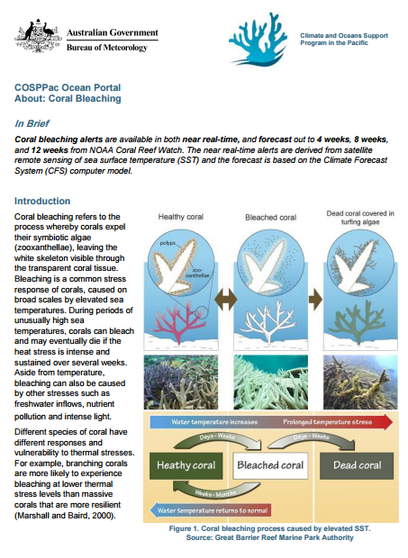
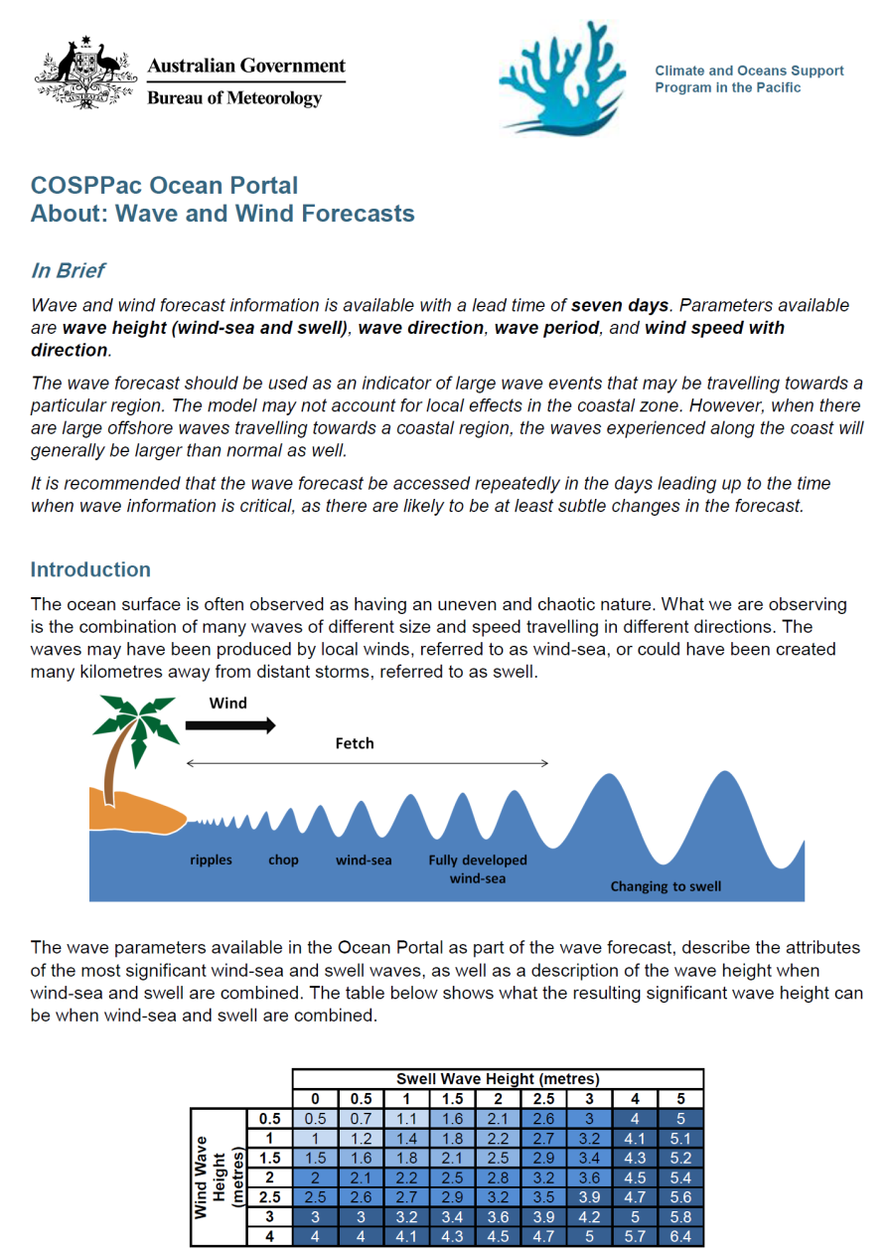
Help Files
Notes:
All ocean data have links to downloadable help files (as pdfs, usually between 4 to 6 pages in length).
These are more than just ‘Help files’- they are individual factsheets in a way, with lots of introductory information and details about the different data sets.
Help files include:
Background ocean science
Instructions for using the Ocean Portal
Examples of Applications
Technical details for datasets with additional links and references

Slide 20
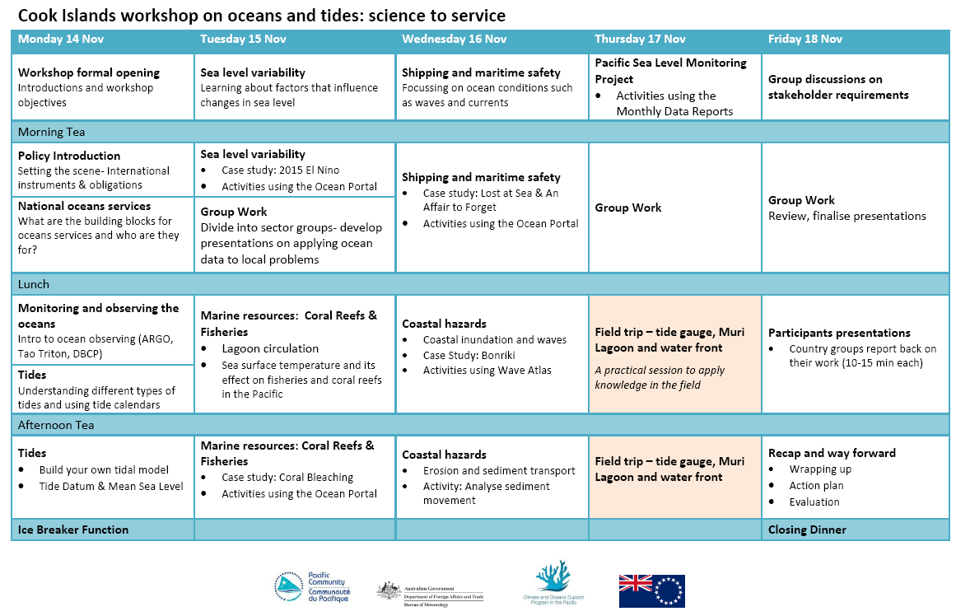
Training and Capacity Building

Slide 21
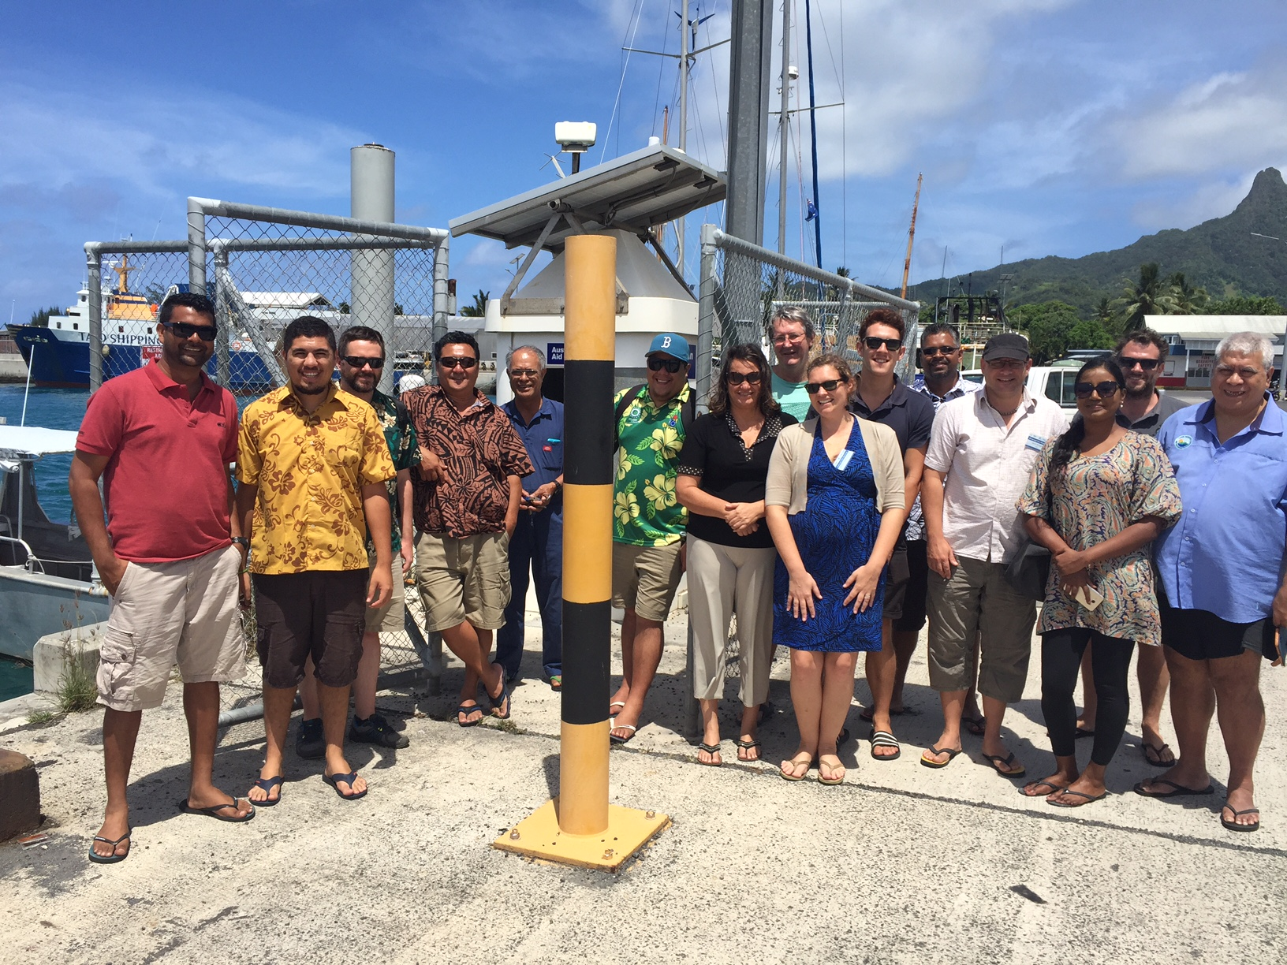
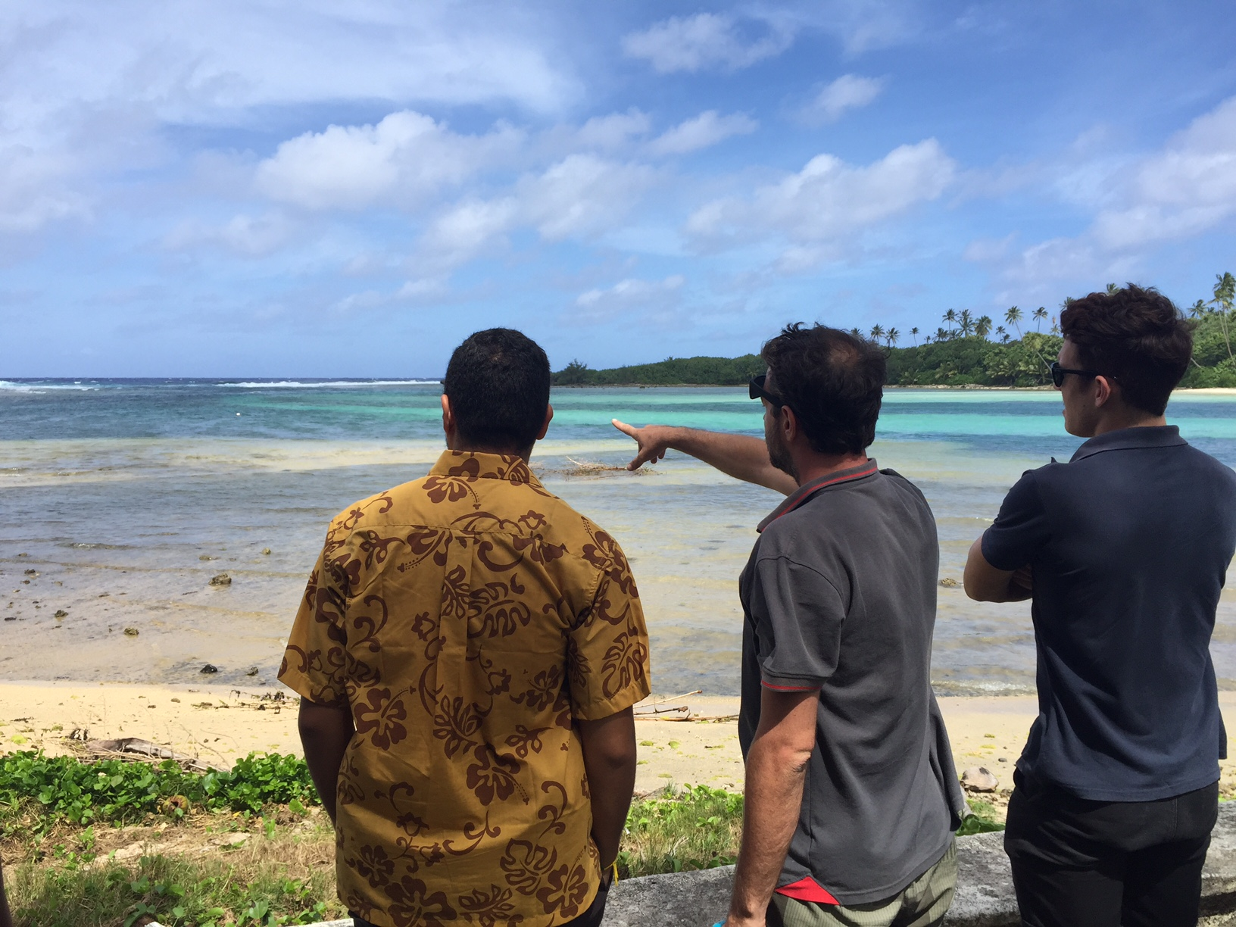
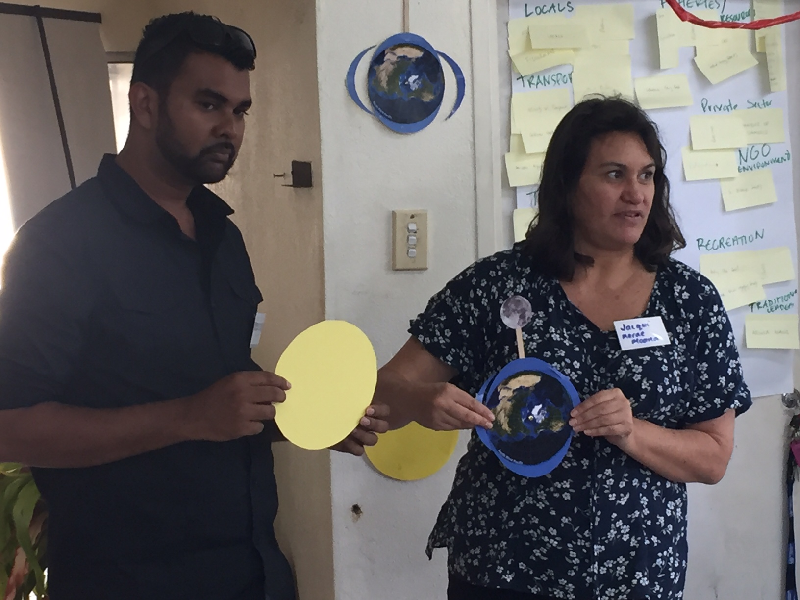
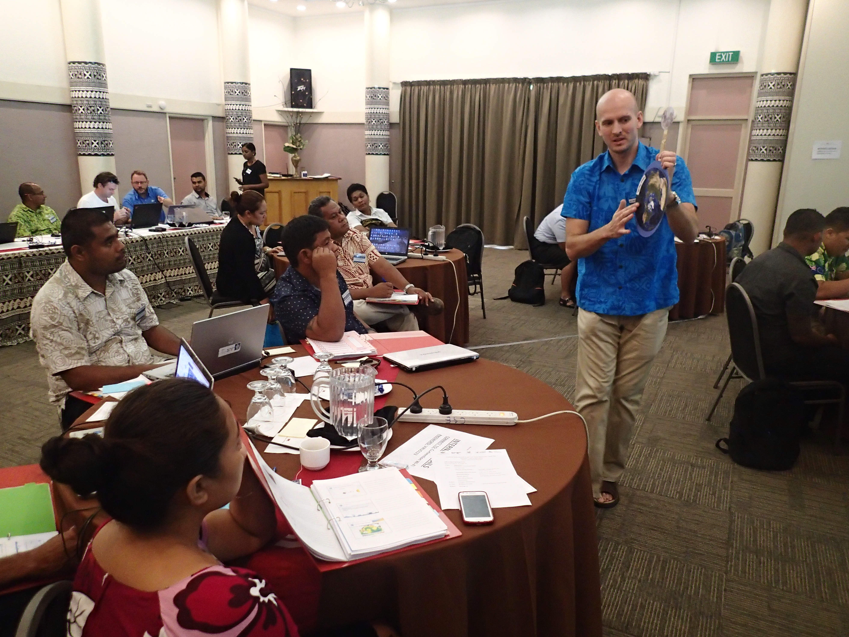
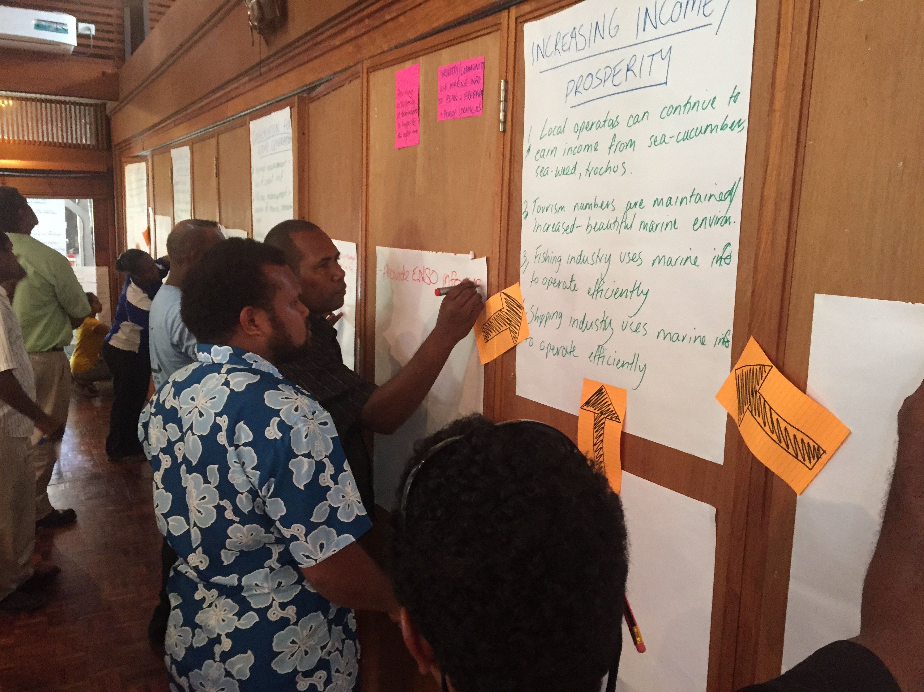
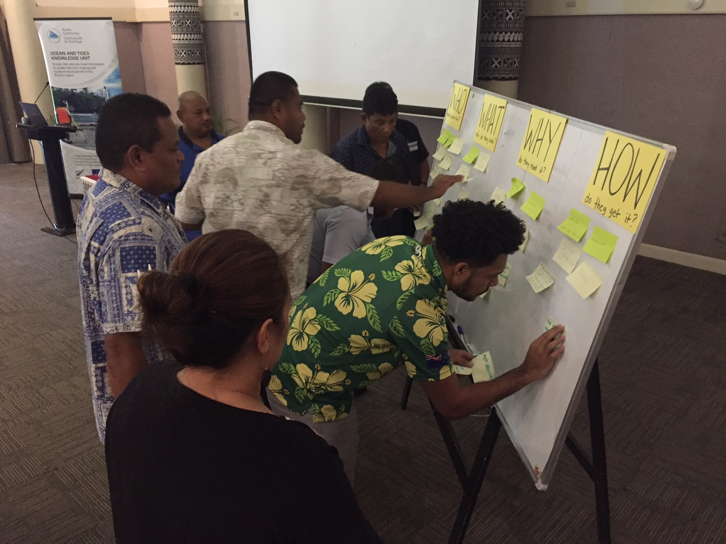
Training and Capacity Building

Slide 22
Ocean Portal Outcomes
Outputs used in reports, presentations (e.g. Cook Islands)
Outputs used in monthly Kiribati Ocean Summary
Requests to automate outputs on Vanuatu, Cook Islands Met websites
Solomon Islands cabinet paper and new position for an oceanographer

Slide 23
Vinaka vakalevu Many thanks!
MollyP@spc.int

