Slide 1
Risk Modelling & Impact Forecasting Tools
Challenges and Opportunities

Slide 2
TC Winston In Numbers
AFFECTED
44
540,000
deaths
60
60,000
days
people displaced
Declaration
State of Emergency
5
Wind
Coastal innundation
River flooding
Coastal erosion
Landslides
1.99
Hazard
Impacts
billion F$
Damage and Losses

Slide 3
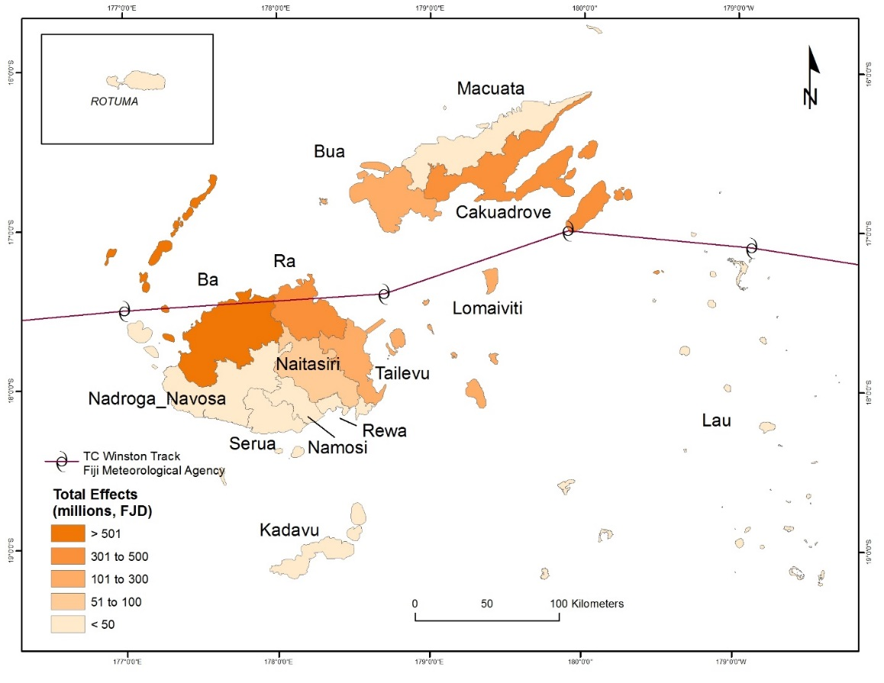
Distribution of TC Winston Impacts
Post Disaster Needs Assessment
May 2016
Estimated value of disaster effects from TC Winston in Fiji is F$1.99 billion (US$0.9 billion):
F$1.29 billion (US$0.6 billion) in damage
F$0.71 billion (US$0.3 billion) in losses

Slide 4
TC Winston In Numbers
Why Risk Tools?
Reducing impacts
AFFECTED
44
540,000
deaths
60
60,000
days
people displaced
Declaration
State of Emergency
5
Early Warning Systems
Land Use Planning
Building & Infrastructure design
Planning
Wind
Storm Surge
Flooding
Coastal erosion
Landslides
1.99
Hazard
Impacts
billion F$
Damage and Losses
Knowing who needs to do what where and when

Slide 5
Challenges & Opportunities
Lack of a centralised database (/catalogue) – knowing what exists
Limited information sharing between agencies
Partnerships designed to both produce risk information and build capacity
Improvement of data-sharing procedures and protocols
How can we, as a community, progress this?

