Slide 1

Spatial tools, capacity building and data to facilitate marine spatial planning
Donna Hayes, Ian McLeod, Piers Dunstan, Tim Skewes, Ben Howell, and Mibu Fisher
CSIRO Oceans and Atmosphere
Notes:
EPOG Project I am involved in.

Slide 2
GIS in Marine Spatial Planning
EPOG
    Regional
    Solomon Islands
    Kiribati
    MSP training Workshops
        Nauru
        Vanuatu
        Timor Leste
        Kiribati

Slide 3
Activities
Marine Spatial Planning Tools (MSP Tools)
        Projects data base
        Simple Mapping tool
Deployment of internet independent version of GeoNode (KiGeo) MFMRD, Kiribati, In collaboration with SPC.
Capacity building
        Training in use of Kigeo (SPC, Macbio)
        Training in QGIS (Macbio, GIZ, SPC)
        Provide training in using MSP tools
        Marine Spatial planning training workshops
Community based Fishery Management (CBFM) ANCORS
        Tarawa Lagoon Marine Spatial Planning Mapping (ANCORS)
        Community Based Fisheries Management (CBFM – ANCORS)
Notes:
ANCORES Australian National Centre for Ocean Research and Security (UOW)
Aurelie Delisle
Brooke Campbell
Quentin Hanich

Slide 4
Activities
Marine Spatial Planning Tools
        Projects data base
        Mapping
Deployment of internet independent version of Geonode to MFMRD, Kiribati, In collaboration with SPC.
Capacity building
        Training in use of Kigeo (SPC, Macbio)
        Training QGIS (Macbio, GIZ)
        Provide training in using MSP tools
        Marine Spatial planning training workshops
Community based Fishery Management (CBFM) ANCORS
        Tarawa Lagoon Marine Spatial Planning Mapping (ANCORS)
        Community Based Fisheries Management (CBFM – ANCORS)
Notes:
ANCORES Australian National Centre for Ocean Research and Security (UOW)
Aurelie Delisle
Brooke Campbell
Quentin Hanich

Slide 5
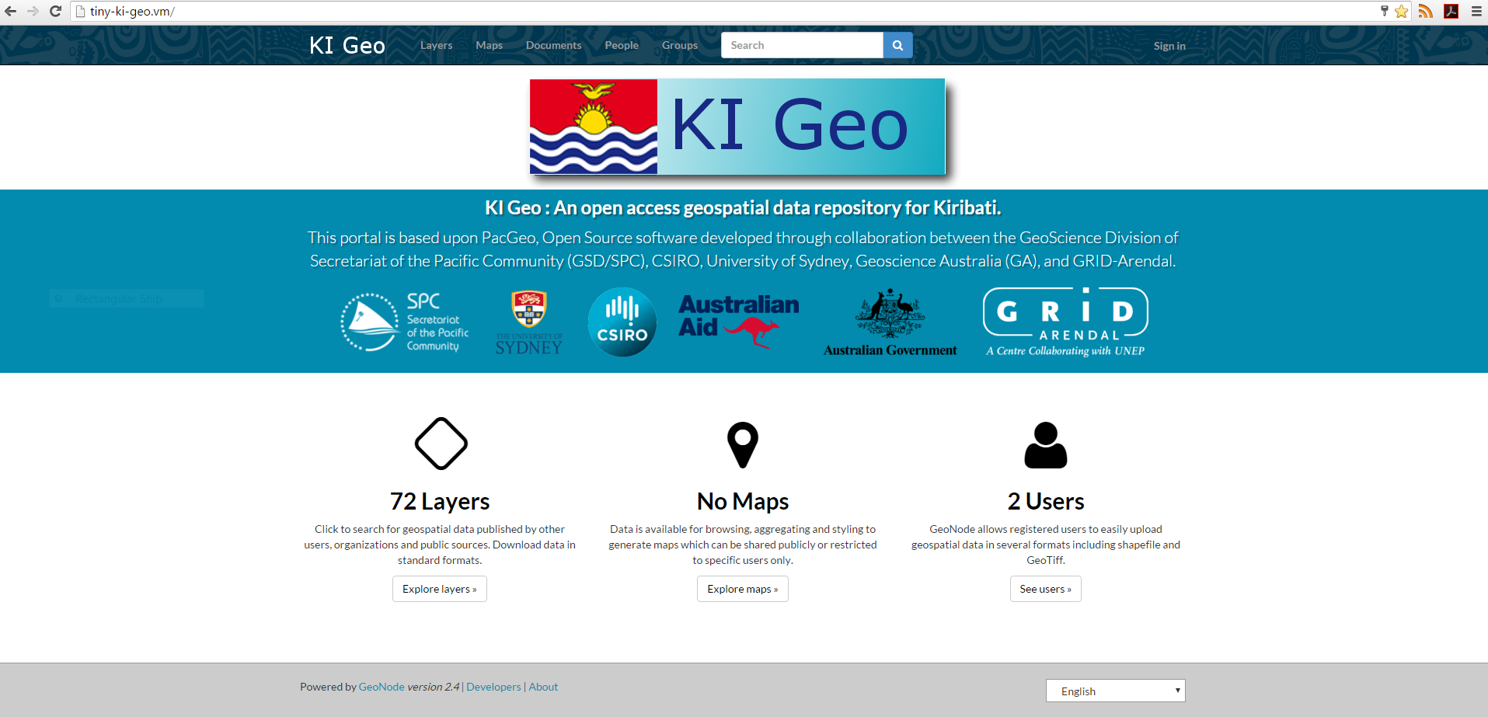
KiGeo
Notes:
Deployed at MFMRD Bairiki. Currently has limited data.
Aim is to work with SPC to upgrade the Kiribati geonode and include a base data set which can be developed.

Slide 6
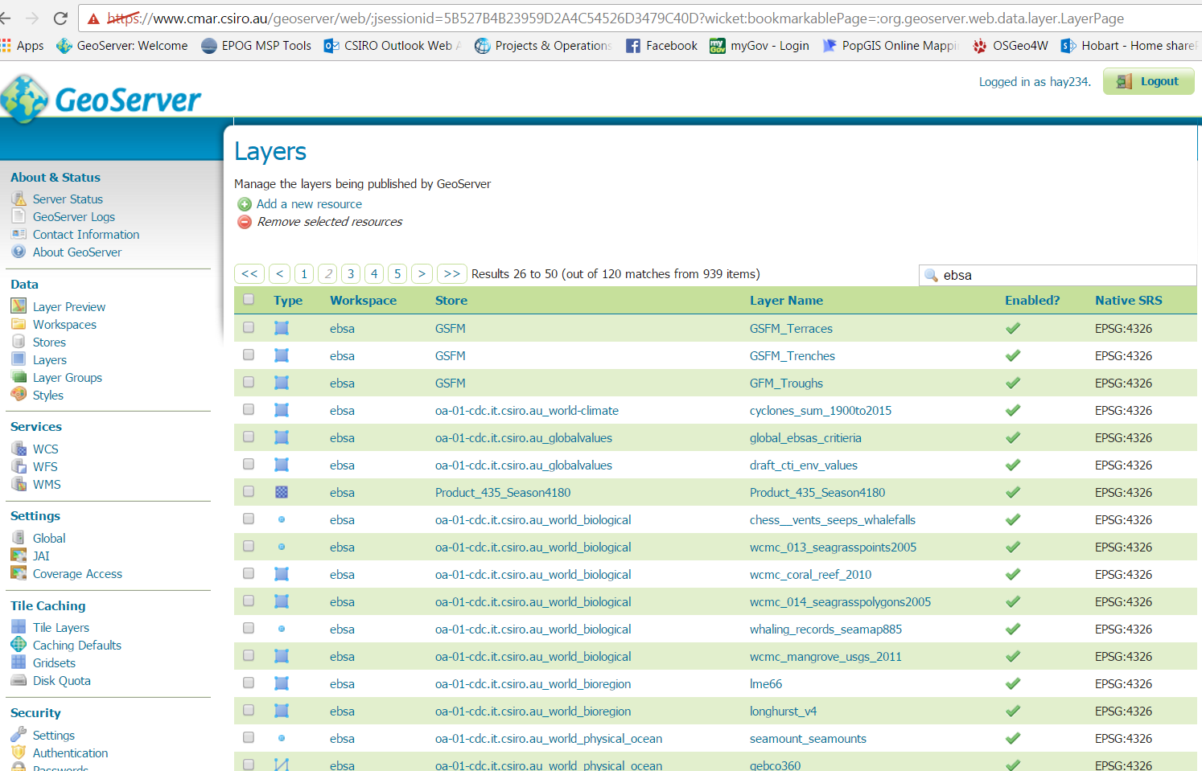
Data Sets
Public datasets
    Satellite SST, SSH, Climatology's, Bathymetry, geomorphology, habitat data (coral reefs, sea grass etc.)
Regional and country sourced data sets
    Shipping, pollution.
Notes:
ANCORES Australian National Centre for Ocean Research and Security (UOW)
Aurelie Delisle
Brooke Campbell
Quentin Hanich

Slide 7
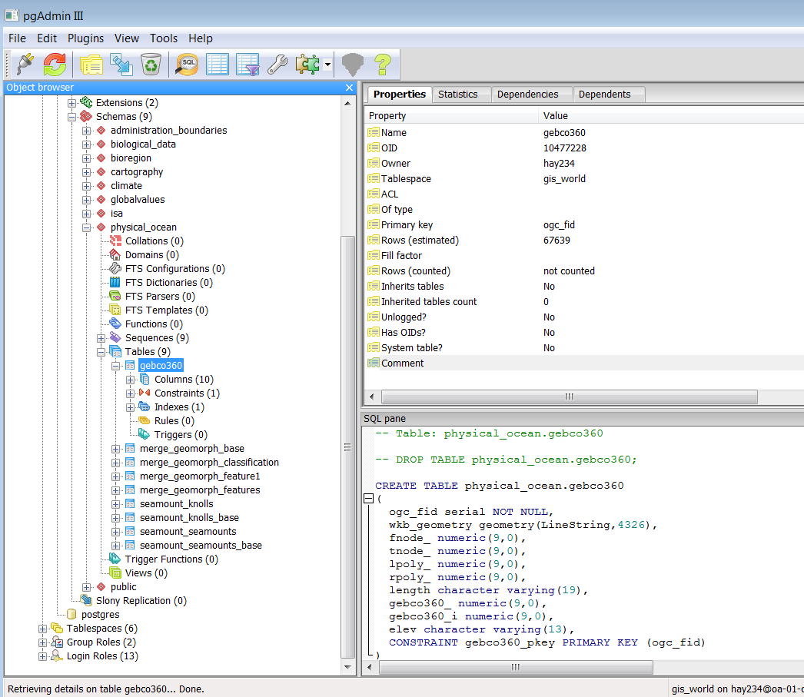
Postgres

Slide 8
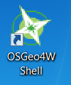
Add data
ogr2ogr -f PostgreSQL PG:"host='oa-01-cdc.it.csiro.au' dbname='gis_world' user='hay234' password='donnah'" \
--config PG_USE_COPY YES \
-lco LAUNDER=YES \
-s_srs EPSG:4326 \
-t_srs EPSG:4326 \
-gt 1000000 \
-nlt polygon -dim 2 -geomfield the_geom \
PG:"host='oa-01-cdc.it.csiro.au' dbname='gis_public' user='hay234' password='donnah' " wcmc.seagrass_richness_2003 \
-nln biological_data.wcmc_seagrass_richness_2003

Slide 9
Activities
Marine Spatial Planning Tools
        Projects data base
        Mapping
Deployment of internet independent version of Pacgeo to MFMRD, Kiribati, In collaboration with SPC.
Capacity building
        Training in use of Kigeo (SPC, Macbio)
        Training QGIS (Macbio, GIZ)
        Provide training in using Marine spatial planning tools
        Marine Spatial planning training workshops
Community based Fishery Management (CBFM) ANCORS
        Tarawa Lagoon Marine Spatial Planning Mapping (ANCORS)
        Community Based Fisheries Management (CBFM – ANCORS)

Slide 10
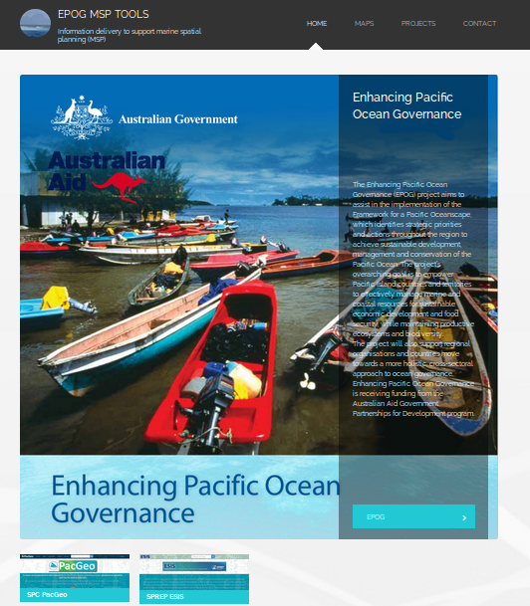
MSP Tools
http://msp.csiro.au/
Web based Drupal tool that can be deployed on a virtual machine with no reliance on internet.
      -Kiribati
Notes:
Drupal: is an open source content management platform powering millions of websites and applications
All data is held in a backgfround AQL database: PostgreSQL: is a powerful, open source object-relational database system
Information can be accessed and used in GIS:
QGIS - A Free and Open Source Geographic Information System

Slide 11
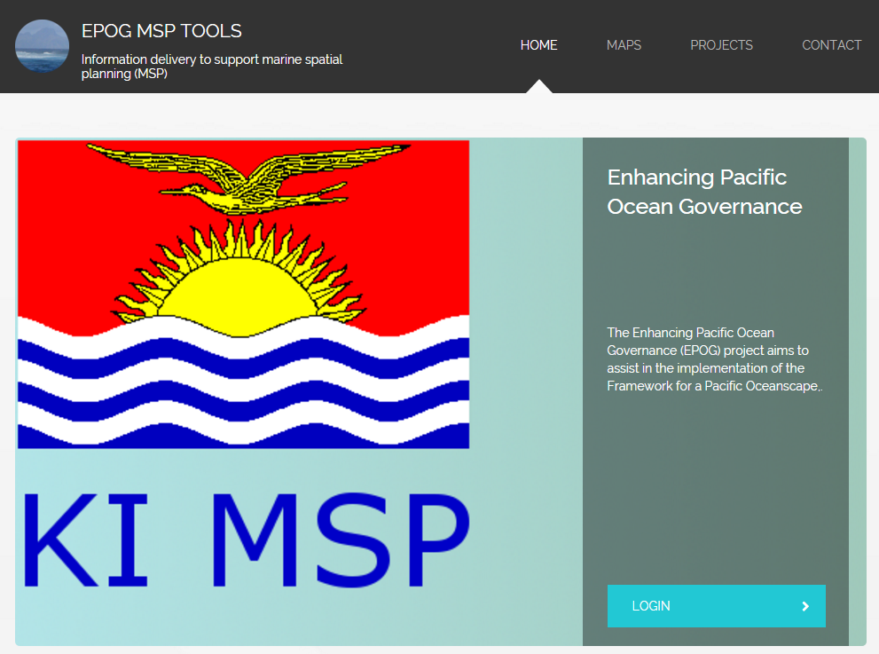
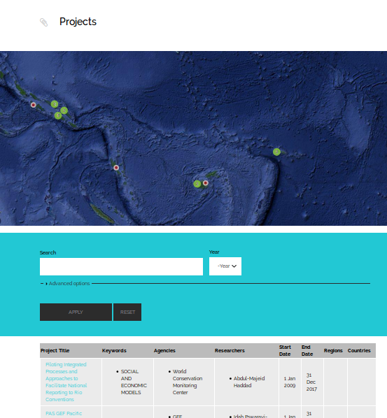
MSP Tools Project Tools
Maintain a more comprehensive ongoing register of initiatives
Notes:
Meeting PIFS needs
Link to International Aid Transparency Initiative (http://iatistandard.org/)

Slide 12
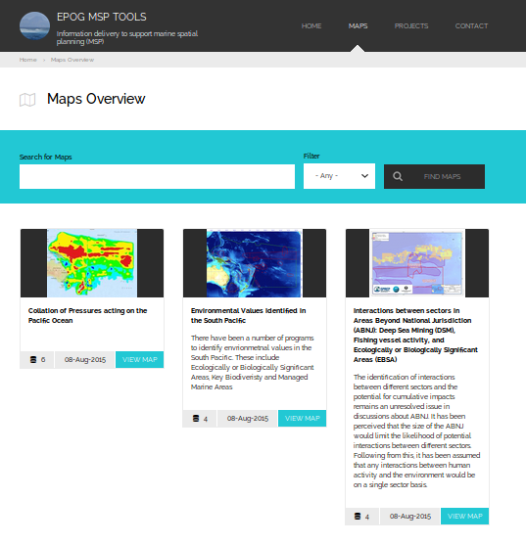
MSP Tools - Maps
Relevant data and information across the spectrum of the Pacific Ocean as a basis for promoting and monitoring the sustainable development
Notes:
A simple map display that displays relevant information for policy and management decisions.

Slide 13
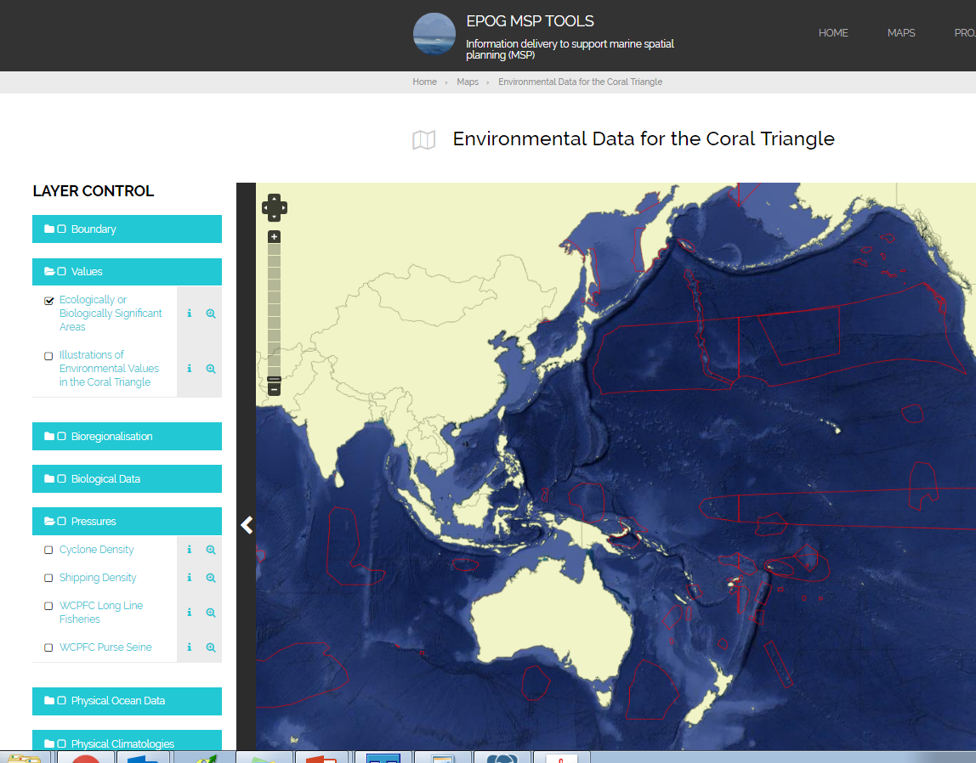
MSP tools Mapping tool

Slide 14
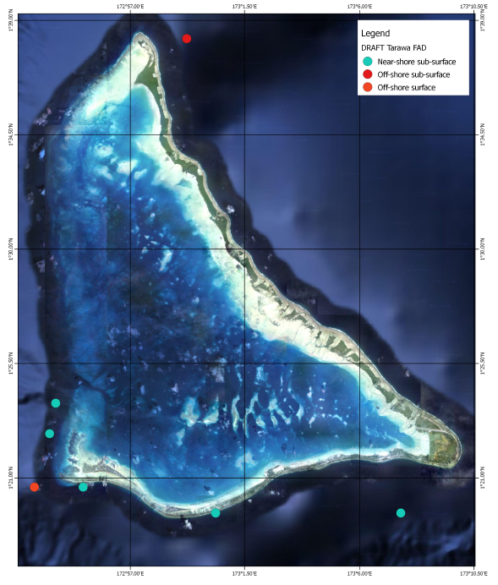
Information on distribution of FADs, Seaweed farms, MPAs, Marine Values
Notes:
Solomon Island coastal FADS.
With distance buffers which is a key placement criteria for MFMR.

Slide 15
Kiribati Activities
Marine Spatial Planning Tools
        Projects data base
        Mapping
Deployment of internet independent version of Pacgeo to MFMRD, Kiribati, In collaboration with SPC.
Capacity building
        Training in use of Kigeo (SPC, Macbio)
        Training QGIS (Macbio, GIZ)
        Provide training in using MSP tools
        Marine Spatial planning training workshops
Community based Fishery Management (CBFM) ANCORS
        Tarawa Lagoon Marine Spatial Planning Mapping (ANCORS)
        Community Based Fisheries Management (CBFM – ANCORS)
Notes:
ANCORES Australian National Centre for Ocean Research and Security (UOW)
Aurelie Delisle
Brooke Campbell
Quentin Hanich

Slide 16
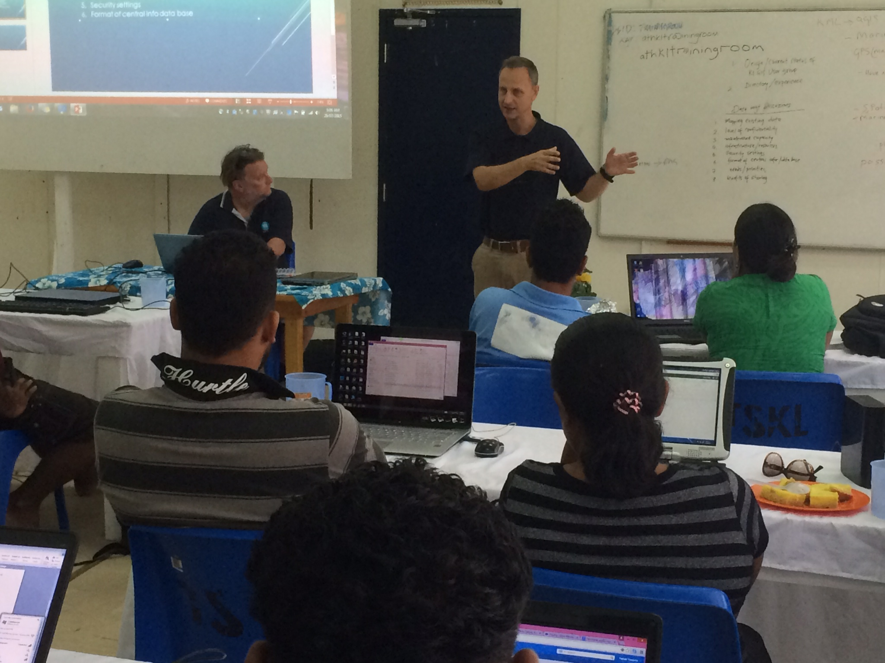
Assisting with Capacity Building (Macbio, SPC, GIZ, CSIRO)
Training Using KiGeo
An introduction to GIS,
using QGIS.
Meeting with Kiribati GIS
uses group.
  What is the GIS users Group?
  What they want out of GIS?
  Training Requirements
  Data management
Notes:
16 Kiribati Representatives
3 MACBIO Representatives Jan Steffen, Jonah Sullivan, Riibeta Abeta
2 EPOG Representatives Ian Mcleod, Donna Hayes

Slide 17
Challenges
Everyone is keen but too busy
Need to ensure there is capacity on ground to maintain infrastructure and tools.
We have provided a series of training sessions, manuals but this isn’t enough.
The administrator position needs to be someone's focus.

Slide 18
I think we have had some successes
Provided access and training to QGIS across government
Focused on fisheries and Minerals assisting staff to digitise and maps their data, FADS, Siq..
Many are comfortable to contact us for assistance and data

Slide 19
Activities
Marine Spatial Planning Tools
        Projects data base
        Mapping
Deployment of internet independent version of Pacgeo to MFMRD, Kiribati, In collaboration with SPC.
Capacity building
        Training in use of Geonode (SPC, Macbio)
        Training QGIS (Macbio, GIZ)
        Provide training in using Marine spatial planning tools
        Marine Spatial planning training workshops
Community based Fishery Management (CBFM) ANCORS
        Tarawa Lagoon Marine Spatial Planning Mapping (ANCORS)
        Community Based Fisheries Management (CBFM – ANCORS)
Notes:
ANCORES Australian National Centre for Ocean Research and Security (UOW)
Aurelie Delisle
Brooke Campbell
Quentin Hanich

Slide 20
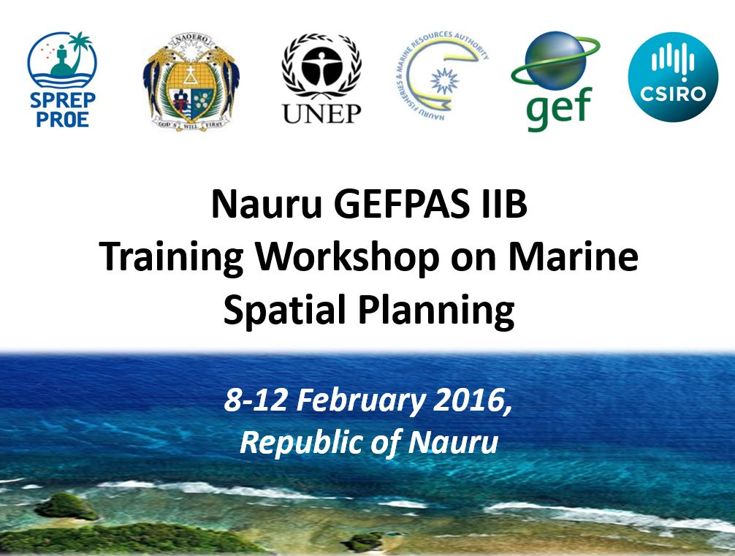
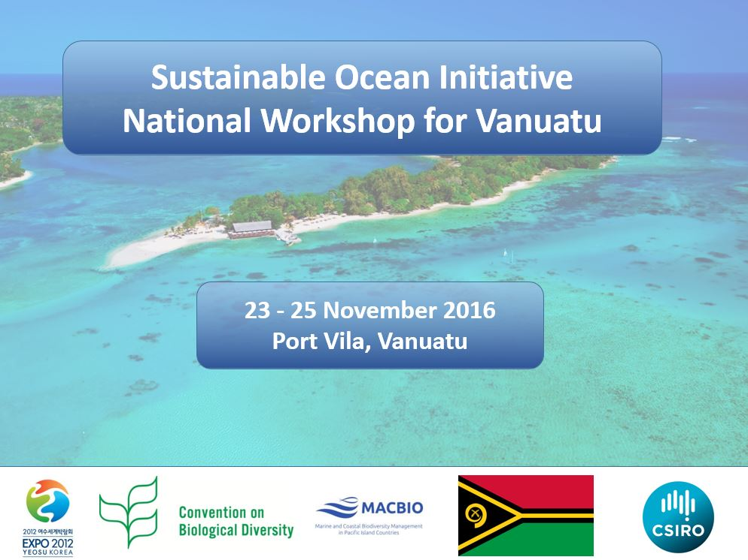
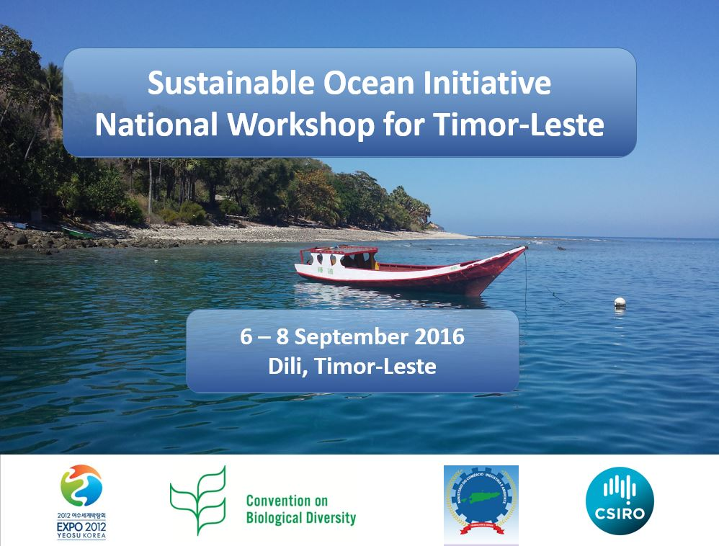
Marine Spatial Planning Training

Slide 21
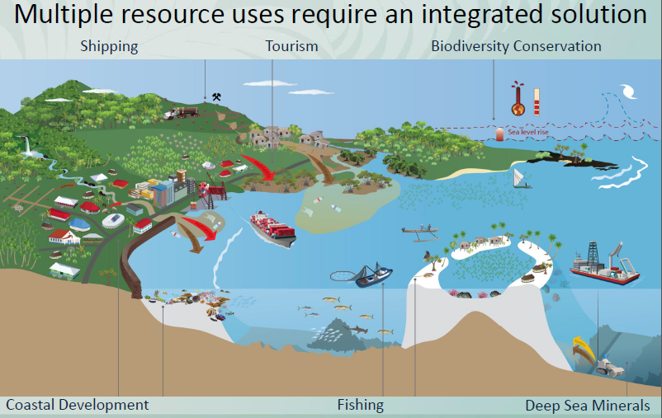
Why MSP?

Slide 22
Process | Training workshop
Scoping | Session1: National and community policy context for marine resource management & Marine Spatial Planning (MSP)
Understanding the Environmental, Social/Cultural and Economic Values | Session 2: Understanding marine resources
Interactions between human activities and Values identified | Session 3: Critical issues related to marine resource management
Management of the values and activities | Session 4: Implementing an Management of marine resources in Timor – Leste
Monitoring the process | Session 5: Monitoring & Evaluating the MSP process
Implementing a MSP process | Session 6: First steps, opportunities and constraints

Slide 23
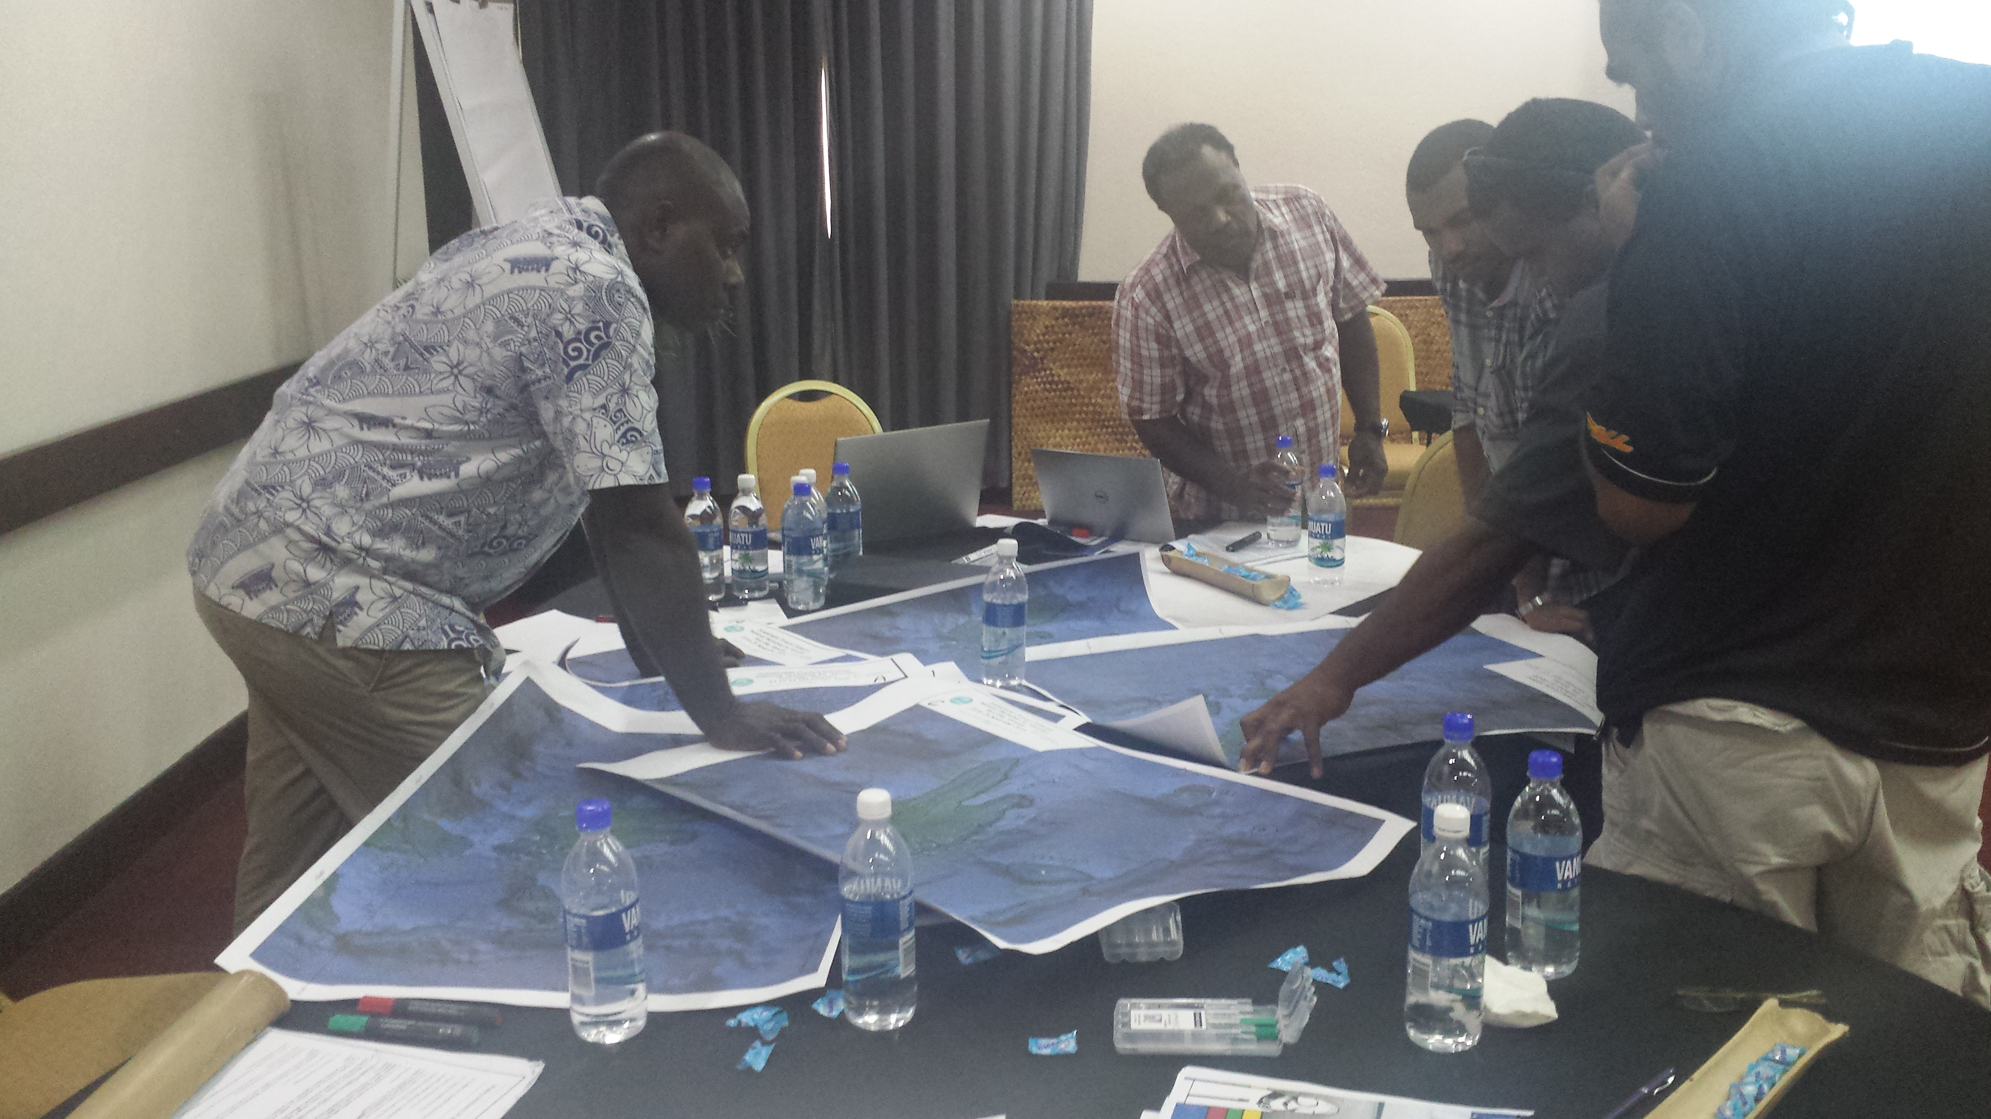
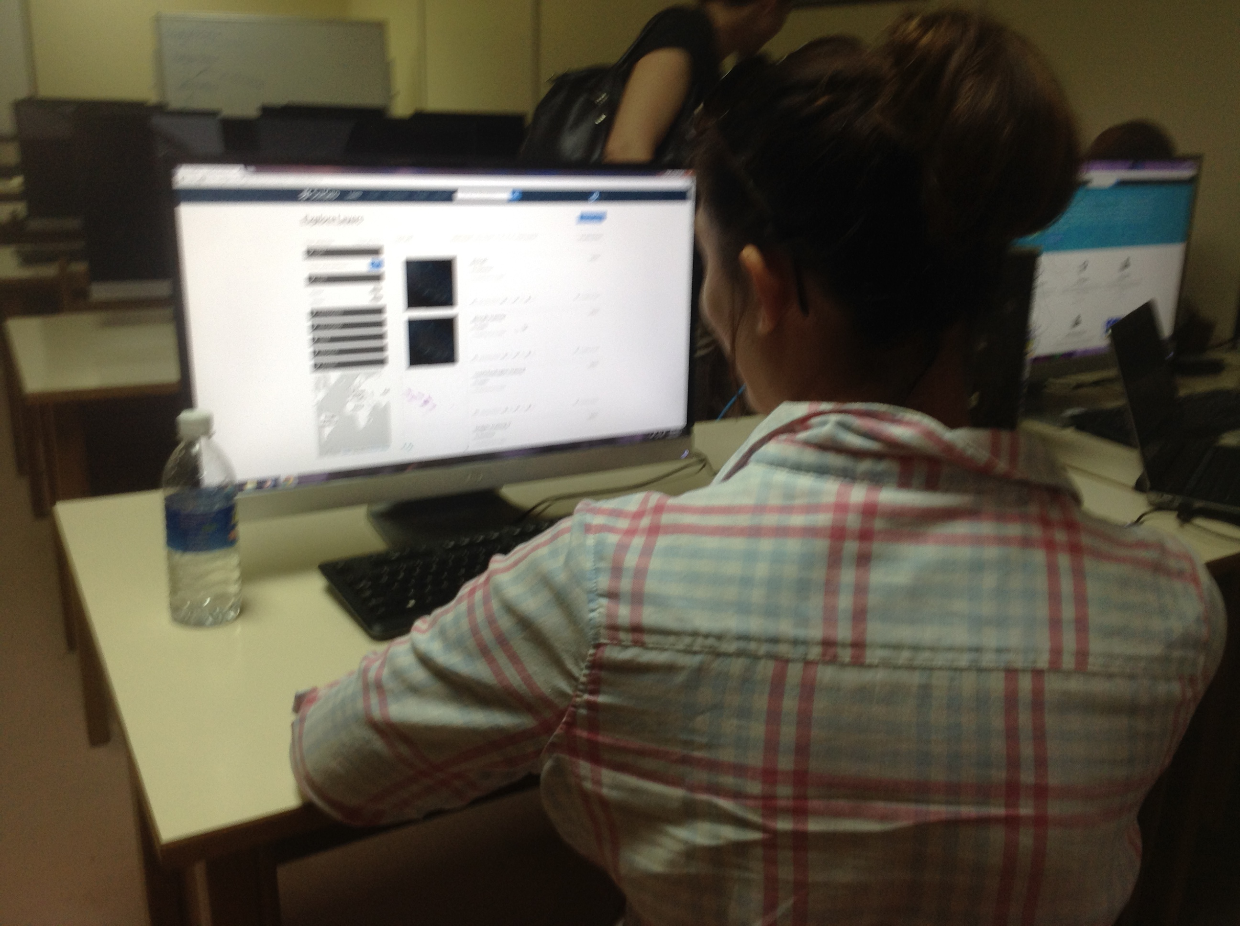
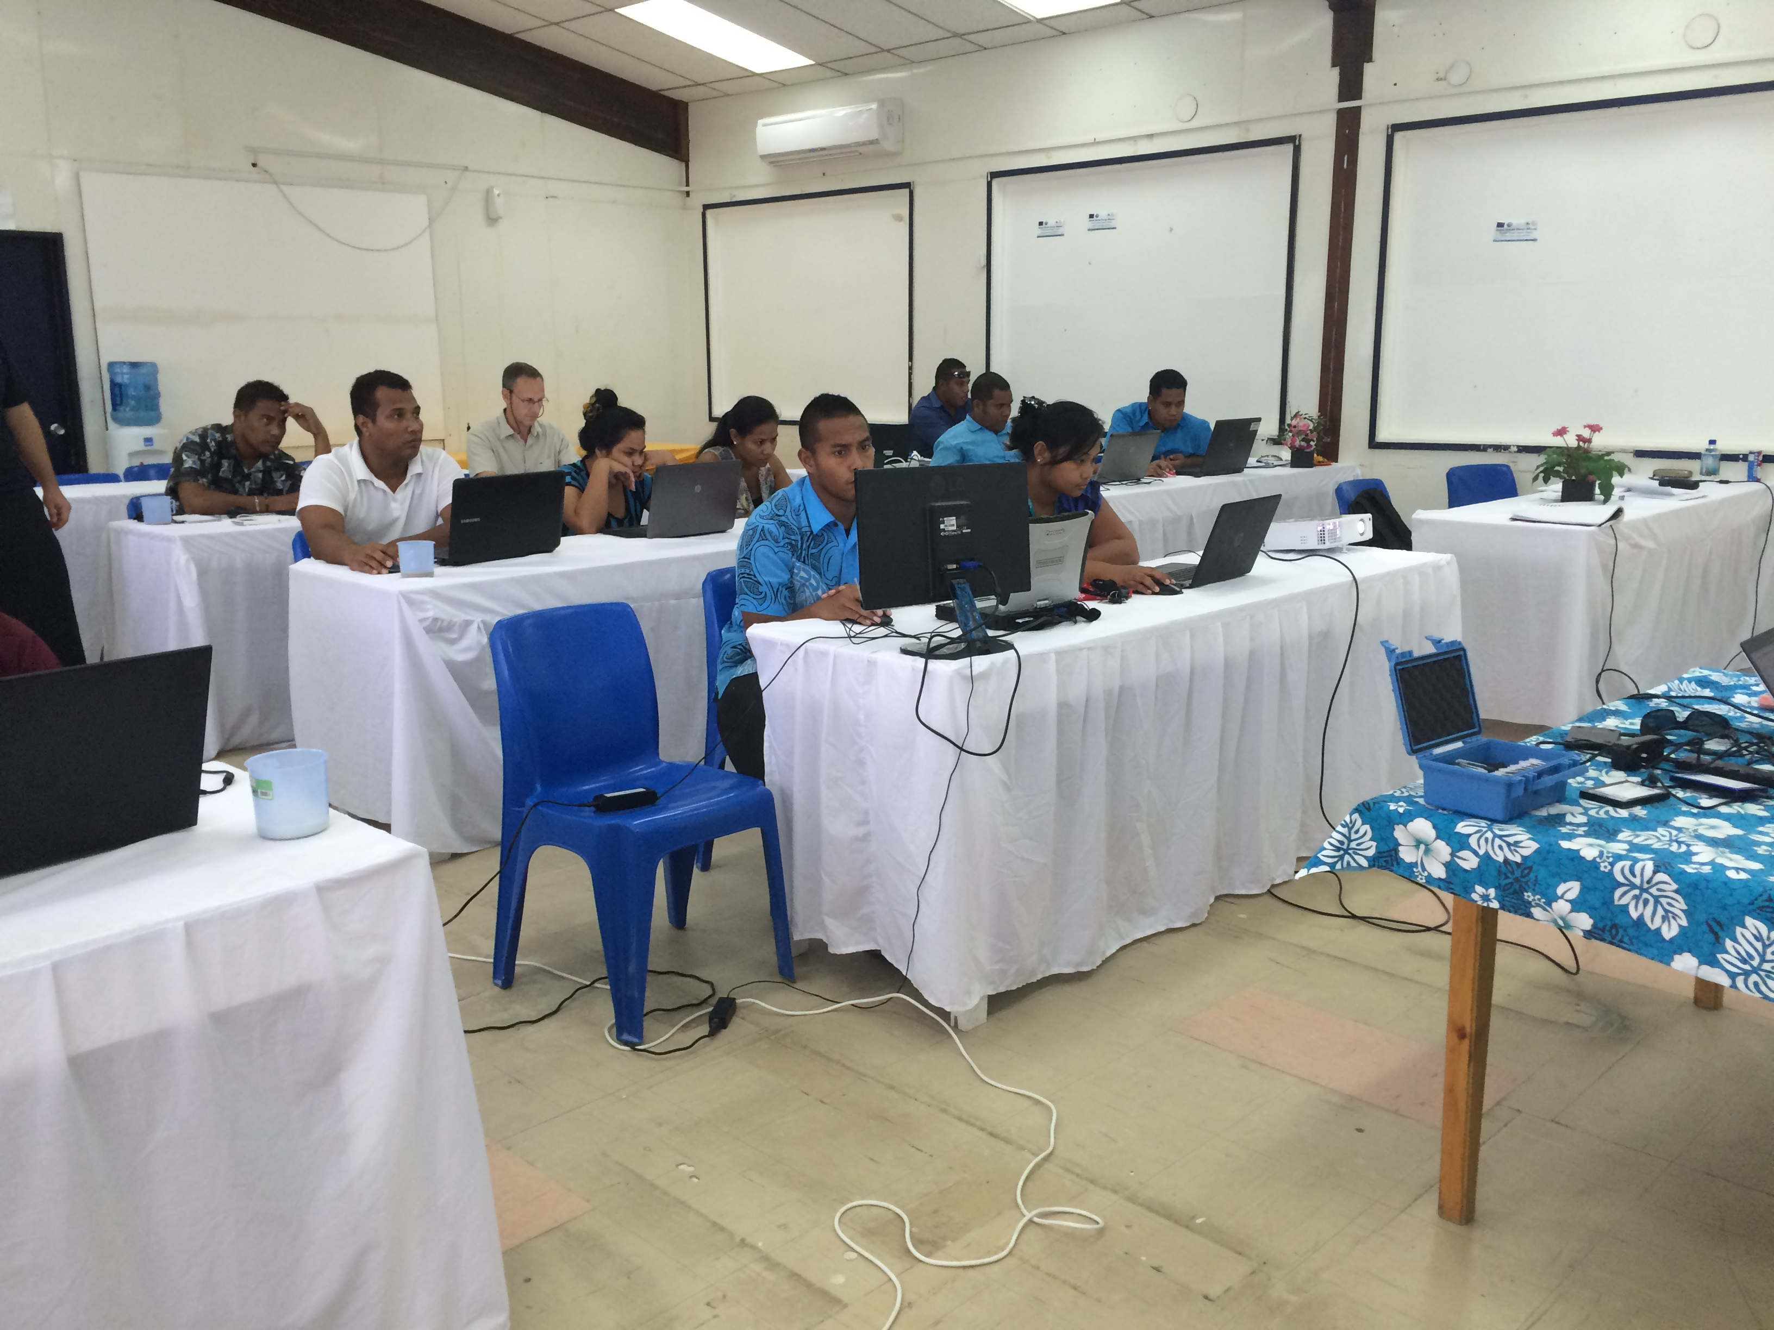

Slide 24
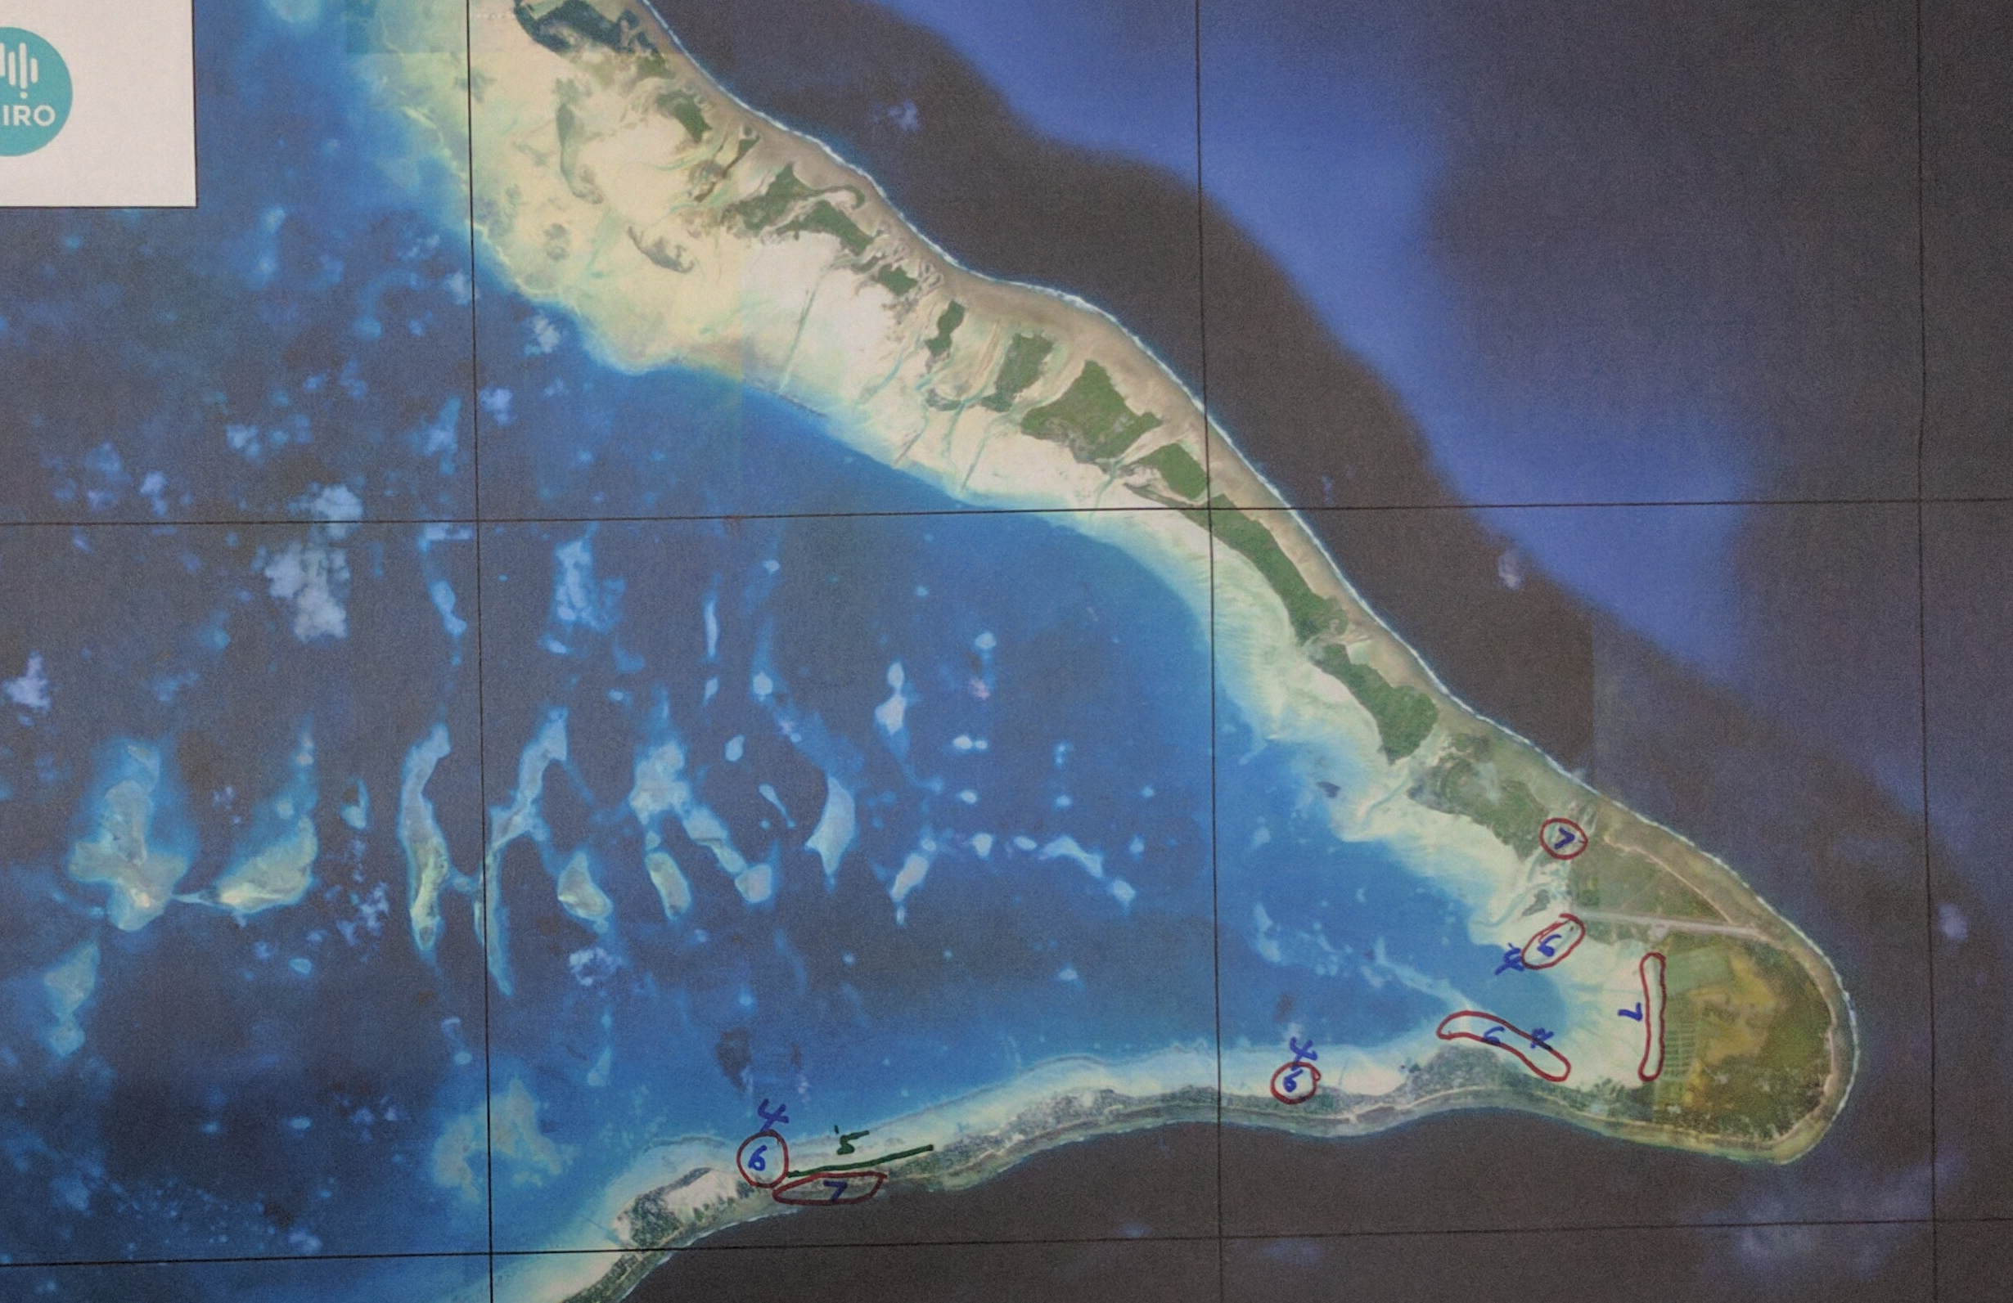
Values

Slide 25
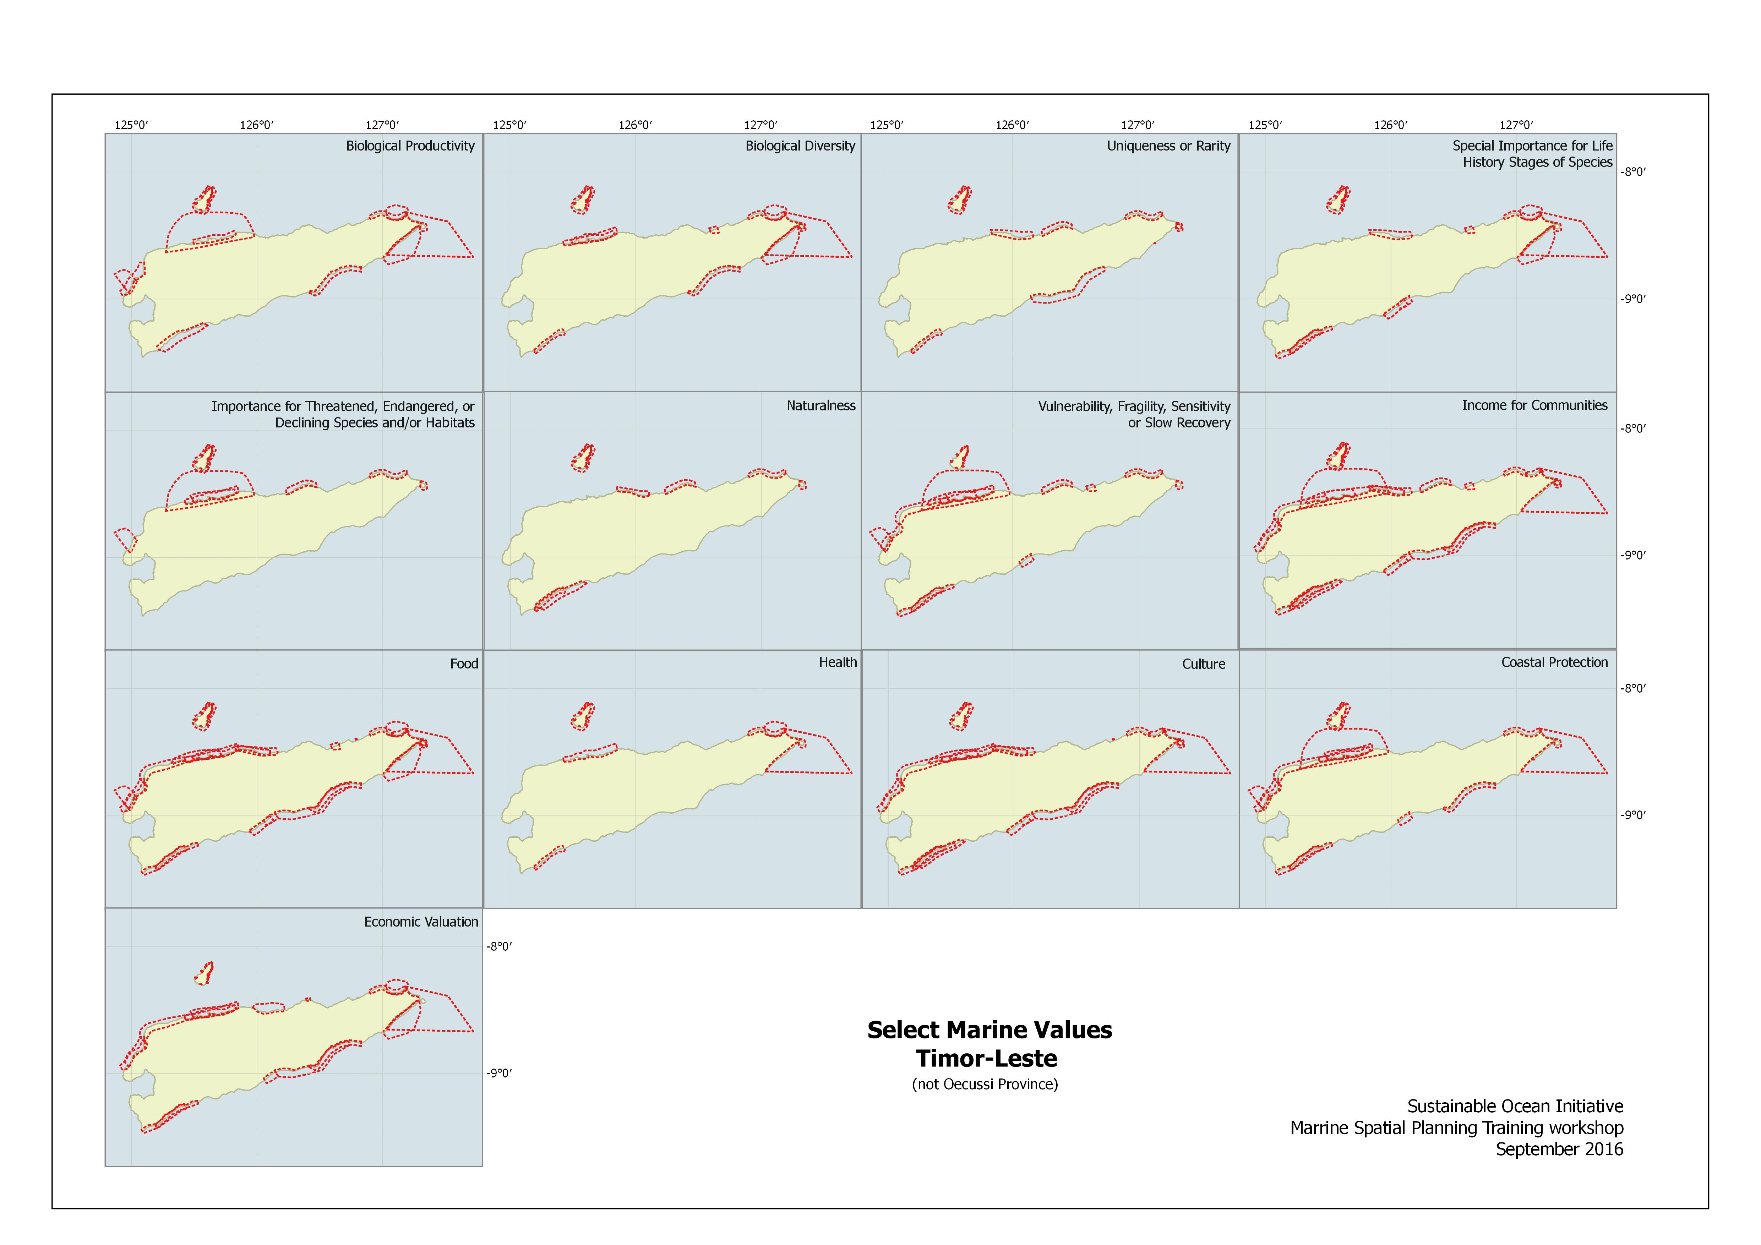

Slide 26
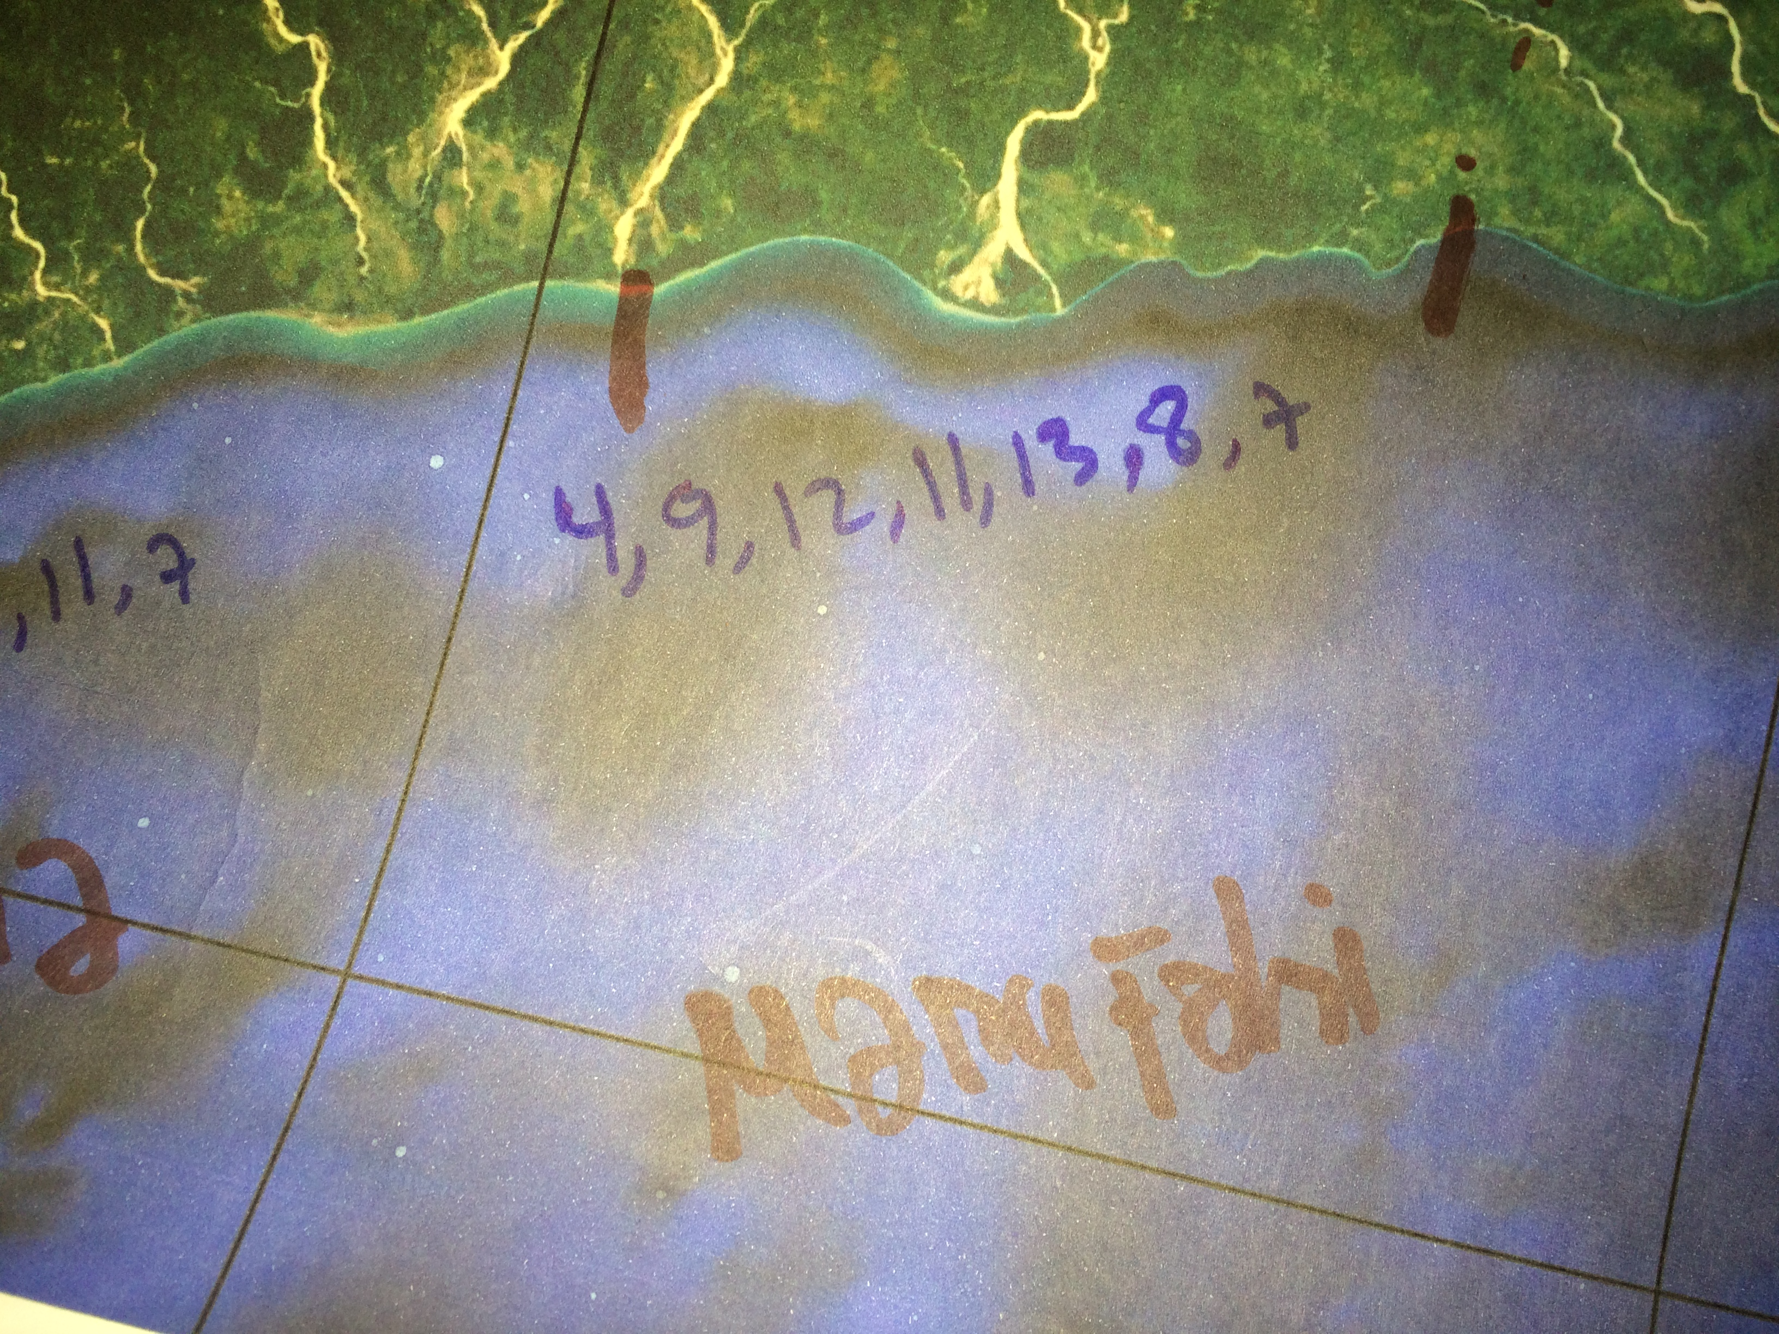
Uses

Slide 27
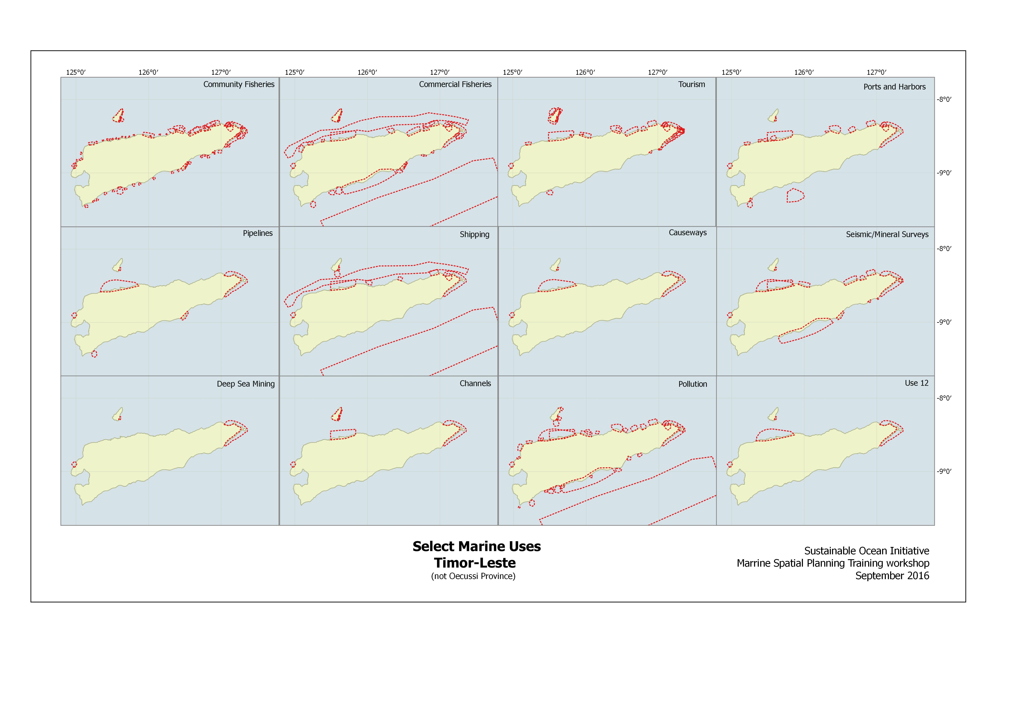
Uses

Slide 28
Many Thanks to all our collaborators
MFMRD, Kiribati Government
GIS Users Group, Kiribati
PIFS
SPREP
SPC (Coastal Fisheries & GSD)
MACBIO
iClim
ANCORS/ACIAR project on coastal fisheries
TNC, Worldfish & CSIRO CTI marine values project & local adaption
SCBD
Governments of Kiribati, Vanuatu, Nauru and Solomon Islands, Australia

Slide 29
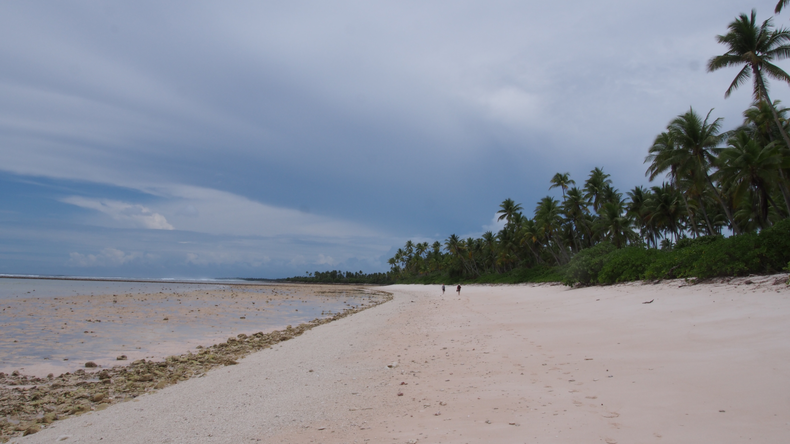
Thank you
Oceans and Atmosphere
  Donna Hayes
  t +61 3 6232 5014
    e Donna.Hayes@csiro.au
    w msp.csiro.au
Oceans and atmosphere

