Slide 1




Marion DROUZY, PhD student
CIFRE Grant, collaboration
between AEL and IRD
“Impact of terrigenous inputs in a tropical lagoon through a 3D hydrodynamic model and a measures network”
PhD director: Christel Pinazo, HDR (MIO)
Co-Director: Pascal DOUILLET (IRD)
PhD : 2015 - 2018

Slide 2
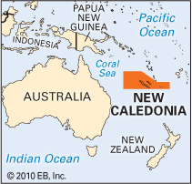

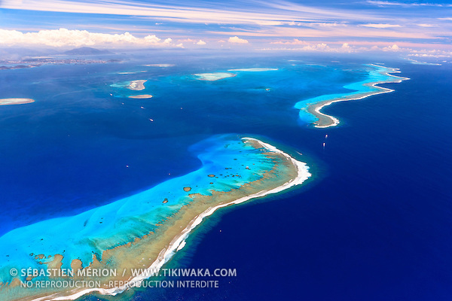
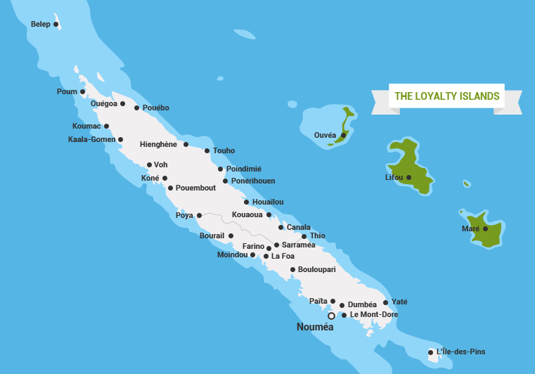
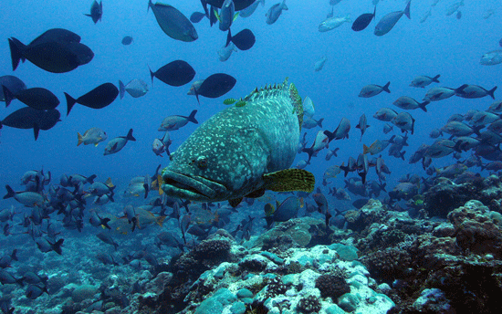
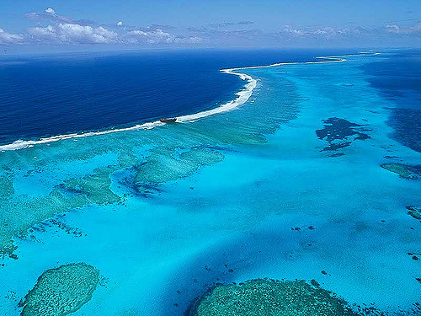
Context and objectives | Data acquisition & analysis | Modeling | First results & prospective
NEW CALEDONIAN REEF
2nd largest in the world:
1 500 km long & enclosing a 24 000 km² lagoon
Greatest marine biodiversity
Lagoons registered in the
Unesco World Heritage sites as:
« Reef diversity and associated
ecosystems »
Conservation of marine
diversity at stake
IRD / S. Andréfouet

Slide 3
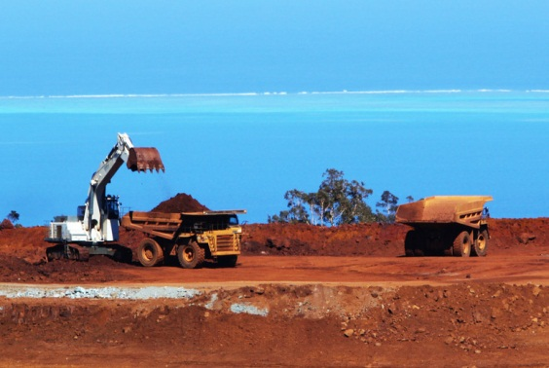
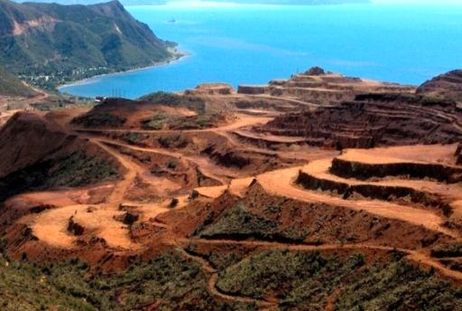
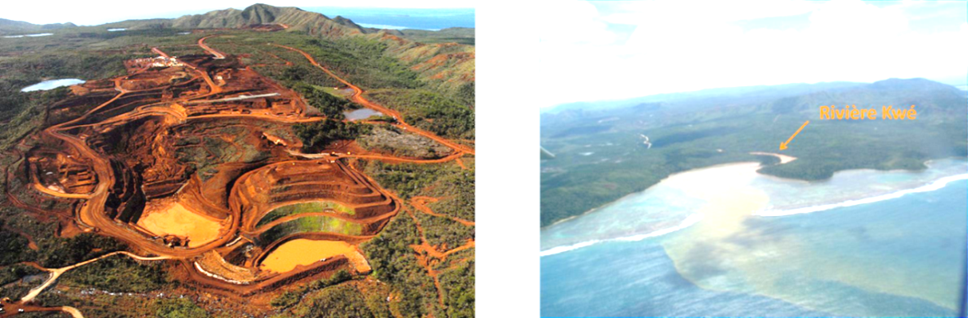
Context and objectives | Data acquisition & analysis | Modeling | First results & prospective
NEW CALEDONIAN MINING INDUSTRY
4th Nickel exporter worldwide
Essential to local economy
More than 20 open-mining sites
Enhanced erodibility
Increased terrigenous inputs
Metallic contamination
Coral shading and smothering
Goro mine, New Caledonia. Photo Julien Thomazo

Slide 4
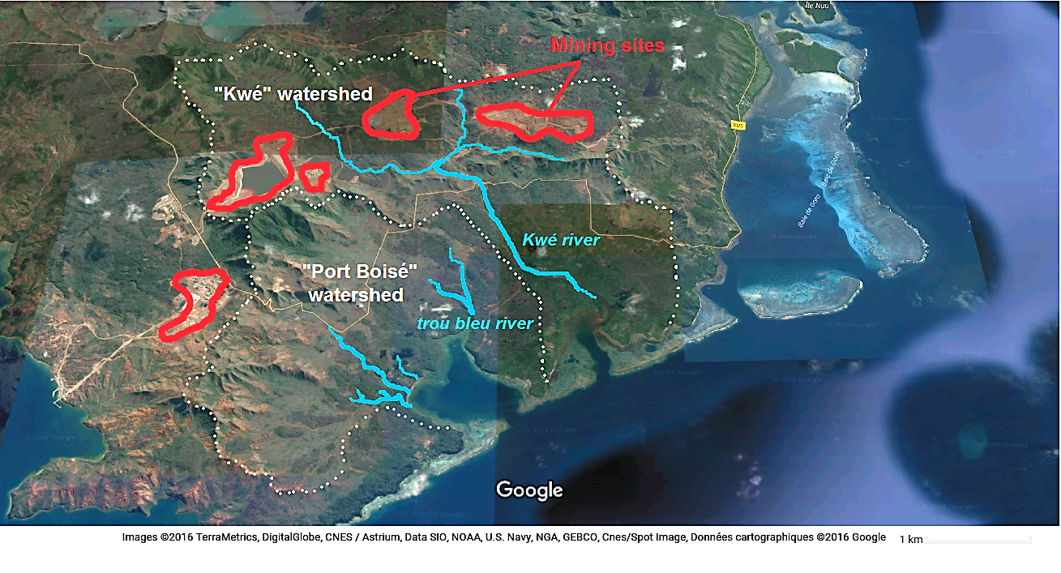
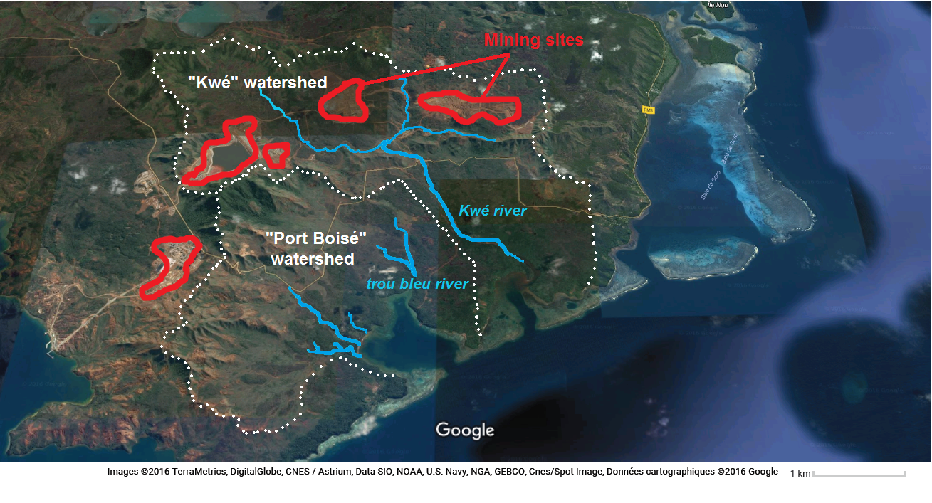
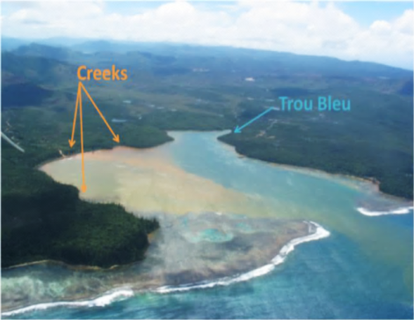
Context and objectives | Data acquisition & analysis | Modeling | First results & prospective
PhD main objective: Development of a 3D model for quantification and impact assessment of the increase of terrigenous inputs into a tropical lagoon
Scientific purposes of the PhD:
Update of a 3D hydrodynamic model with a deposition module in order to simulate terrigenous impacts on a tropical coral reef and lagoon.
Quantify and characterize inputs transport and deposition patterns through measurements
Built a decision-making support tool, in order to assess the impact of particulate terrigenous inputs generated by mining processes on the lagoon for a sustainable management
Numerical Modeling benefits relative to measurements:
Versatile, non-intrusive, fast and efficient at low cost.
Enables the repeatability and reproducibility of test cases:
Test cases: synoptic results in time or space
Separate approach of each physical forcing
Long term prediction
Collaborative work with joined models (biogeochemical …)
However: measures necessary for model Calibration & validation
Study site: Two bays in the South-East lagoon
Bay of Port Boisé : Watershed devoid of open mines
Bay of Kwé : Watershed containing several open mines

Slide 5
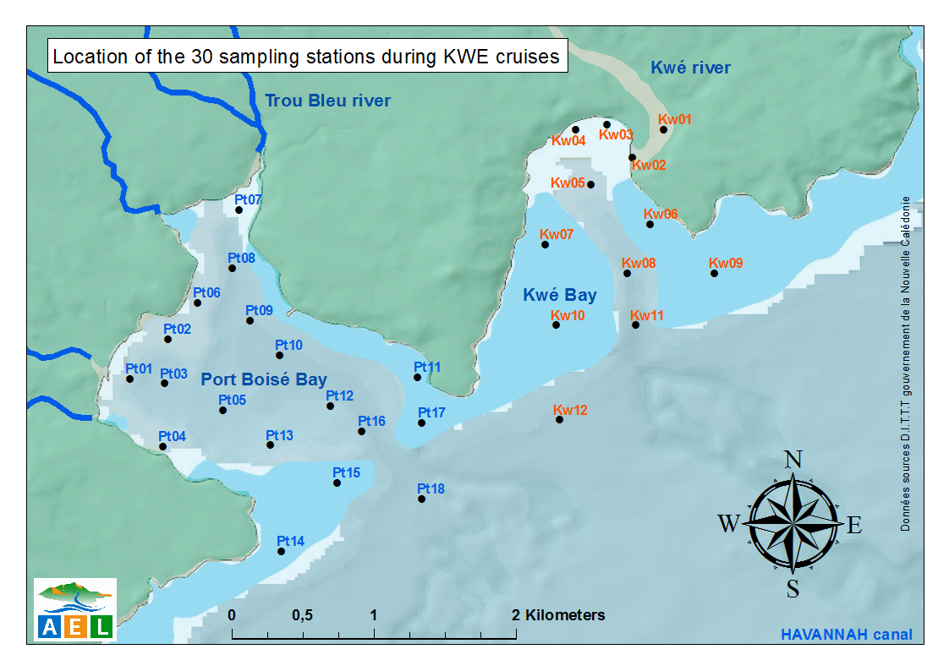
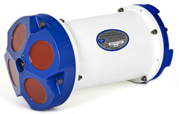
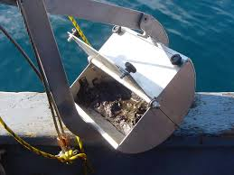
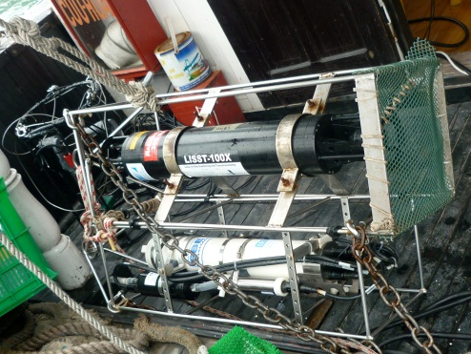
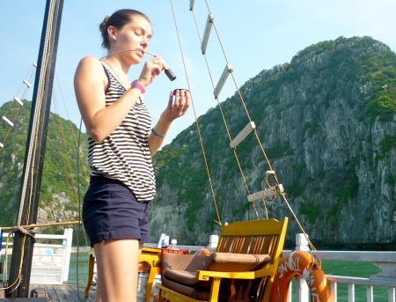
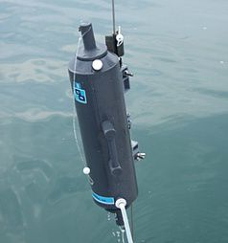
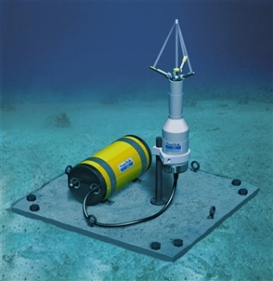
Context and objectives | Data acquisition & analysis | Modeling | First results & prospective
Measurements network, in-situ data acquisition
Over a year, 3 days campaigns were realized monthly to get seasonal variability of different parameters
CTD profiles Conductivity, temperature, depth
Doppler loggers (ADCP & ADV) Currents speed and direction
Niskin bottle sampling SPM filtering on nuclepore 0,4µm
VanVeen grab sampler sediments sampling & size sorting
Laser in situ scattering (LISST) SPM size sorting in water
Turbidity profiles Charge in particles in the water column
Spectrometer Sea surface Reflectance

Slide 6
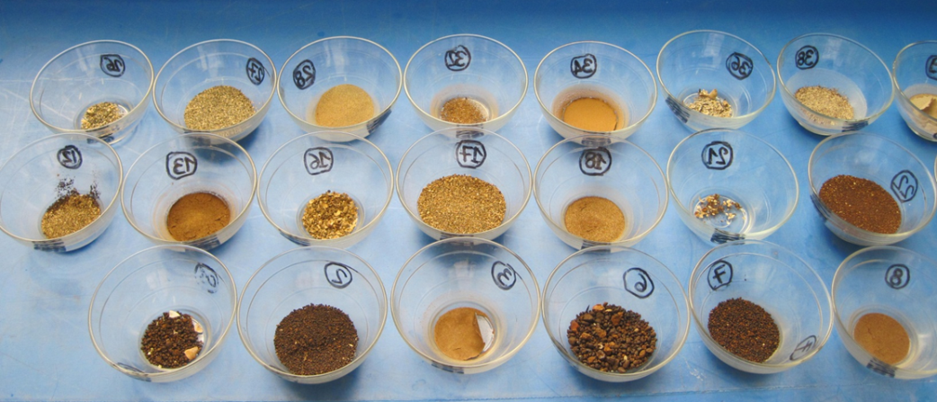
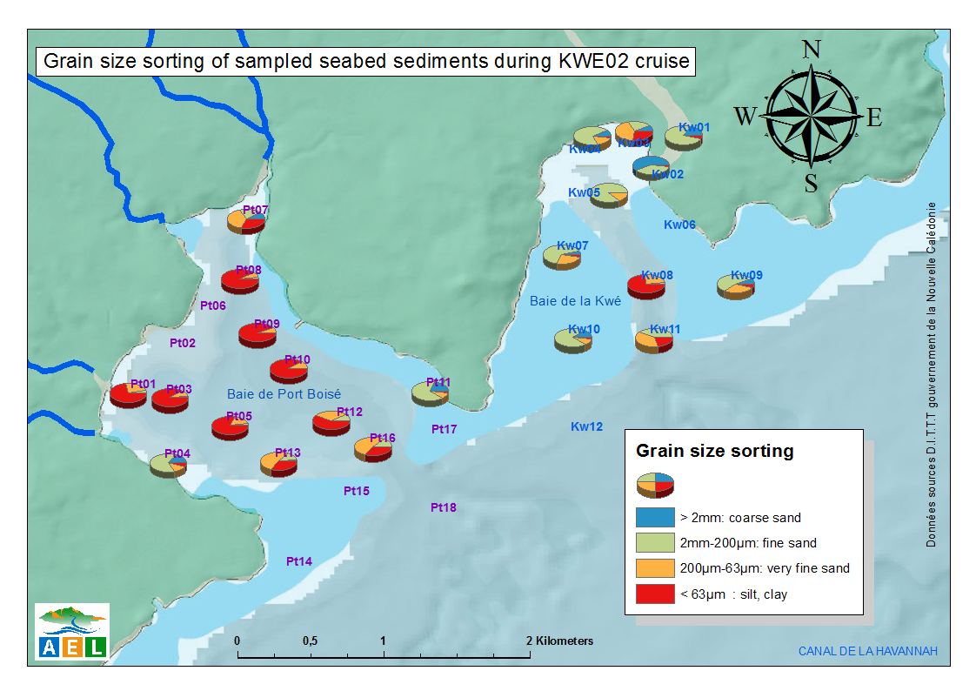
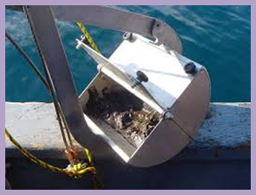
Context and objectives | Data acquisition & analysis | Modeling | First results & prospective
Sediments grain size sorting
Sampling and sieving of sediments
Mapping of sediment distribution in the study site
Silts predominant in channels and deep stations
Fine sands predominant at reef stations
Coarser sand predominant at
river mouth stations
Sediment sorting after sieving and drying
Van Veen grab sampler

Slide 7
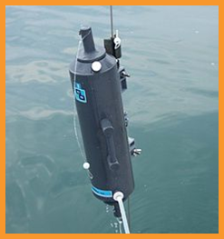
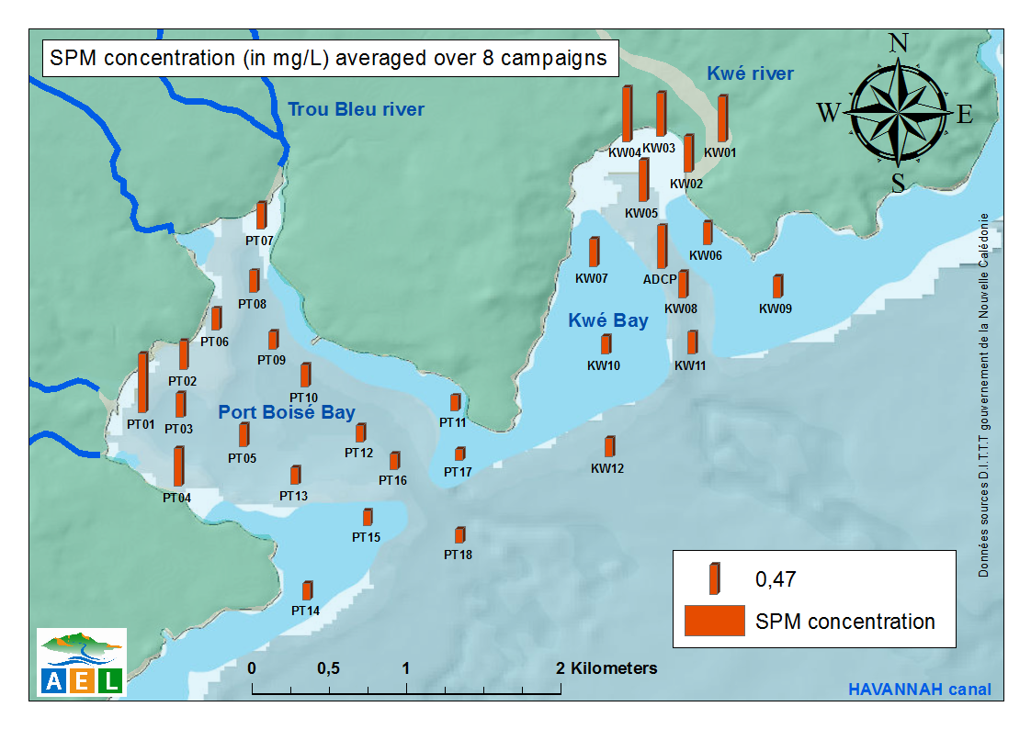
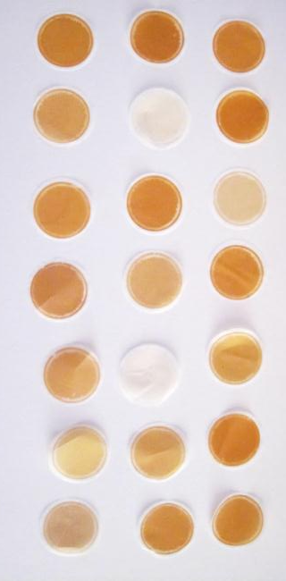
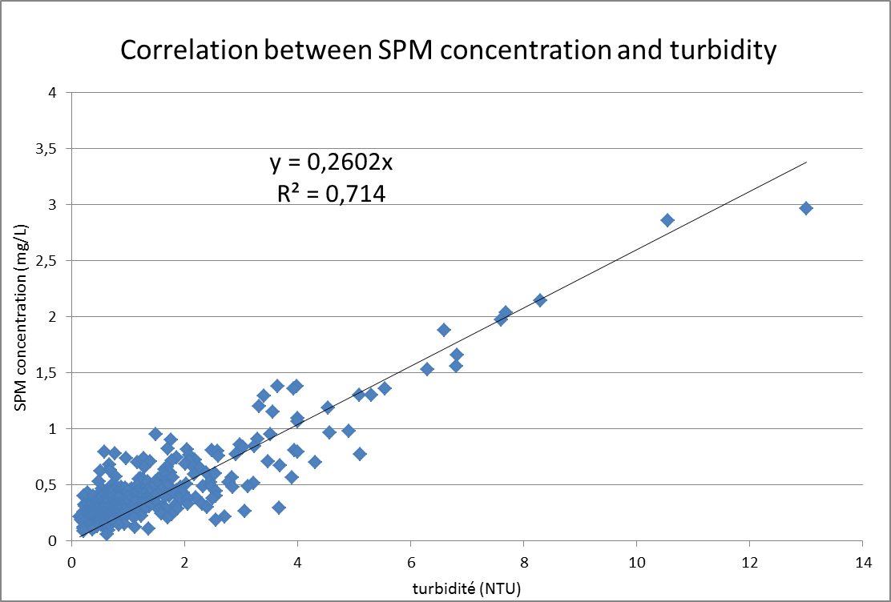
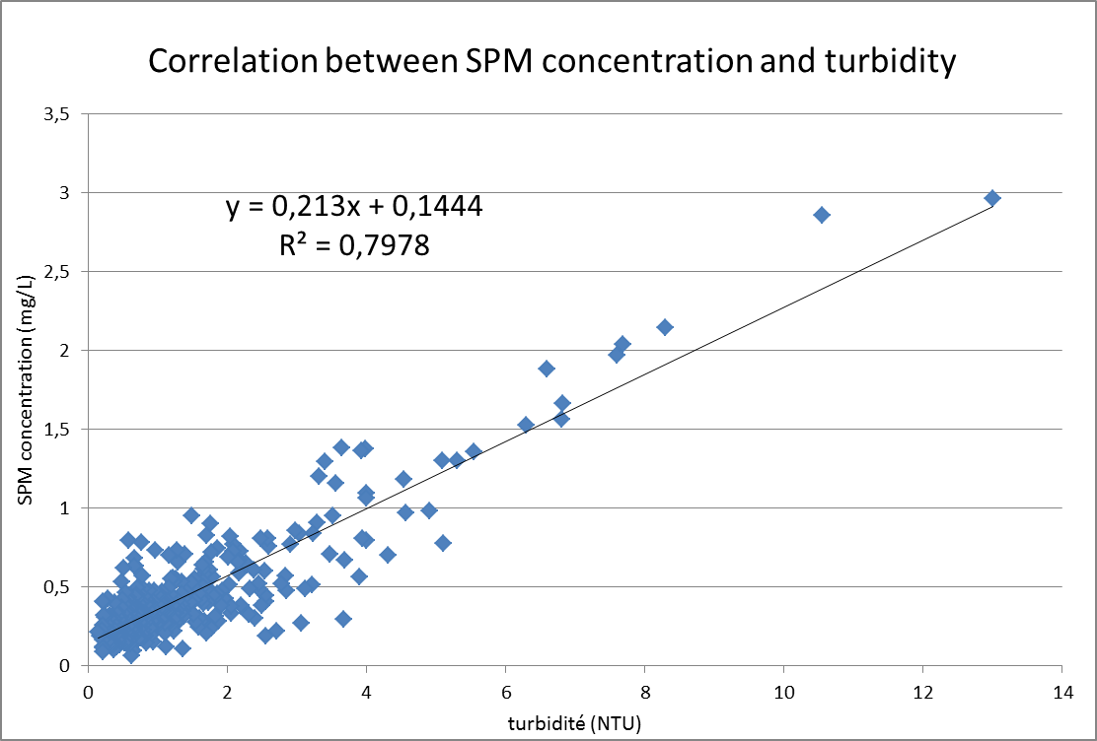
Context and objectives | Data acquisition & analysis | Modeling | First results & prospective
Suspended particles (SPM) concentration related to turbidity
9 field campaigns : 409 exploitable SPM concentration over the 30 stations
Greatest values found near river mouths,
lowest values at reef stations (highest currents)
New Caledonian lagoon waters generally oligotrophic (order of magnitude 0,1 – 1 mg/L)
2016 “El Nino year” : low precipitation and river inputs
➔ Difficulties to get high values of SPM concentration and turbidity to complete the relationship
Niskin sampling bottle
Retrieval of SPM concentration from turbidity
Nuclepore membrane
after filtration of 500ml

Slide 8
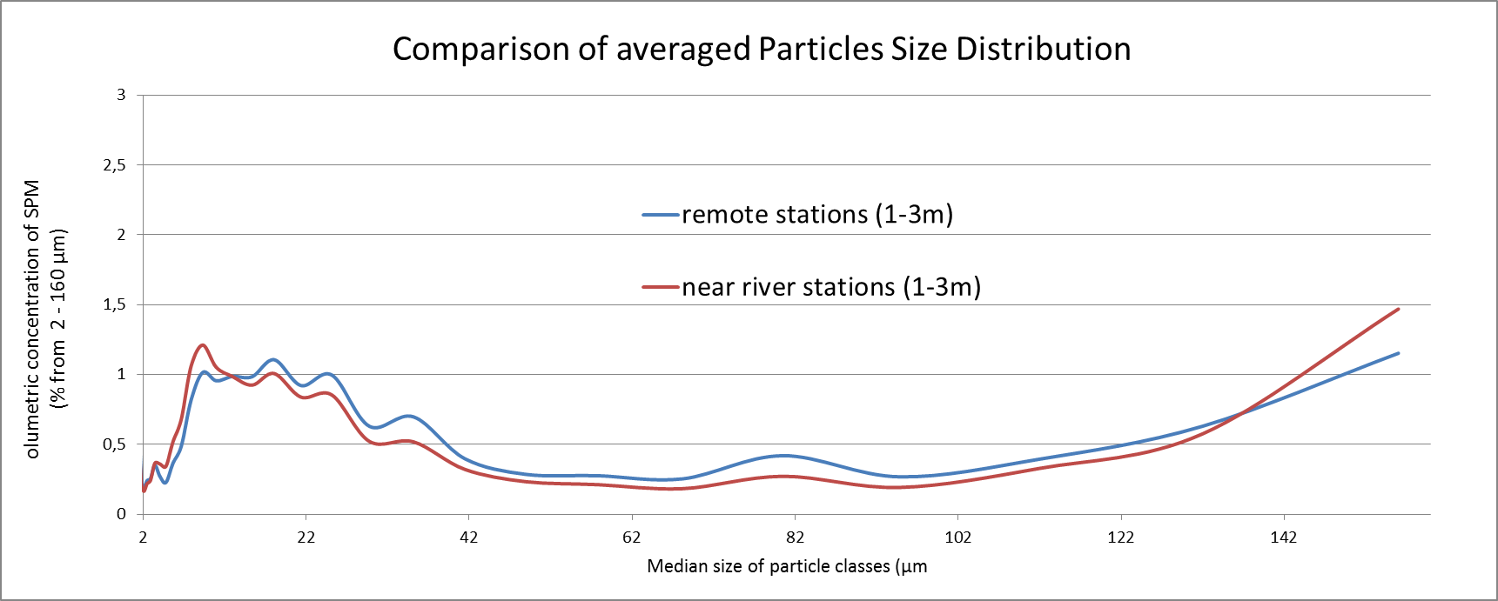
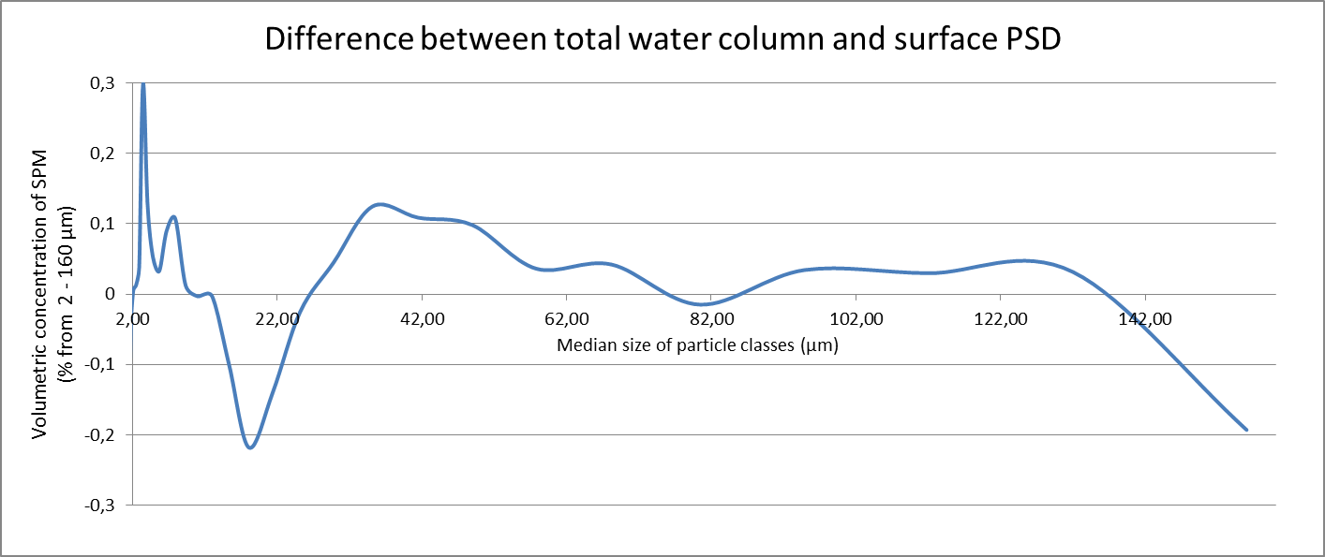
Context and objectives | Data acquisition & analysis | Modeling | First results & prospective
Particles’ size distributions retrieved from the LISST in the water column
General PSD (Averaged over time & space):
Particles size signatures (peaks):
4µm, 9µm, 18µm, 25µm, 35µm, 80µm
Max concentration of 9µm for near river stations
Max concentration of 18µm for remote stations
Hypothesis ➔ 9µm diameter particles preferentially found at near river & shallow stations are terrigenous inputs signature
Variability of PSD over depth :
(for deep stations, we distinguished surface
and bottom layer)
In surface layer:
Max of 18µm diameter particles
Hypothesis ➔ Particles of 18µm are 9µm particles flocs linked by biological or physical that allow buoyancy
In deeper layer:
More 4 and 35µm in the deeper layers, less 18µm, 9µm equivalent
9µm
25µm
80µm
4µm
18µm
35µm
4µm
35µm
Predominant in middle and bottom layers(1-3m)
9µm
18µm
Predominant in surface layer (1-3m)
Hypothesis ➔ predominance of bigger particles in the deeper layers of the water column (and 4 µm peak) show the sinking of biological waste and of heavy terrigenous particles
Notes:
Hypothesis ➔ Particles of 18µm are 9µm particles flocs linked by biological or physical that allow buoyancy
Hypothesis➔ predominance of bigger particles in the deeper layers of the water column (including the 35µm peak) Deeper in the water column, abundance of very fine particles (bio-waste) and bigger particles in depth (nature?? Heavy flocs? )

Slide 9
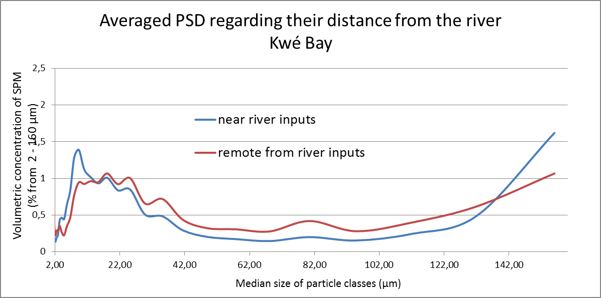
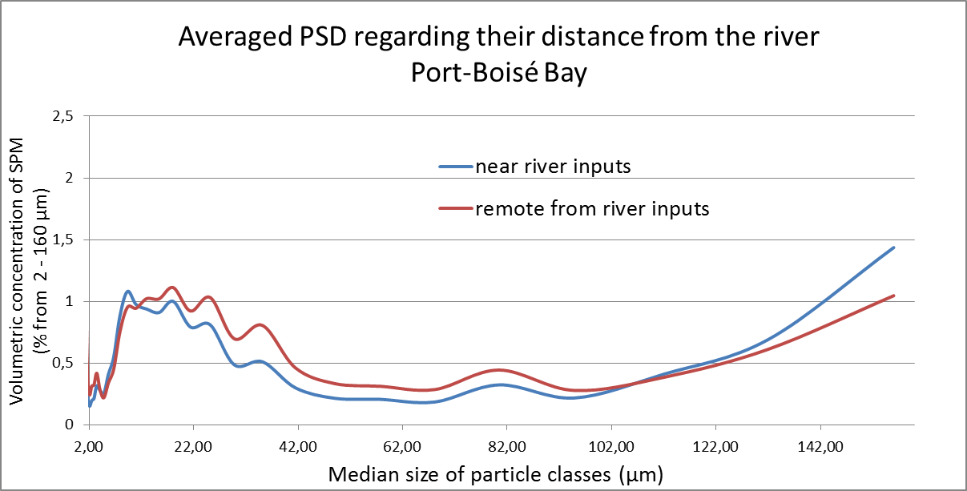
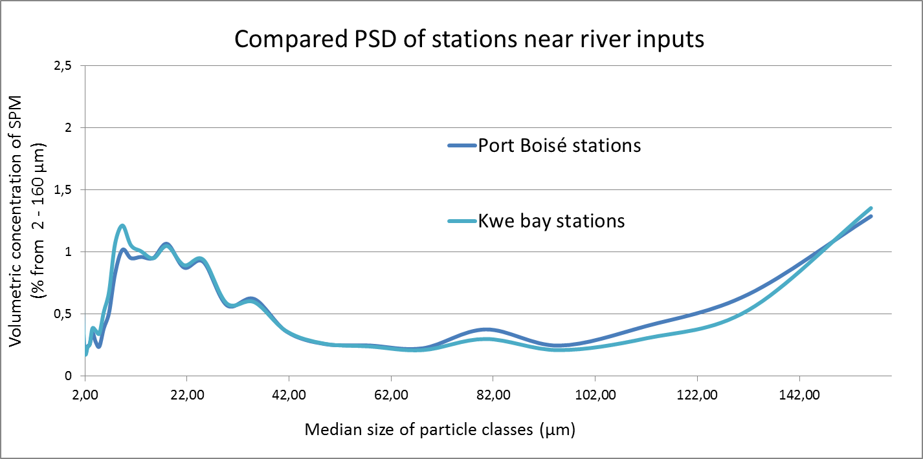
Context and objectives | Data acquisition & analysis | Modeling | First results & prospective
Comparison of Kwe Bay and Port Boisé bay Particles’ size distribution
O’Callaghan, in 1999, found that representative terrigenous particles inputs had sizes ranging between 7 and 10µm.
-> For both bays, we found very similar PSD for stations distant from the rivers
-> Higher relative concentrations of particles found in remote stations, except for 9µm particles
-> The amount of 9µm particles is greater in Kwé bay shallow stations (peak weaker in Port Boisé bay)
➔ Kwe river, whom watershed contains mining sites, triggers larger terrigenous matter discharge in Kwe Bay than Port Boisé rivers
Notes:
(OCallaghan 1999). À dumbea: les particules majoritaires trouvées dans la vase avaient un diamètre de 9µm

Slide 10
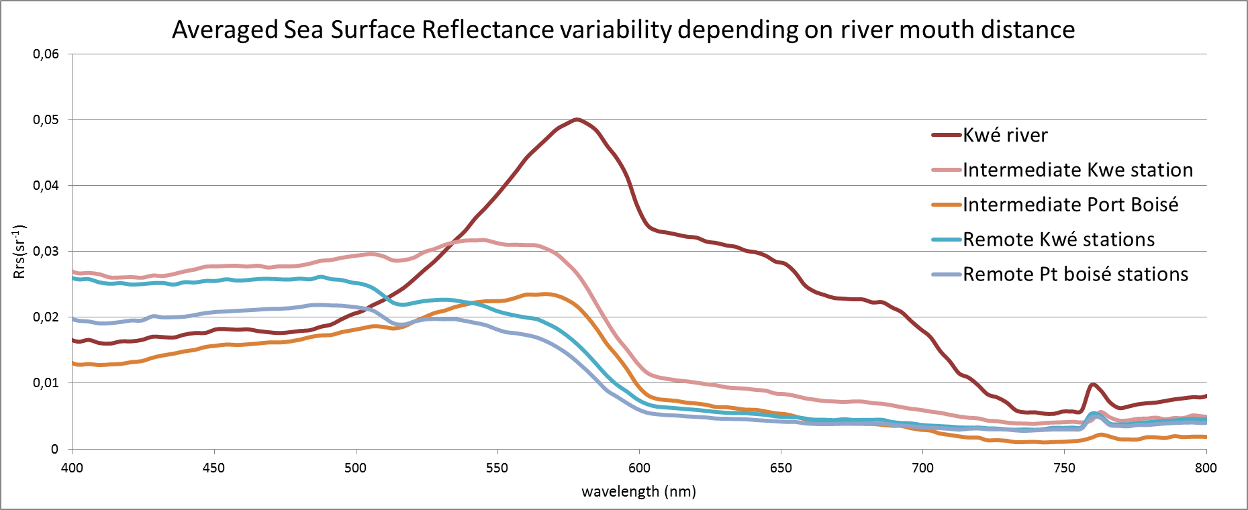
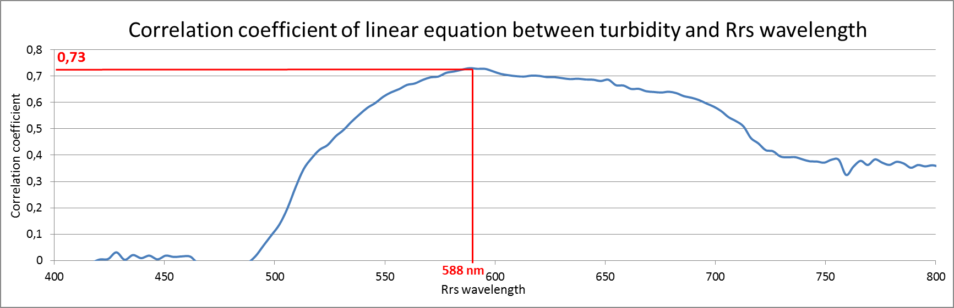
Context and objectives | Data acquisition & analysis | Modeling | First results & prospective
Sea surface reflectance (Rrs)
Spectra depends on particles and colored dissolved matter concentration and nature in the surface layer.
16 stations spectra could be gathered in 3 main signatures:
Main signature spectra:
River mouth station: relative low Rrs in the blue (400-500nm), high Rrs in yellow (550-600nm) and medium in the red
Intermediate stations: lower Rrs in the blue than in the yellow
Remote stations: high reflectance in the blue, medium in the yellow and low in the red
Ratio [ Rrs(570nm)-Rrs(470nm) ] / Rrs(570nm)
the smaller values the more oligotrophic waters, the greater the more charged in colored dissolved matter or particles
Kwé river | Intermediate Kwe | Intermediate Port Boisé | Remote Kwé | Remote Port Boisé
0,615 | 0,068 | 0,305 | -0,370 | -0,410
Retrieval of surface turbidity from Rrs
The best correlation coefficient between turbidity and Rrs is found at 588nm all stations combined
Notes:
Sea surface reflectance, as well as remote sensing Reflectance (from satellite) are useful to detect biological activities such as blooming or to assess the spatial spreading of terrigenous discharge from river. The remote sensing reflectance is not available by cloudy weather. Sea surface reflectance, measured in situ can be use to determine the spectra signature of charged or oligotrophic waters.

Slide 11
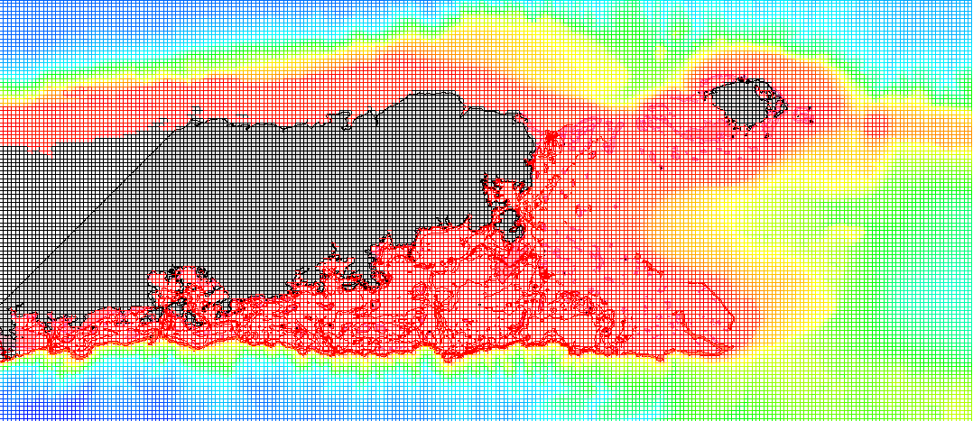
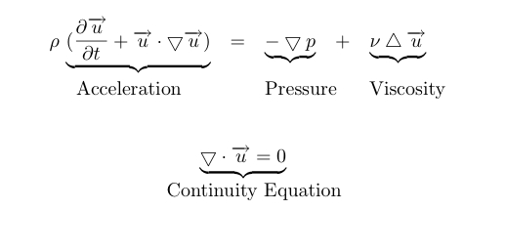

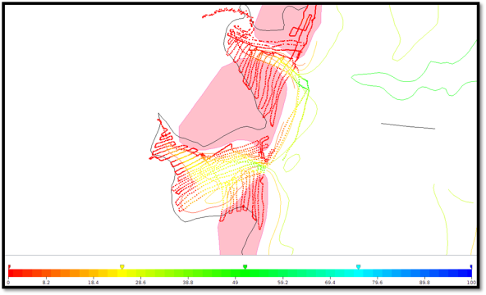
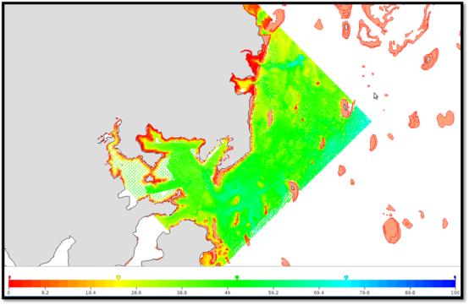



Context and objectives | Data acquisition & analysis | Modeling | First results & prospective
MODEL used: MARS3D, developed by IFREMER (Lazure et Dumas, 1998).
Coastal circulation, dissolved and particulate matter transport.
What does a 3D model needs to reproduce local hydrodynamic ?
- 3D Grid of constant meshes, 30 layers on the vertical
- Navier-Stokes equations and falling velocity of particles
- Physical forcing (initial and boundary conditions)
- Accurate bathymetry of the study site (sounding and interpolation)
Wind Precipitations
(intensity ,direction) (river inputs)
Heat fluxes Tide and waves
Sounding campaign routes
Interpolated bathymetry
→ Simulation of water masses movements, along with particles transport and deposition on the seabed
Notes:
Il s’agit d’une grille de calcul, dans les 3D, constituée de mailles de taille constante ou variable. Elle représente le volume de la baie, du lagon, ou bien de l’océan dont on souhaite modéliser l’hydrodynamique.
À l’aide d’un certain nombres de variables connues, les équations du mouvement (Navier-Stokes) sont résolues en chacune de ces mailles en chaque pas de temps, permettant la simulation des masses d’eau dans la zone étudiée.

Slide 12
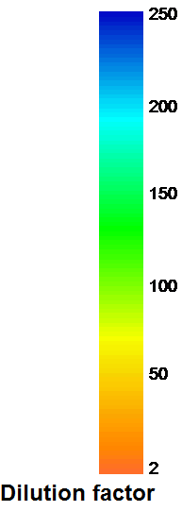
Context and objectives | Data acquisition & analysis | Modeling | First results & prospective
Simulation: transport of a dissolved tracer depending on meteorological forcing
Testing wind conditions and river flow impact on transport patterns in Kwe Bay :
TEST 1
RIVER FLOODING, NO WIND, NEAP TIDE
TEST 2
LOW FLOW, 12M/S TRADEWIND, NEAP TIDE
→ Different tracer’s transport patterns depending on physical forcing (flow rate, tidal range and wind)

Slide 13
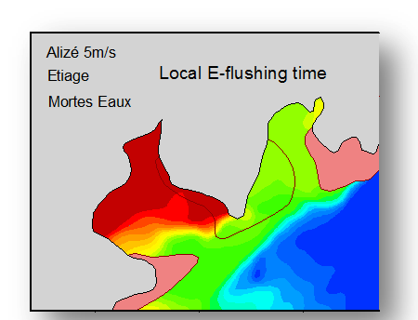
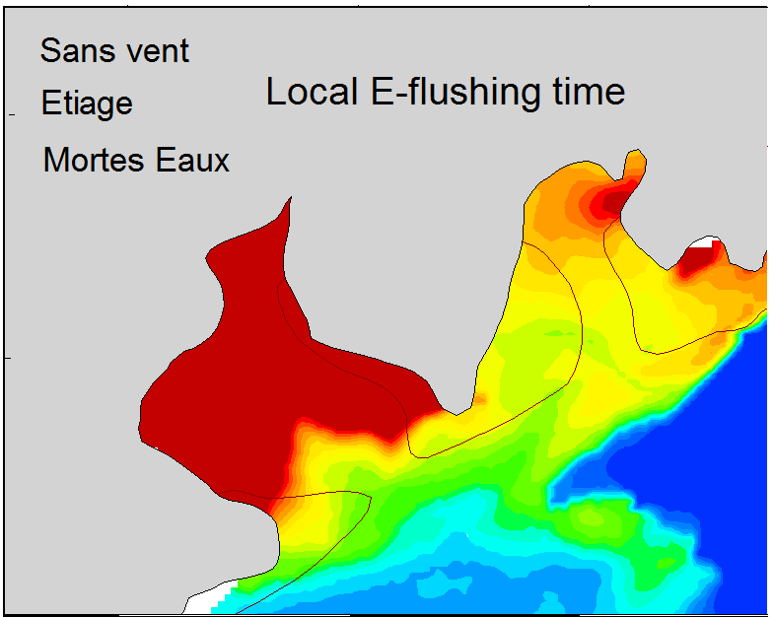
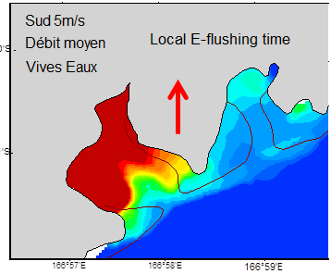
Context and objectives | Data acquisition & analysis | Modeling | First results & prospective
Simulation: Local E-flushing time
Comparative study on local flushing times depending on physical forcing: flowrate, wind and tide range
No wind, low flow & neap tide
Trade wind, low flow & neap tide
South wind, medium flow & spring tide
3 to 5 days in Kwé bay
More than 5 days in Port Boisé bay
Water masses driven offshore in the surface layer, with no preferential direction
2 to 3 days in Kwé bay
3 to 5 days in Port Boisé bay
Water masses driven offshore in the surface layer, toward the West
Few hours to 2 days in Kwé bay
3 to 5 days in Port Boisé bay
No water masses driven offshore in the surface layer
→ Wind and tide are the main parameters forcing water renewal.

Slide 14
Context and objectives | Data acquisition & analysis | Modeling | Prospectives
Implement deposition & sediments’ dynamic in the model
Mineralogical analysis to determine the nature of sediment
Distinguish terrigenous from organic particles constituting SPM
Temporal series of in situ data to validate the model
Notes:
What is Turbidity?
This river owes its muddy appearance to high turbidity levels.
Turbidity is an optical determination of water clarity ¹. Turbid water will appear cloudy, murky, or otherwise colored, affecting the physical look of the water. Suspended solids and dissolved colored material reduce water clarity by creating an opaque, hazy or muddy appearance. Turbidity measurements are often used as an indicator of water quality based on clarity and estimated total suspended solids in water.
The turbidity of water is based on the amount of light scattered by particles in the water column ². The more particles that are present, the more light that will be scattered. As such, turbidity and total suspended solids are related. However, turbidity is not a direct measurement of the total suspended materials in water. Instead, as a measure of relative clarity, turbidity is often used to indicate changes in the total suspended solids concentration in water without providing an exact measurement of solids ¹.
Tannins from decomposing vegetation have colored this river red.
Turbidity can come from suspended sediment such as silt or clay, inorganic materials, or organic matter such as algae, plankton and decaying material. In addition to these suspended solids, turbidity can also include colored dissolved organic matter (CDOM), fluorescent dissolved organic matter (FDOM) and other dyes ¹⁴. CDOM is also known as humic stain. Humic stain refers to the tea color produced from decaying plants and leaves underwater due to the release of tannins and other molecules.
This discoloration is often found in bogs, wetlands or other water bodies with high amounts of decaying vegetation in the water. CDOM can cause water to appear red or brown, depending on the type of plants or leaves present. These dissolved substances may be too small to be counted in a suspended solids concentration, but they are still part of a turbidity measurement as they affect water clarity.

Slide 15
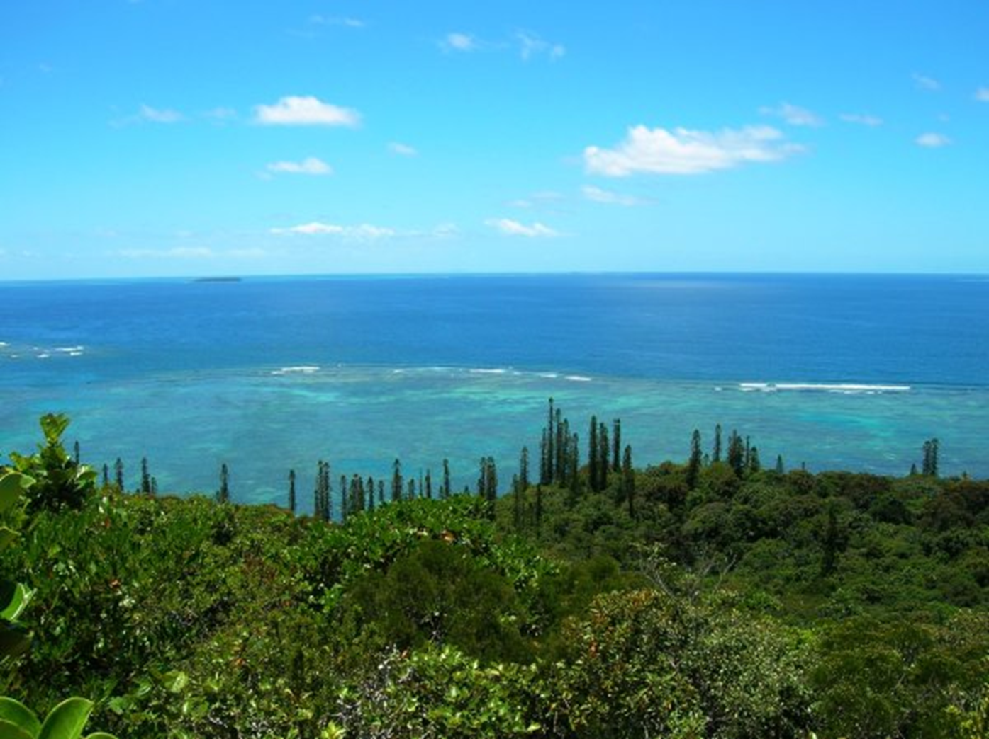
Thanks for your attention!
Vinaka!!

Slide 16
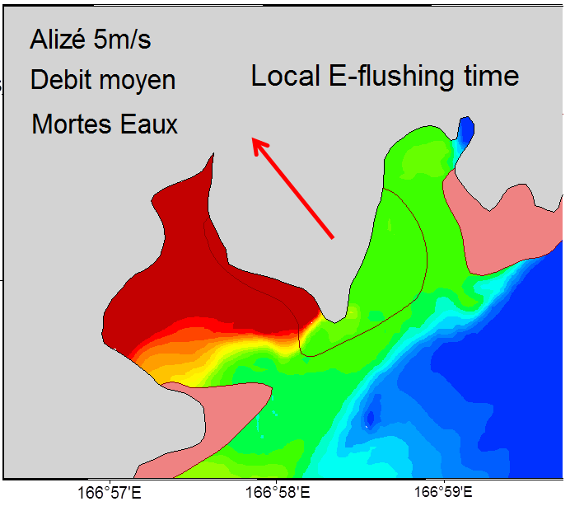
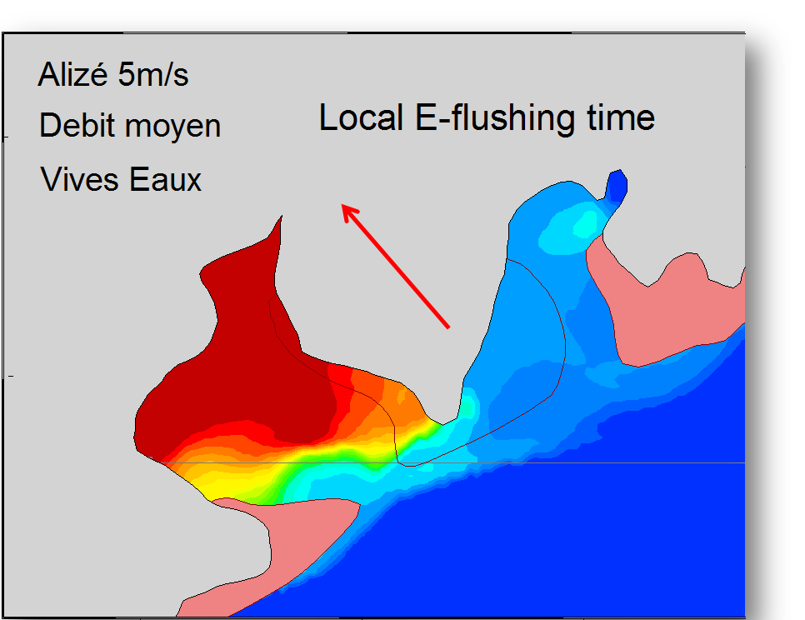
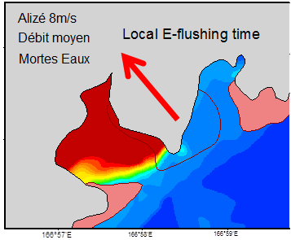
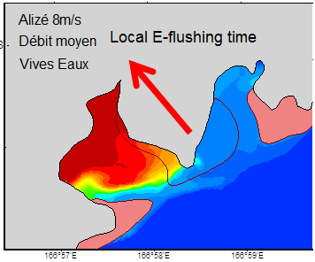
Context and objectives | Data acquisition & analysis | Modeling | First results & prospective
Simulation: Local E-flushing time
Neap tide
Spring tide
- Trade wind 5m/s, mean flow rate
With medium speed wind, flushing time varies a lot in Kwé Bay with the tide range and lightly in Port Boisé.
→ With medium wind, the tide range is the main forcing parameter on flushing time
Neap tide
Spring tide
- Trade wind 8m/s, mean flow rate
With high speed wind, the tide range triggers little difference in flushing time
→ Tide range is no longer the main forcing parameter when the wind speed is high

Slide 17
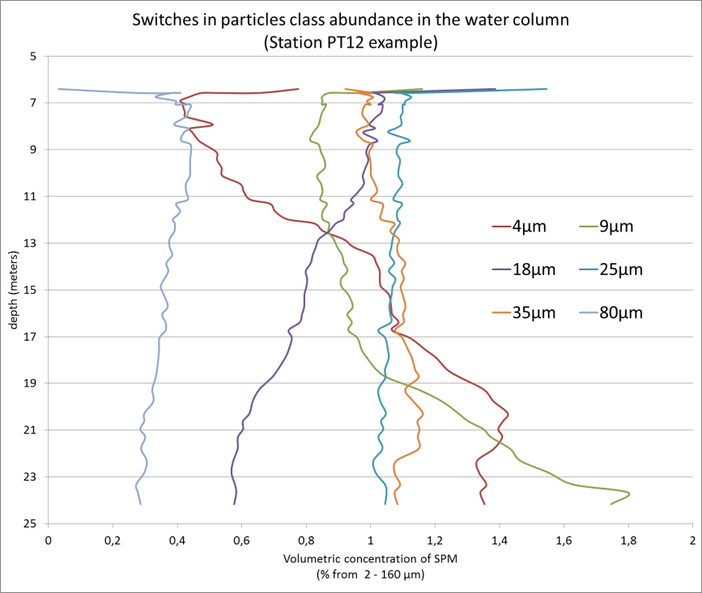
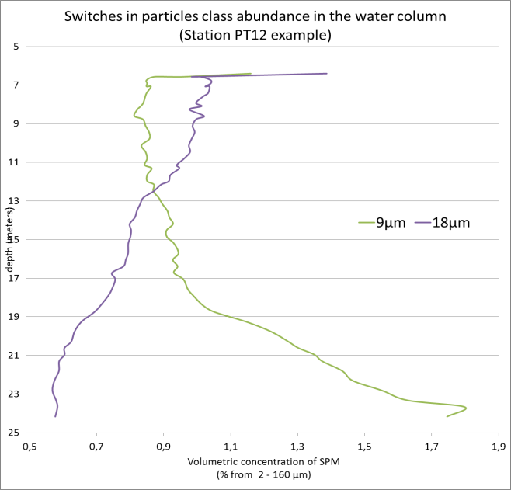
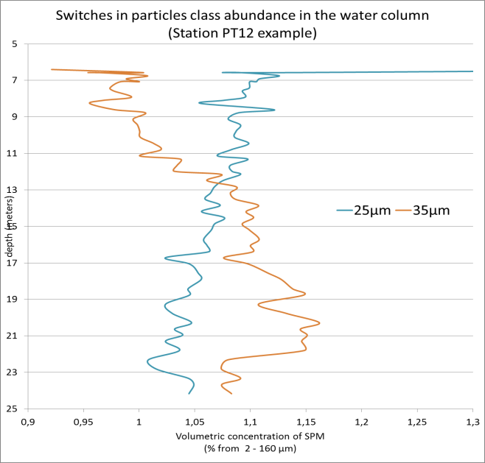
Context and objectives | Data acquisition & analysis | Modeling | First results & prospective
Particles’ size distribution switches in the water column
Vertical variability of the main peaks size particles:
For main stations (deep enough), the vertical variability assumed before is reflected
4µm and 9µm diameter particles increase in proportion with depth
But it is also visible that some particles size classes switch from one to another with depth:
9µm particles increase with depth at the expense of 18µm particles. Their respective amount is linked and the sum of both is nearly constant on the vertical
The same pattern is observed between 25 and 35µm particles. 35µm tend to sink while 25µm remain in the surface layer.
Notes:
Living organism? Flocs of terrigenous matter bond by organic ligand??

