Slide 1
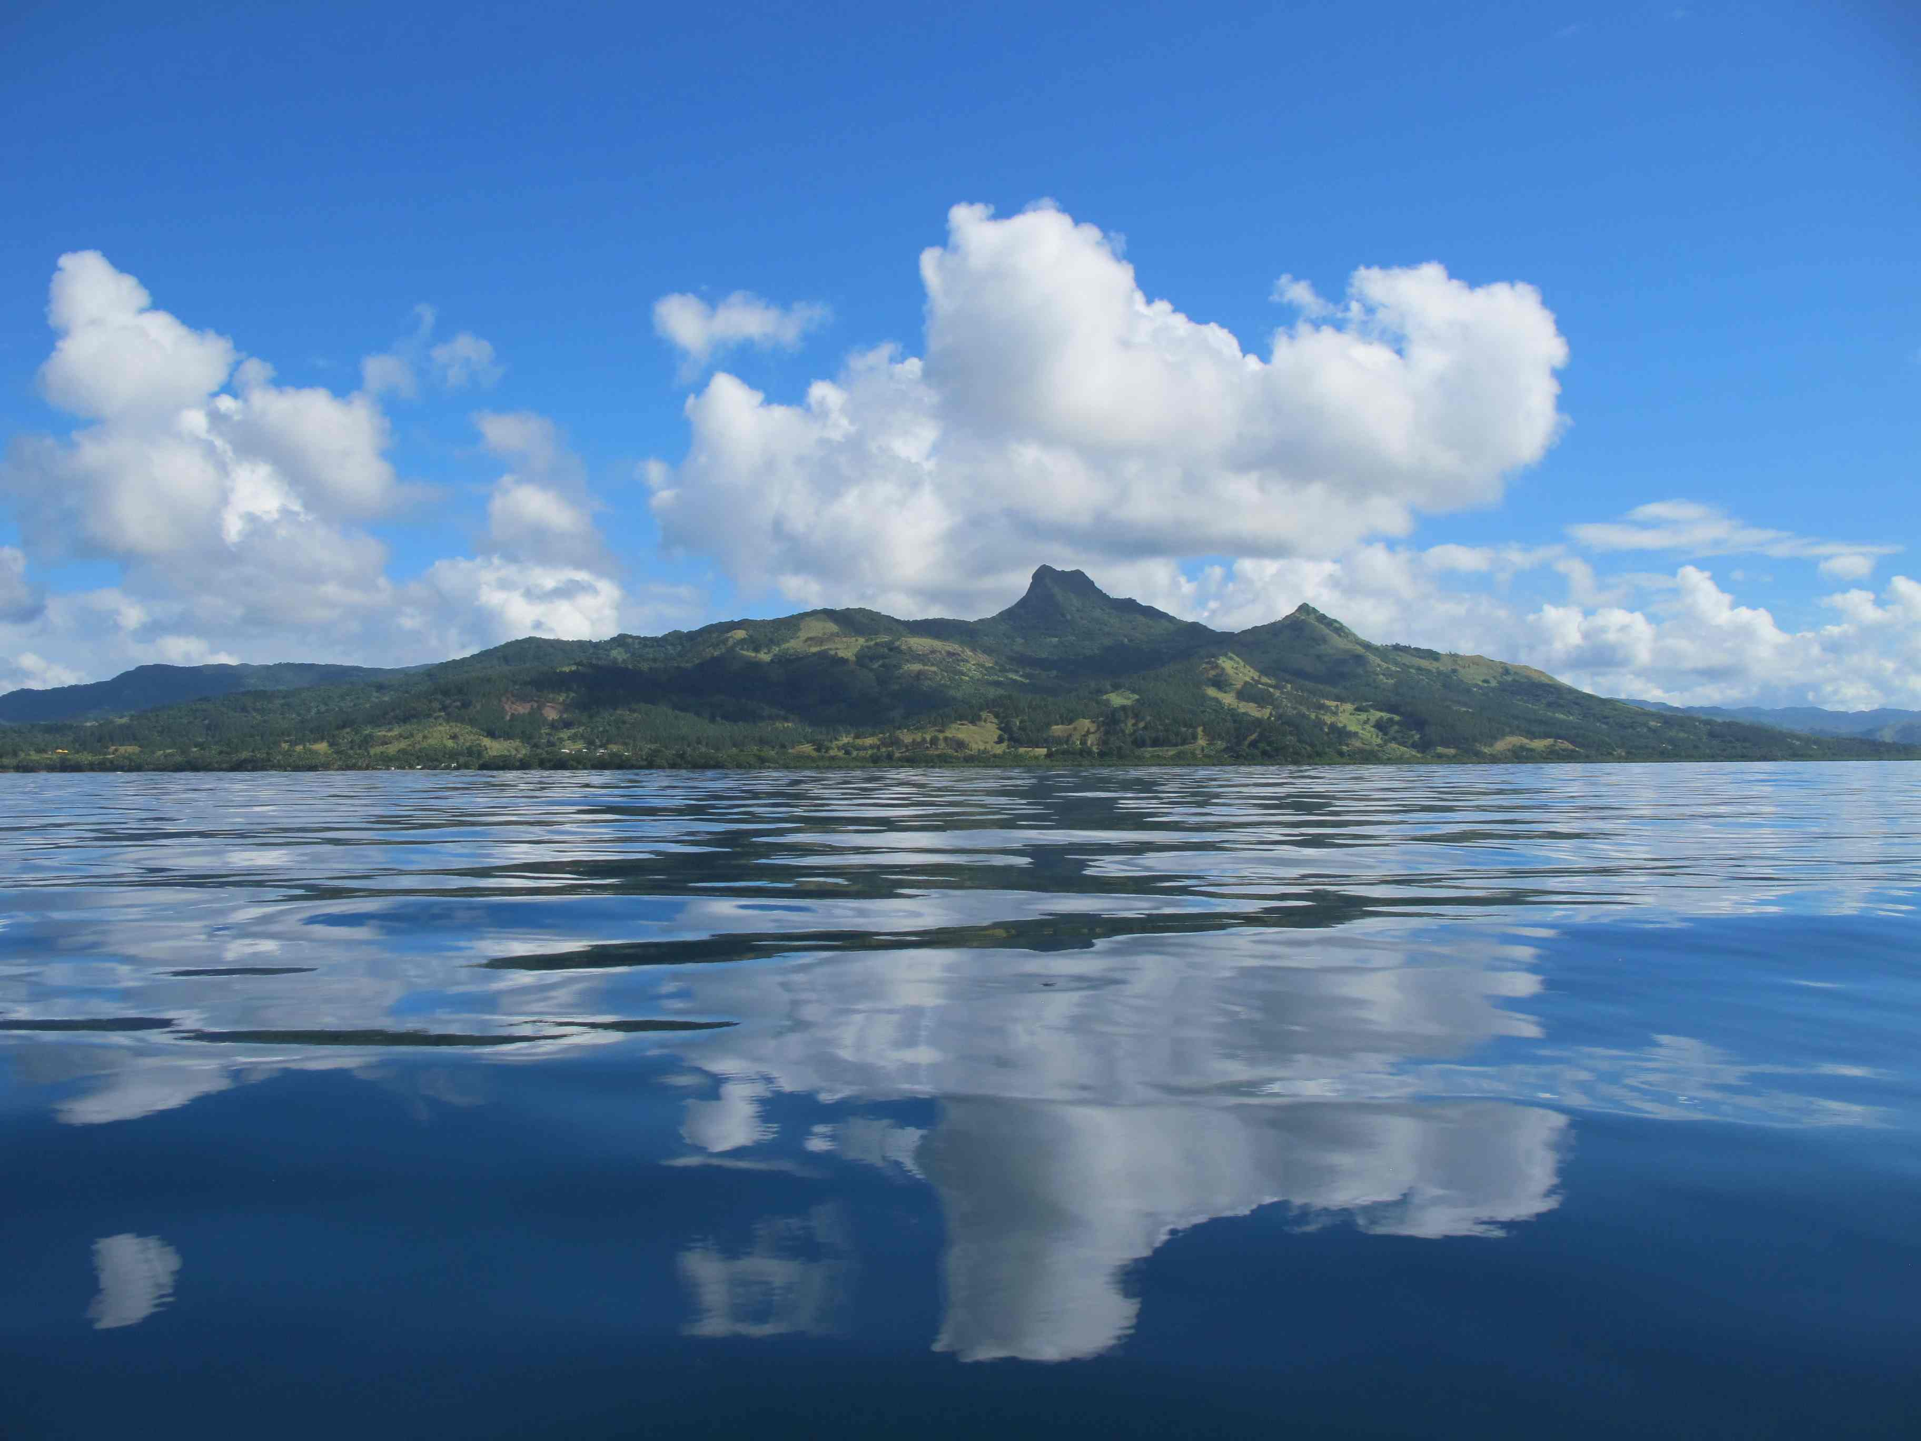
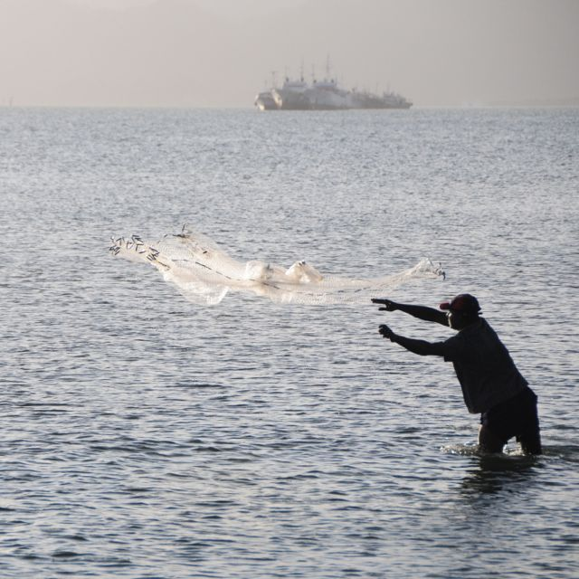
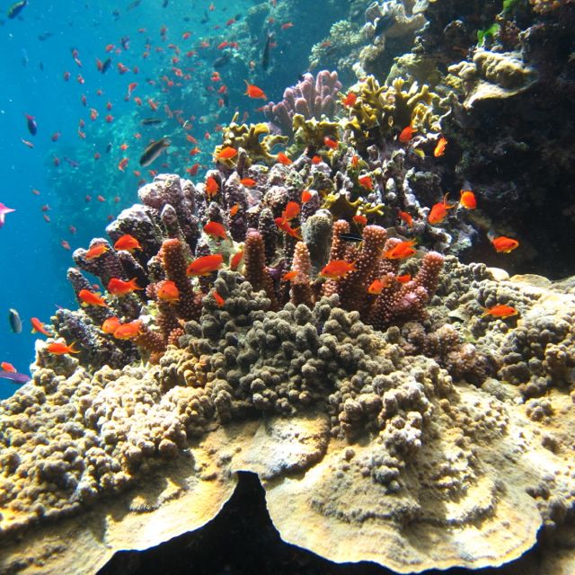
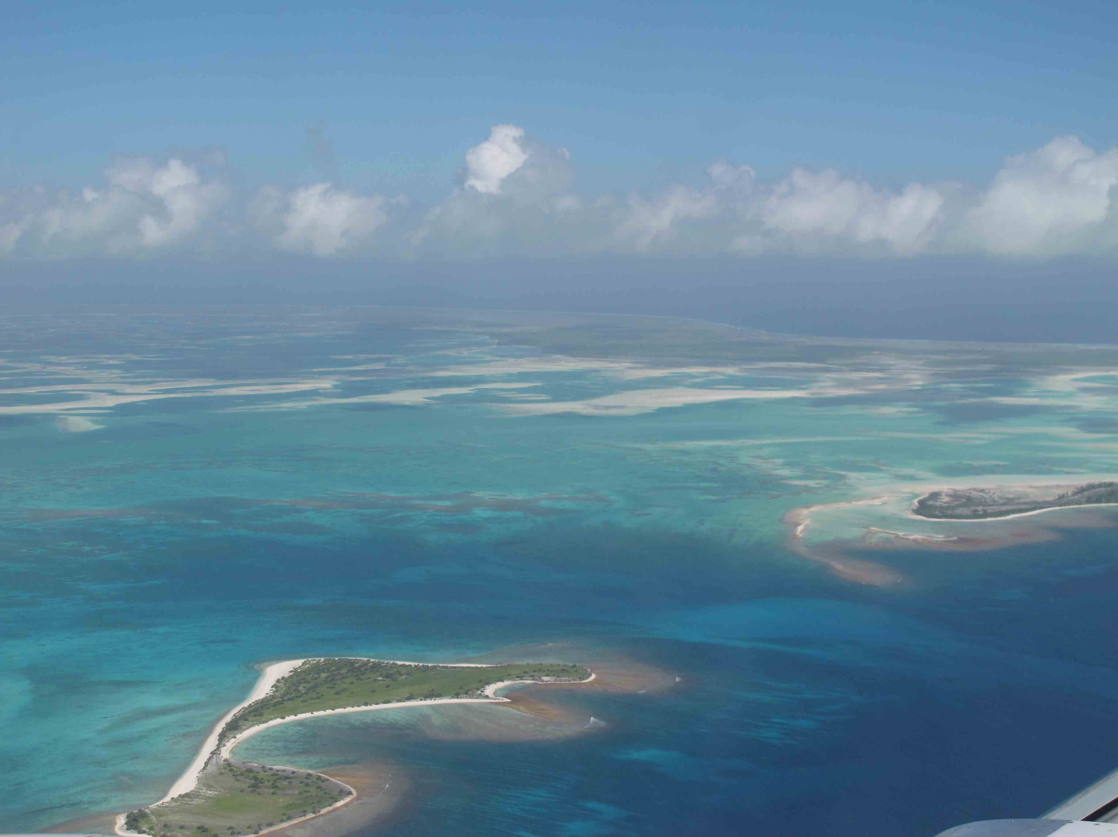


Slide 2
Marine Protected Areas
Old Paradigm:
  Protect areas where we know there is high biodiversity
  Protect areas with endemic species
NOW we know
  Protecting these areas is important BUT not enough to protect the ecosystems AND
  We have imperfect information about these anyway

Slide 3
Marine Protected Areas
New Paradigm:
  Ecologically representative network of marine protected areas
    Convention on Biological Diversity (CBD) Aichi Target 11 is 10% of marine areas
    Includes examples of all habitat types
  We don’t have complete information about biodiversity in the marine environment so how do we choose “ecologically representative” (versus special, unique) areas to protect?

Slide 4
Solution: use bioregions
Defined as: “a region defined by characteristics of the natural environment rather than by man-made divisions.”
It is a value-neutral way to describe the entire marine environment.
Bioregions can be described using comprehensive layers of environmental data: surrogates for imperfect biological information.
Every part of the marine environment belongs to one bioregion or another.
No bioregion is more important than any other.

Slide 5
What are bioregions?
Areas of relative similarity
  Habitats, communities, and physical features within a bioregion are more similar to each other than those in a different bioregion.
A way to represent the full range of biodiversity
A hierarchical or nested classification of habitat types (provinces, biomes, habitat complexes, etc.)

Slide 6
Bioregions as a planning tool
If the objective is an ecologically representative network of marine protected areas covering 10% of the marine environment with the goal of enhancing biodiversity (CBD Aichi Target 11)
Then a protected area target of 10% for each bioregion will help meet that goal

Slide 7
Bioregions as a planning tool
If one objective is an ecologically representative network of marine protected areas covering 10% of the marine environment with the goal of enhancing biodiversity (CBD Aichi Target 11)
Then a protected area target of 10% for each bioregion will help meet that objective

Slide 8
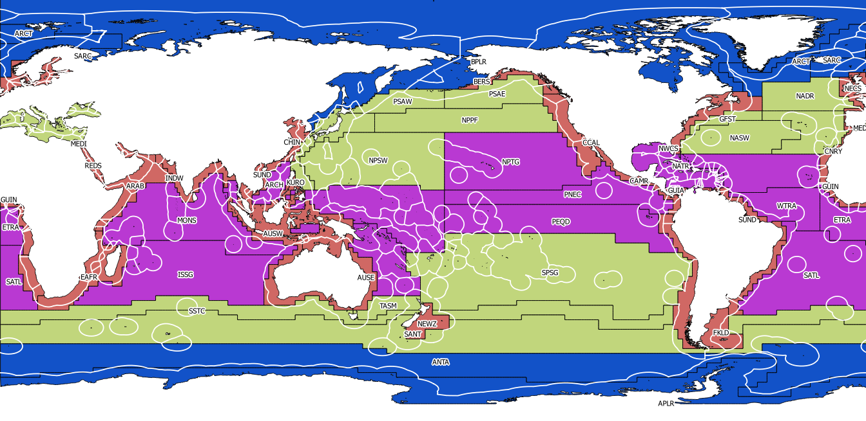
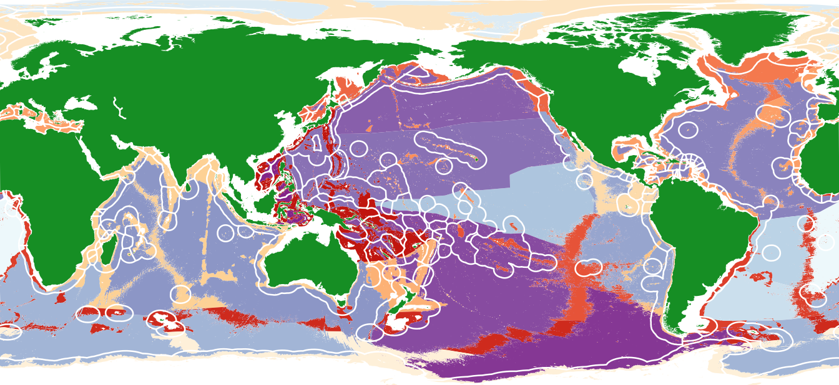
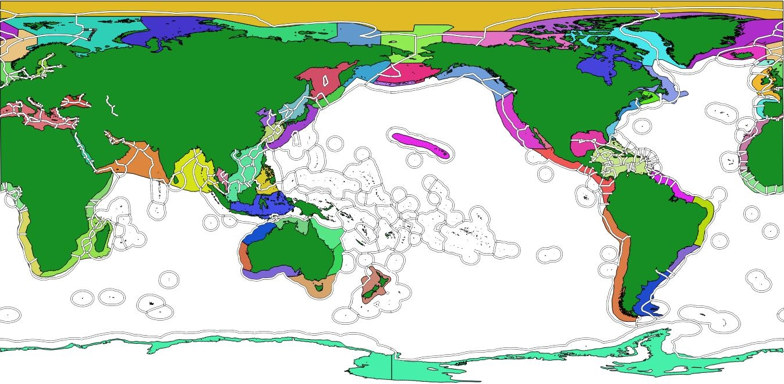
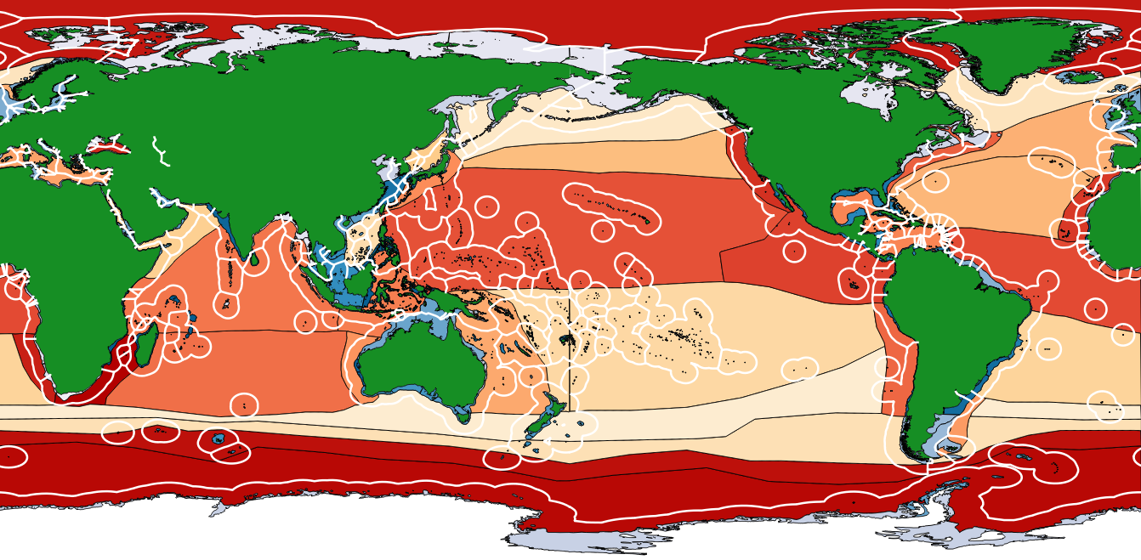
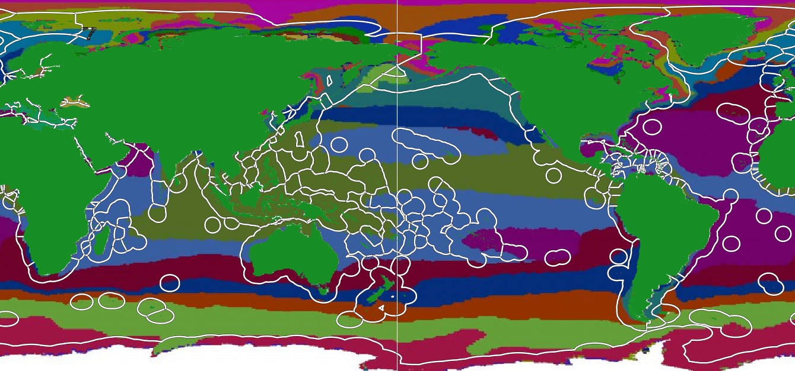
Global bioregions
Biogeographical Provinces
  GOODS
LME
  .MEOW / PPOW
EMU

Slide 9
Longhurst, 2010. Biogeographical Provinces
  4 global provinces: 3 in Oceania
  52 sub-provinces: 9 in Oceania

Slide 10
Longhurst, 2010. Biogeographical Provinces
  Factors: Based on biophysical proxies: phytoplankton abundance (chlorophyll concentration), mixed layer depth, currents, clarity.
  Method: Expert-driven approach

Slide 11
Spalding, et al., 2012. Marine Ecoregions and Pelagic Provinces of the World (MEOW PPOW)
  62 MEOW ecoregions: 21 in Oceania
  7 PPOW provinces: 3 in Oceania

Slide 12
Spalding, et al., 2012. Marine Ecoregions and Pelagic Provinces of the World (MEOW PPOW)
  Factors: Based on taxonomically homogeneous areas
  Method: expert-driven approach

Slide 13
Watling, et al., 2013. Global Open Ocean and Deep Sea (GOODS) Classification
  14 abyssal provinces: 4 in Oceania
  14 bathyal provinces: 5 in Oceania

Slide 14
Watling, et al., 2013. Global Open Ocean and Deep Sea (GOODS) Classification
  Factors: depth, temperature, salinity, dissolved oxygen, particulate organic carbon flux
  Method: expert-driven approach

Slide 15
NOAA. 2013 Large Marine Ecosystems (LME)
  66 LMEs: 0 in Oceania

Slide 16
NOAA. 2013. Large Marine Ecosystems (LME)
  Factors: bathymetry, hydrograpy, productivity, trophic relationships
  Method: expert-driven approach

Slide 17
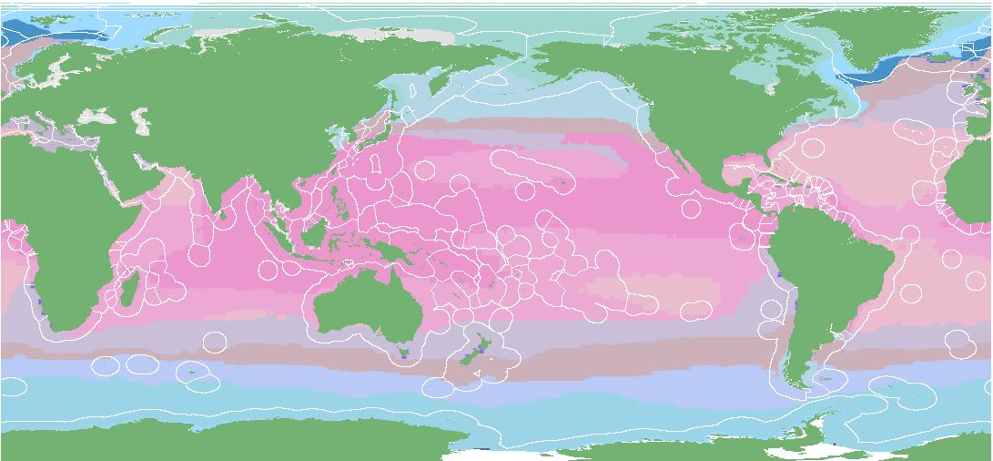
Wright, et al., 2016 Ecological Marine Units (EMU)
  37 ecological marine units at 9 depth levels: 3 in Oceania

Slide 18
Wright, et al., 2016 Ecological Marine Units (EMU)
  Factors: Depth, Temperature, Salinity, Dissolved Oxygen, Nitrate, Phosphate, Silicate.
  Method: k-means clustering algorithm

Slide 19
Bioregions as a planning tool
The MACBIO project is working with 5 countries to conduct Marine Spatial Planning within their EEZs. Global-scale bioregions are not useful for national scale marine planning and management.

Slide 20
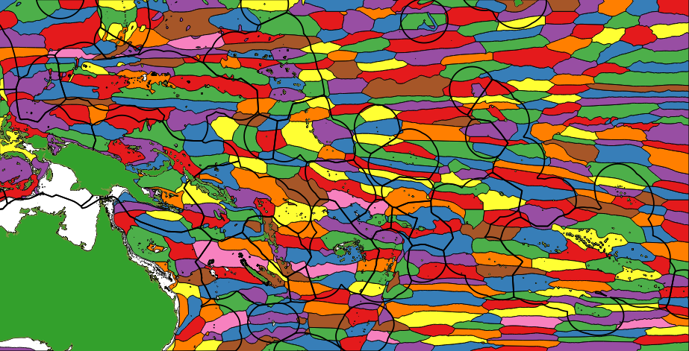
MACBIO Deep Water Bioregions
  400 Deep Water Bioregions in Oceania

Slide 21
MACBIO Deep Water Bioregions
  Factors: ocean chemistry: calcite, oxygen, nitrate, solar irradiance, pH, phosphate, salinity, silicate, chlorophyll. physical characteristics: depth, 20°C isotherm, mixed layer depth, temperature at surface, 30m, 200m, 1000m, dynamic height of sea surface, distance from land.
  Methods: k-means clustering, hierarchical clustering

Slide 22
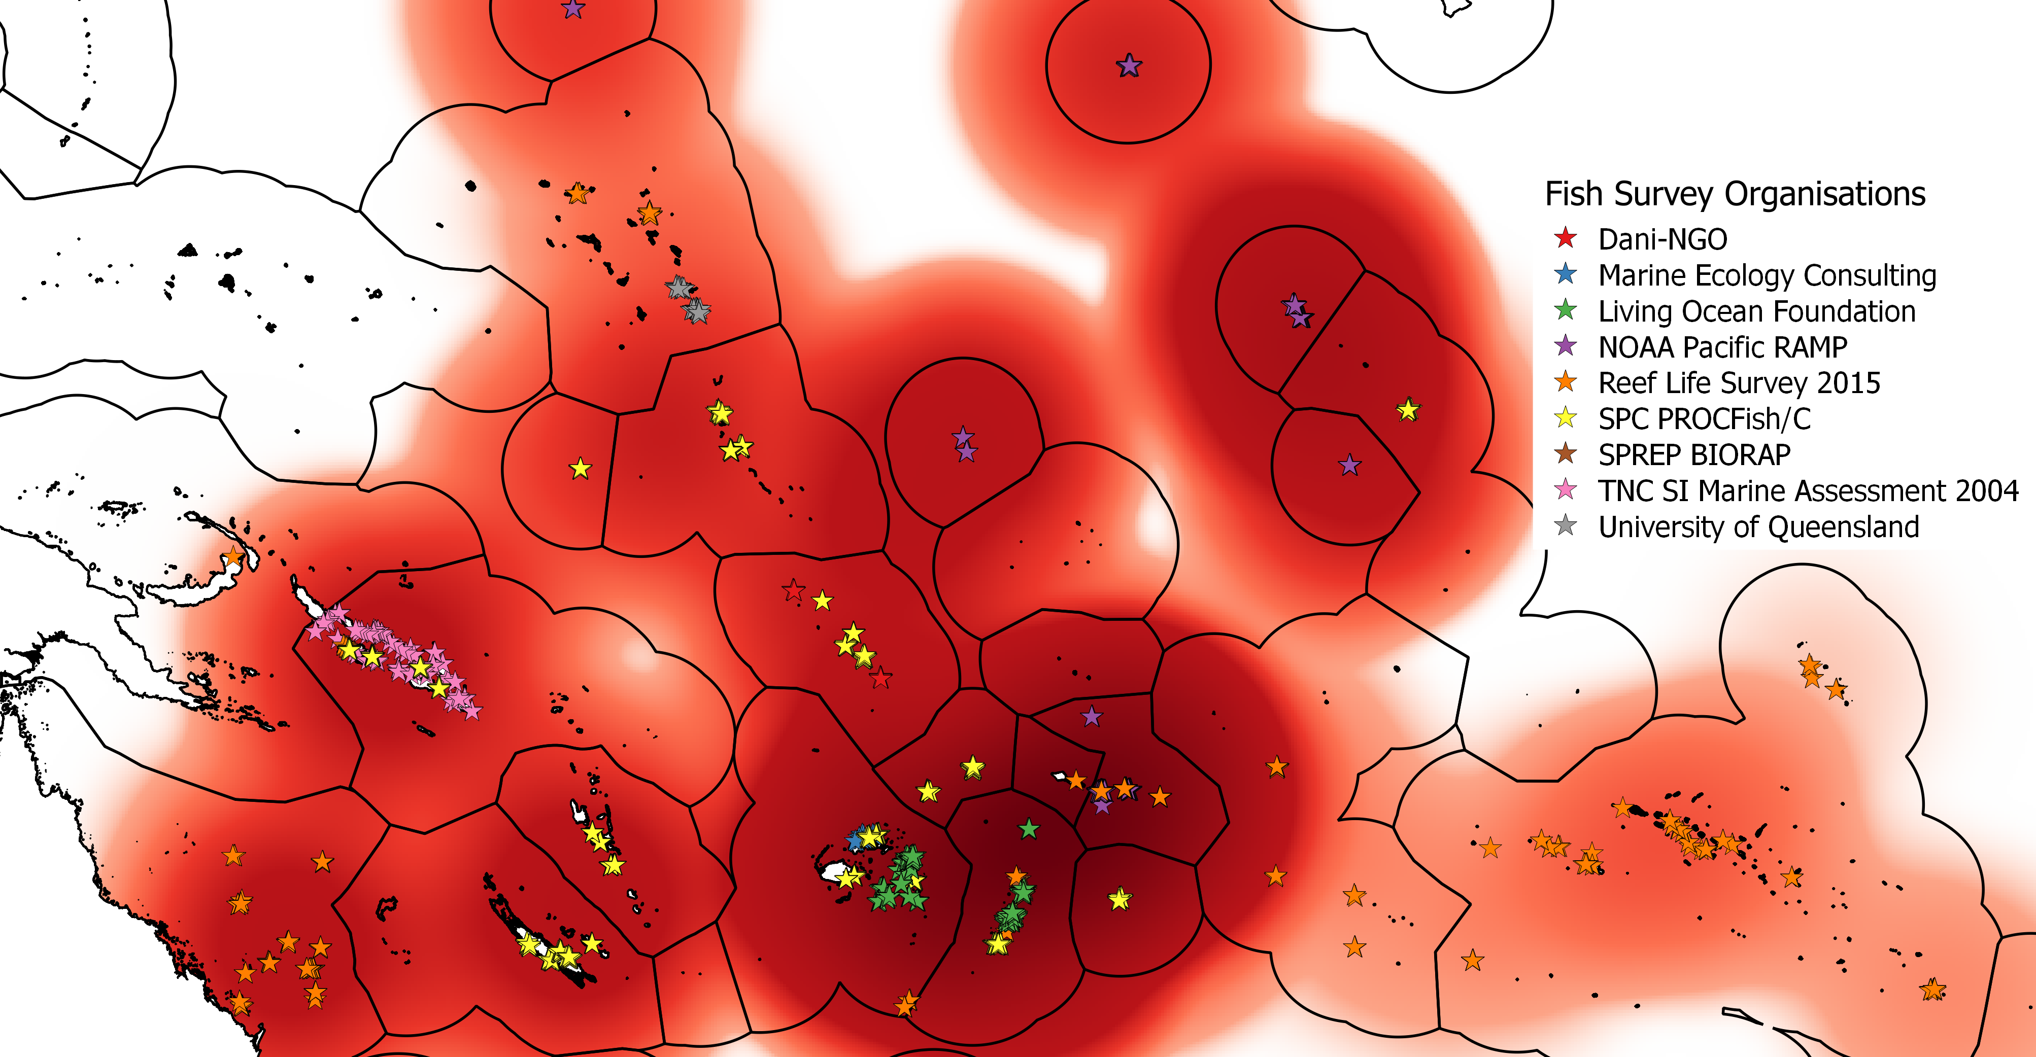
MACBIO Reef-Associated Bioregions
  Factors: 1,405 fish species surveyed at 3,846 sites. Modelled 435 fish species occurrence probability for all inshore areas using chemical and physical characteristics: calcite, chlorophyll, and nitrate concentration, solar irradiance, pH and sea surface temperature.
  Methods: hierarchical clustering

Slide 23
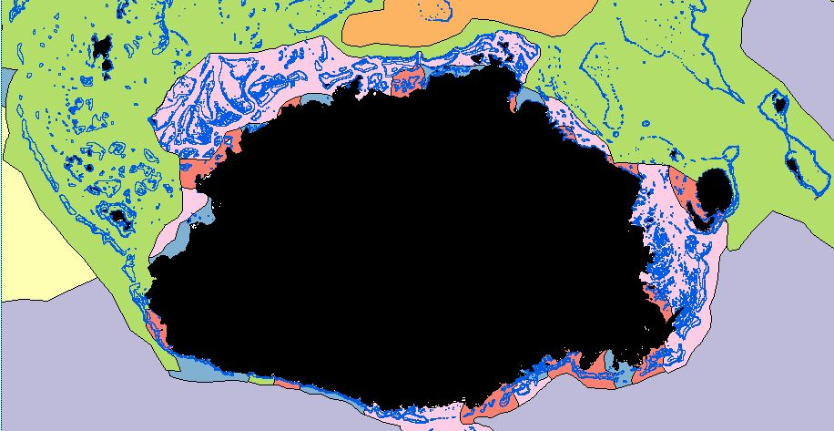
MACBIO Reef-Associated Bioregions
  Factors: 1,405 fish species surveyed at 3,846 sites. Modelled 435 fish species occurrence probability for all inshore areas using chemical and physical characteristics: calcite, chlorophyll, and nitrate concentration, solar irradiance, pH and sea surface temperature.
  Methods: hierarchical clustering

Slide 24
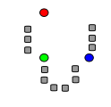
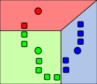
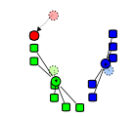
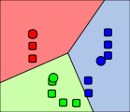
Clustering Algorithms
k-means: a vector quantisation algorithm that iteratively partitions observations into clusters with the nearest mean.

Slide 25
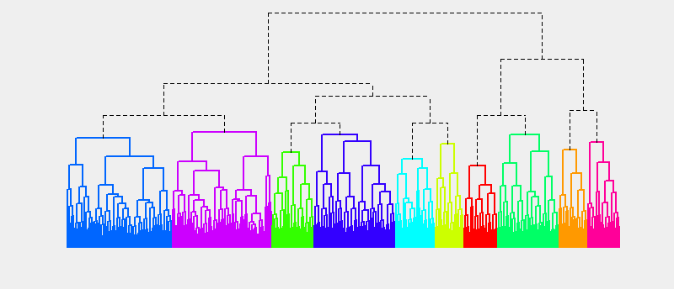
Clustering Algorithms
Hierarchical Clustering: a divisive hierarchy of clusters; all observations start in one cluster and splits are done recursively.

Slide 26
Next Steps
Deep Water Bioregions
  Expert input to adjust boundaries
  Finalise bioregions
Reef Associated Bioregions
  Expert input to adjust boundaries
  Finalise bioregions
Integration of both sets of bioregions

Slide 27
Questions?
Jonah Sullivan
Marine and Coastal Biodiversity Management in Pacific Island Countries (MACBIO) Senior GIS Officer
The International Union for Conservation of Nature (IUCN)
jonah.sullivan@iucn.org

