Slide 1
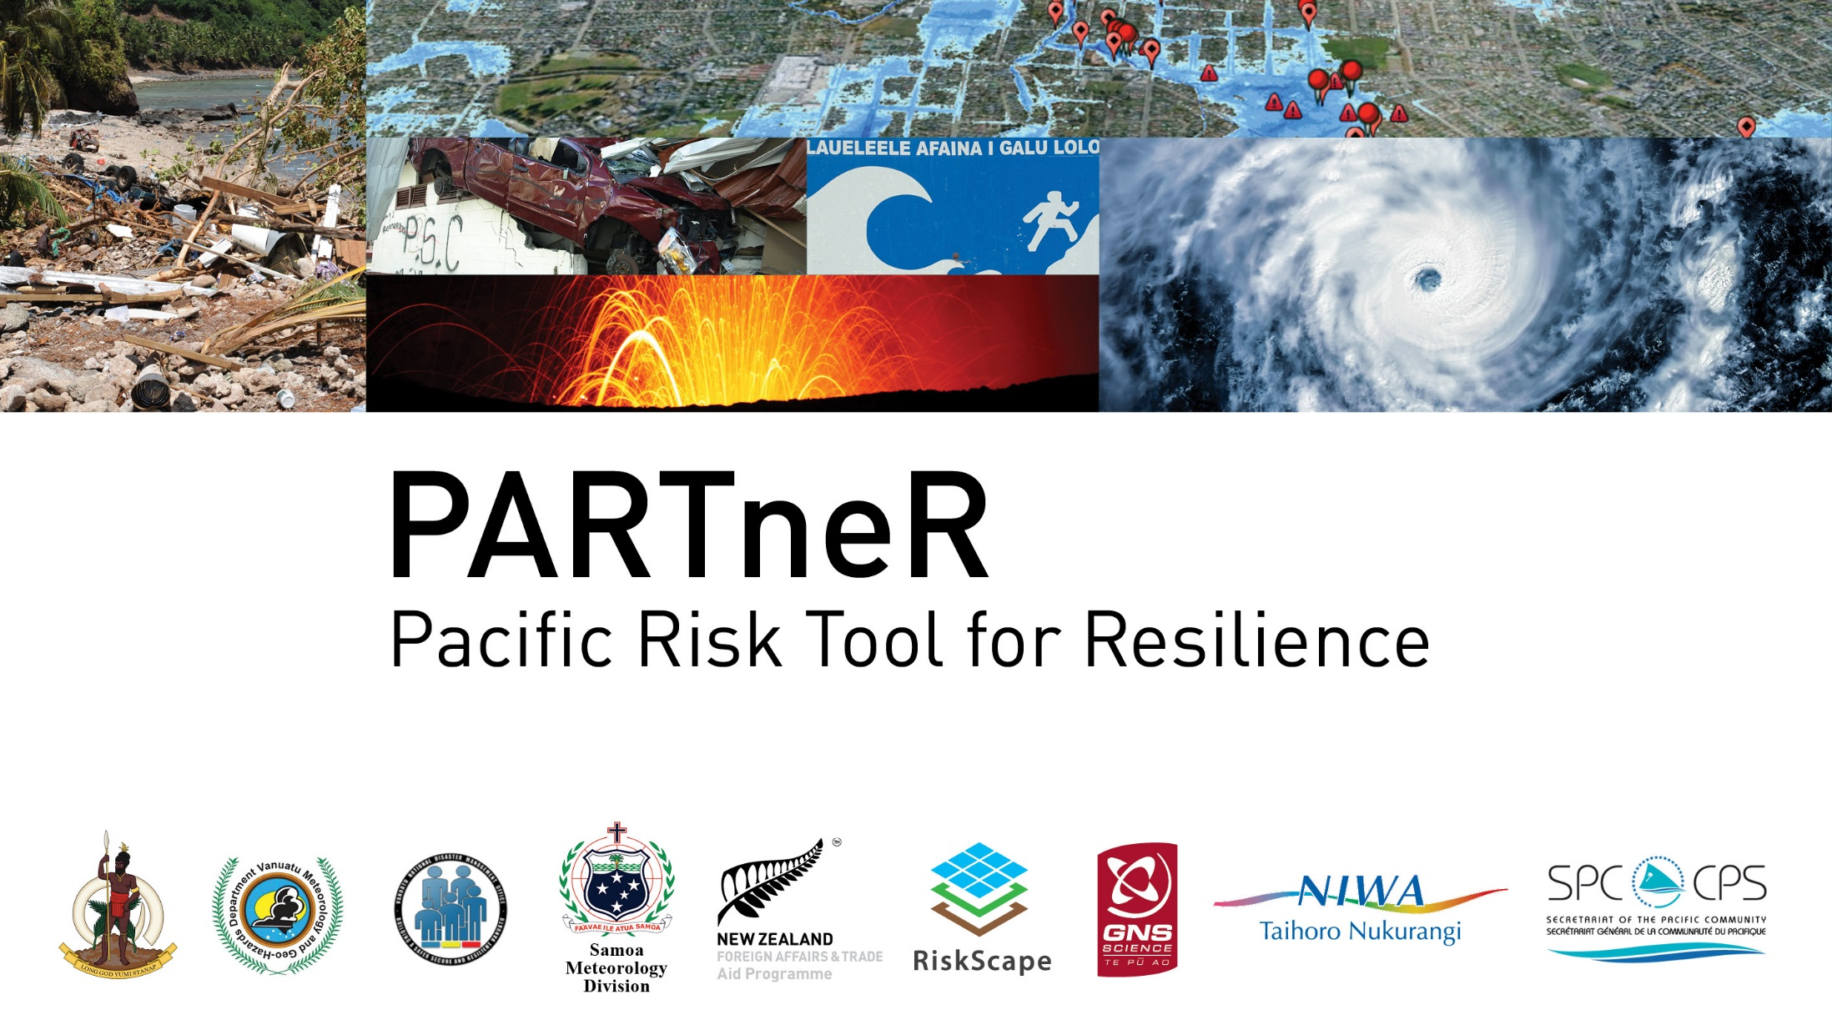

Slide 2
Introduction to PARTneR: Pacific Risk Tool for Resilience
Kate Crowley¹, Shaun Williams², Litea Biukoto³, Herve Damlamian³, Nick Horspool⁴, Filomena Nelson⁵, Titimanu Simi⁵, Esline Garaebiti⁶, Peter Korisa⁷, Doug Ramsay⁸, Juliana Ungaro¹ , Ryan Paulik¹ , Gabriella Turek¹ and Sheng Lin Lin⁴
National Institute of Water and Atmospheric Research Limited, 301 Evans Bay Parade, Wellington, New Zealand.
National Institute of Water and Atmospheric Research Limited, 10 Kyle Street, Christchurch, New Zealand.
Geoscience Division, Pacific Community, 241 Mead Road, Nabua, Fiji.
GNS Science, 1 Fairway Drive, Avalon, Wellington.
National Disaster Management Office, Ministry of Natural Resources and Environment, 3rd Floor TATTE Building, Apia, Samoa.
Geohazards Division, Vanuatu Meteorology and Geohazards Department, PMB 9054, Port Vila, Vanuatu.
National Disaster Management Office, PMB 9107, Port Vila, Vanuatu.
National Institute of Water and Atmospheric Research Limited, Gate 10 Silverdale Road, Hamilton, New Zealand.

Slide 3
Content
Collaboration
Data
Tools
Used
Sharing
Risk
Background
PARTneR project
Phase 1 results
Next steps
Questions

Slide 4
Background
Calls made by Pacific planning and disaster management agencies to use risk-based information to support hazard/risk related decision-making.
Particularly within the development context.

Slide 5
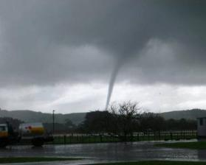
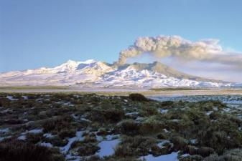
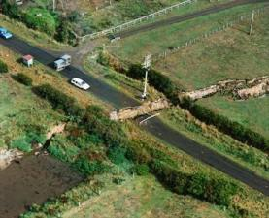
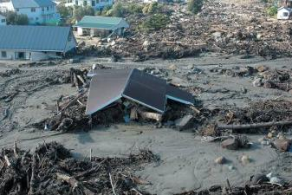
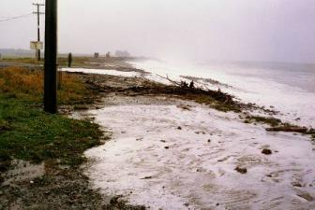
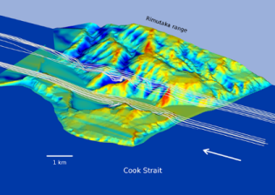
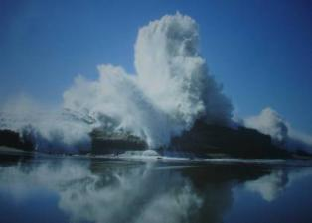
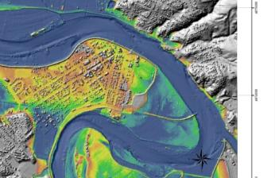
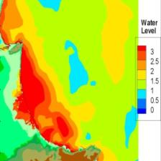
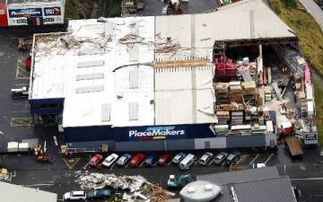
What is RiskScape?
A research programme to study the impacts of natural hazards on communities and to develop models to forecast future impacts;
RiskScape impact and loss modelling software that is freely available and provides information about what could happen in a natural hazard event.

Slide 6

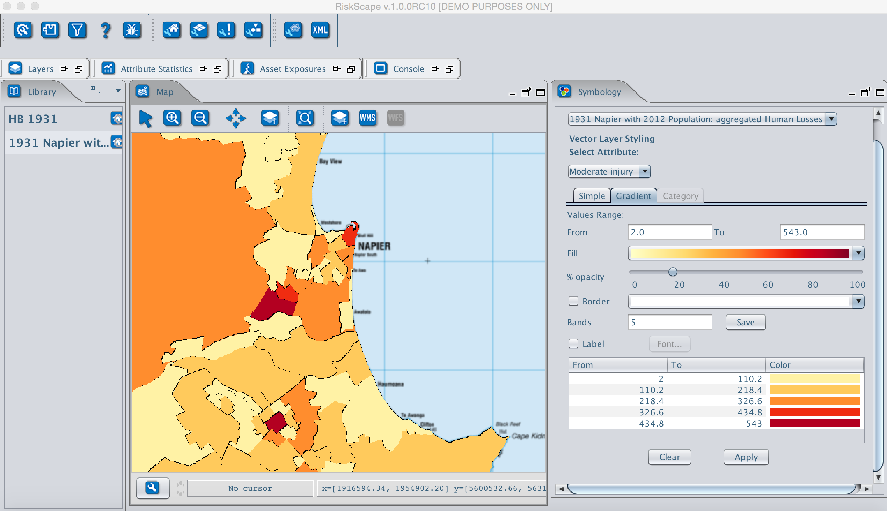
Damage
Direct losses
Lifelines
Agriculture
Buildings
People
Downtime
Casualties
Earthquakes
Tsunami
Volcanic ash fall
Floods
Wind
?
Notes:
The RiskScape framework links hazard models (what is the intensity of the hazard distributed spatially), the exposure (what are the characteristics of the elements of society at risk – e.g. buildings, lifelines, people, businesses), what are the vulnerabilities of the exposure (how will they respond to the hazard), and this is used to estimate direct impact and downstream consequences to the economy (using the MERIT tool). RiskScape models impacts to lifelines, buildings, people and agriculture. It can quantiy the impacts as damage, direct economic losses, downtime and casualties.

Slide 7
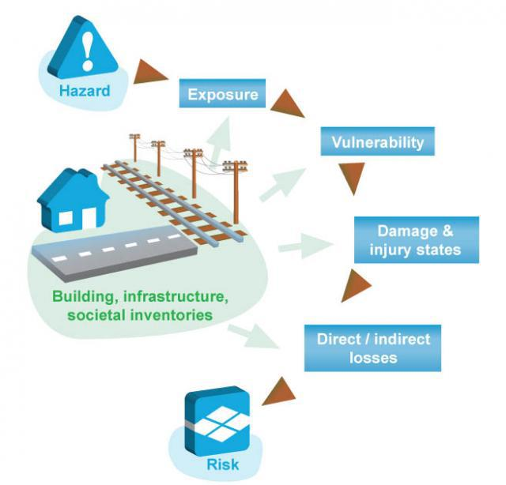
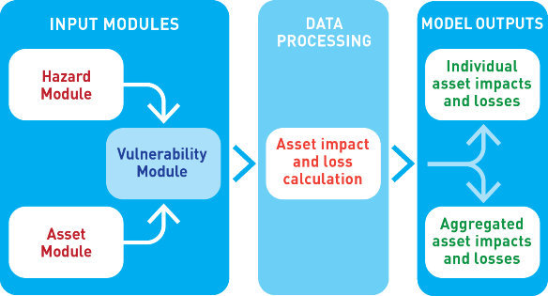
Background

Slide 8
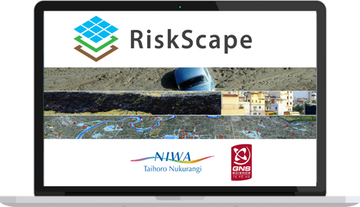
Background
Uses default functions
Can be tailored
Run scenarios
Stand alone software
Mapping and statistical outputs
Accessible and easy to use
Notes:
Thus - through a NZAID Partnerships funded project, NIWA in partnership with GNS Science, the Geoscience Division of the Pacific Community, the NDMO’s of Samoa and Vanuatu and VMGD are piloting the PARTneR project in Samoa and Vanuatu.

Slide 9
Notes:
Why Samoa & Vanuatu:
Exposure to multiple hazards
Ranked as ‘environmentally’ and ‘highly’ vulnerable
Complementary policies
Commitment to owning the activity and using the tool

Slide 11
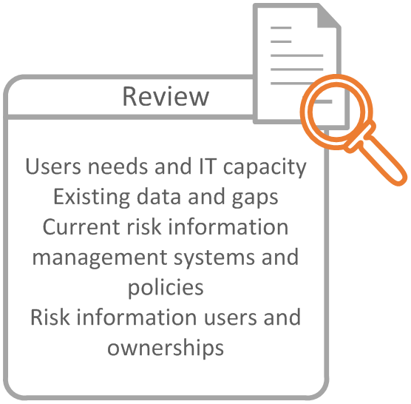
Phase 1 – Data Review and Case Studies

Slide 12
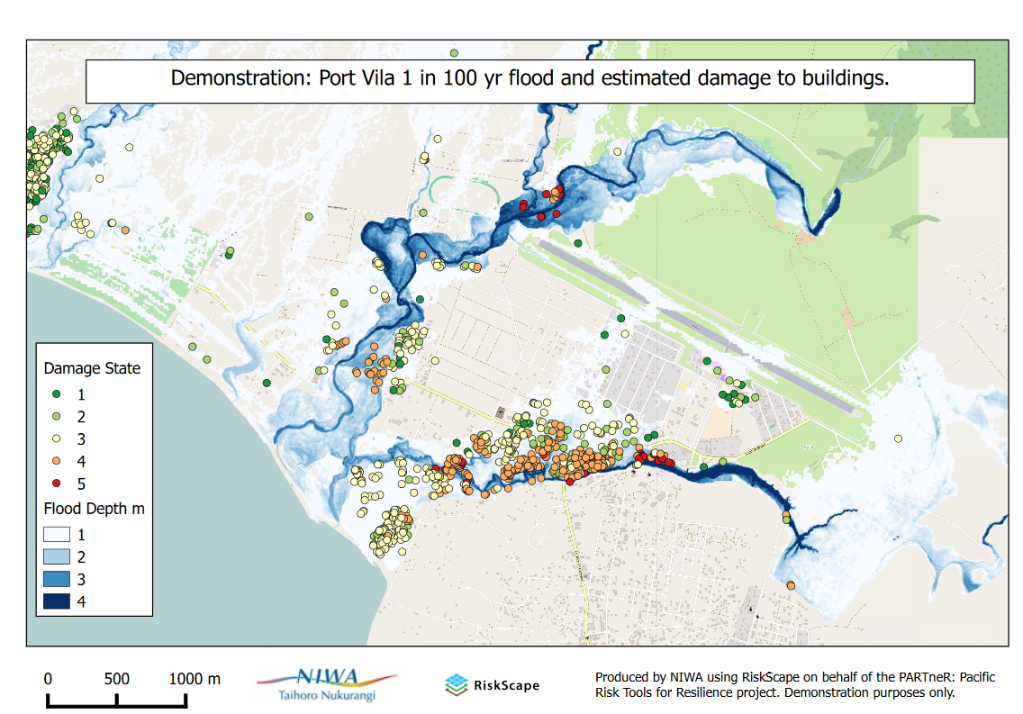
Notes:
Case study example

Slide 14
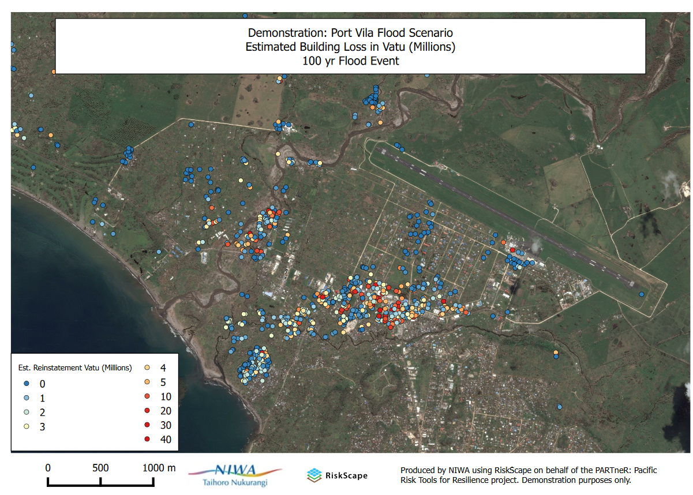

Slide 16
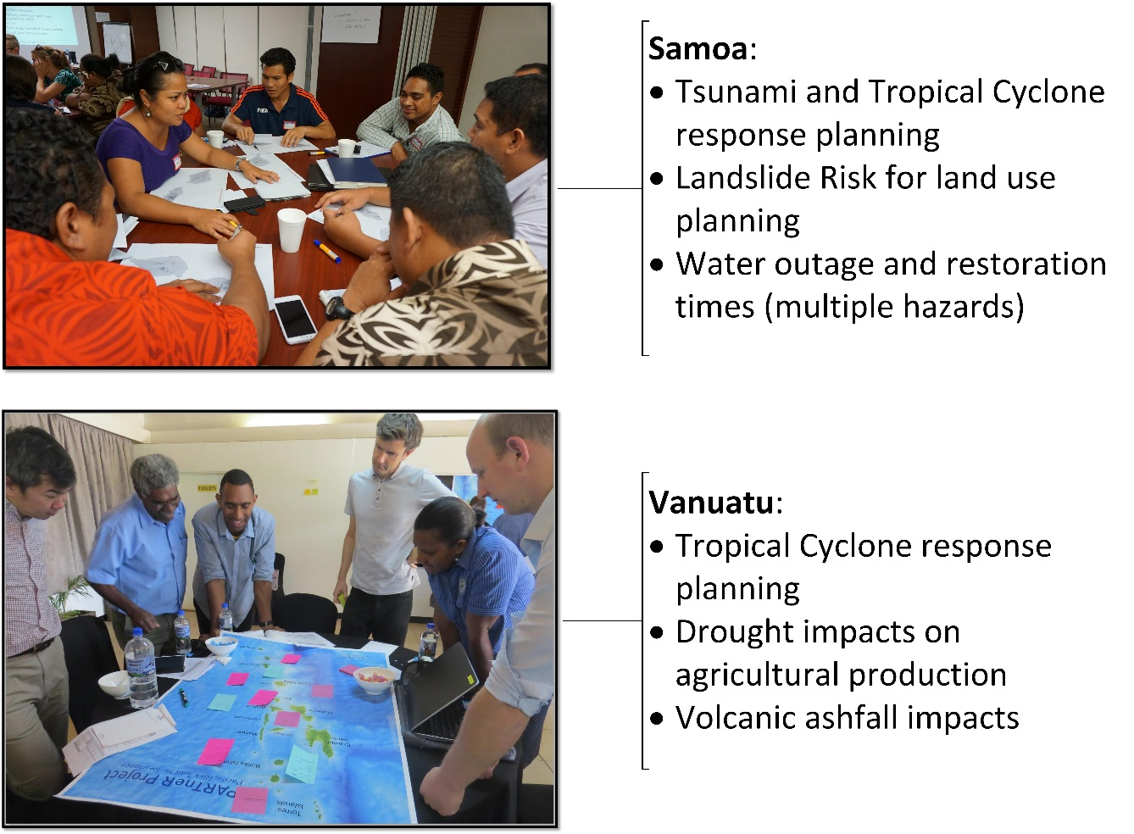
Case Study Design Workshop outputs:

Slide 17
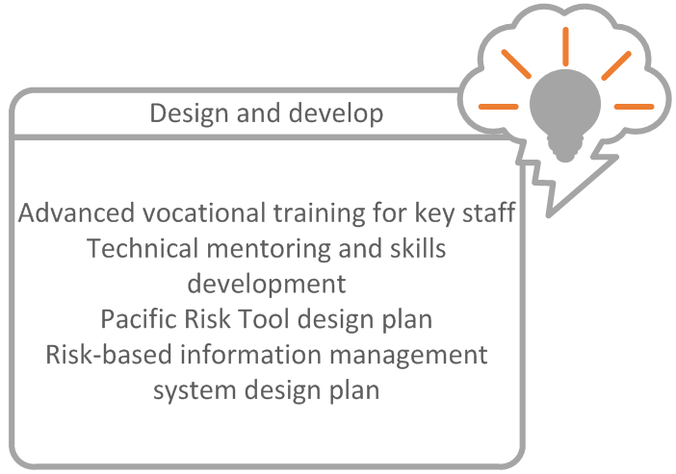
Phase 2 – Training and Data Management

Slide 18
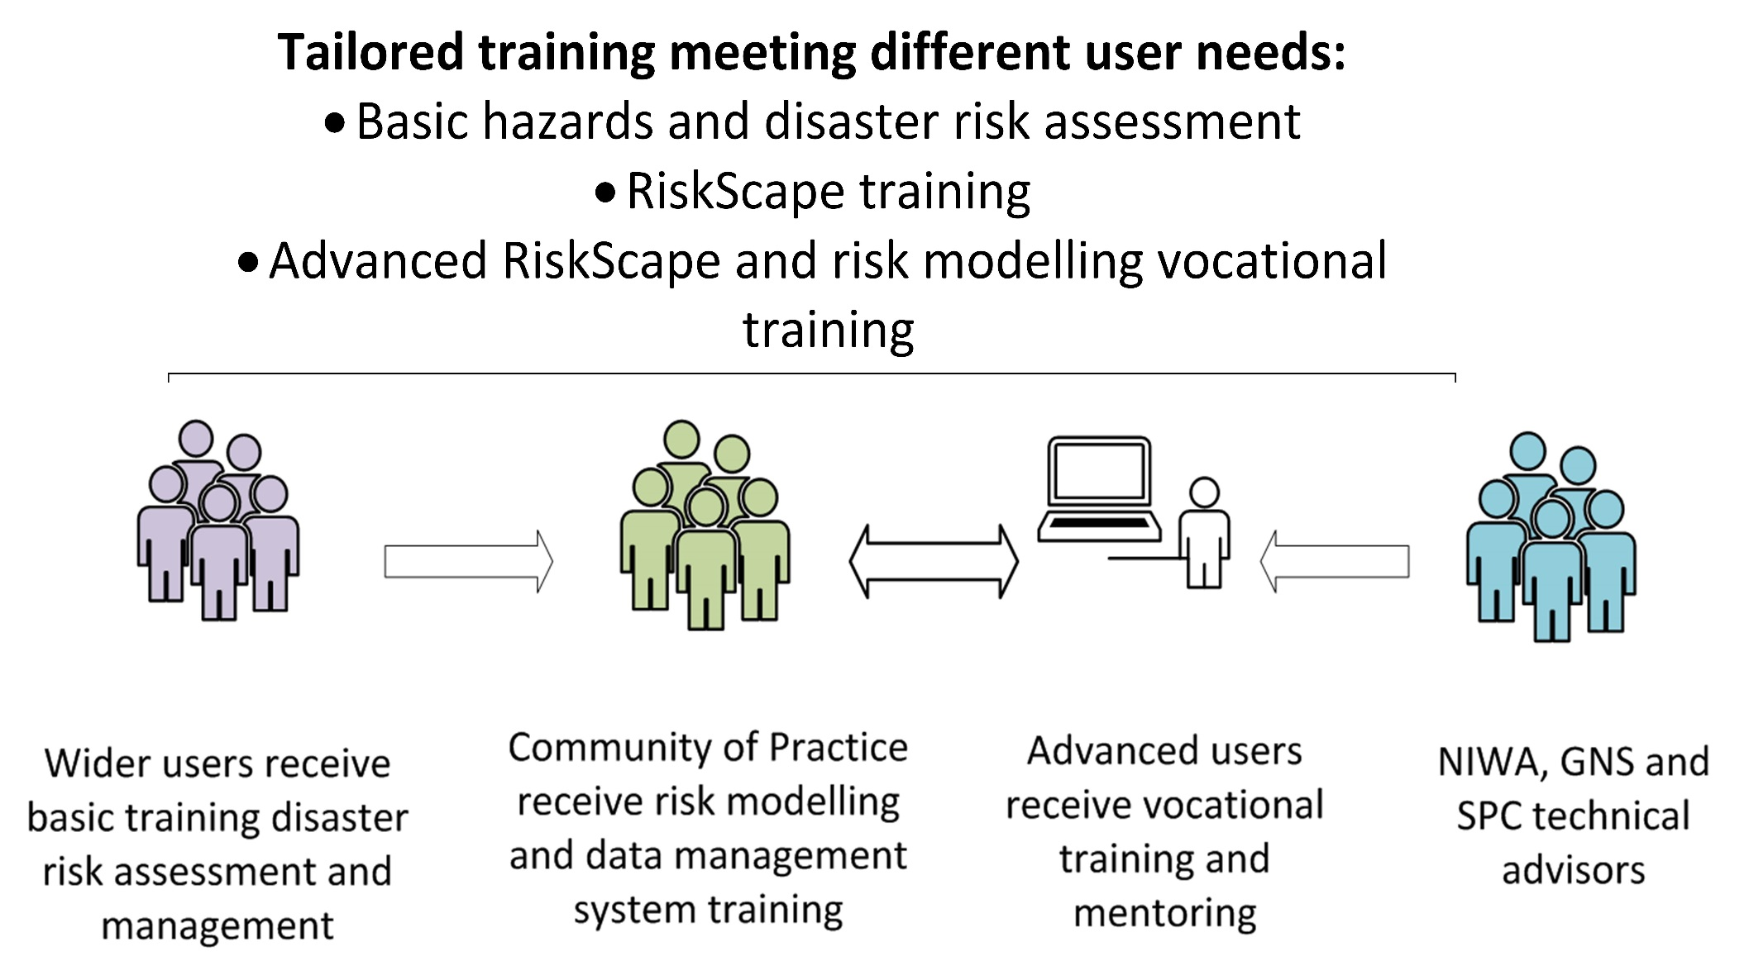
Project stakeholders

Slide 19
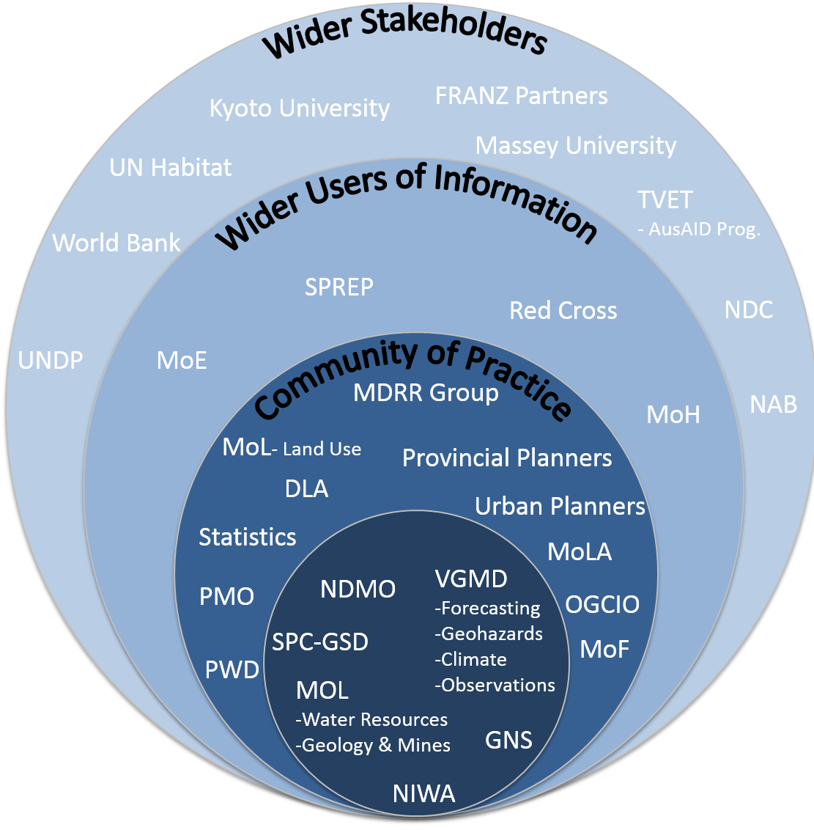
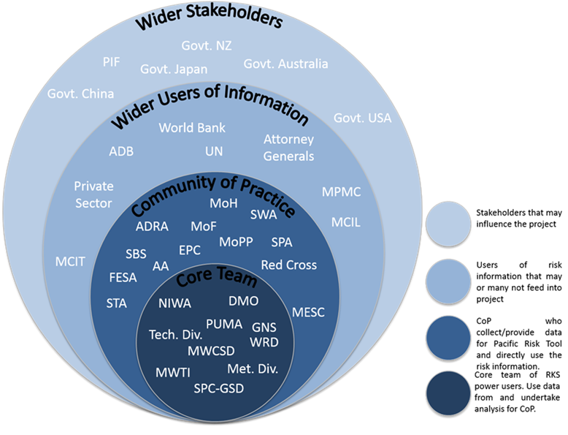
Vanuatu and Samoa stakeholders and team

Slide 20
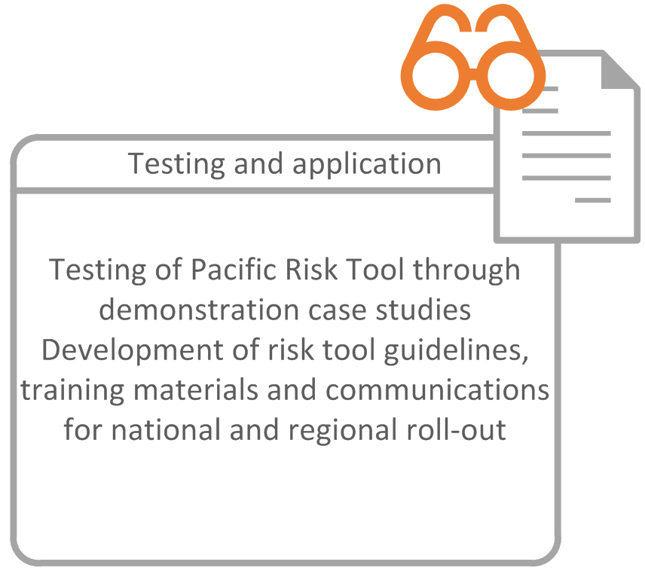
Phase 3: Tool application and testing

Slide 21
Overview

Slide 22
Project Manager NIWA:
Kate Crowley
Email: kate.Crowley@niwa.co.nz
Tel: 0064 4 3860833
GNS Science:
Nick Horspool
Email: n.horspool@gns.cri.nz
SPC-GSD:
Paul Taylor
Vanuatu project managers:
Peter Korisa, Vanuatu Disaster Management Office
Esline Garaebiti, Vanuatu Meteorology and Geohazards Department
Samoa project manager:
Filomena Nelson, Samoa Disaster Management Office

