Slide 1
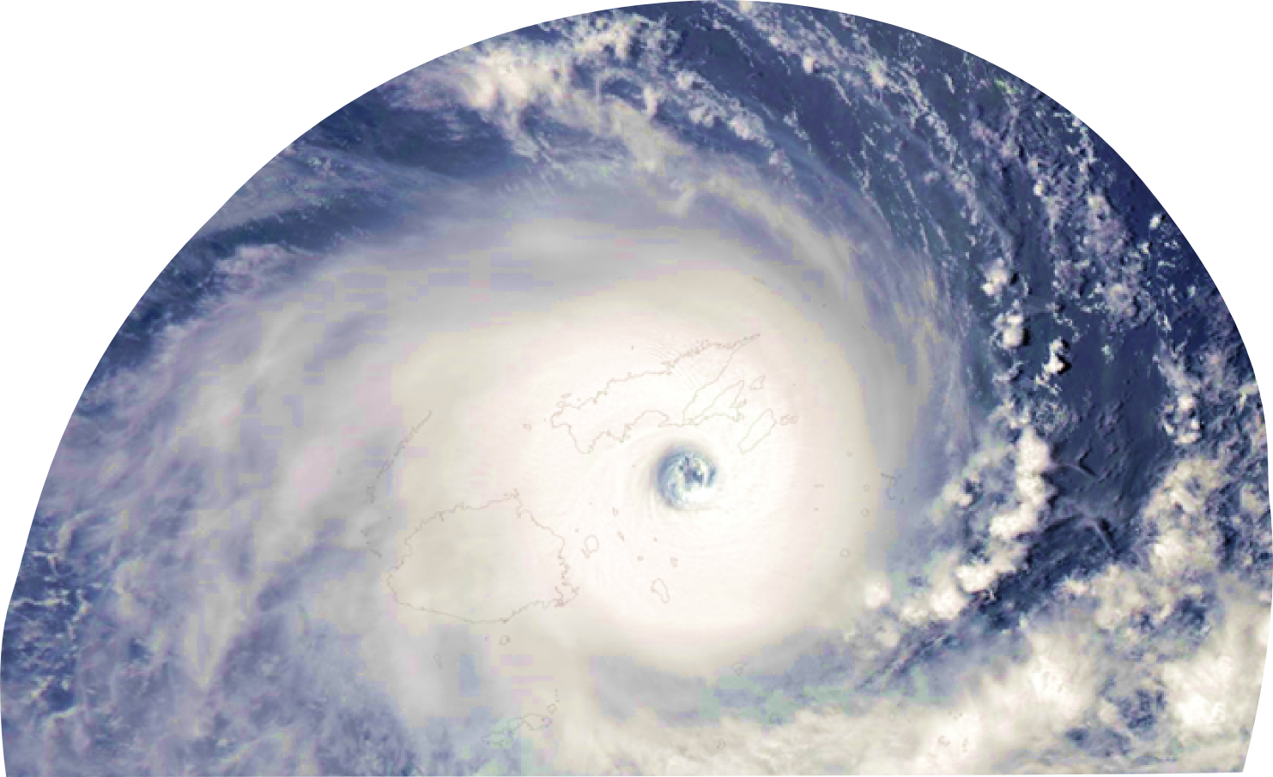
Tropical Cyclone Winston Coastal Inundation
Cyprien Bosserelle, Herve Damlamian, Zulfikar Begg, Mereoni Ketewai, Deepika Lal, Arieta Navatoga,
Joy Papao, Keleni Raqisia, Jens Kruger

Slide 2
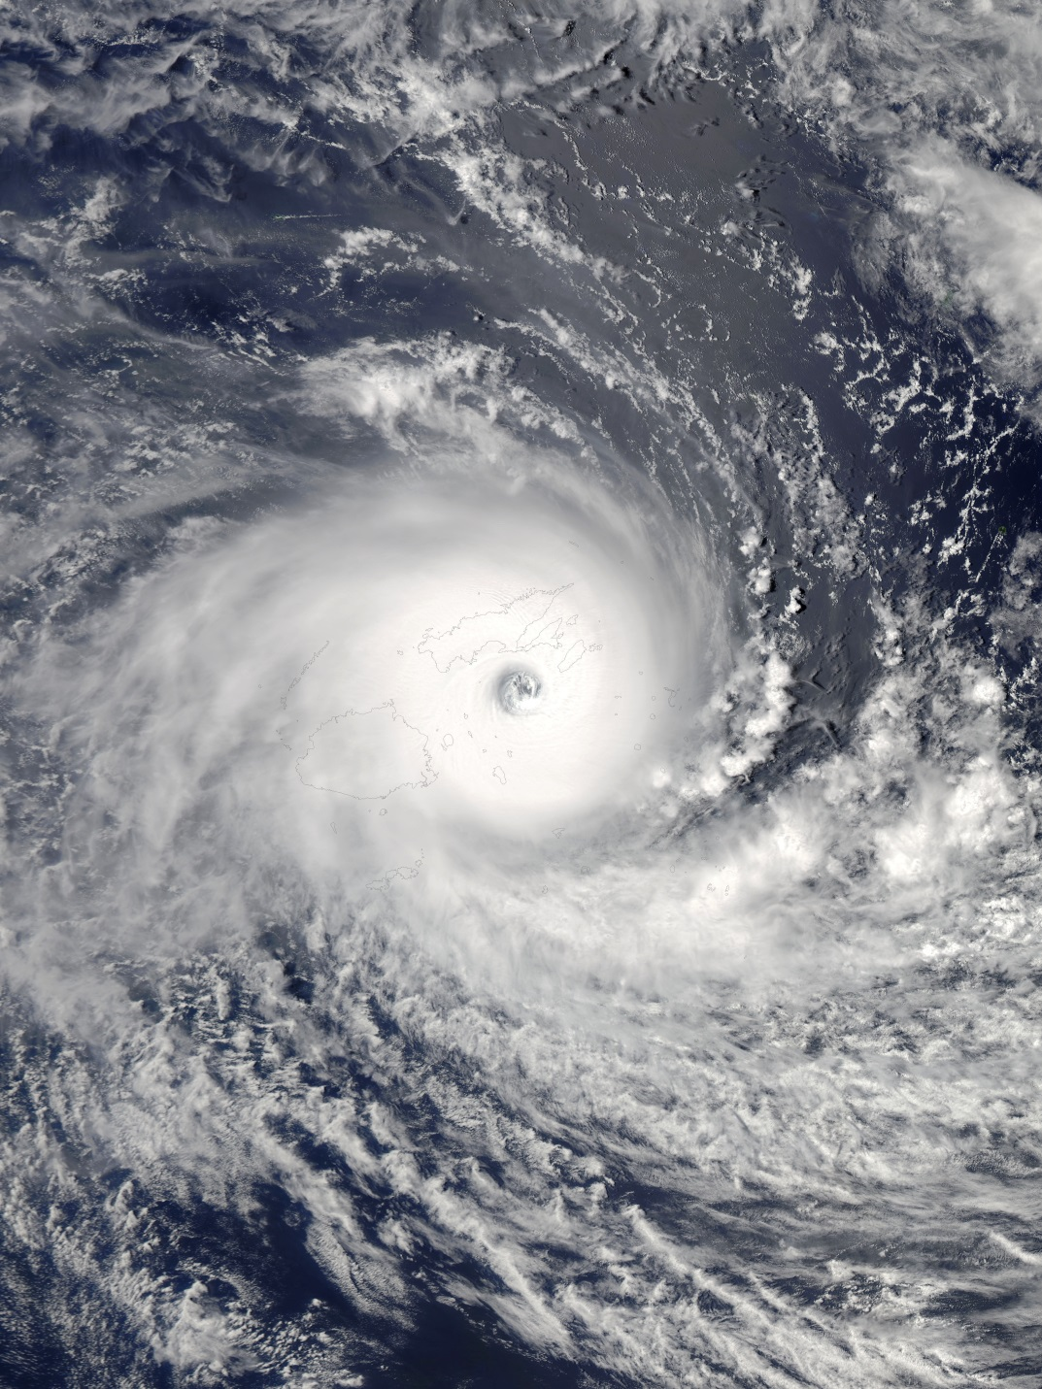
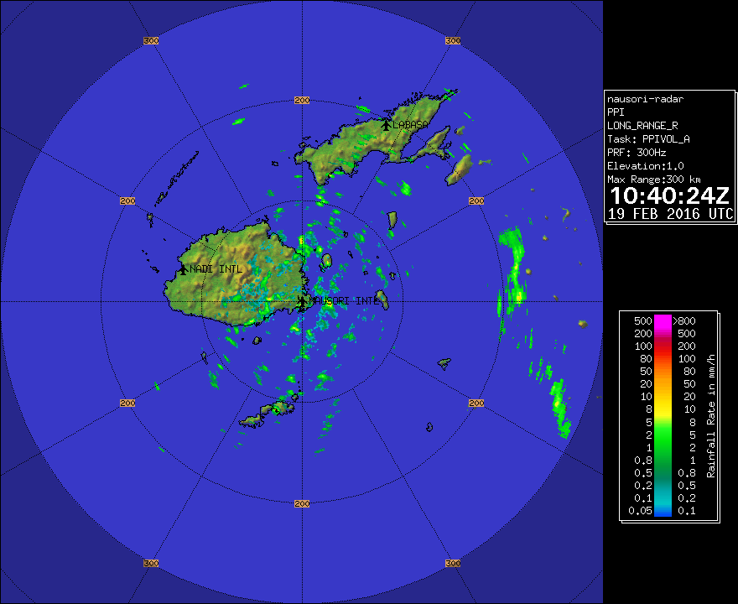
Tropical Cyclone Winston wiki
Highest winds
10-minute sustained:
233 km/h (145 mph) (Gust: 306km/h)
1-minute sustained:
285 km/h (180 mph)
Lowest pressure
929 hPa (mbar);
Summary of impact
Human
44 Casualties
50,000 people in evacuation centers
350,000 people affected (~40% of Fiji pop.)
Main cause of death from STC Winston
Infrastructures
~30,000 homes destroyed
7 Ferries wrecked/stranded
240 schools severely damaged/destroyed
Economy
FJ$2.0 billion Loss
FJ$0.5 billion Damage
80% of the loss is from Agriculture
80% of the nation without power
From coastal Inundation
Notes:
Most Tragic Natural disaster in Fiji since 1979
At least 16 death by drowning in sea water
~30 death can be attributed to in sea water inundation

Slide 3
News clippings (Fiji times, Fiji sun, UNOCHA…)
Wind and waves from hell
They saw high waves from the sea leap with ferocious speeds towards their homes. These people want to move to safety now.
[..]huge waves threw up debris and coral boulders on the street's main town.
[…] killed by huge waves […]
[…] waves snatched four persons […]
[…]tidal waves higher than the high ..walls of the old Methodist church[…]
[…] sea swells swept through land.
We [had] not prepared ourselves and we just stay in the house and see the big wave, call it Tsunami. In Fijian we call it Ualoka,[…]
This is the first time a tsunami came in our village. Four big waves came from the sea, came through, entered into our houses.
[…] strong winds and the tidal wave demolished […]
[…]father was swimming to take the baby to higher ground during the height of the cyclone[…]
[…] huge waves and strong winds gushed on to the road and pushed our cars to the side[…]
It was very scary, the sea came flooding in […]

Slide 4
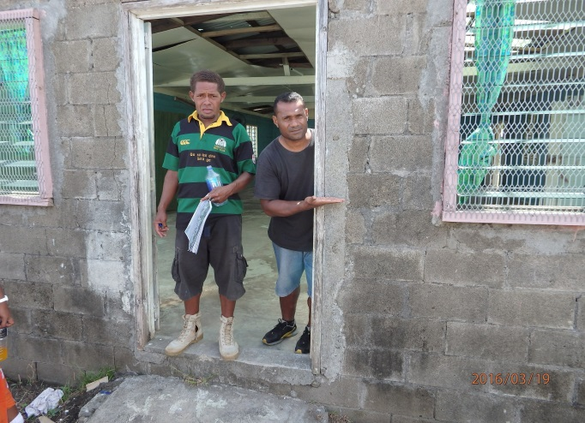
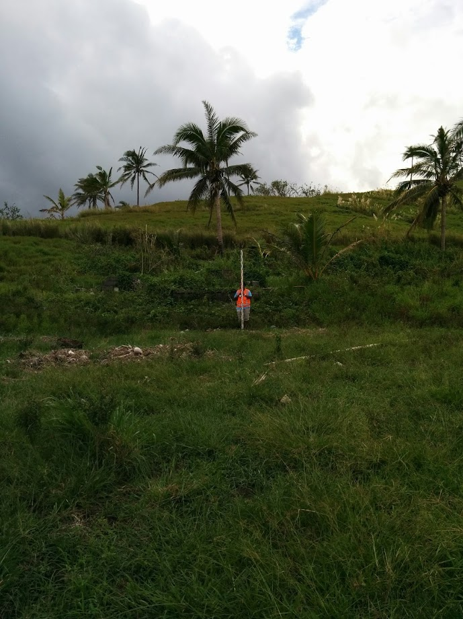
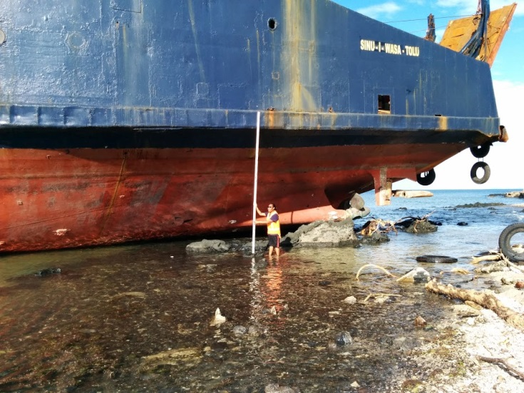
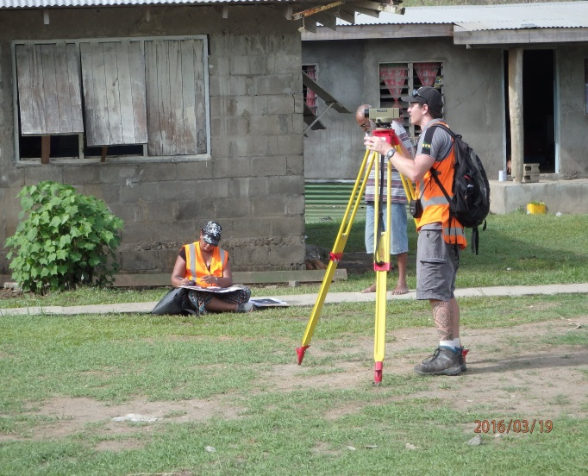
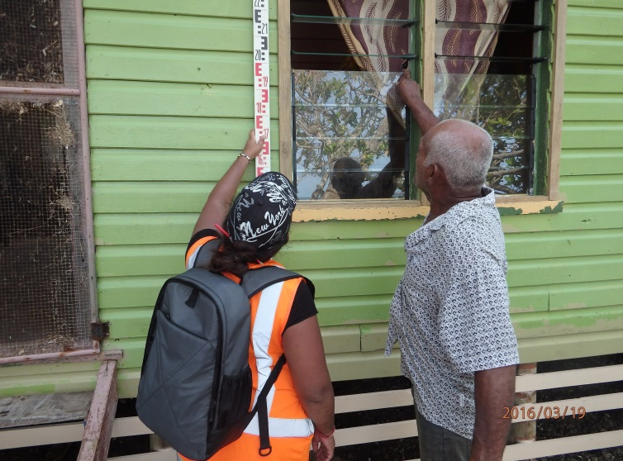
Post-inundation survey: 18 –25 March 2016
Low tech, light weight = Low impact
Collect data on run-up, flow depth, inundation extent and building damages
1 week long survey
2 teams of 4 staffs
21 villages/settlements in Ovalau
26 Villages/settlement on Vanua Levu
~800 Building assessed

Slide 5
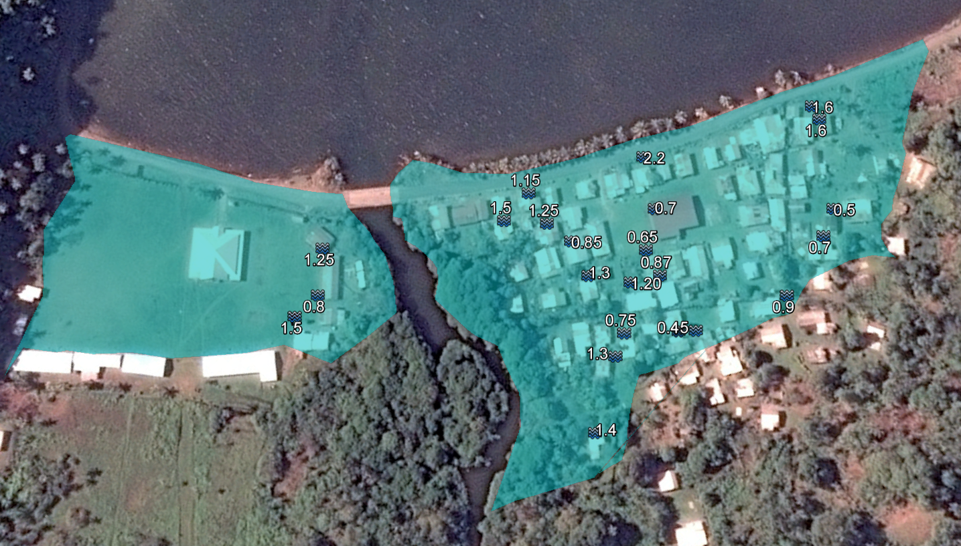
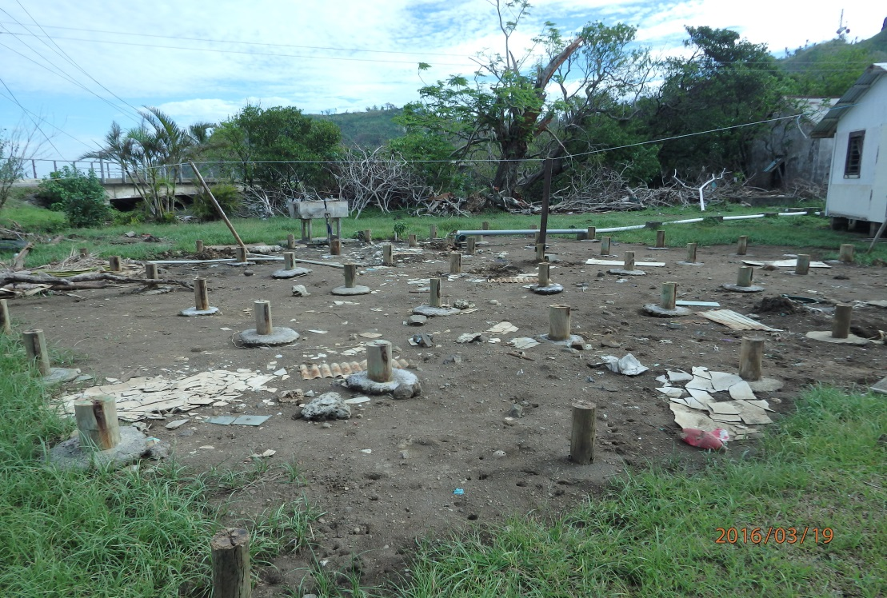
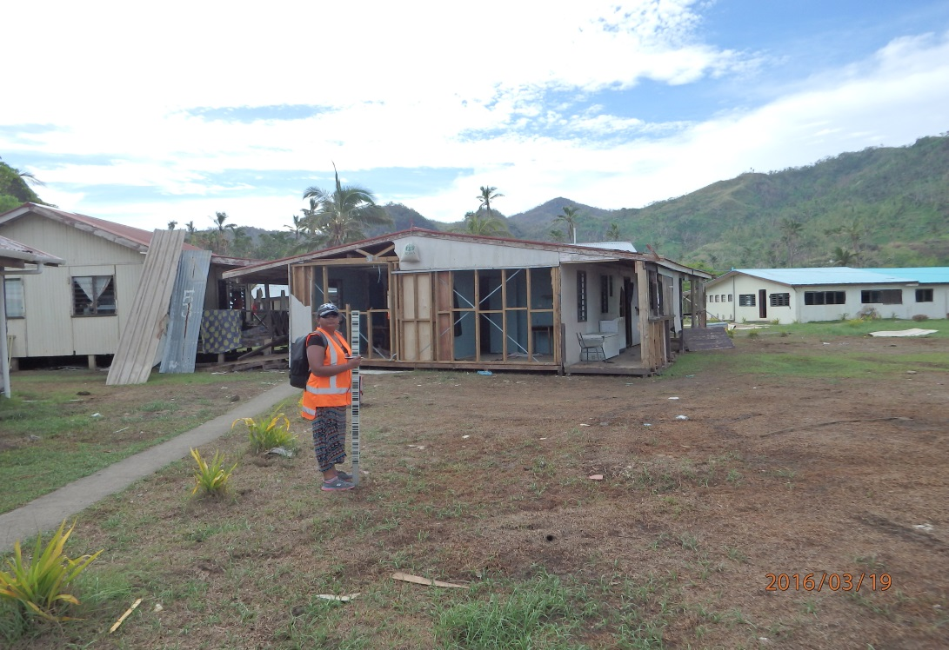
Example Inundation maps: Tokou, Ovalau
Damages:
None ;
Minor ;
Moderate ;
Severe ;
Destroyed ;

Slide 6
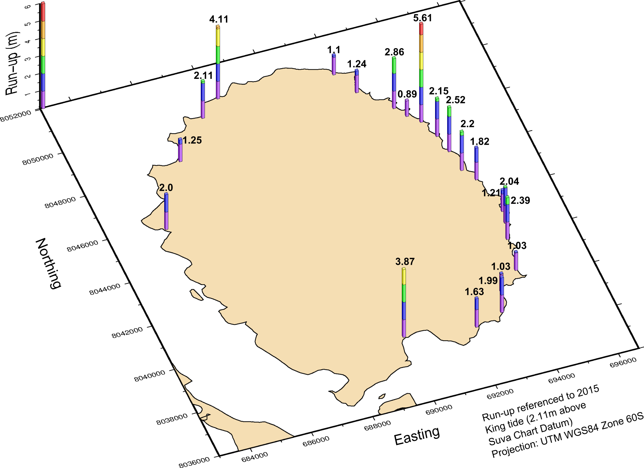
Ovalau maximum runup

Slide 7
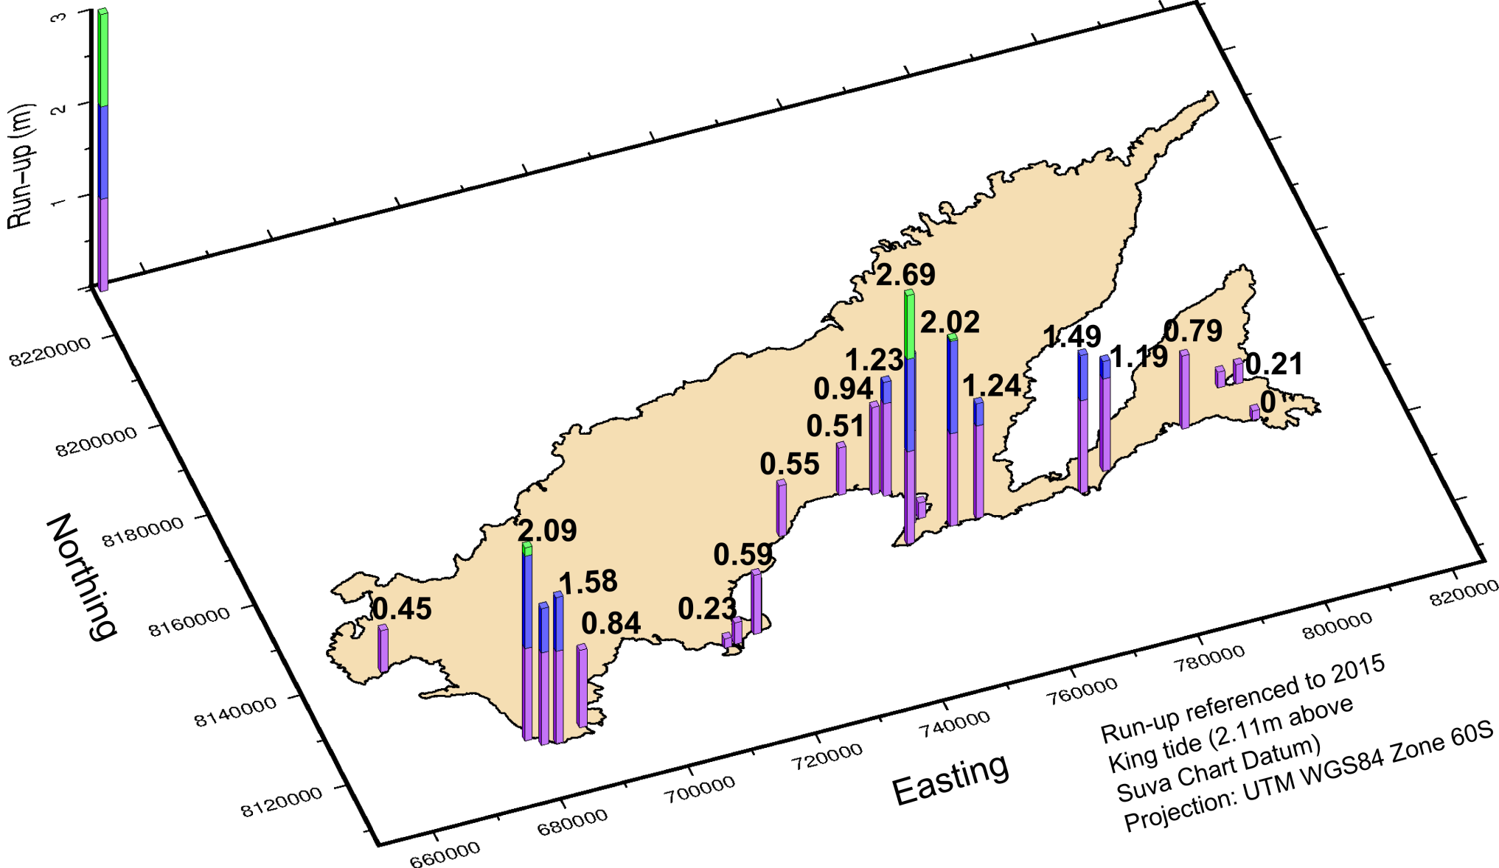
Vanua Levu maximum runup

Slide 8
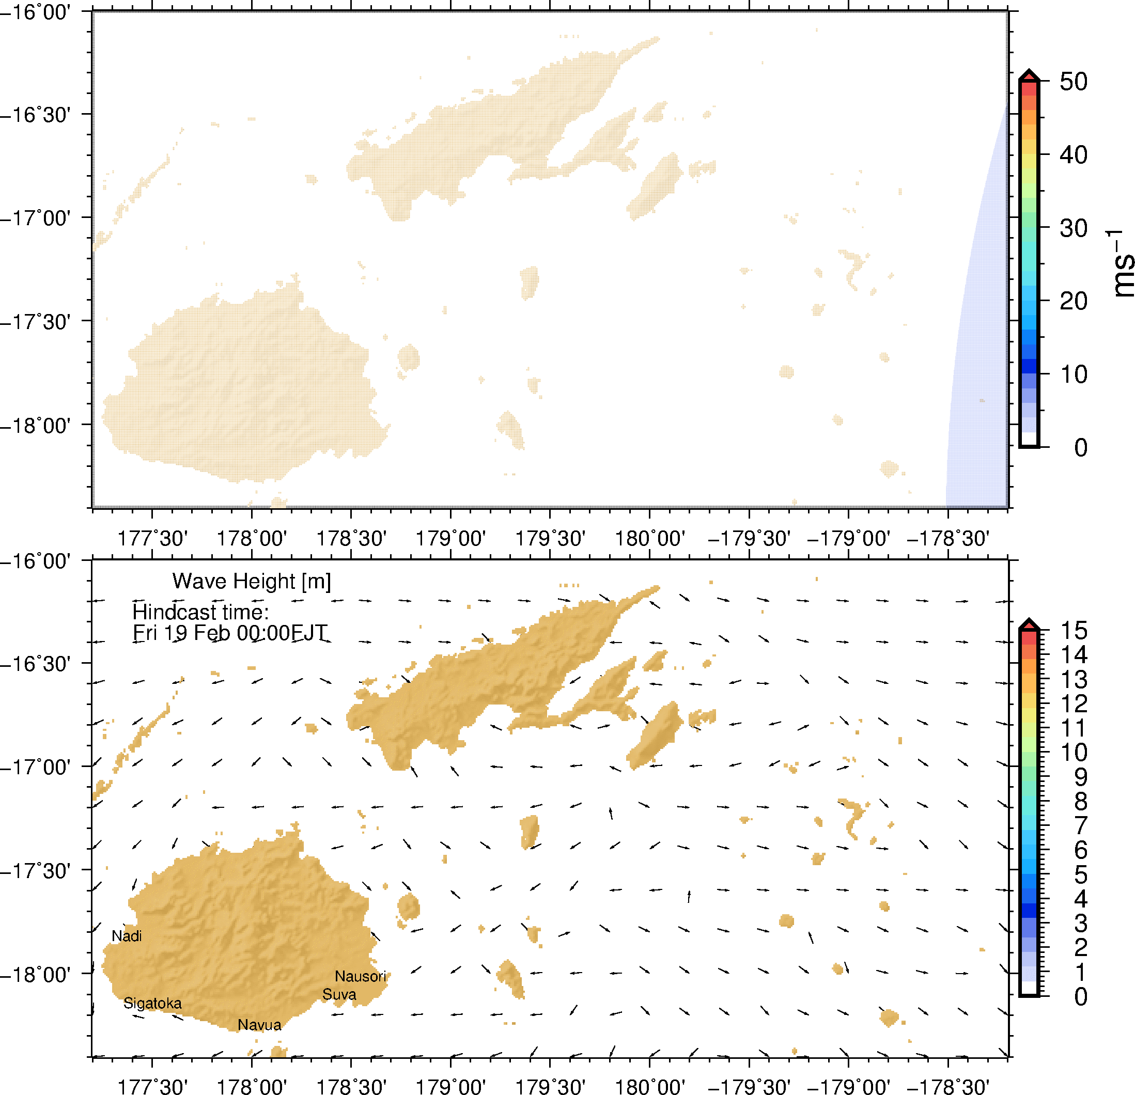
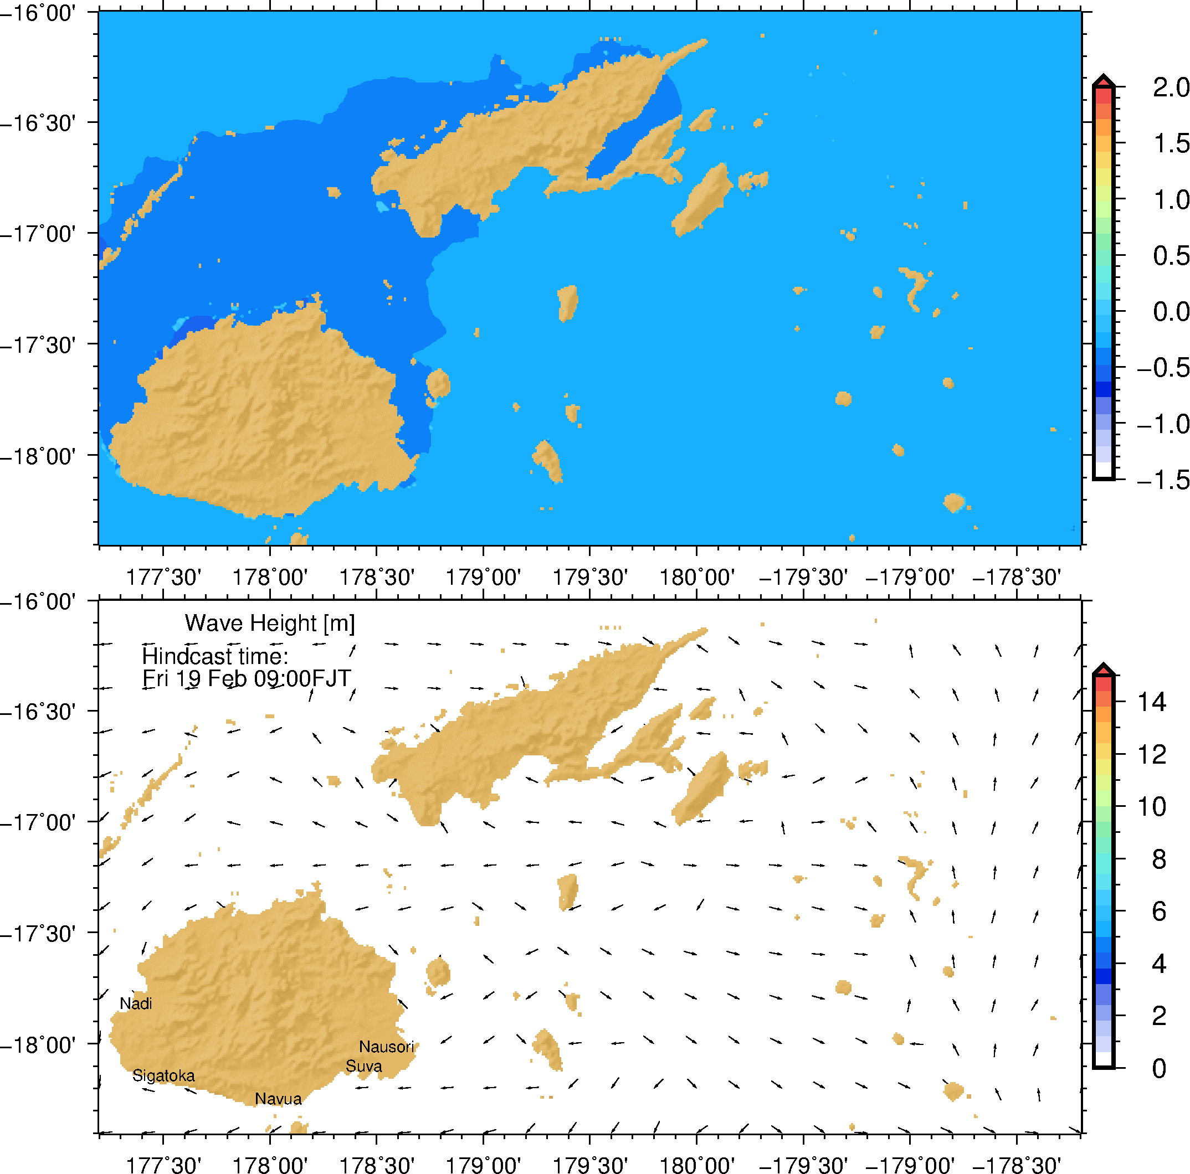
TC Winston wind, wave, model
For TC Nerds:
JTWC best track
Young & Sobey wind model
For Storm Surges Nerds:
Delft3D – DFLOW FM
2 drag breakpoints
Uncoupled (no wave force)
For Wave Nerds:
SWAN
WESTH
Cdcap=0.002

Slide 9
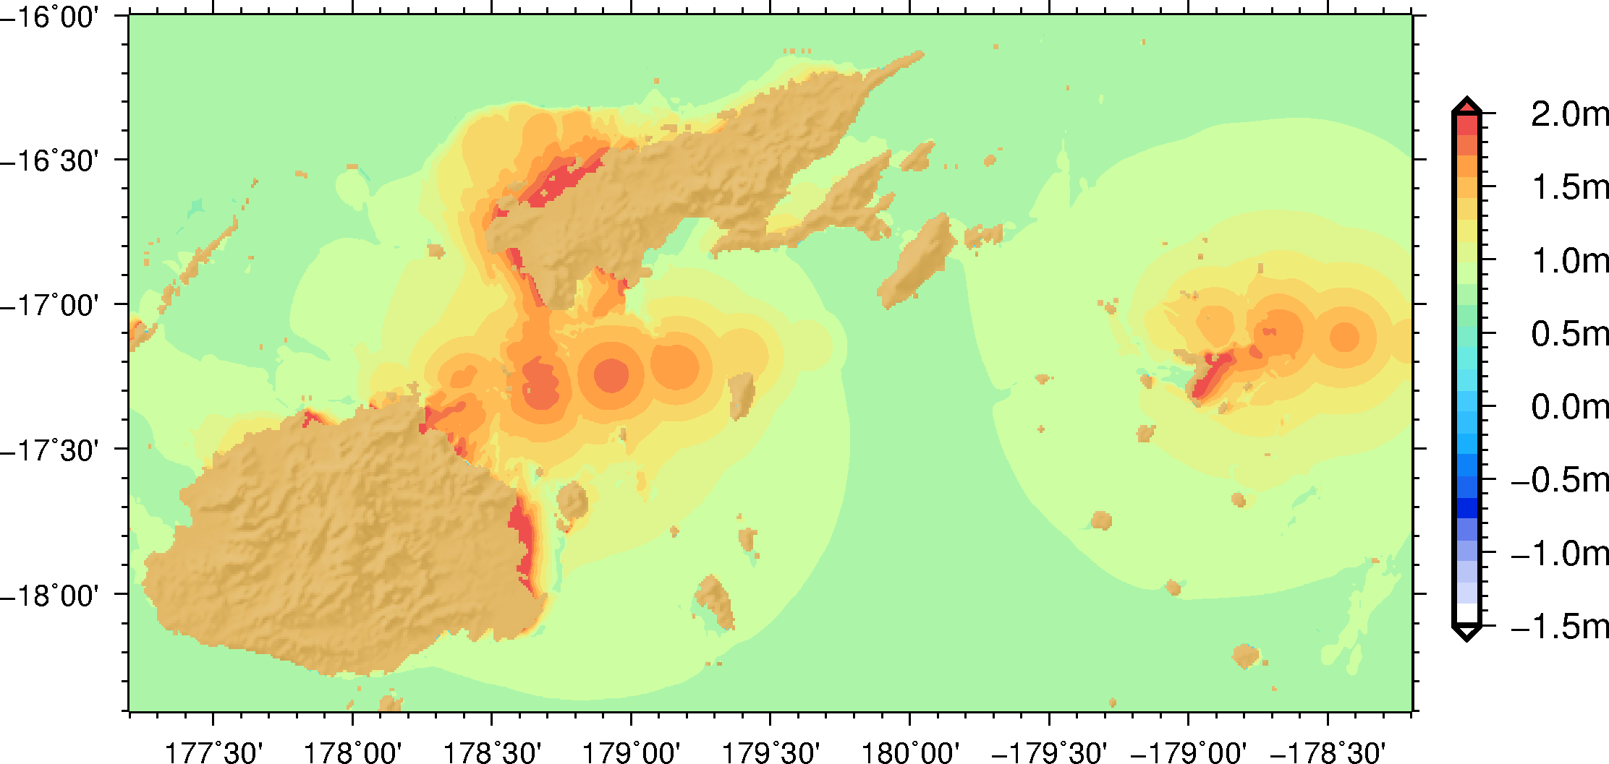
Maximum Storm tide
Low storm tide
High storm tide

Slide 10
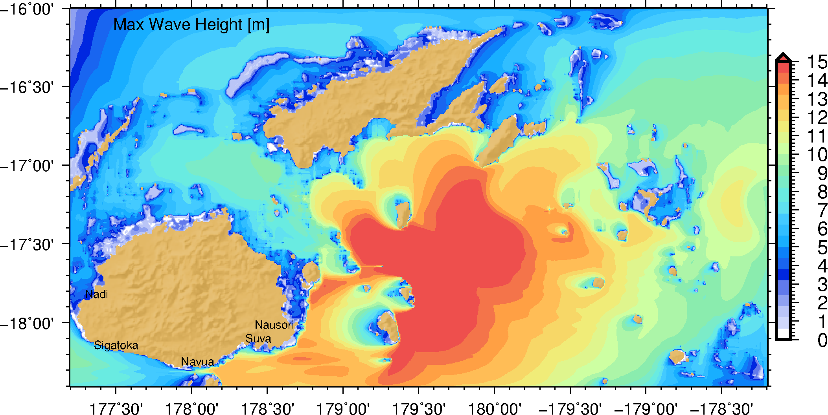
Maximum Wave height
V large waves
V large waves

Slide 11
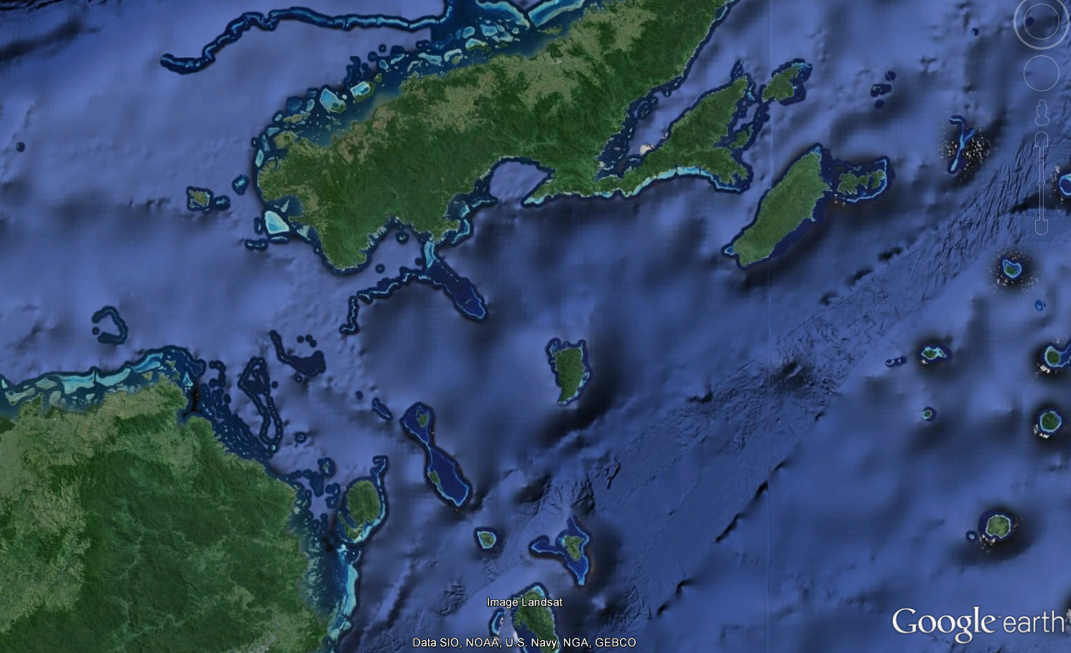
Dynamical model is necessary to reach this level of details
Storm surge driven inundation
Storm Surge
inundation
Wave inundation
Protected by offshore Reefs

Slide 12
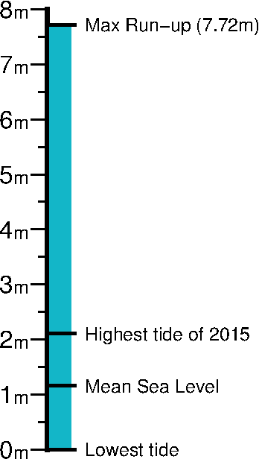
Highest runup in Ovalau Holiday Resort
111 m
+Infragravity
Grassy hill
+waves
Tide +storm surge
Road
Beach
Mean sea level

Slide 13
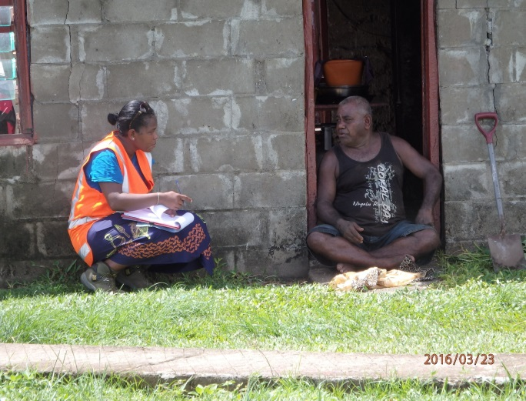
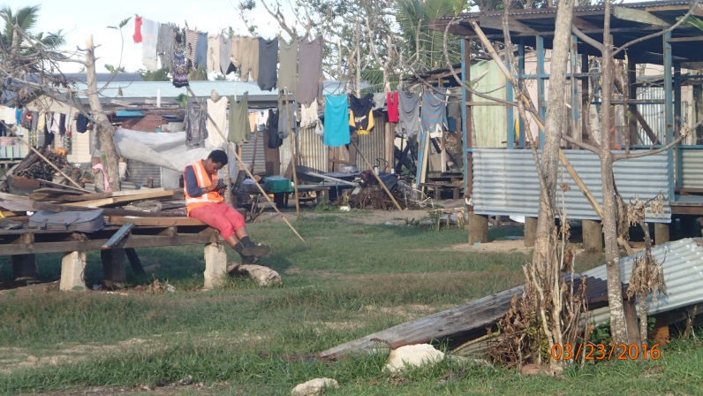
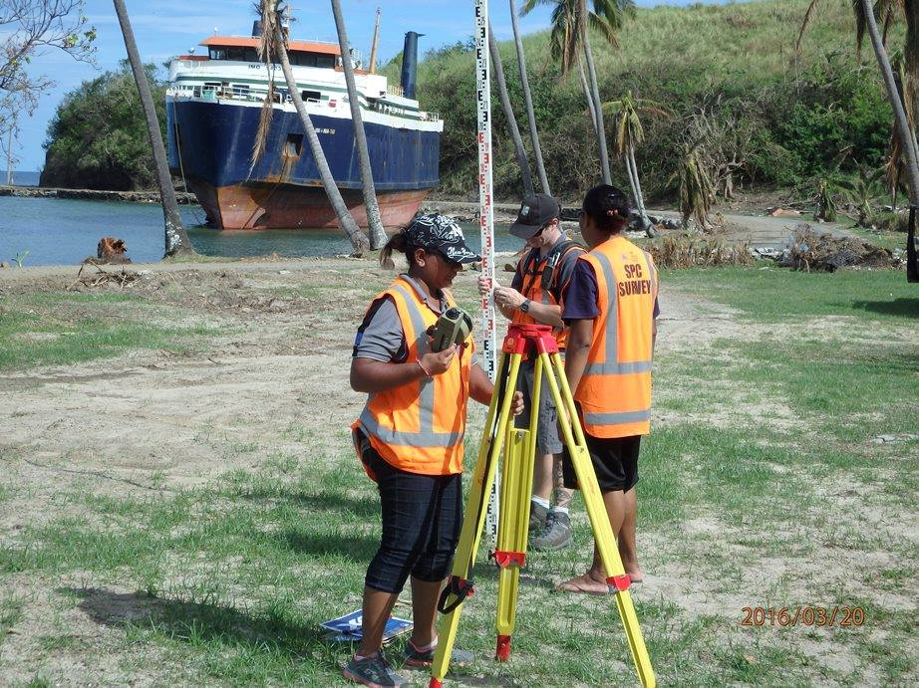
Summary
Lessons from Winston for the Pacific
Coastal inundation was responsible for 25% of casualties
High variability of run-up can be explained by wave and storm surge variability
Awareness on coastal inundation was very low
Communities have been exposed to severe coastal inundation…
Some ways forward to reduce vulnerability to TC inundation
Raising awareness on coastal inundation– Government, NDMO, NGO, Communities…
Operational forecasting of run up with CIFDP-Fiji
Wave, storm surge and run up
Improved warning messages (more targeted?)
Reinforced evacuation planning for coastal communities
Improved coastal planning (policies?) to limit development in vulnerable areas

