Slide 1
Vertical Reference Frame
Pacific
Andrick Lal
SPC Geoscience Division
GIS&RS User Conference
29th November 2016 – USP, Fiji.

Slide 2
What does it mean?
All buildings and features have a height. But what is it relative to?
Land Surveyors general refer heights relative to “Mean Sea Level”
Hydrographers (marine surveyors) refer to “Chart Datum/Lowest Astronomical Tides”
Use of these two different vertical reference surfaces was never an issue when accuracies (Precisions) were in the order of decimeters/meters.

Slide 3
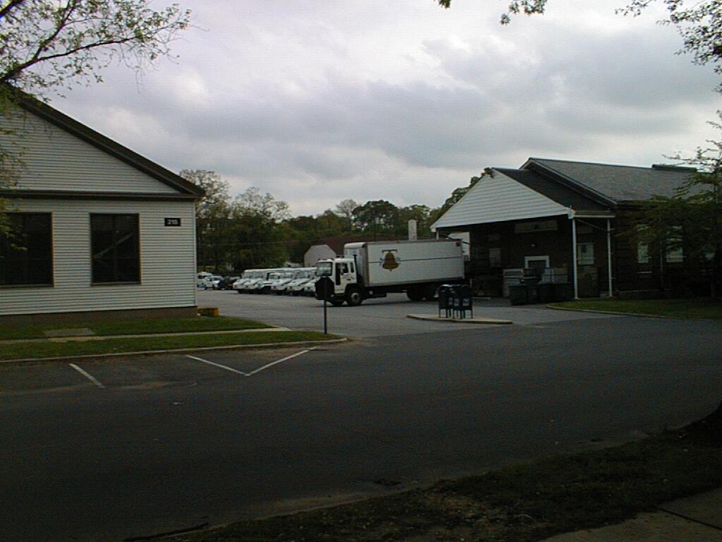
Relative Approach
Building 215
Post Office
Geographical (latitude, longitude & height) – Locational Data & information

Slide 4
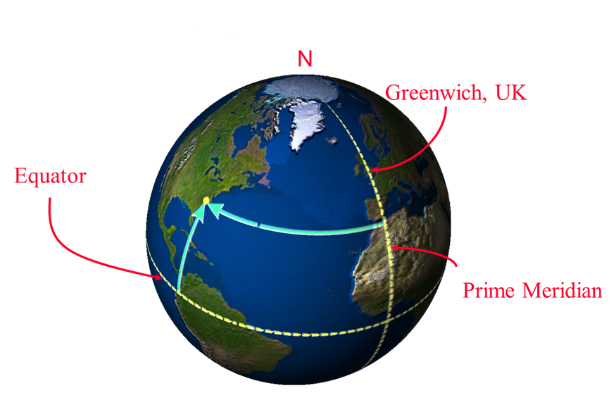
Absolute Approach

Slide 5
Introduction
One dimensional coordinate system used to define the distance of a point from a reference surface along a well defined path
Complex description because there are a number of reference surfaces and a number of well defined paths
Two types of height systems:
Physical – based on Earth’s gravity field and measured along the curved plumbline (e.g. orthometric heights)
Geometric – not based on gravity field (e.g. GNSS ellipsoidal heights)
Purpose: become more aware of the different reference surfaces and different paths

Slide 6
Introduction
Traditionally people prefer to know their height relative to sea level (physical height surface):
Water flow for drainage systems
Height of buildings above a flooding river
Satellite positioning systems (GNSS and remote sensing) determine heights relative to the ellipsoid (geometric)
These height systems aren’t aligned, but can be connected (e.g. using geoid models)
It is important to understand how these systems are different and how data from these systems can be used together

Slide 7
Earth-Centered, Earth-Fixed (XYZ)
Z Axis
Conventional
Terrestrial
Pole
P
(X,Y,Z)
Earth’s
Surface
Zero
Meridian
Z
Origin
Y Axis
(0,0,0)
Center of Mass
X
Y
X Axis
Mean Equatorial Plane
Dan Roman, 2007

Slide 8
Latitude, Longitude, Ellipsoidal Height (LLH)
Z Axis
(X,Y,Z) = P (φ,λ,h)
P
h
Earth’s surface
Zero
Meridian
Reference Ellipsoid
Y Axis
φ
λ
X Axis
Mean Equatorial Plane
Dan Roman, 2007

Slide 9
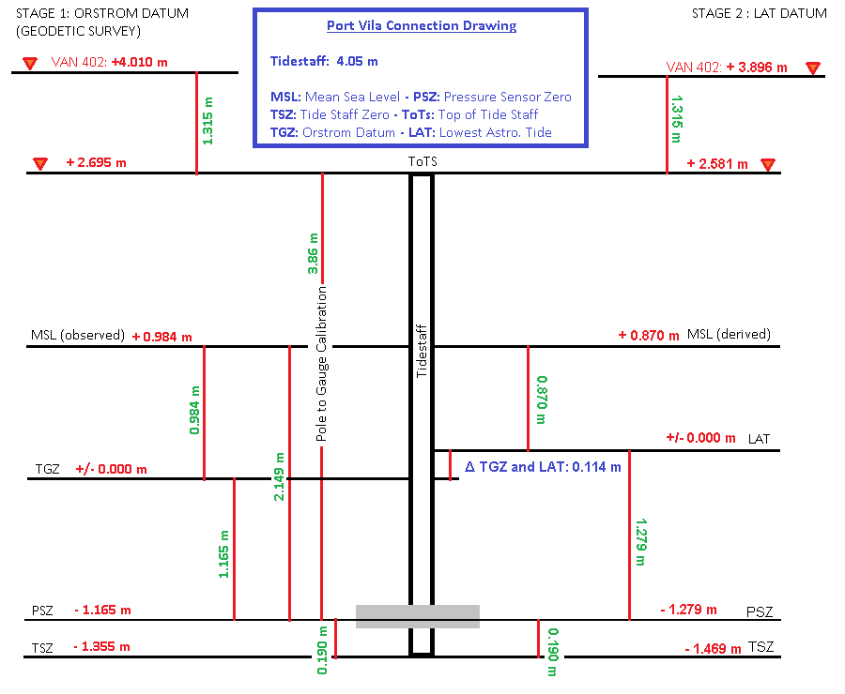
Vertical Datum

Slide 10
Global Geoid Model

Slide 11
Global Geoids
Derived from analysis of satellite measurements
Long wavelength (low resolution)
Consist of spherical harmonic coefficients (SHM)
Modern GGMs to very high degree & order
Geoid, gravity & geopotential quantities can be computed from SHM
Some include surface gravity data, e.g. EGM2008
Most are purely satellite-based
Often accurate to sub-decimetre

Slide 12
Regional Approach - VRF
Physical
Gravity only
Geometric
GNSS levelling
Combined or fitted
Gravity based geoids combined with GNSS-levelling

Slide 13
Pacific Sea Level Monitoring Project (PSLMP)
The Pacific Sea Level Monitoring (PSLM), operates under the Climate and Oceans Support Program in the Pacific (COSPPac). It is a continuation of the 20-year South Pacific Sea Level and Climate Monitoring Project (SPSLCMP)
Comprises of a tide gauge network component and geodetic monitoring component
To monitor sea level over a long time period, vertical crustal movement of the earth needs to be accounted for, to provide an absolute reading from the tide gauge
Geodetic monitoring component is maintained by Geoscience Australia
Providing a long term height time series of data
Consistent, accurate, global geocentric terrestrial reference frame – ITRF2008
Meeting accuracy requirements to match the expected sea level rise determined from over a century previous global tide gauge measurements of 1mm/annum

Slide 14
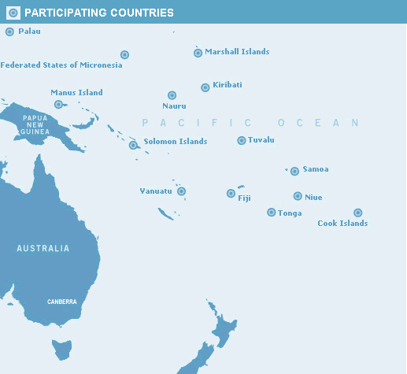
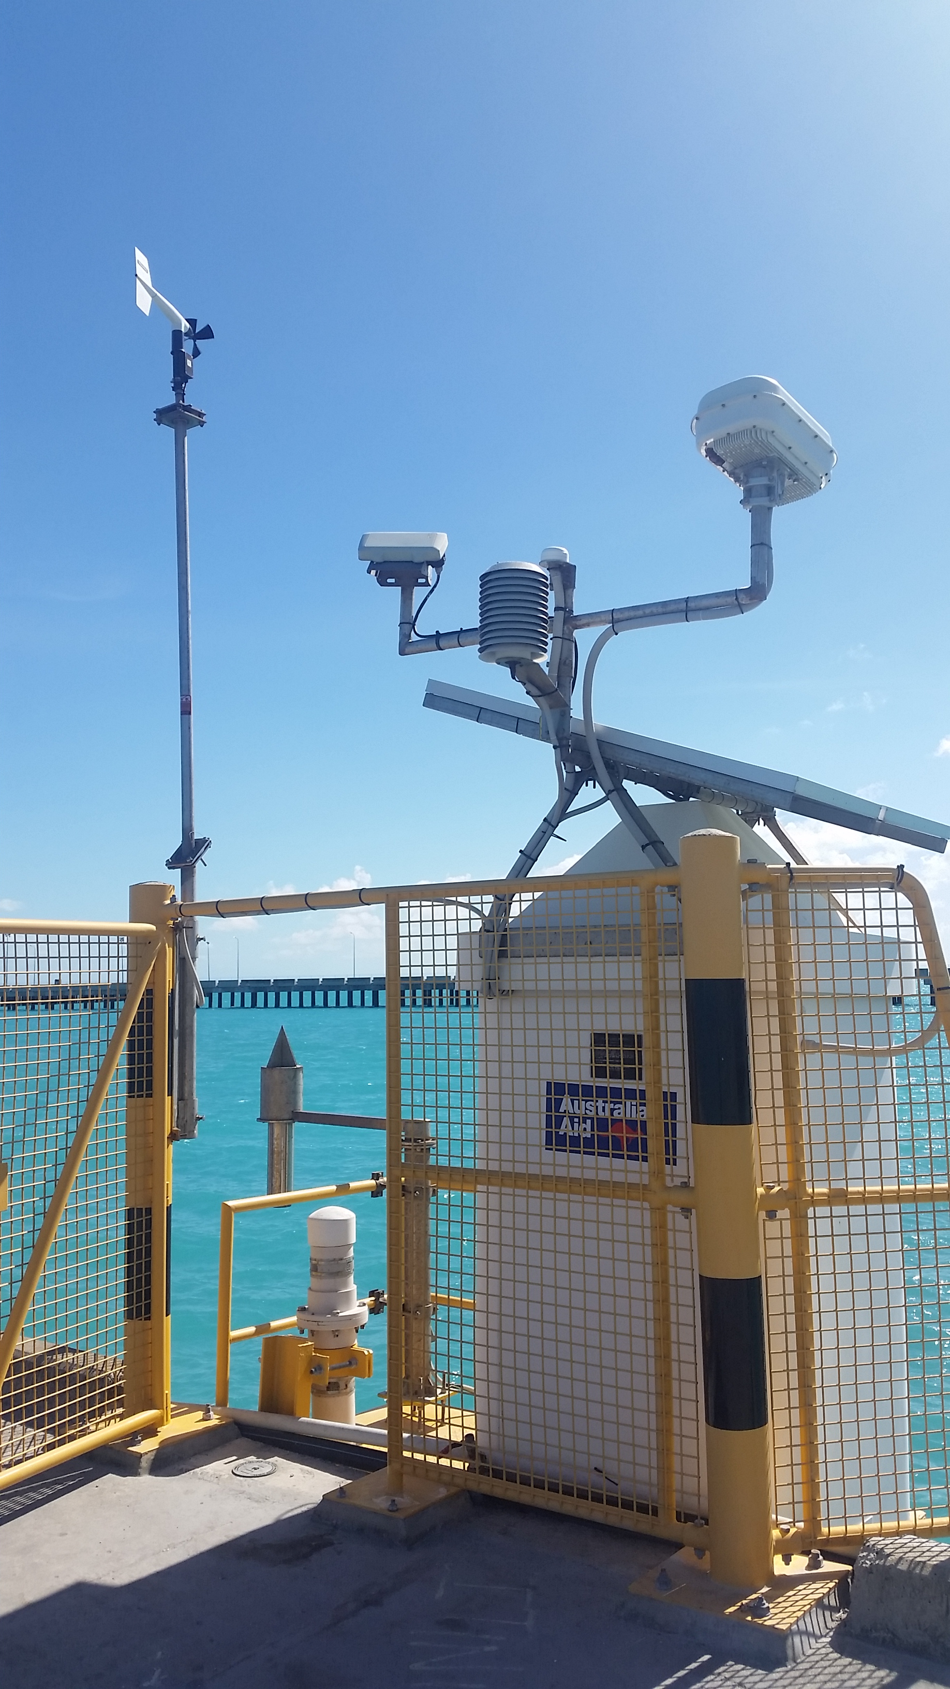
Pacific Sea Level Monitoring Project
Tide Gauge Station

Slide 15
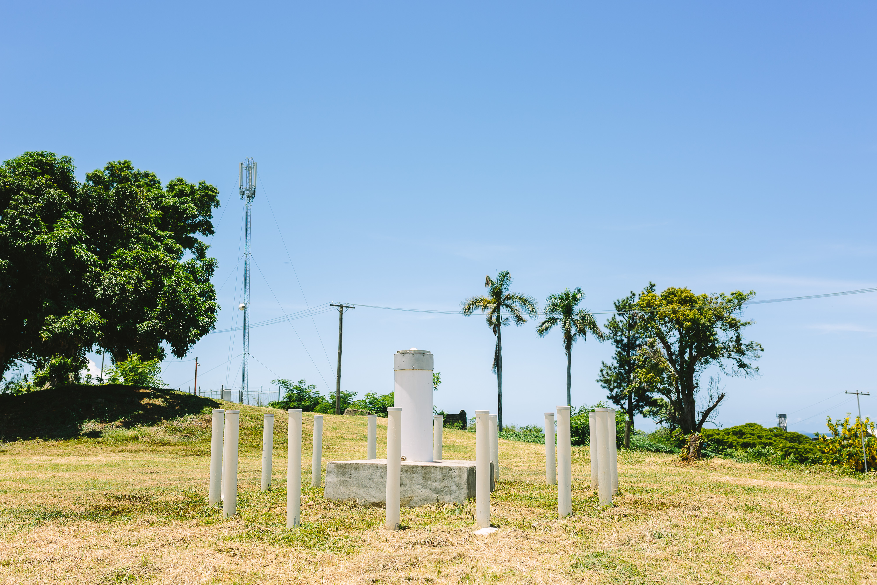
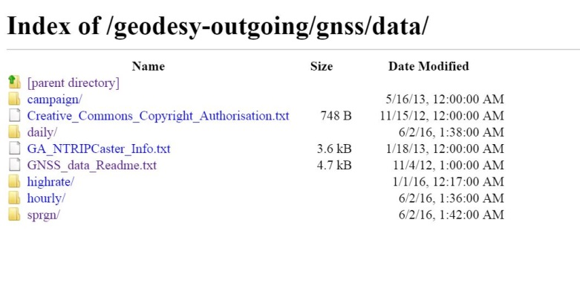
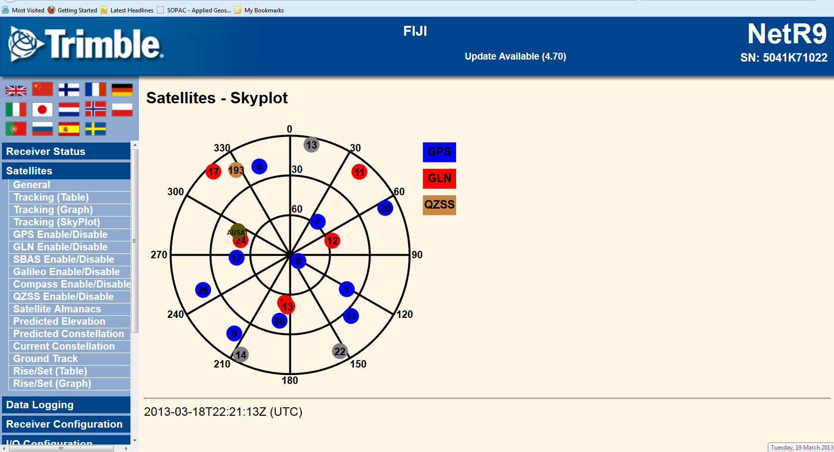
GNSS Station (CORS) - Lautoka
Established in November 2002; Supported by Lautoka Lands Department
ftp://ftp.ga.gov.au/geodesy-outgoing/gnss/data/
http://auscors.ga.gov.au/status/
http://www.ga.gov.au/scientific-topics/positioning-navigation/geodesy/gnss-networks

Slide 16
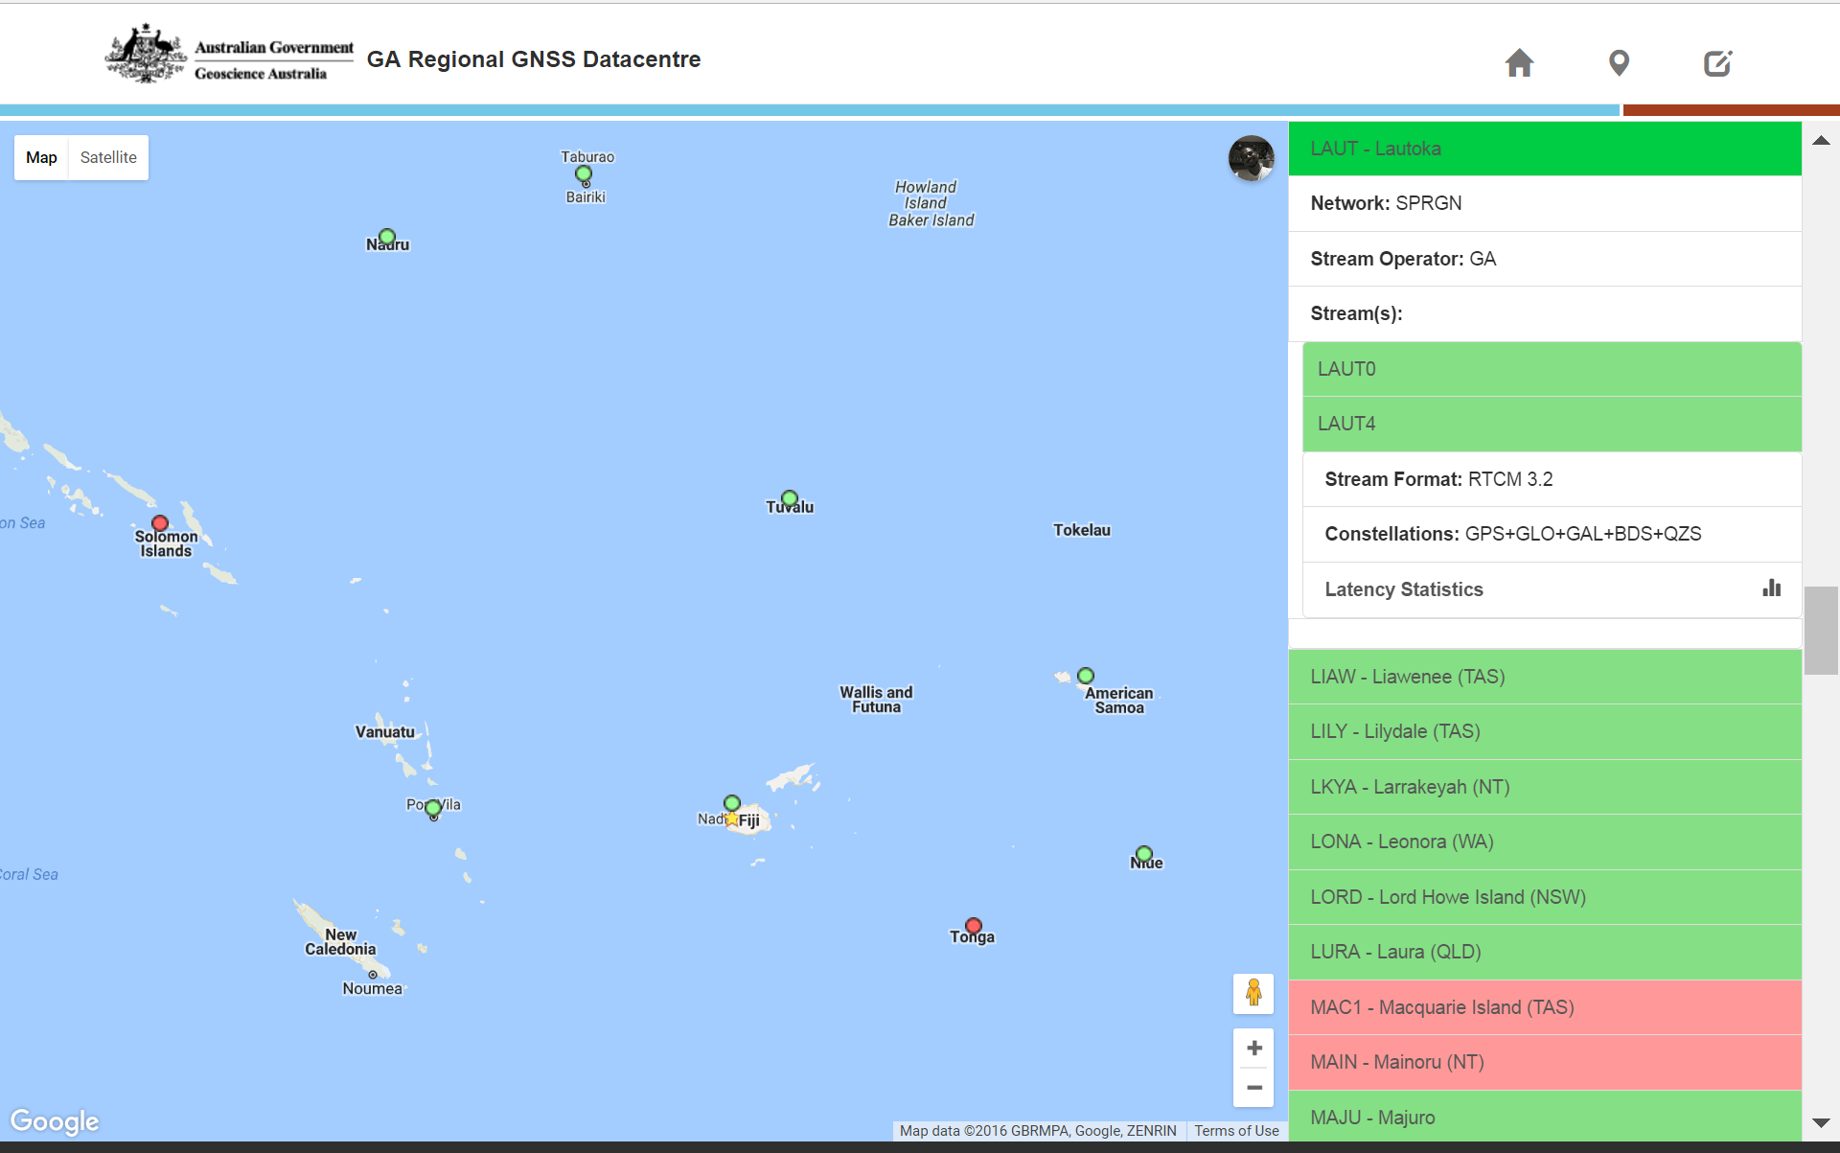
http://www.auscors.ga.gov.au/status/

Slide 17
GNSS Station (CORS) - Lautoka
IGS Network
http://www.igs.org/network http://www.igs.org/igsnetwork/network_by_site.php?site=laut

Slide 18
13 sites across the pacific
1 x permanent tide gauge at each, measuring local sea level
1 x Constant GNSS station at each, measuring local earth movement in an absolute coordinate system
Regular levelling survey between the tide gauge and CGNSS station allow absolute determination of the vertical height of the tide gauges that measure sea level

Slide 19
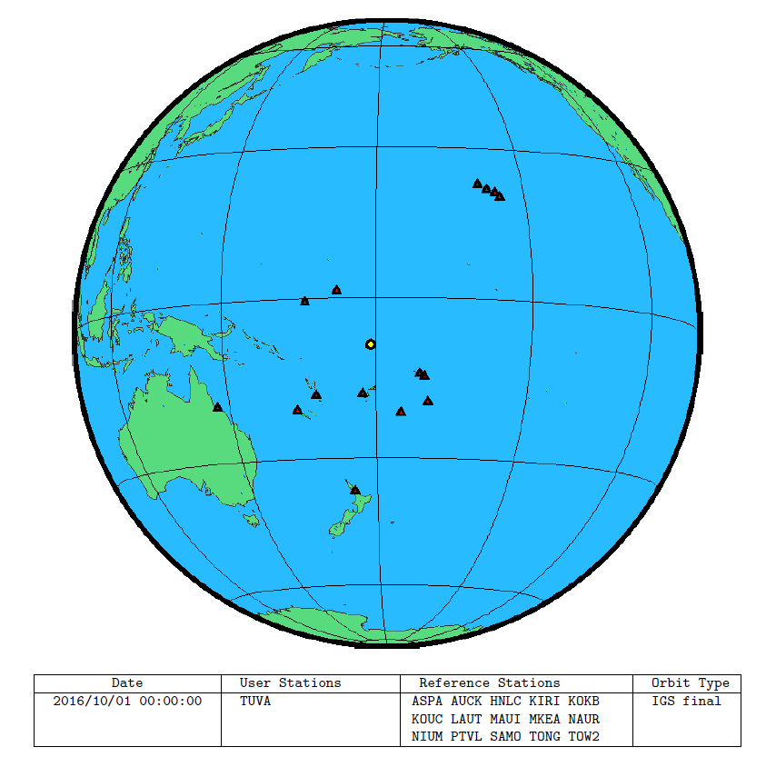
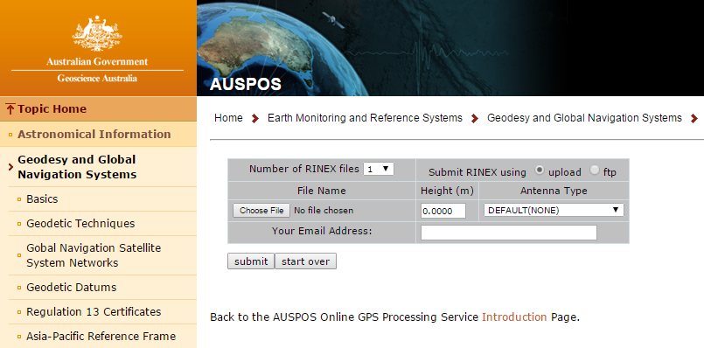
Online GNSS Solutions
AUSPOS, OPUS, PositioNZ, Canadian PPP

Slide 20
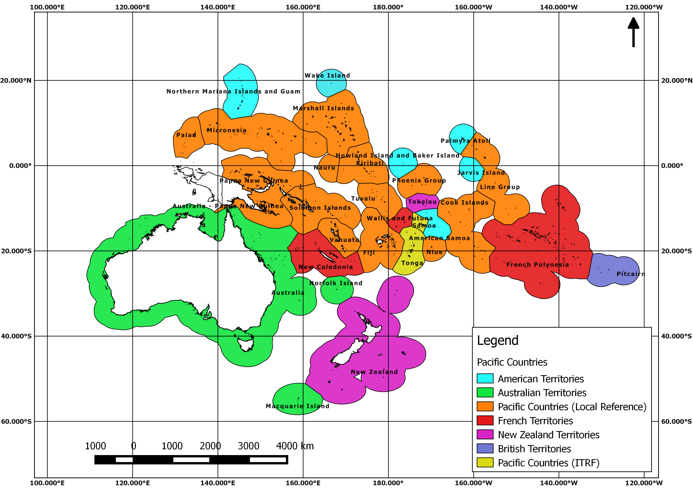
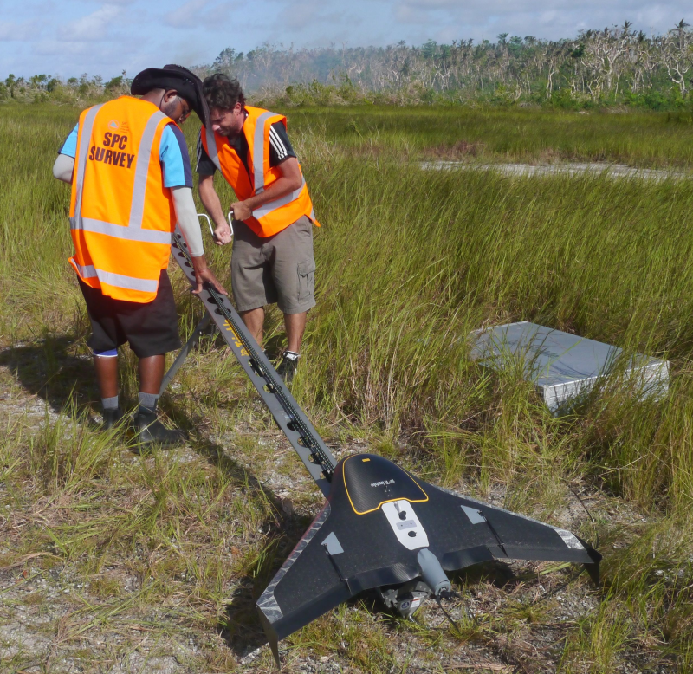
Geodetic Reference Frame - Pacific
The geodetic stations contribute to the implementation of the UN resolution on the Global Geodetic Reference Frame for sustainable development;
Recognising the importance of positioning geospatial information to address global challenges

Slide 21
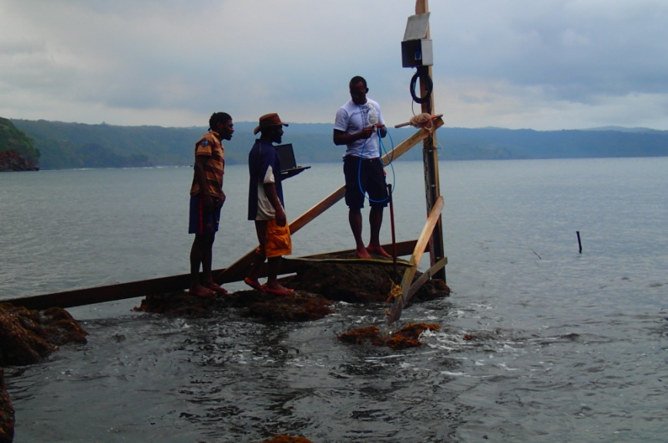
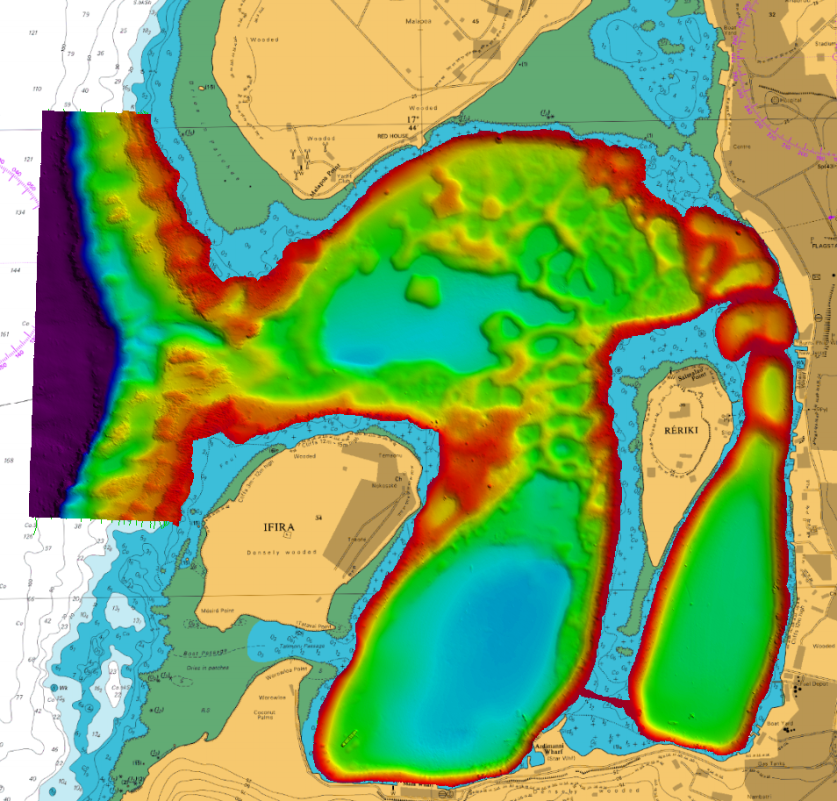
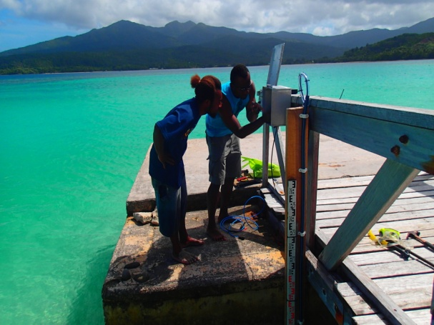
Tide Gauges & Vertical Reference Frame
Hydrographic Surveys/Charts - UKHO

Slide 22
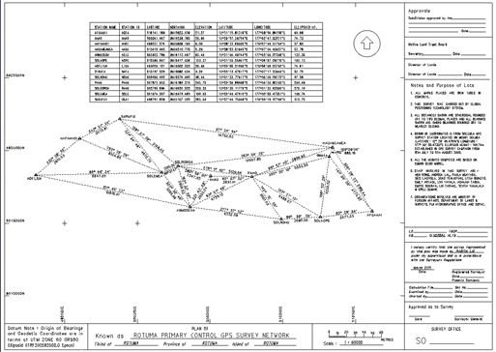
Local Vertical Reference Frame
A local Constant GNSS site can provide the opportunity to preform accurate baseline measurements when the user only has 1 geodetic quality GNSS receiver available.
Having observations from a CORS available will allow local Lands & Survey departments to update their current network of survey control from a Local coordinate system onto the International Terrestrial Reference Frame [currently ITRF2008].

Slide 23
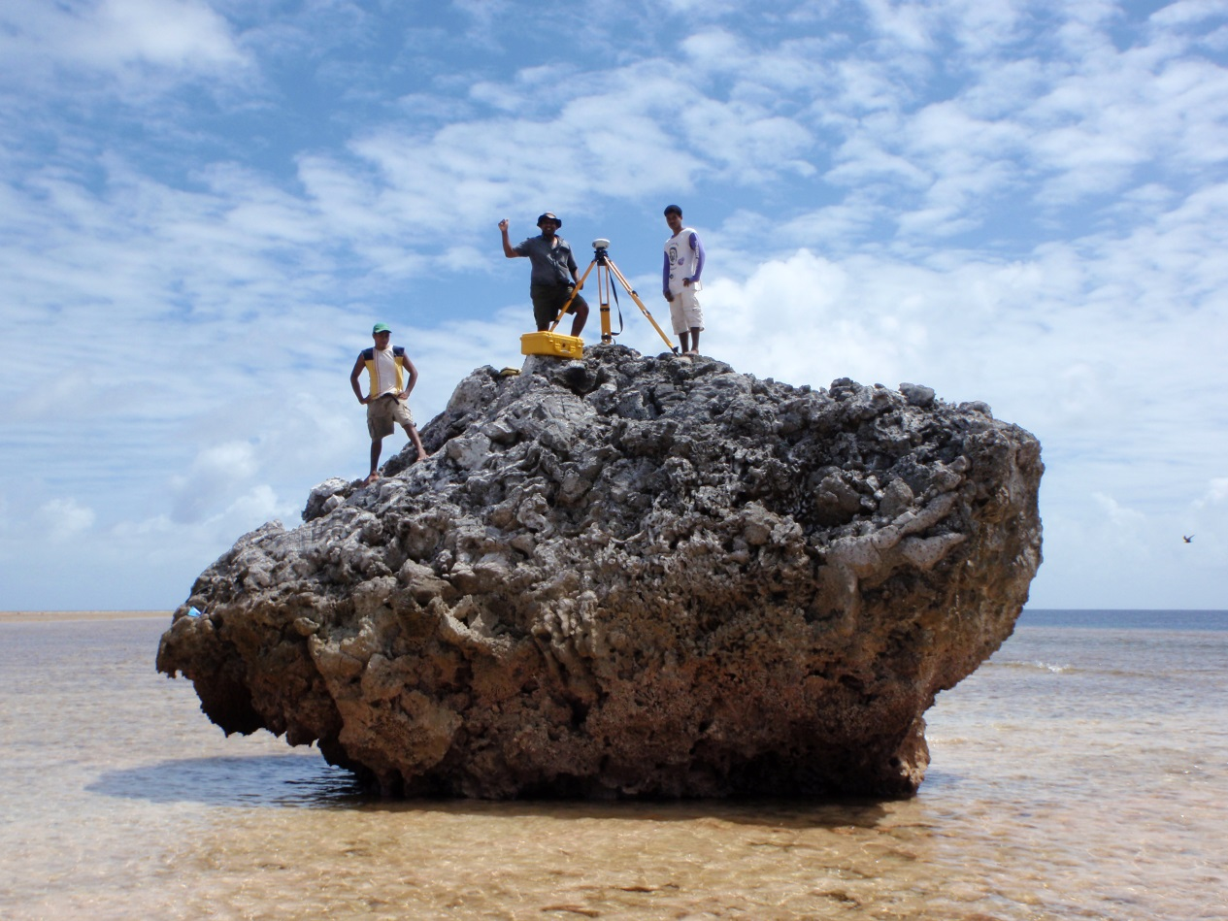
Vinaka Vaka Levu
‟Geodetic Infrastructure underpins ALL Infrastructure”

