Slide 1
A QGIS Cookbook for the
Pacific GIS Community

Slide 2
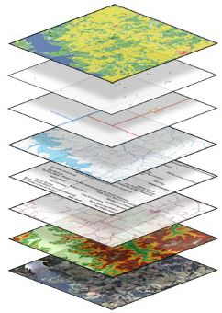
Free & open source
Easy to use
Self taught
Community support
Notes:
Why qgis?

Slide 3
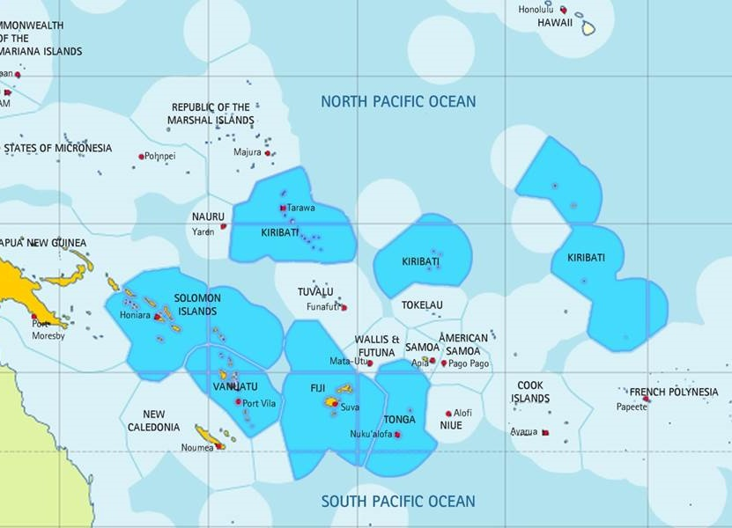
Relatable: Local Scenarios
Tailored to users’ background
QGIS & ArcGIS Dualism
Notes:
The QBOOK approach

Slide 4
How does it work

Slide 5
7 Admins
90 +Users

Slide 6
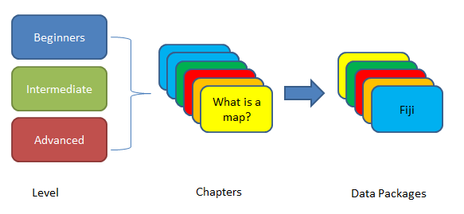
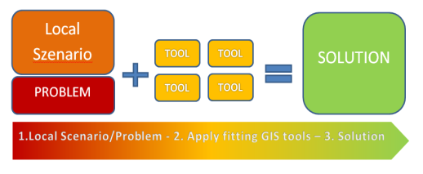
Tutorial based
Scenario based
Notes:
What and why moodle?

Slide 7
Beginners
Intermediate
What is a map?
What is a map?
Fiji
Advanced
Level
Chapters
Data Packages
Notes:
Skill based learning

Slide 8
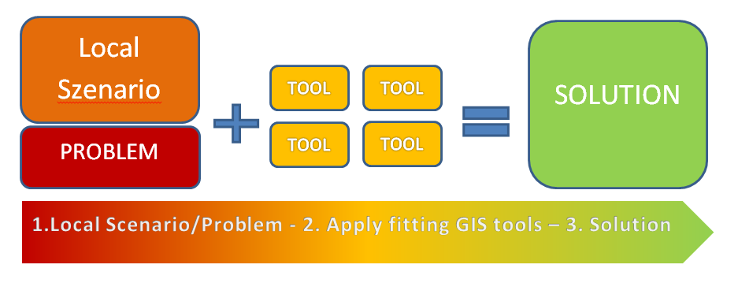
Scenario
Method
Method
Notes:
Scenario based learning
Can become market place for solutions
We want your case studies

Slide 9
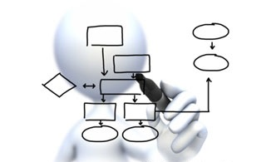
User Friendly
Feedback
Quiz
Survey
Forums Chatrooms
Links
Communication
Collaboration
Evaluation
Tailor & Adjust
Notes:
To moodle – process of enjoyable tinkering that can lead to growing knowledge, insight and creativity.
Basic Principles:
Storage (Database, Files, Webpage, links)
Communication (Forum, Chatroom, Messaging, Link to existing resources)
Collaboration (Stakeholder Participation)
Evaluate (Quiz, Survey, Feedback)

Slide 10
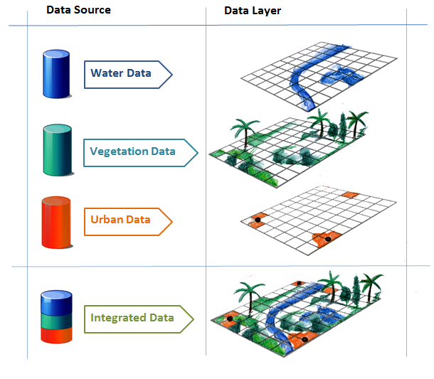
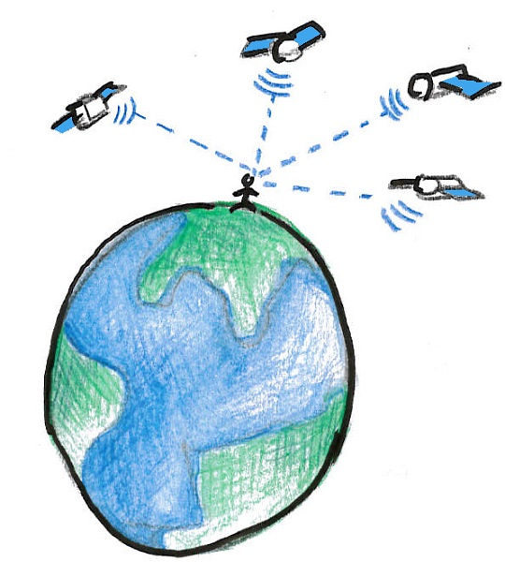

Slide 11
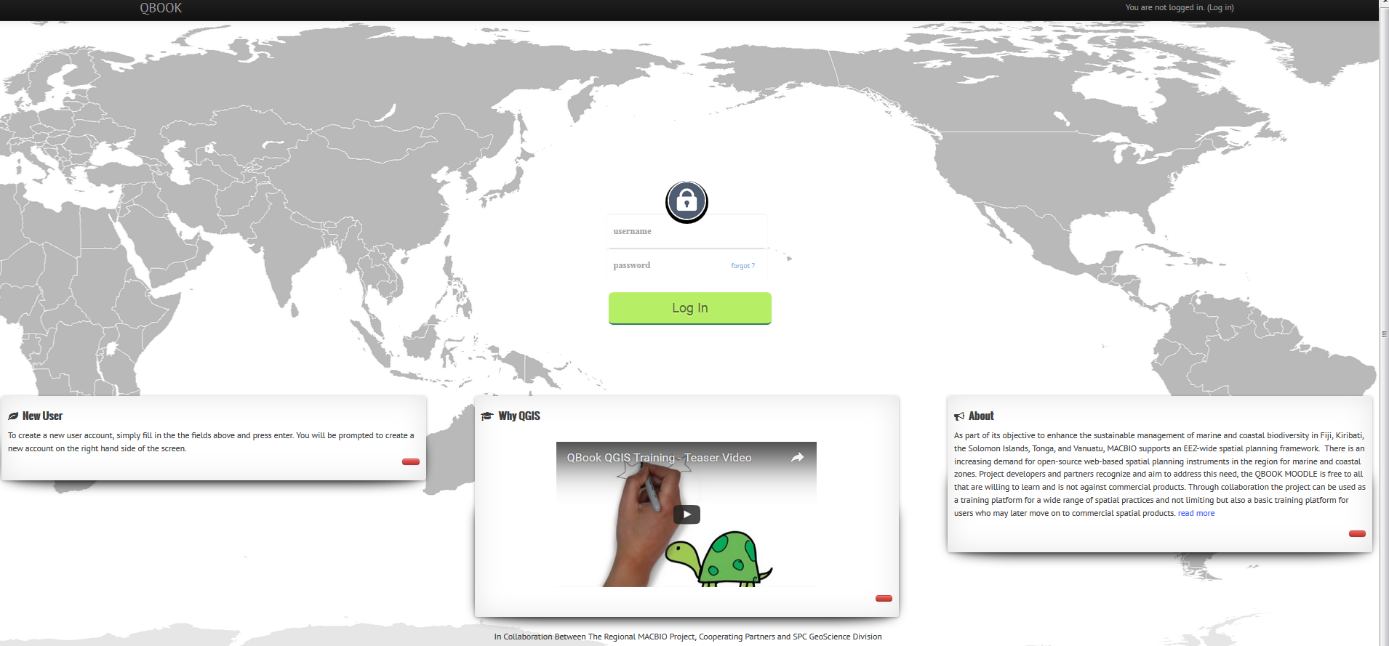
www.pacgeo.org/static/edu/

