Slide 1
Land Cover Change Detection
in Fiji
Through Collect Earth
Ministry of Forests

Slide 3
Rule Set for Fiji
Hierarchy Role
1. Settlement
2. Cropland
3. Forest
4. Grassland
5. Wetland
Allocated single land class for multi-class plot using hierarchy rule set:
If > 10% of cover is settlement then plot is settlement: 3 plots
If > 20% of cover is cropland then plot is cropland: 5 plots
If > 30% of cover is forest then plot is forest: 8 plots
If > 30% of cover is grassland then plot is grassland: 8 plots
If > 30% of cover is wetland then plot is wetland: 8 plots

Slide 4
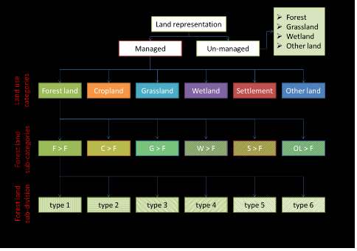
Regional Land Use Classification System
COLLECT EARTH RESULT IN FIJI
Fiji is covered with 50% of forest
5,000 sample plots covering forest land are established, submitted and analysed
Each plot covers one (1) hectare a
statistical sound data basis

Slide 5
Sampling Structure

Slide 6
Examples – Images of the Submitted two(2) land use category: Left-Forest (Natural Forest). Below- Cropland (Rice Farming)

Slide 7
Saiku Analysis Result
43% forested covered.
9% of cropland covered.
25% of grassland covered.
Note: This figure was collected from Vanualevu and few Outer Islands which was done during the submitted of data.

Slide 8
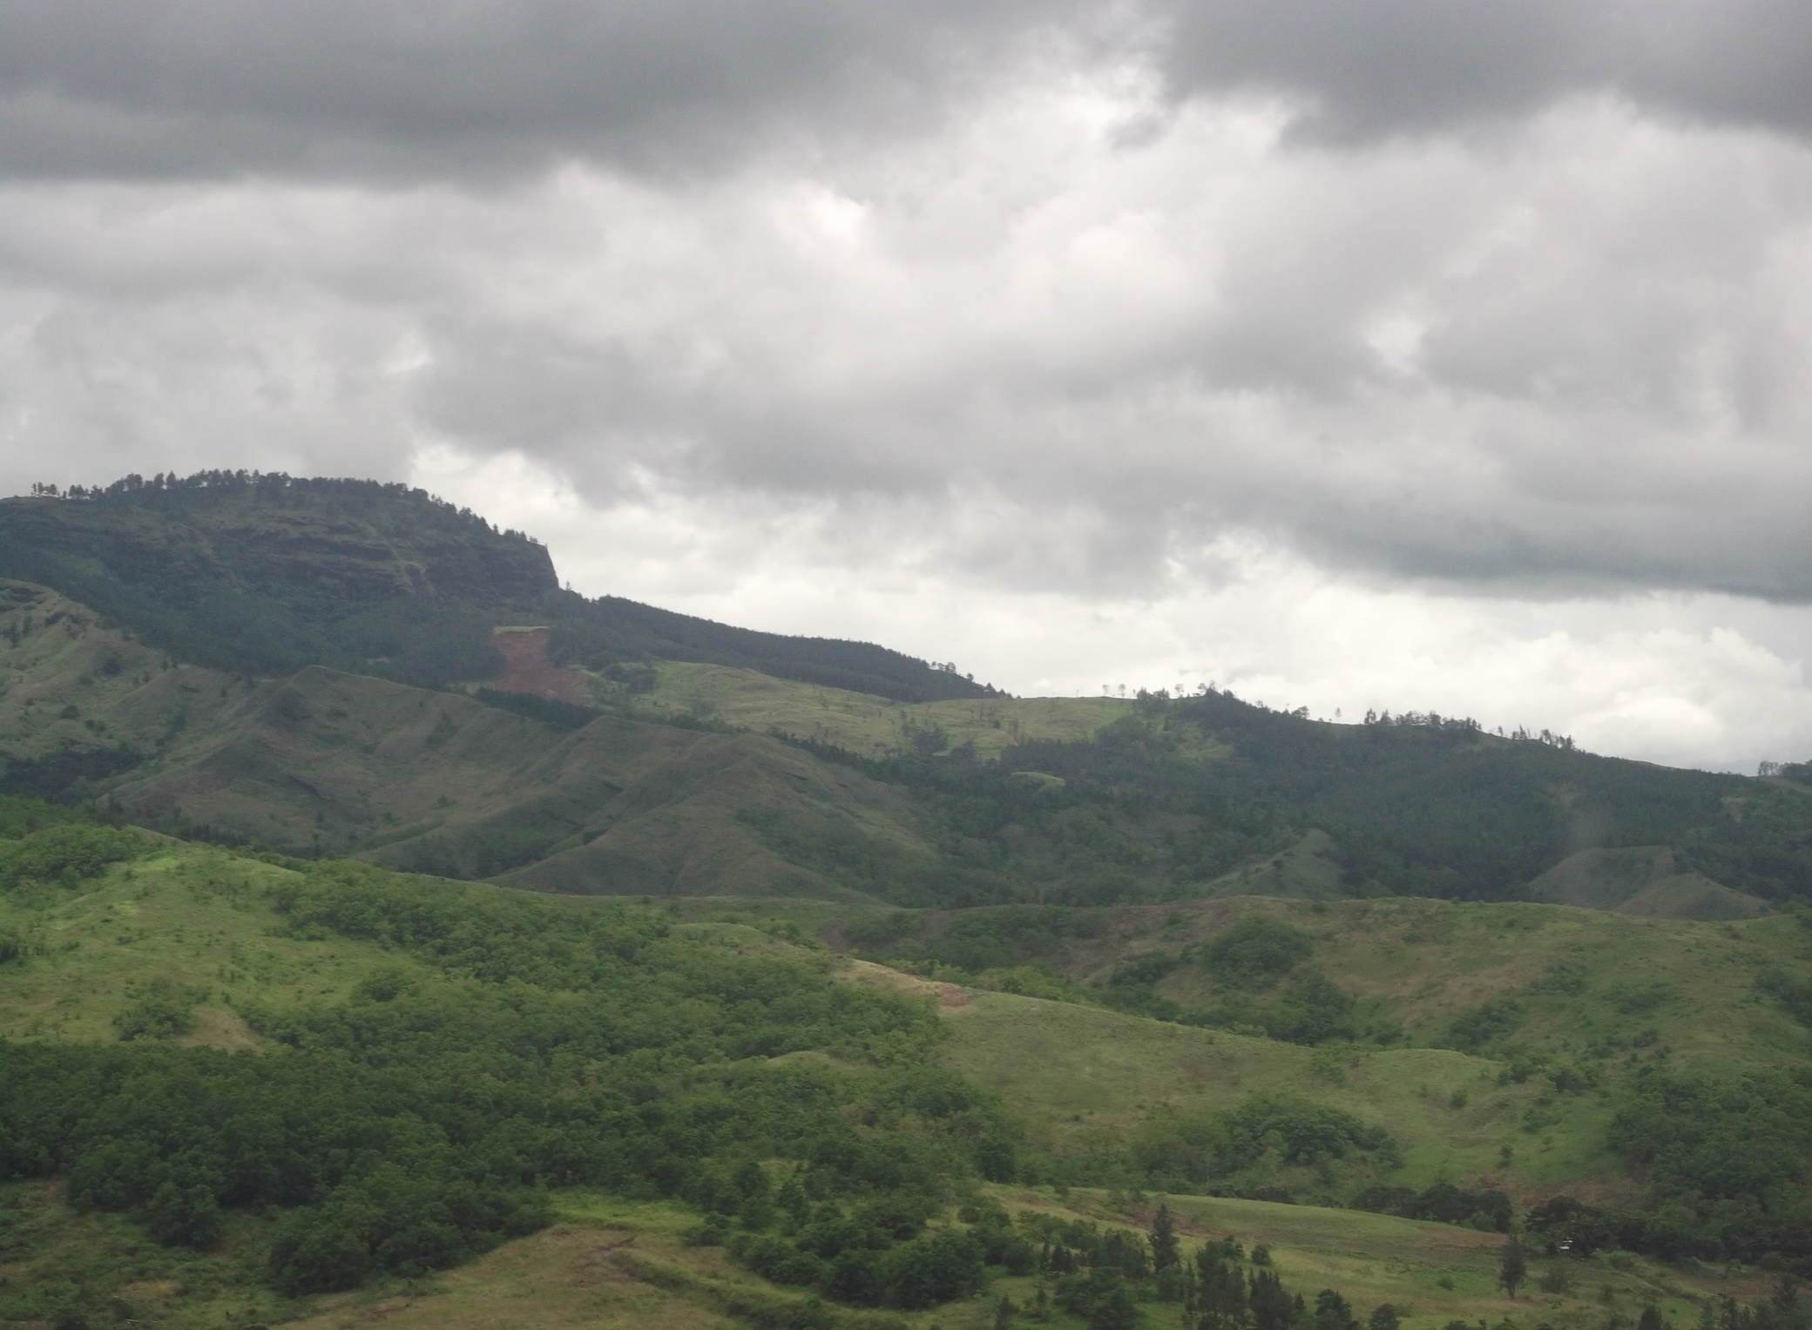
Vinaka

