Slide 1


Using Hansen's Global Forest Cover Change Datasets to Assess Forest Loss in Terrestrial Protected Areas
A Case Study of the Philippines
Armando Apan (Prof.), L.A. Suarez, Tek Maraseni & Allan Castillo
University of Southern Queensland
Toowoomba, Queensland 4350 AUSTRALIA
apana@usq.edu.au

Slide 2
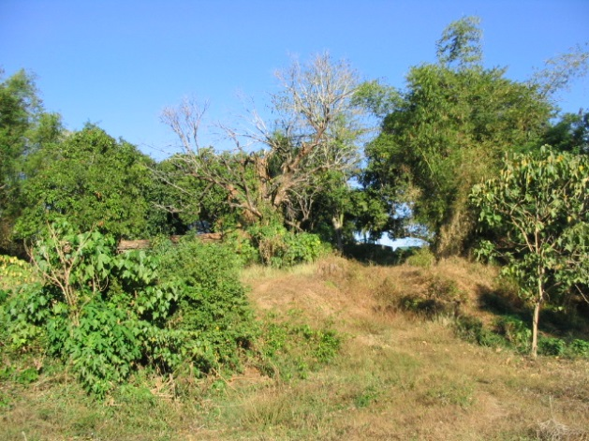
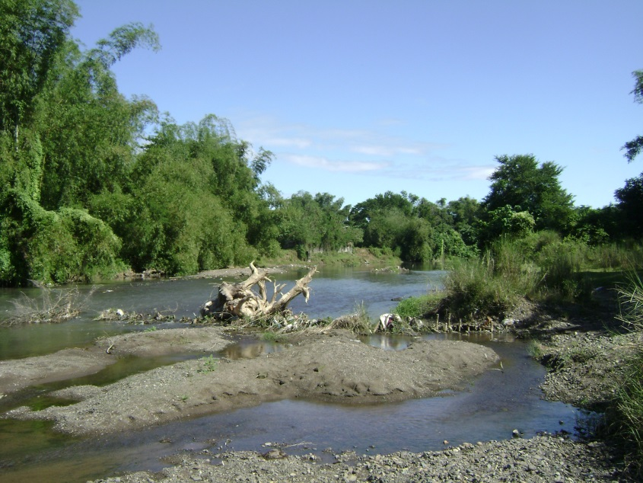
Outline of Presentation
Introduction
Methods
  Study Area
  Data Acquisition
  Analysis of forest loss
  Logistic regression analysis
Results and Discussion
  Rate and extent of forest loss
  Logistic regression models
Conclusions
p. 2/24

Slide 3
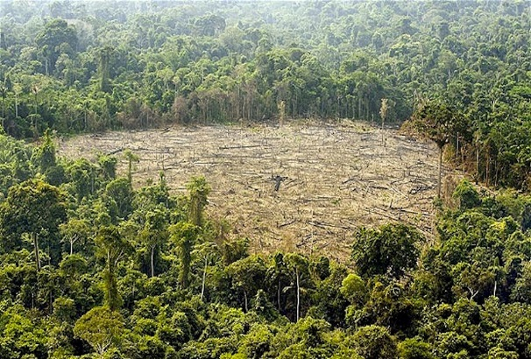
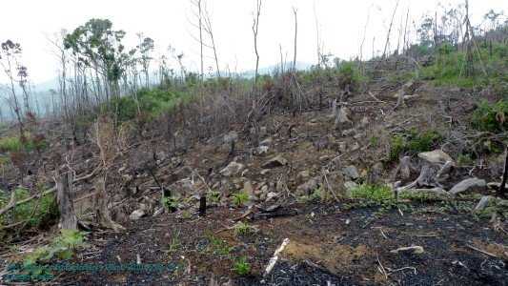
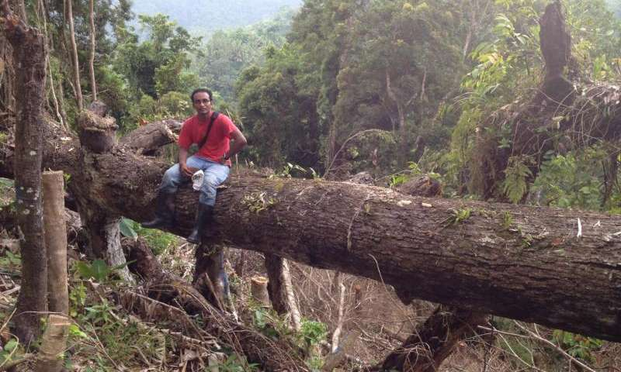
… Introduction
Deforestation in the Philippines has been rampant and rapid.
Forest cover has declined from 17.1 M ha (1937) to 8.0 M ha (2015)
Protected Areas are effective in reducing deforestation; some are not.
Need to understand the drivers of deforestation in protected areas.
Forests 4 Climate
JLR, 2010
p. 3/24
Sharif Mukul, 2016

Slide 4
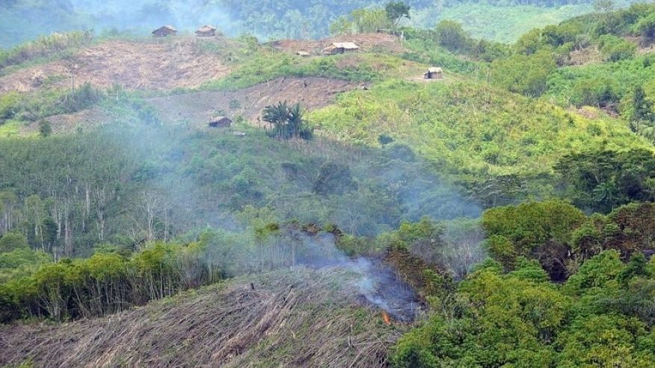
… Introduction
This study assessed:
  forest cover loss in all terrestrial protected areas (PAs) of the entire Philippines
  covering 198 PAs with a total area of 4.68 million ha
AFP/File, 2013
p. 4/24

Slide 5
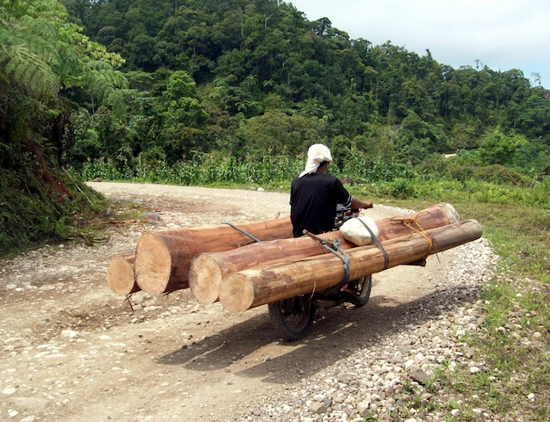
… Introduction
Objectives:
to compare the rate and extent of forest loss:
  entire country vs. terrestrial protected areas vs. buffer areas
Philippine EnviroNews
  to determine the significance and magnitude of the relationships between forest cover and selected spatially explicit variables.
p. 5/24

Slide 6
Methods
Study Area
covers 298,170 km²
tropical climate
101 million people (2016)
one of world’s top biodiversity-rich countries
p. 6/24

Slide 7

… Methods
Data Acquisition
1. “Global Forest Change” map (Hansen et al., 2013)
  derived from Landsat imagery (30m)
  analysis performed using Google Earth Engine (cloud platform)
  Trees are defined as “all vegetation taller than 5m in height”
  forest loss: “a stand-replacement disturbance or the complete removal of tree cover canopy.”
p. 7/24

Slide 8
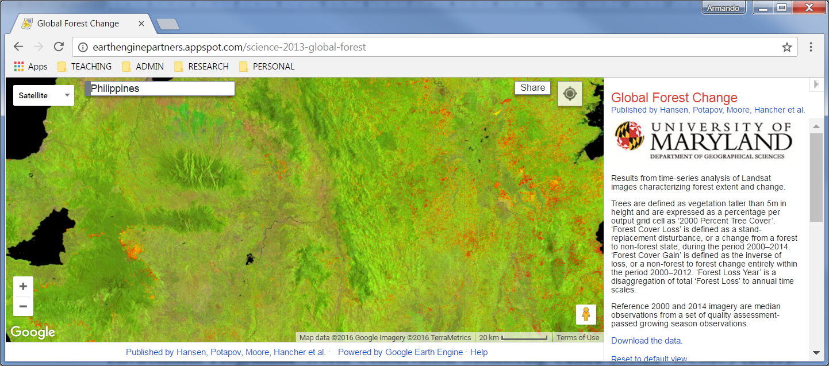
… Methods
Data Acquisition
used “time-series spectral metrics” as key algorithm
output layers: tree cover (2000); forest loss and gain (2000-2012)
reported accuracy of 99.6%
free download
p. 8/24

Slide 9
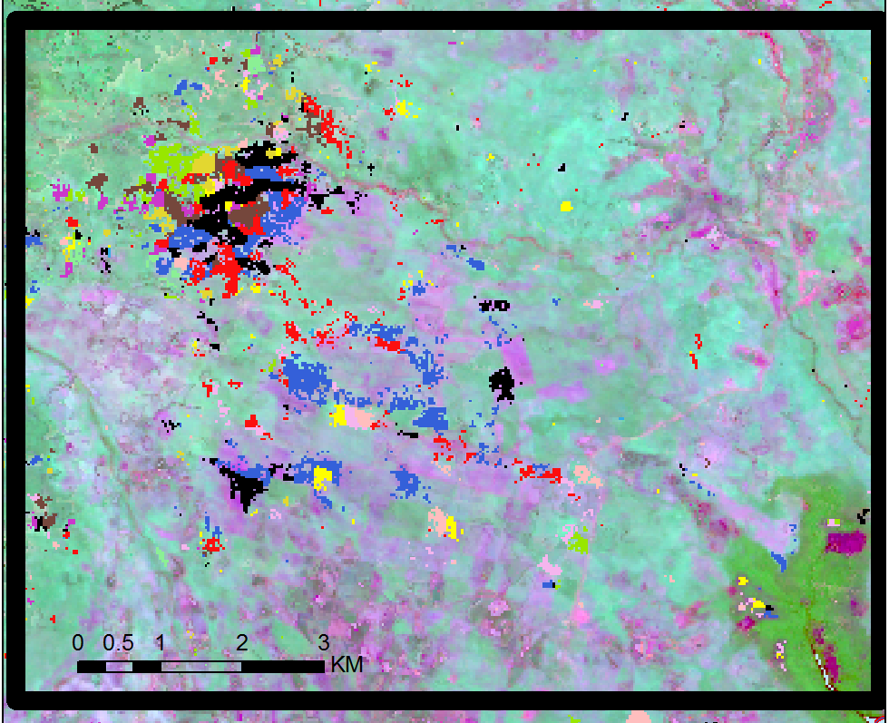

… Methods
  Yearly Forest Cover Loss (2001-2012)
p. 9/24

Slide 10
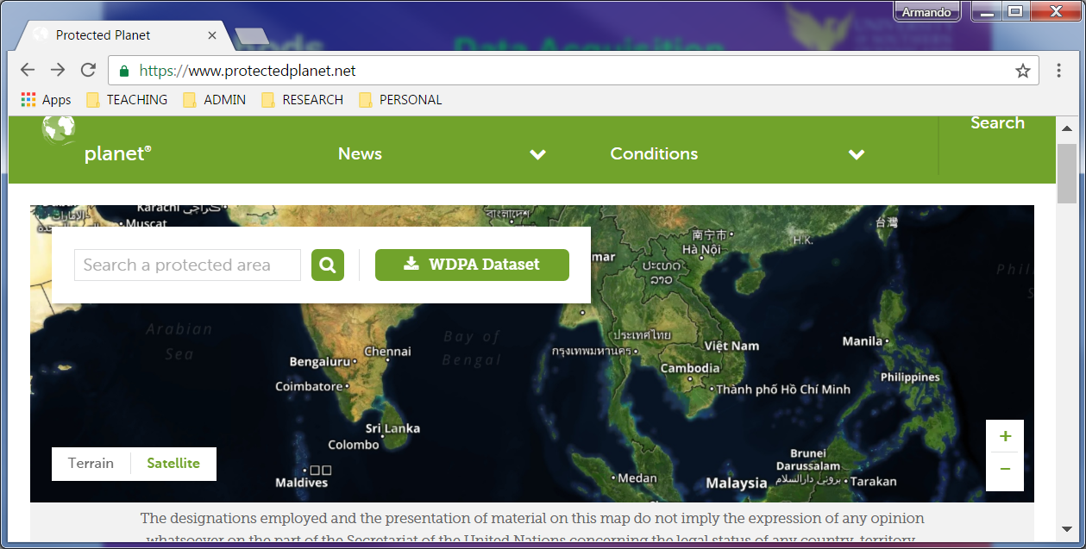
… Methods
… Data Acquisition
“World Database on Protected Areas” (UNEP-WCMC, 2015)
p. 10/24

Slide 11
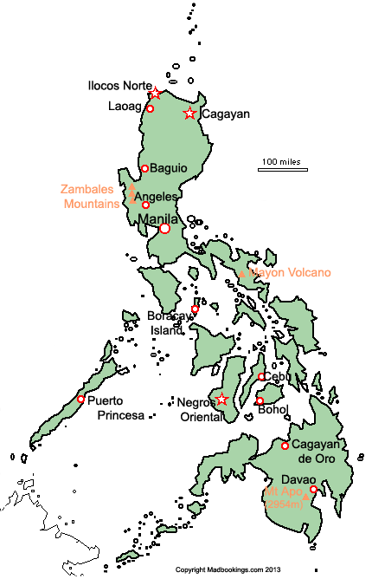
… Methods
… Data Acquisition
Land use (ISCGM, 2011)
Population Density (WorldPop, 2015)
Digital Elevation Model (SRTM)
Land Cover (NAMRIA, 2013)
Road (OpenStreetMap, 2015)
River (Lehner et al., 2006)
p. 11/24

Slide 12
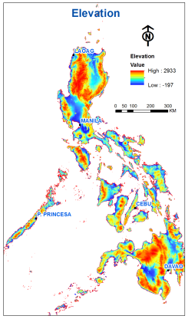
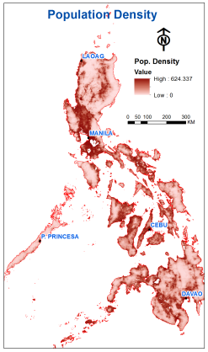
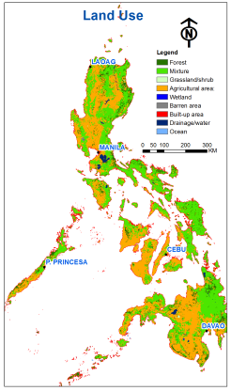
… Methods
p. 12/24

Slide 13
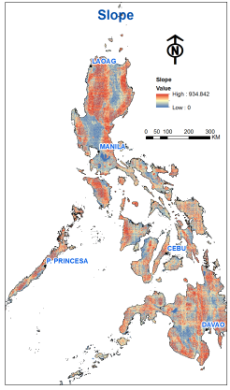
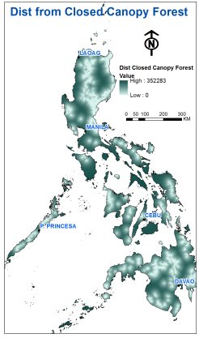
… Methods
p. 13/24

Slide 14
… Methods
Data Processing & Analysis
Assess accuracy of forest cover map (2012)
Extract forest areas with >10% canopy cover
Intersect with “Forest Cover Loss” maps
Intersect with “Protected Areas” map
p. 14/24

Slide 15

… Methods
Data Processing & Analysis
Logistic Regression
estimated the probability of deforestation occurrence
modelled the relationship between:
    independent variables (11 maps)
    dependent variable (“no forest loss”, “forest loss”)
used Spearman's rho to assess any multi-collinearity issues
p. 15/24

Slide 16
Results and Discussion
Overall Accuracy of Hansen dataset (2012) : 93.1%
Rate of forest loss in protected areas (vs. entire Philippines) is marginally lower
But it is equivalent to a total of 3,738 ha over 12 years
p. 16/24

Slide 17
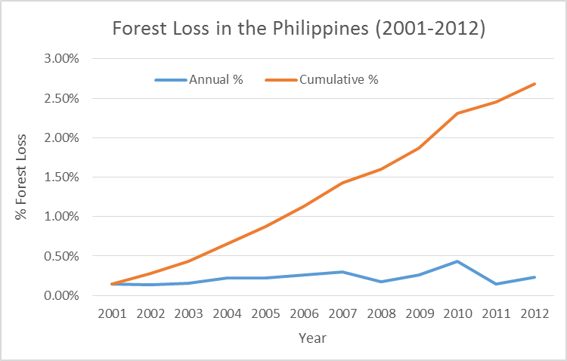
… Results and Discussion
Annual and cumulative forest loss in the Philippines
p. 17/24

Slide 18
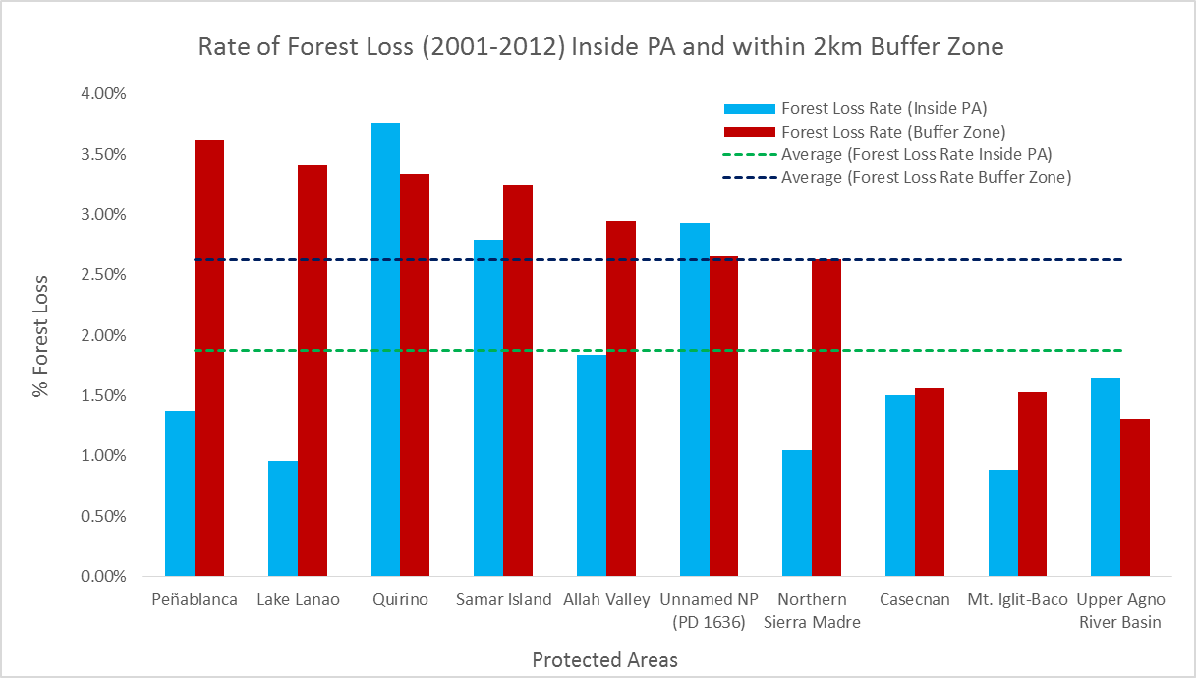
… Results and Discussion
Inside PAs forest loss rate was lower (1.87%) vs. 2-km buffer (2.63%).
Forest loss in buffer zones is 1.4 times (40.6%) higher than the PAs.
p. 18/24

Slide 19
… Results and Discussion
But some PAs have phenomenal forest loss rates (e.g. 21%)
p. 19/24

Slide 20
… Results and Discussion
Some areas with vast areas of forest loss (e.g. 48,583 ha)
p. 20/24

Slide 21
… Results and Discussion
Spatial predictor variables have no or weak relationships with forest cover loss.
p. 21/24

Slide 22
… Results and Discussion
Model fit and classification accuracies were not good, with only 15% of the variance explained.
Only 15% improvement
p. 22/24

Slide 23

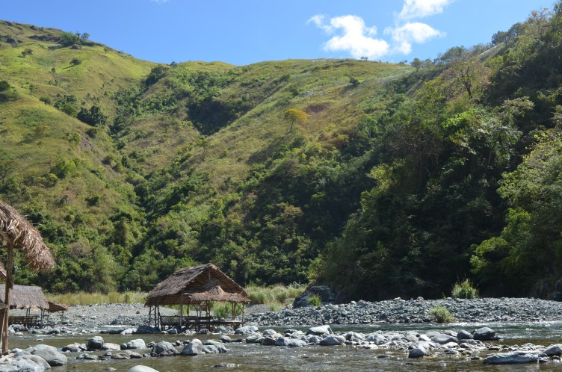
Conclusions
Global Forest Cover Change datasets: useful for the country-wide assessment of forest loss.
Protected areas are generally effective in reducing deforestation.
However, some areas indicate the ineffectiveness of PAs.
Selected variables are not reliable for predictive modelling of forest loss.
p. 23/24

Slide 24
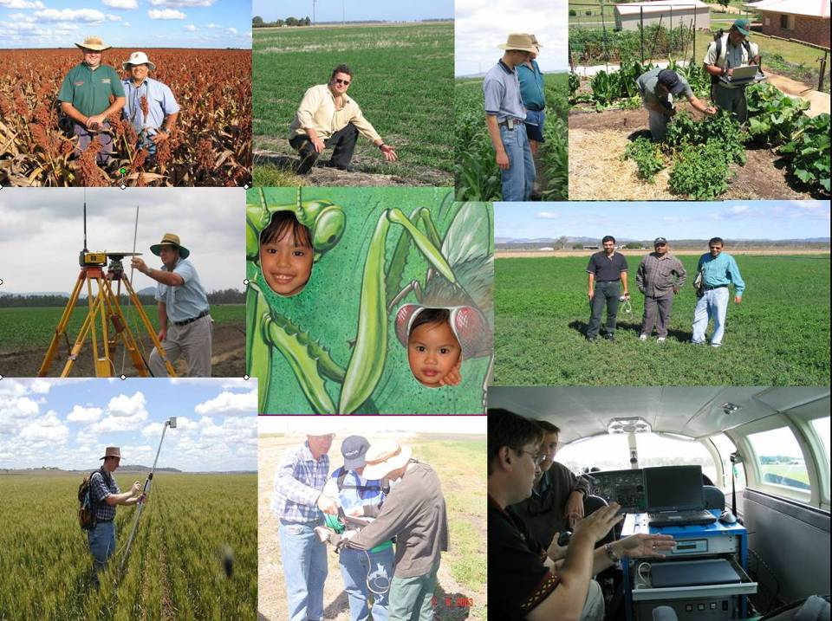
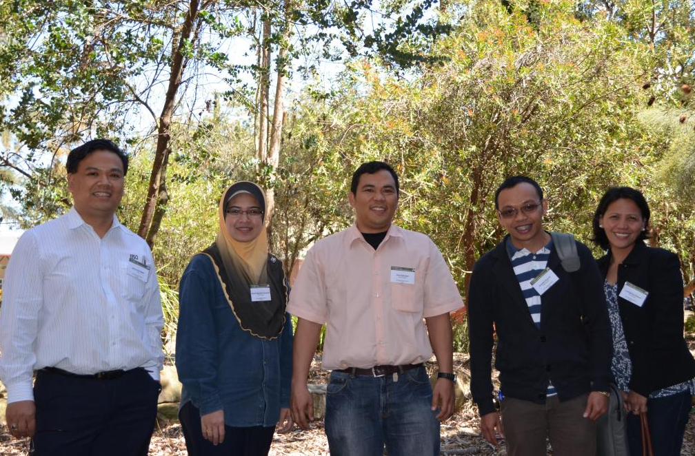
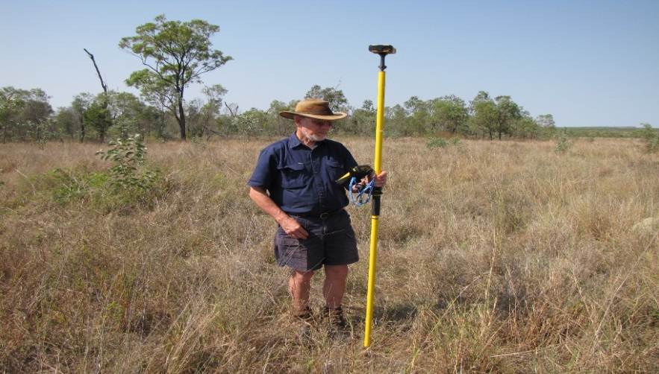

THANK YOU!

