Slide 1
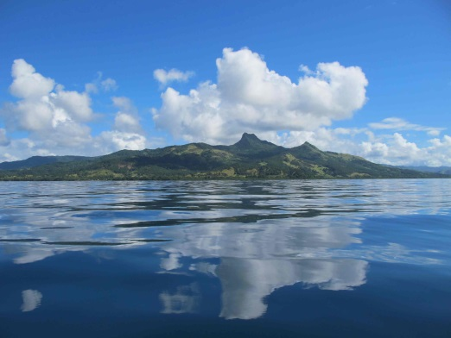
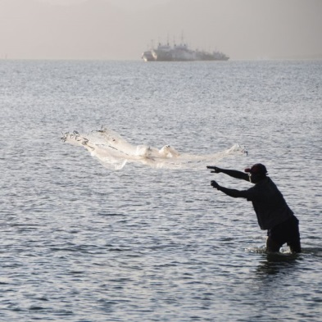
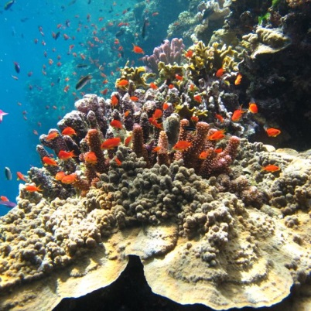
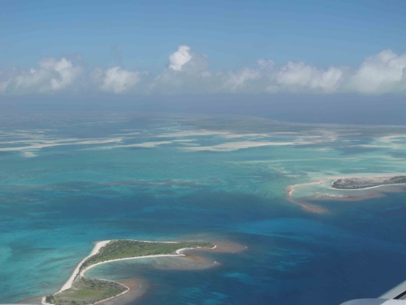
MACBIO
Marine and Coastal Biodiversity Management
in Pacific Island Countries

Slide 2
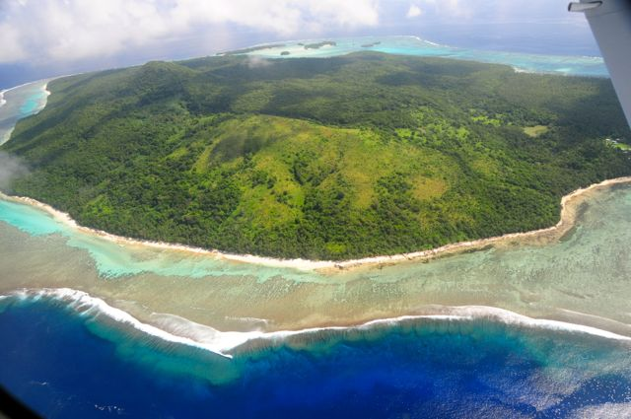
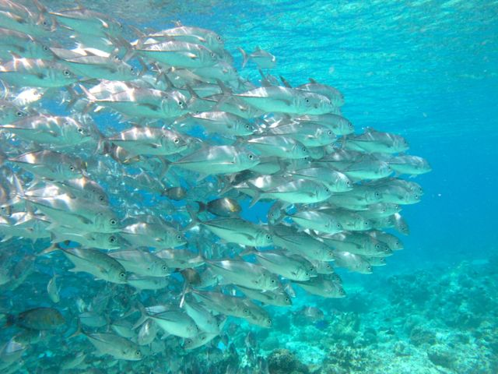
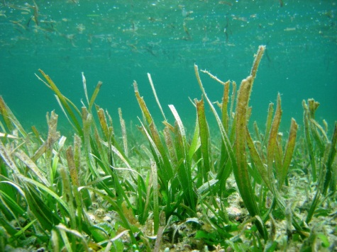
Python Geoprocessing Modules
arcpy raster/vector/crs processing module
ArcGIS (closed source software)
gdal/ogr/osr raster/vector/crs processing modules
QGIS (free open source software)
Notes:
Marine and Coastal Biodiversity Management in Pacific Island Countries and Atolls

Slide 3
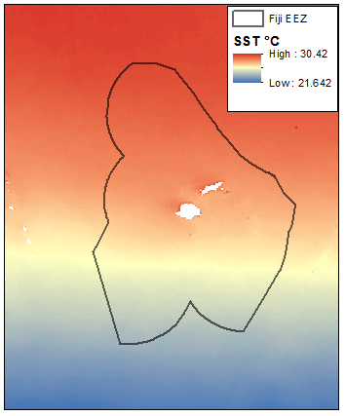
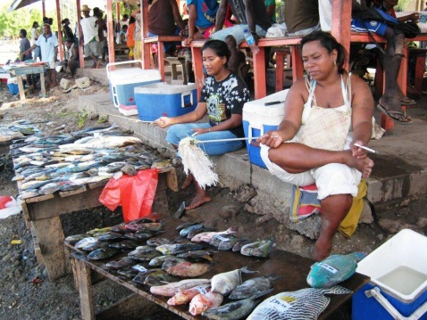
Task: Clip Raster with Polygon
EEZ: http://www.marineregions.org/
SST: http://www.oracle.ugent.be/

Slide 4
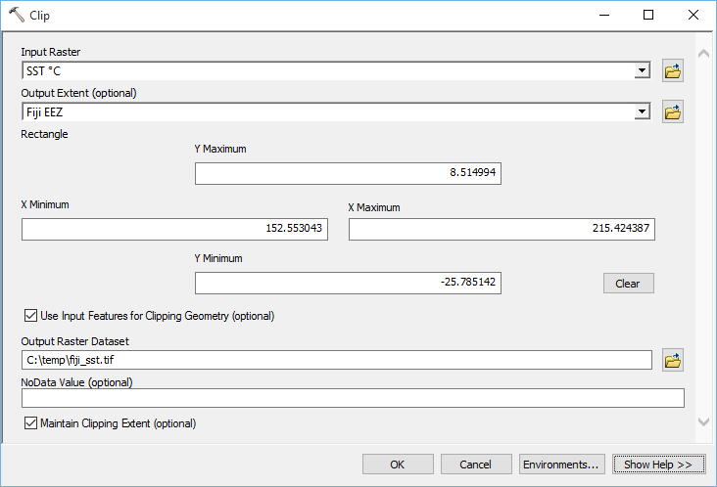
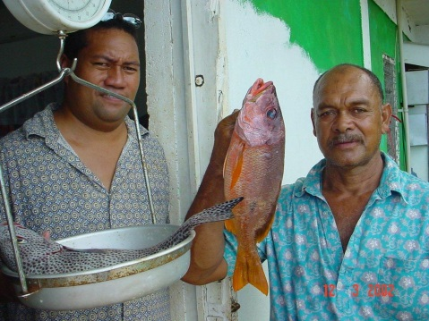
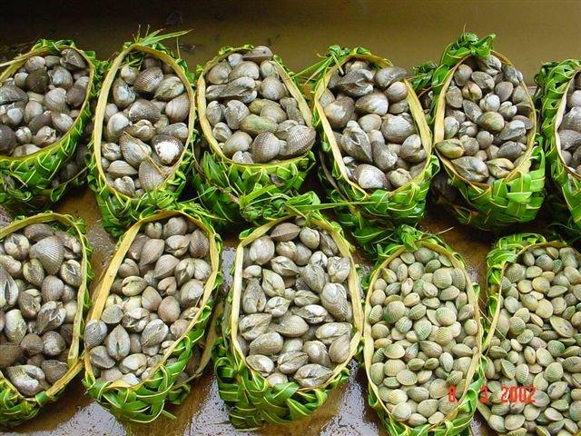
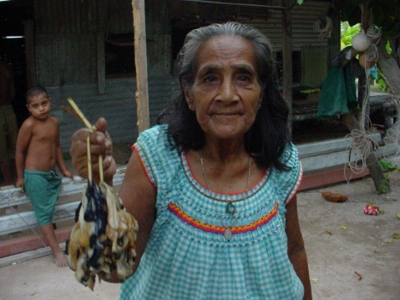
Task: Clip Raster with Polygon [ArcMap GUI]

Slide 5
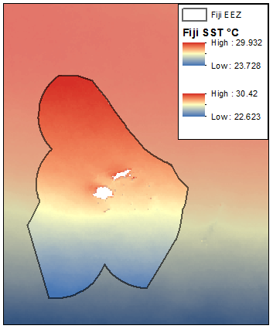
Output from ArcMap GUI

Slide 6
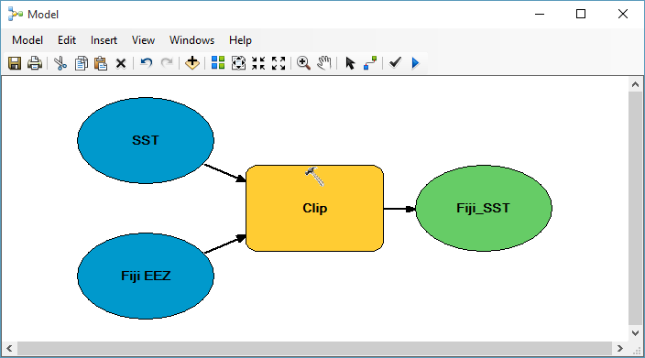
ArcGIS Model Builder: design process

Slide 7
Output from ArcGIS Model Builder

Slide 8
ArcGIS Model Builder: export python script

Slide 9
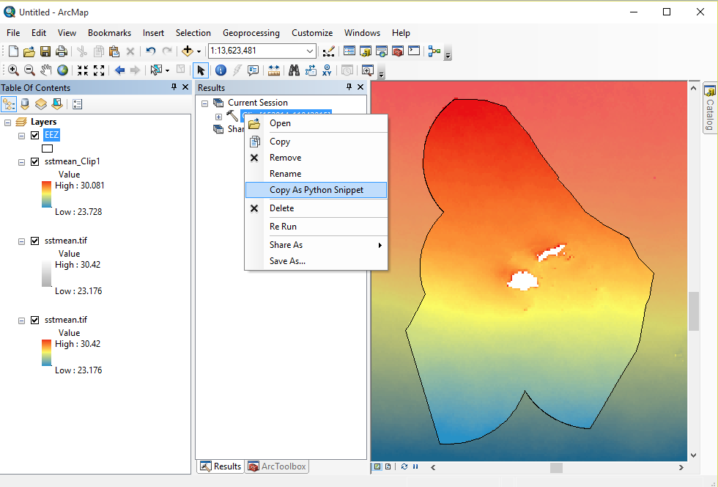
ArcGIS Model Builder: export python script

Slide 10
Python script from ArcGIS Model Builder
Import Module
# Import arcpy module
import arcpy
# Local variables:
inFiji_EEZ = r"C:\temp\FIJI_EEZ.shp“
inSST = r"C:\temp\SST.tif"
outFiji_SST = r"C:\temp\FIJI_SST.tif"
# Process: Clip
arcpy.Clip_management(SST, “#", Fiji_SST, Fiji_EEZ, #", "ClippingGeometry")
Import module
Import module
Assign input/output
Process Data

Slide 11
Output from python script

Slide 12
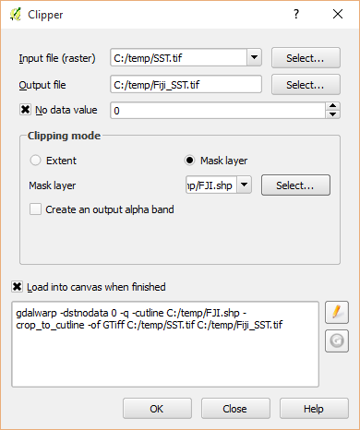
Task: Clip Raster with Polygon [QGIS GUI]

Slide 13
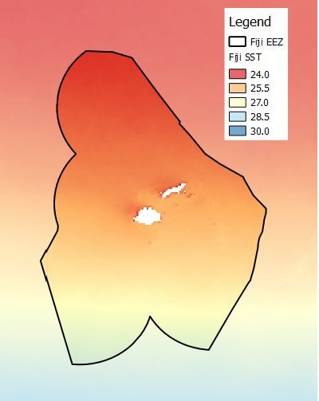
Output from QGIS GUI

Slide 14
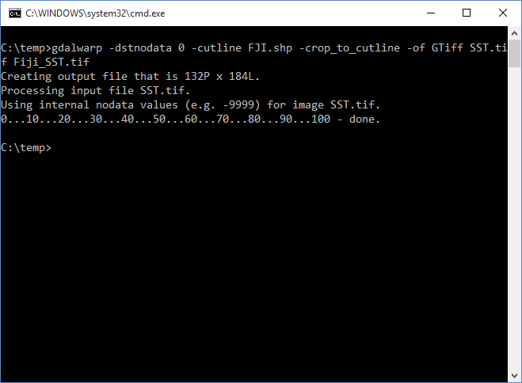
Clip Raster with Polygon [QGIS]
Console command generated by QGIS

Slide 15
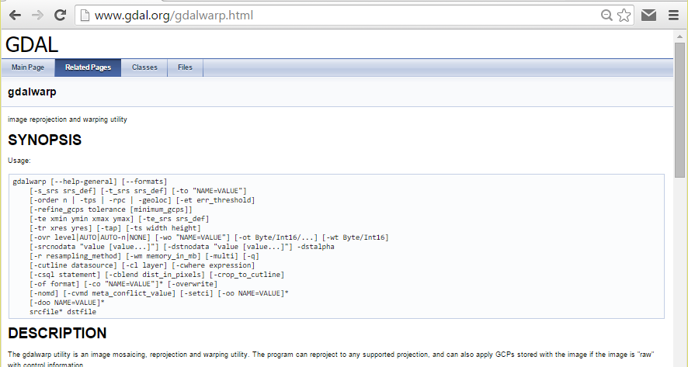
Clip Raster with Polygon [GDAL]
gdalwarp.exe
-dstnodata 0
-q
-cutline C:/temp/EEZs/FJI.shp
-crop_to_cutline
-of GTiff
C:/temp/SST.tif
C:/temp/EEZs/FJI_SST.tif
Call executable program
Assign nodata value
Quiet (no progress reports)
Assign clip geometry
Write nodata outside clip
Assign output format
Assign input file
Assign output file

Slide 16
Python script from GDAL Command
Import Module
# Import arcpy module
import os
# Local variables:
inFiji_EEZ = r"C:\temp\FIJI_EEZ.shp“
inSST = r"C:\temp\SST.tif"
outFiji_SST = r"C:\temp\FIJI_SST.tif"
# Process: Clip
command = ['gdalwarp',
'-dstnodata 0',
'-cutline',
inFiji_EEZ
'-crop_to_cutline',
'-of GTiff',
inSST,
outFiji_SST]
os.system(' '.join(command))
Import module
Import module
Assign input/output
Process Data

Slide 17
Output from command line

Slide 18
Automation of arcpy using python script
Import Module
# Import modules
import os
# Local variables:
shapeFolder = r"C:\temp\EEZs"
sstRaster = r"C:\temp\SST.tif“
# Set workspace
arcpy.env.workspace = shapeFolder
# Process: Clip
for ds in arcpy.ListFeatureClasses():
outRaster = ds.split(‘.')[0] + "_SST.tif"
arcpy.Clip_management(sstRaster, "#", outRaster, ds, "#", "ClippingGeometry")
Assign input
Import module
Process list of datasets
Assign output
Process Data
Execution time: 115.5 seconds

Slide 19
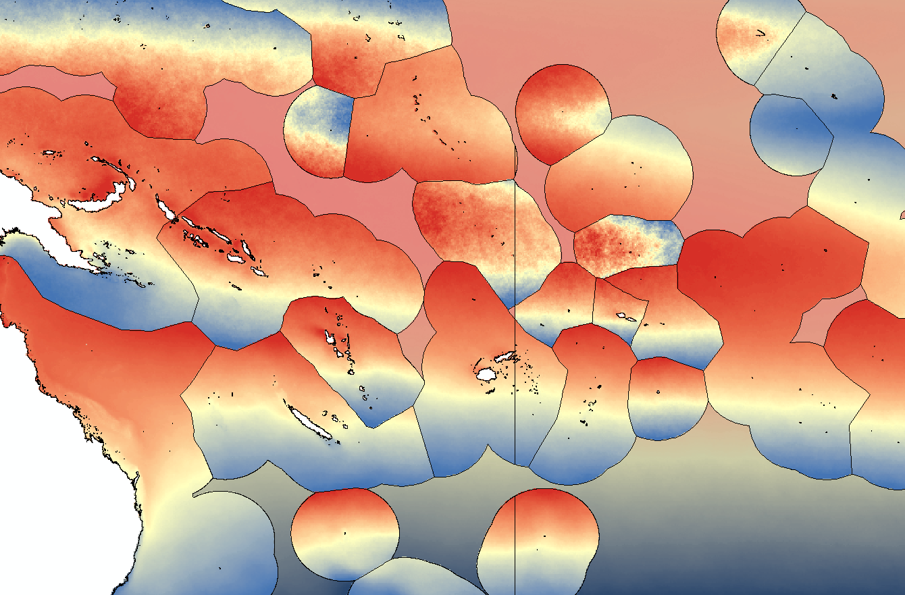
Output from automated arcpy python script

Slide 20
Automation of GDAL using python script
Import Module
# Import modules
import os
# Local variables:
shapeFolder = r"C:\temp\EEZs"
sstRaster = r"C:\temp\SST.tif“
# Process: Clip
for ds in os.listdir(shapeFolder):
if ds.endswith(‘.shp’):
outRaster = ds.split(‘.')[0] + "_SST.tif“
command = ['gdalwarp',
'-dstnodata 0',
'-cutline',
inFiji_EEZ
'-crop_to_cutline',
'-of GTiff',
inSST,
outFiji_SST]
os.system(' '.join(command))
Assign input
Import module
Process list of datasets
Assign output
Process Data
Execution time: 20.4 seconds

Slide 21
Output from automated gdal python script

Slide 22
Further visualization of spatial data
# import modules
import arcpy
import matplotlib.pyplot as plt
import numpy as np
# set local variables
shapeFolder = r"C:\temp\EEZs"
sstRaster = r"C:\temp\SST.tif"
rasterList = []
countryList = []
# process each shapefile
arcpy.env.workspace = shapeFolder
for ds in arcpy.ListFeatureClasses():
outRaster = ds.split('.')[0] + "_SST.tif"
arcpy.Clip_management(sstRaster, "#", raster, ds, "#", "ClippingGeometry")
array = arcpy.RasterToNumPyArray(outRaster)
rasterList.append(np.ma.compressed(np.ma.masked_less_equal(array, 0)))
countryList.append(ds.split('.')[0])
# create boxplots
fig, ax = plt.subplots()
ax.set_ylabel("degrees C", )
bp = plt.boxplot(rasterList)
plt.xticks(np.arange(1, len(countryList)+1), countryList, rotation='vertical')
plt.title('SST values for each country')
plt.show()
Import Modules
Import Modules
Import Modules
Assign input
Import module
Hold data in memory
Create storage in memory
Process list of datasets
Create output rasters
Hold data in memory
Write data to memory
Create boxplot object
Create y-axis label
Add data to boxplots
Add x-axis label
Add title

Slide 23
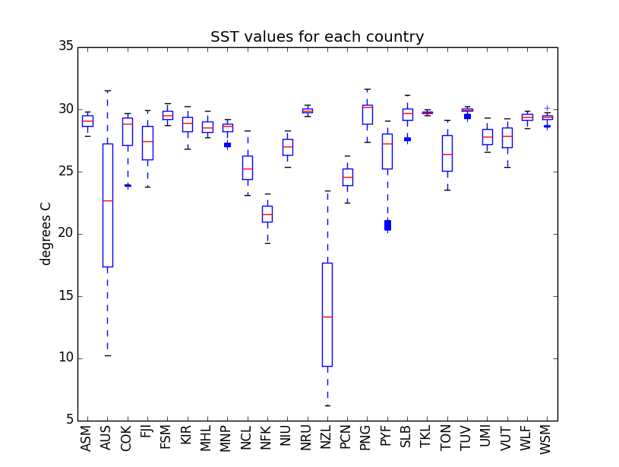
Output of python script

Slide 24
Questions or Comments?
Jonah Sullivan Marine and Coastal Biodiversity Management in Pacific Island Countries (MACBIO) Senior GIS Officer
Oceania Regional Office (ORO) | The International Union for Conservation of Nature (IUCN)
5 Ma’afu Street, Private Mail Bag, Suva, Fiji Islands.
http://www.iucn.org/oceania
Jonah.Sullivan@iucn.org

