Slide 1
- Reef to Coast - Airborne mapping of developments in the coastal region
Presented by
Veroniva Macovei and Dr. Holger Eichstaedt

Slide 2
Objectives
Efficient and fast mapping for:
Engineering, planning and preventive maintenance
Identification of climate change effects
accessing Environmental impact and monitoring pollution
Establishment of baselines
Available also under conditions like difficult accessibility, large areas required, complicated weather conditions

Slide 3
Technical solution
Multisensory airborne approach combining required sensors in one flight:
Topographic and bathymetric airborne Lidar systems with full waveform data collection
Hyperspectral sensors in different bands (reflective VNIR and SWIR, thermal LWIR)
Multiple digital camera systems
Airborne Radar in different bands
Guided through GPS and all data orientated by GNSS and Inertial systems

Slide 4
Positioning of the technical solution of airborne operations
Between satellite scale
better spatial and spectral resolution for direct engineering and mitigation work
but higher costs than satellites
and UAV scale
more and calibrated sensors
working under more complex weather conditions
efficient also above 3 sqkm

Slide 5
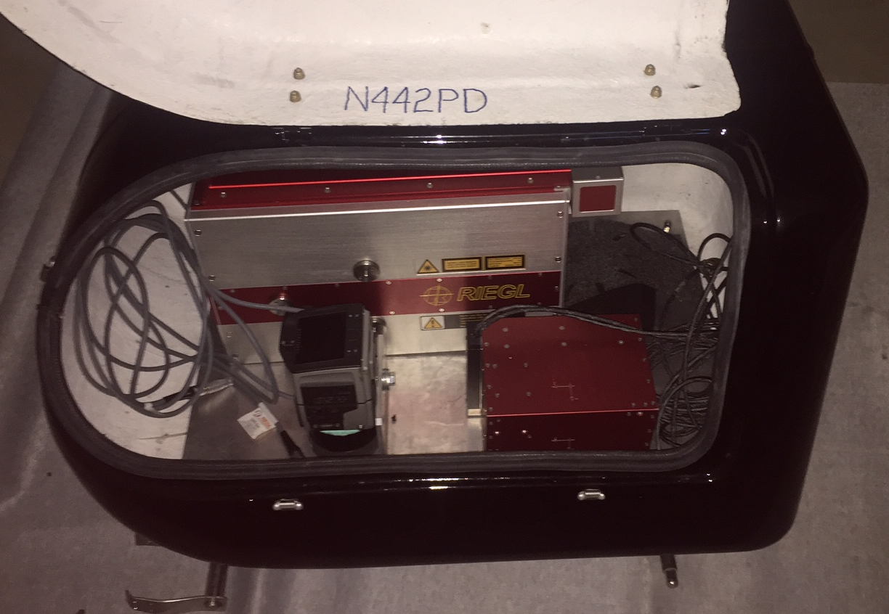
Technical solution

Slide 6
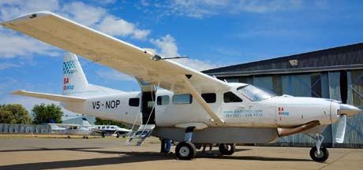
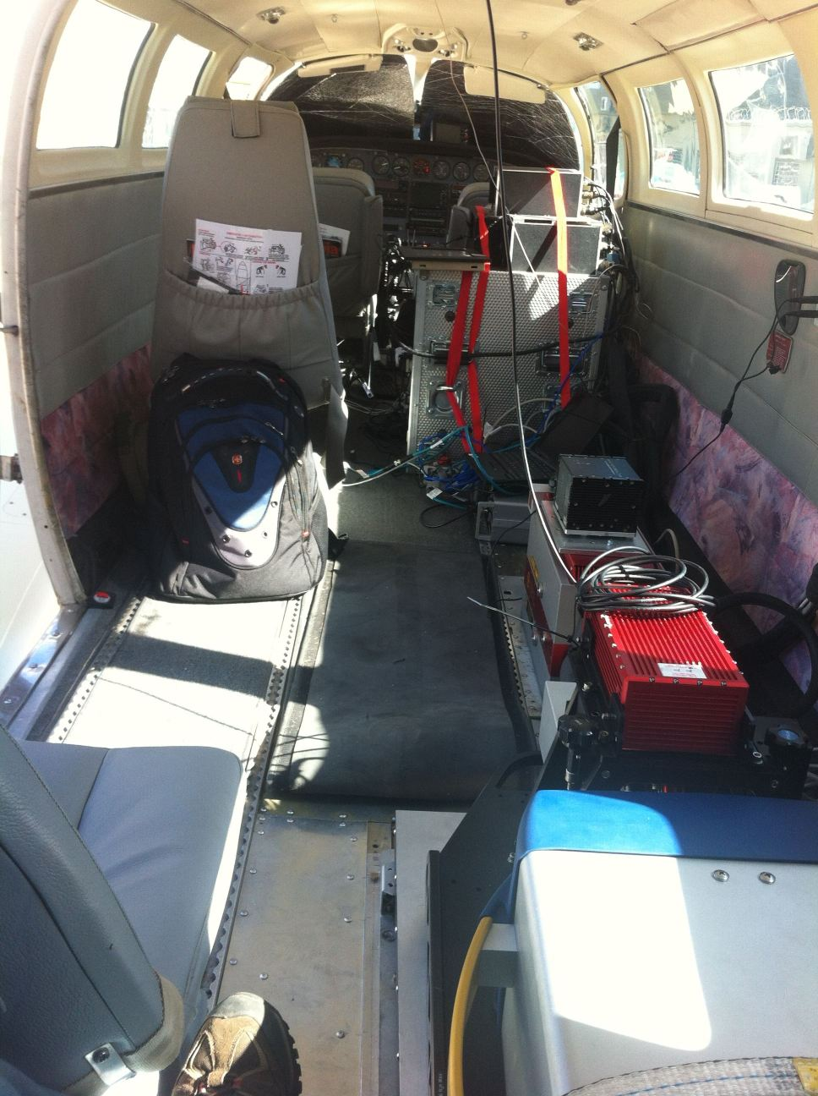
Technical solution

Slide 7
Technical solution
Multisensory airborne approach combining required sensors in one flight:
Topographic and bathymetric airborne Lidar systems with full waveform data collection
Hyperspectral sensors in different bands (reflective VNIR and SWIR, thermal LWIR)
Multiple digital camera systems
Airborne Radar in different bands
Guided through GPS and all data orientated by GNSS and Inertial systems

Slide 8
Technical solution
Data processing:
With or without ground control point
Accuracies for Lidar data within 10cm for topography and 20cm for bathymetry
Image and hyperspectral data with between 0.5 and 1.5 pixel accuracy (0.03 to 3m depending on sensor and
Airborne Radar in different bands 0.5 to 3m accuracy
Data fusion to object based approaches, 3D objects and thematic maps according to client request

Slide 9
Results and Examples - 1
Combined bathymetric/topographic mapping of the aquatic interface using a dual frequency Lidar solution for planning, infrastructure, estimation of climate change effects and flood modelling
Dual Lidar green in 634nm and IR in 1550nm
Flying height: 600m
Swath width (overlap 30%): 350m
Penetration: 1 to 1.5 Secchi depth
Point densities: 1 per sqm for bathymetry, 8 per sqm for topography
Productivity: approx. 15 to 30 sqkm/flight hour

Slide 10
Sending two Laser beams out
green for water depth
infrared for topographic mapping

Slide 11
Accuracy considerations and ground

Slide 15
Results and Examples - 2
Integration of Hyperspectral VNIR into the solution for mapping of Reef conditions, vegetation, chlorophyll, turbidity and water pollution
Flying height: still 600m
Same flight as dual Lidar solution
Spectral resolution: 160 bands in 400 to 1000nm
Spatial resolution: 0.3 to 0.5m

Slide 16
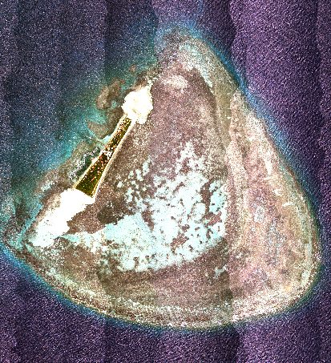
Marine System - Coral Reef Example
A true color image of îlot Maître – New Caledonia (based on VNIR Hyperspectral data)

Slide 17
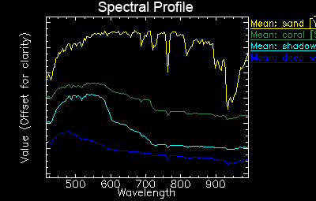
Spectral difference

Slide 18
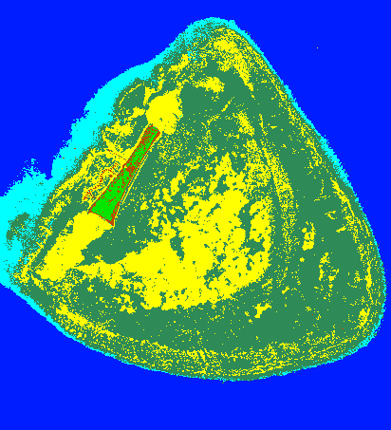
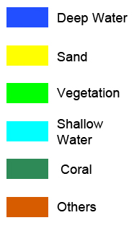
Decision Tree final classification result

Slide 19
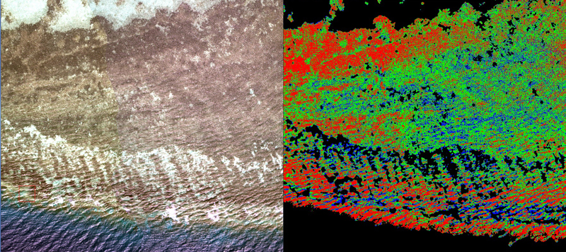
Further analysis
Different coral group can be extracted for further analysis
Ground truth will be needed for coral group identification

Slide 20
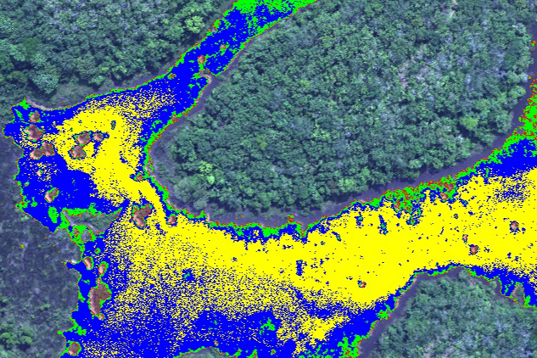
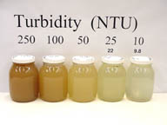
Turbidity Example
Less turbid
More turbid

Slide 21
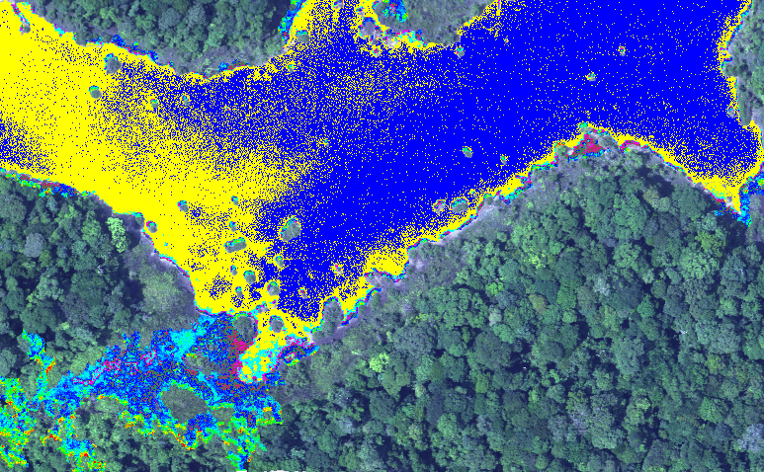
Chlorophyll-a
Lower concentration
Higher concentration

Slide 22
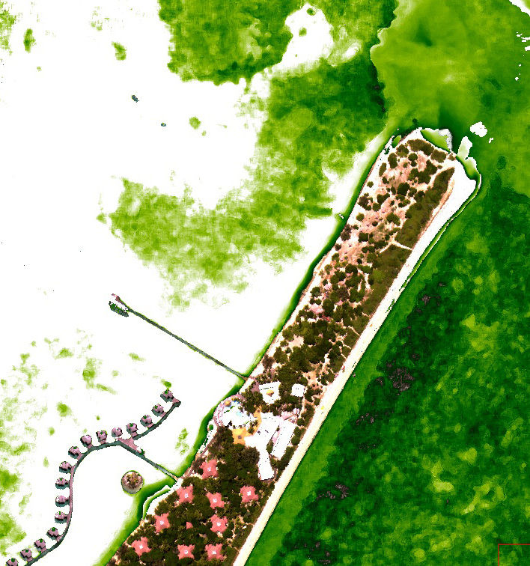
Total Phosphorus (TP) - îlot Maître (NC)
Lower concentration
Higher concentration

Slide 23
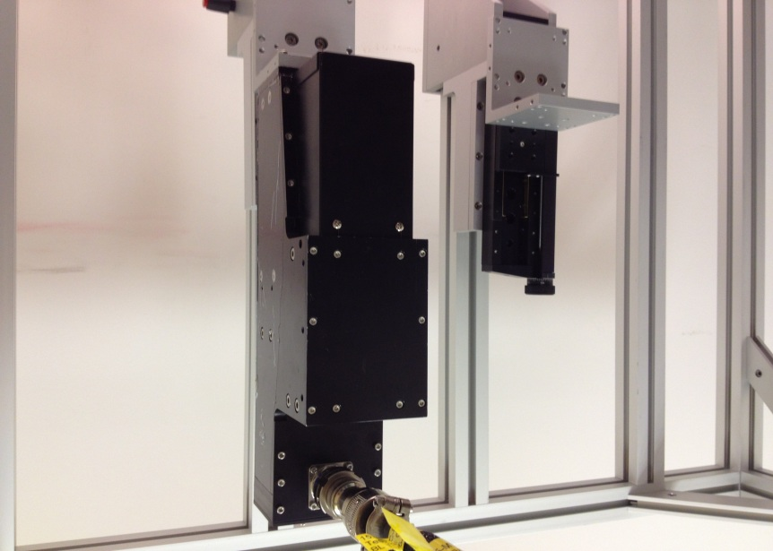
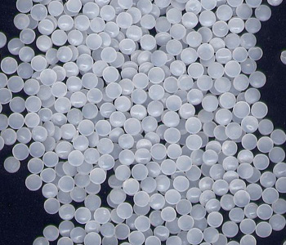
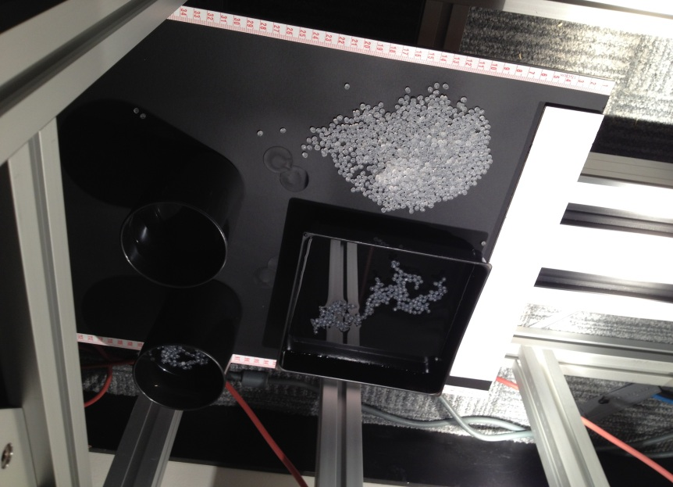
Incident Mapping - Pellets Pollution Example
pellets (also other plastic components)

Slide 24
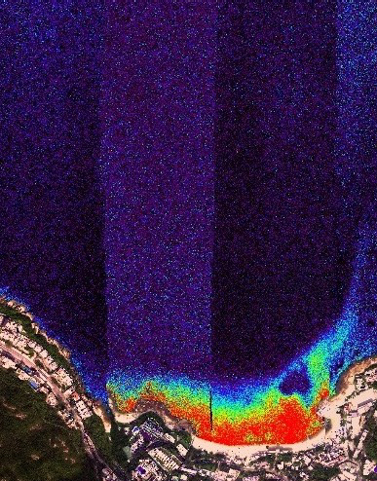
With laboratory results, a spectral library is built and pellets detection is performed
Detection results have been proven to show pellets distribution

Slide 25
Results and Examples - 3
Integration of Hyperspectral VNIR and SWIR into the solution for mapping of land vegetation, soils, detailed land use, forestry and agricultural parameters, geotechnical facts, pollution on land
Flying height: still 600m
Same flight as dual Lidar solution
Spectral resolution: 416 bands in 400 to 2500nm
Spatial resolution: 1m

Slide 26
Forestry Map

Slide 27
Forestry Map

Slide 28
Heavy metal pollution

Slide 29
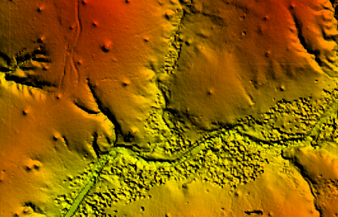
Mineral and Mining maps

Slide 30
Results and Examples - 4
Integration of thermal broadband or hyperspectral for polluter analysis
Flying height: still 600m (for broadband), 1000+m for thermal hyperspectral
Same flight as dual Lidar solution (for thermal hyperspectral additional flight)
Spectral resolution: 130 bands in 7800 to 11800nm
Thermal resolution: better 0.018K
Spatial resolution: 1m

Slide 31
Industrial pollution
Changes in water temperature identified

Slide 32
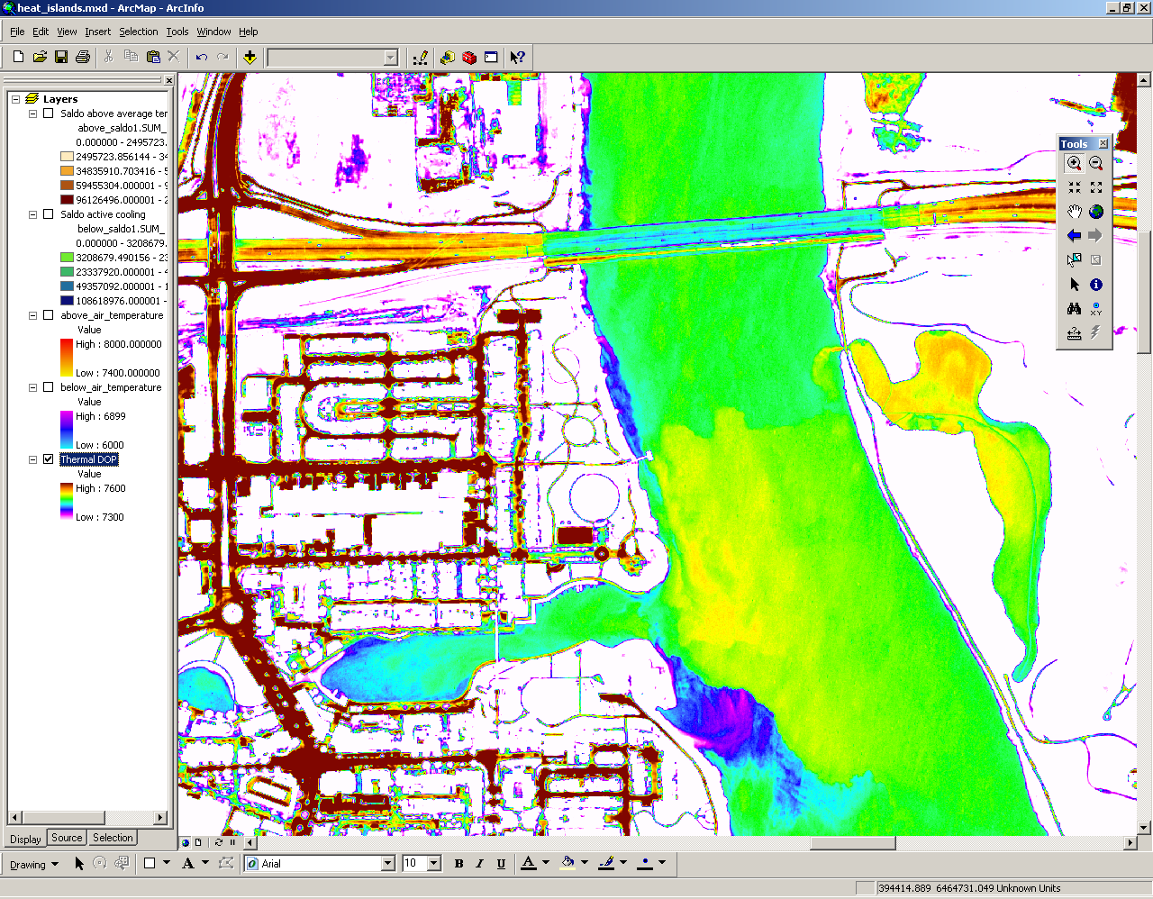
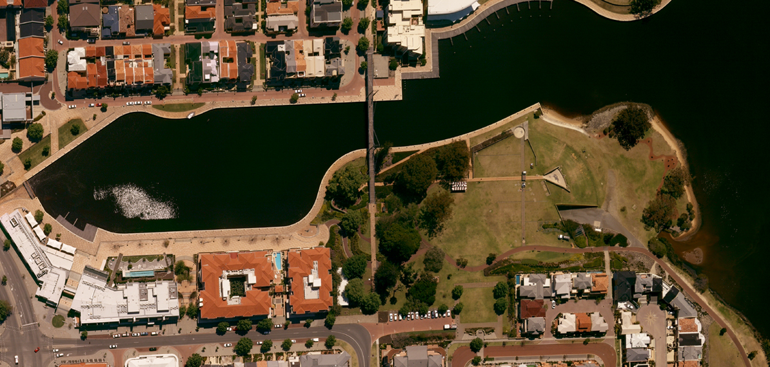
Domestic pollutions and freshwater seapages

Slide 33
Analysis of pollution effects along the coast line
The ship berthed at the wharf prevents the warmer water drifting northwards
Warmer water collects against the shoreline

Slide 34
Thanks for your attention
and please feel free to ask any question
Holger@helipro.com.fj

