Slide 1
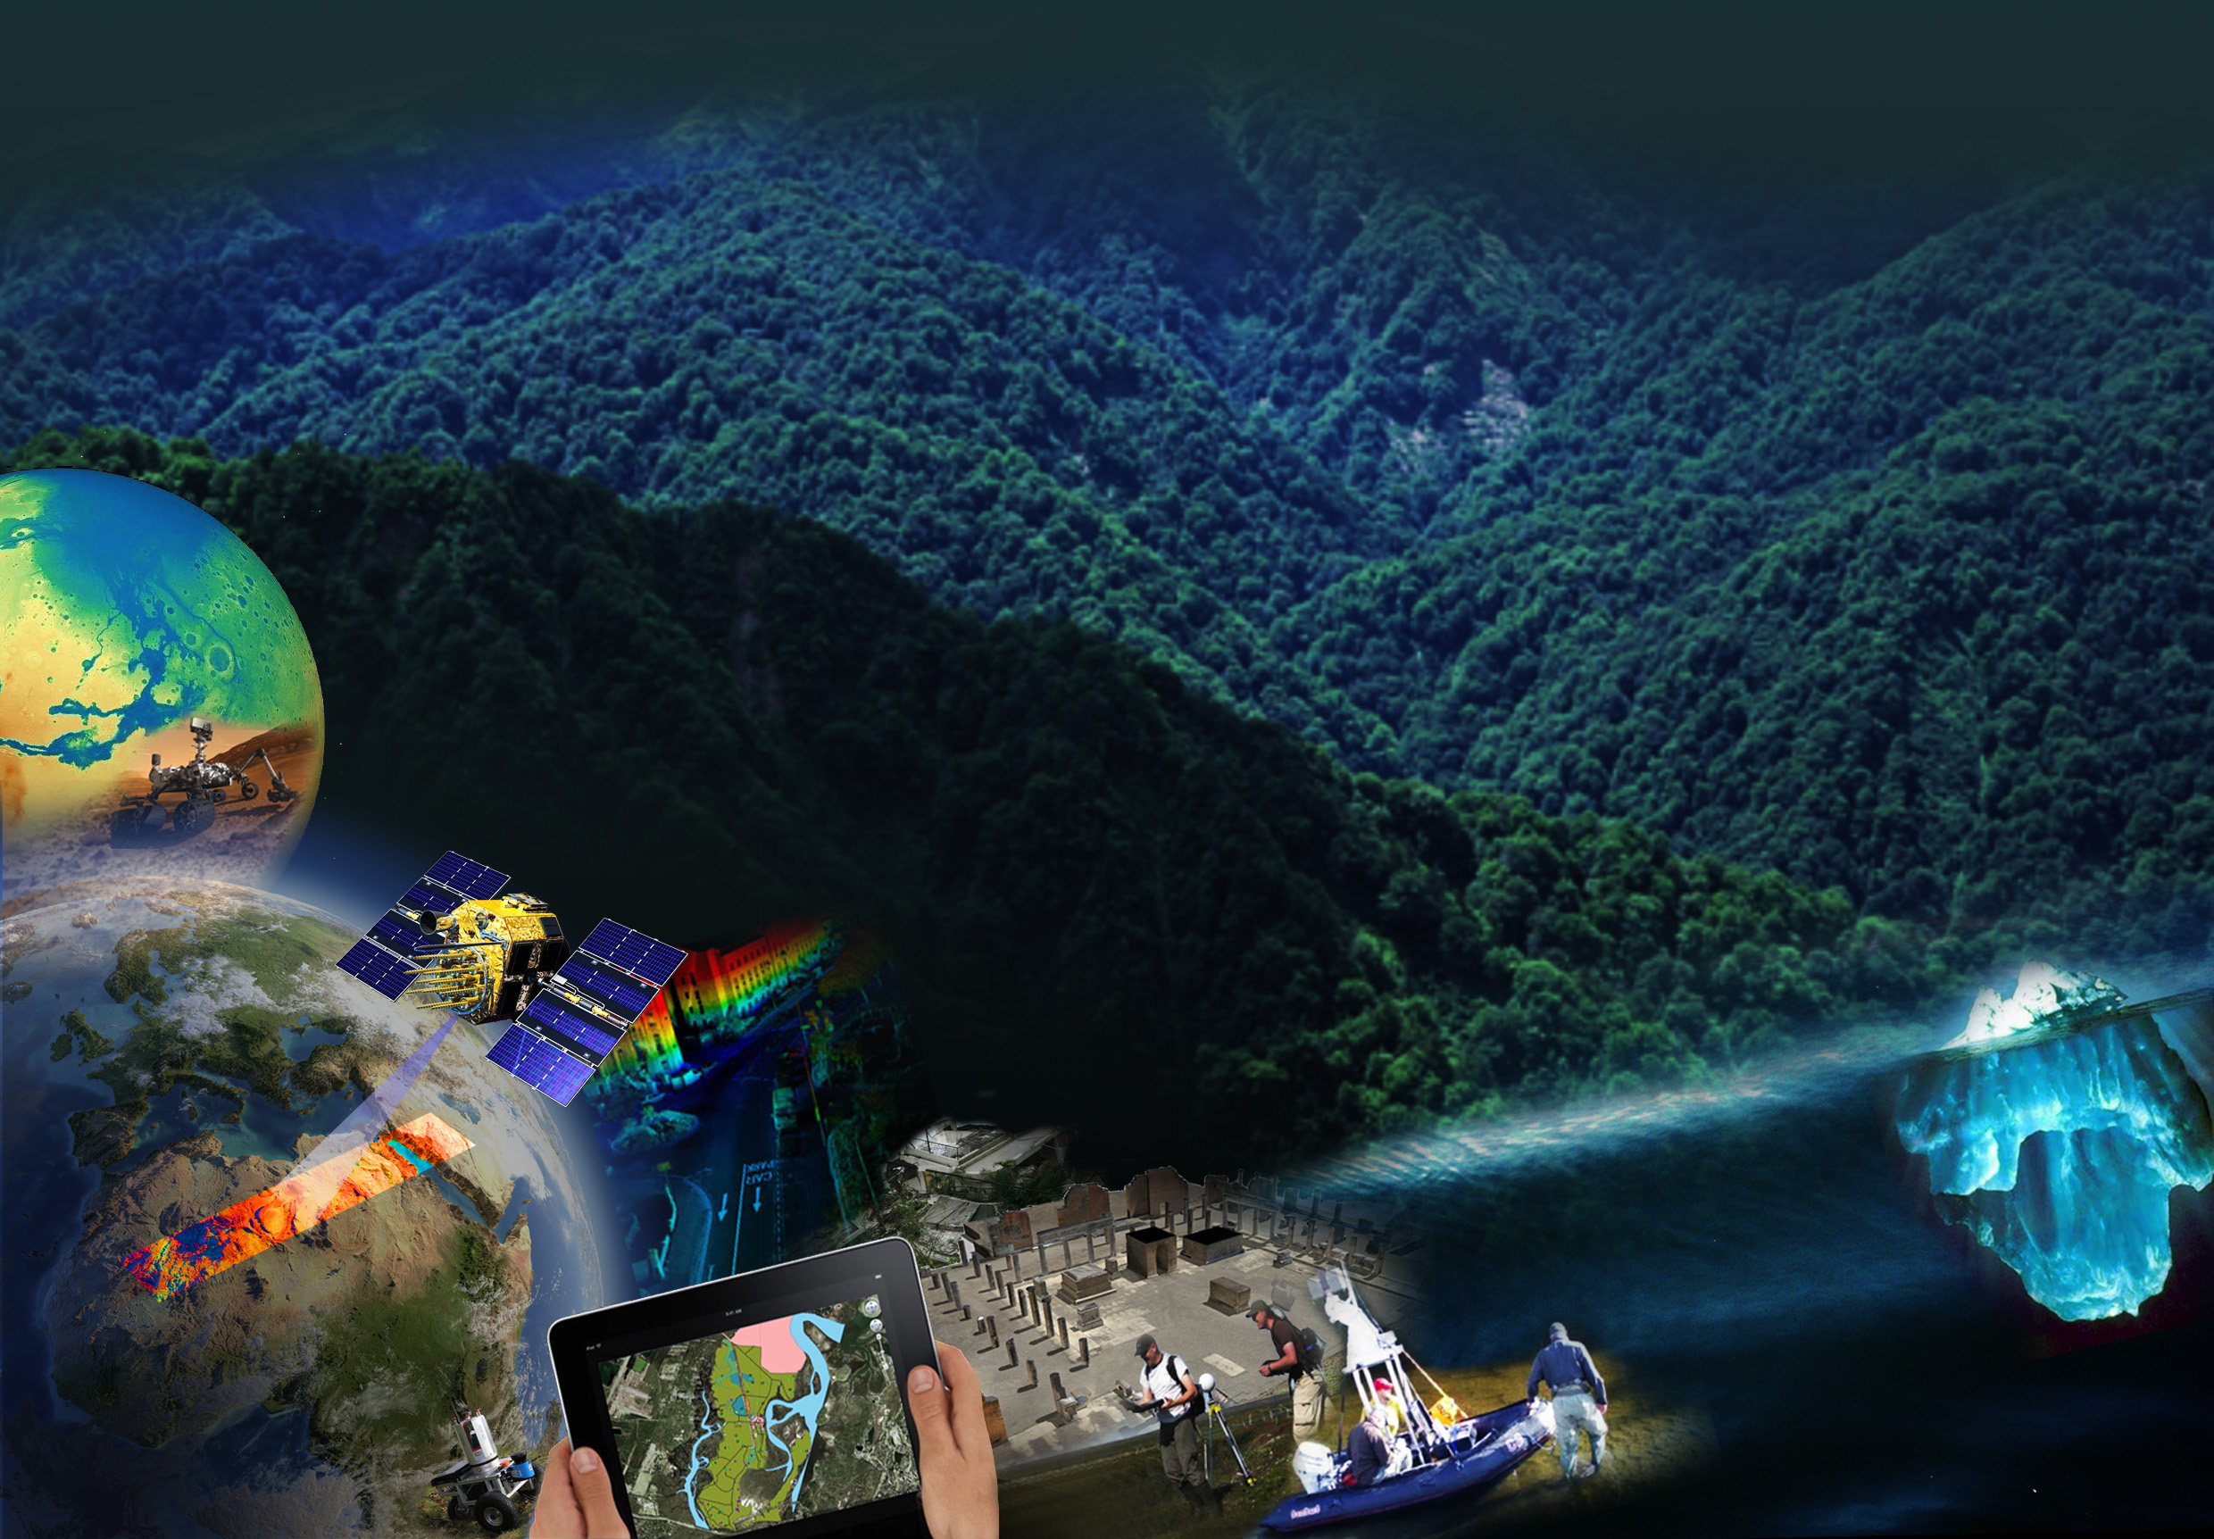
ISPRS International Society for Photogrammetry and Remote Sensing Serving society with information from images

Slide 2
Relevance of Information from Imagery
Sustainable development
Urban and rural, mega cities, energy , …
Environmental monitoring
Global warming, sea level rise, …
Disaster mapping and monitoring
Sendai tsunami, Japan 2011, …
Autonomous driving and navigation
Mobility, safety, …
Homeland security, …

Slide 3
ISPRS is …
… an international NGO with a focus on
science and development
in photogrammetry, remote sensing, spatial information
cooperation between all relevant stakeholders
academia, private industry, government, end users
truly global cooperation
education, technology transfer, capacity building
more than 100 years old
institutional and individual membership

Slide 4
Science and development
THE raison d’être of ISPRS, far beyond topo. mapping
Photogrammetry
computer vision, autonomous driving, robotics, cultural heritage, industrial measurement
Remote sensing
constellations and swarms, “the whole earth every day” (in real time), monitoring and data continuity
Spatial information science
spatio-temporal modelling, crowd sourcing, social media, personal navigation, ubiquitous computing

Slide 5
Science and development
The underlying concepts
big data, big data platforms – also “big brother”
parallel computing, cloud computing
machine learning, semantic scene understanding
The Internet of Things
openX (software, data, access)
to be adapted and integrated into our solutions
to be further developed in cooperation with others
Information from Imagery:
Digitisation of our planet in real time

Slide 6
Global cooperation
… with sister societies
ICA, IAG, FIG, IHO, IEEE-GRSS, … -> JB GIS
ICSU, GEO, UN-GGIM, UN-OOSA, …
Education
a Commission dedicated to education and outreach
ISPRS Student Consortium
special summer schools on locally relevant topics
special sessions at scientific meetings
Reg. rep’s in areas with less contact to ISPRS
ISPRS Foundation, travel grants

Slide 7
ISPRS activities
Research coordination
Commissions, Working Groups, benchmark tests
International scientific meetings
Congress, Geospatial Week, Symposia, Workshops
Education and outreach
Student Consortium, summer schools
Bridge into commercial world
Exhibitions, Sustaining Member advisory committee
Network of scientists and professionals
Scientific Publications, Web, eBulletin

Slide 8
Mission and vision

Slide 9
ISPRS Mission: why we exist
… to advance the photogrammetry, remote
sensing and spatial information sciences
through international cooperation in research,
development and education for the benefit of
society and for environmental sustainability.
(from ISPRS Strategic Plan 2010)

Slide 10
ISPRS Vision: where we want to go
… to be the foremost scientific society in its field and for the Society at large,
to speak for all people working in the field,
to provide the necessary resources to develop the field.
(from ISPRS Strategic Plan 2010)

Slide 11
Development of ISPRS

Slide 12
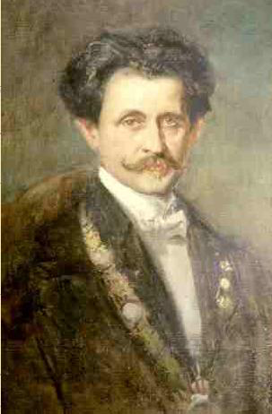
The beginning
founded on July 4, 1910 in Vienna on the initiative of Prof. Eduard Doležal
International Society of Photogrammetry (ISP)
oldest international
umbrella organisation
in its field
Eduard Doležal, a professor for practical geometry at Vienna University of Technology

Slide 13
ISPRS beyond photogrammetry
Name change in 1980 to include Remote Sensing
Ad hoc Committee report in 1990:
‘acquisition of spatial data by photogrammetry and remote sensing can not be divorced from subsequent processing and management’
‘recent developments … have seen ISPRS activities expand .. into a much wider range of topics’
Today, ISPRS activities include acquisition, modelling, analysis, DB management and visualisation of geospatial data in different applications with a focus on imagery: Information from Imagery

Slide 14
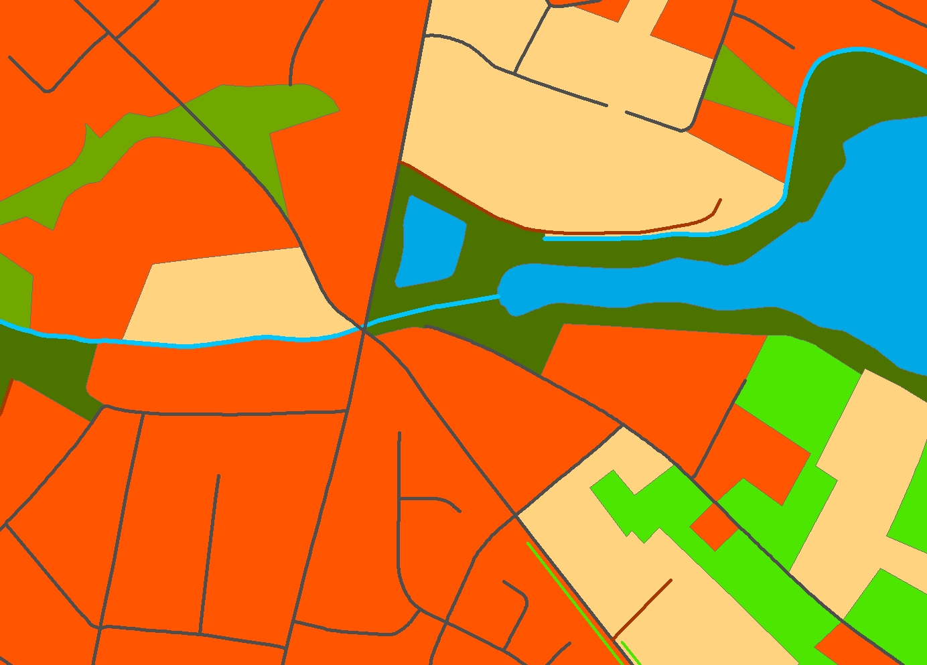
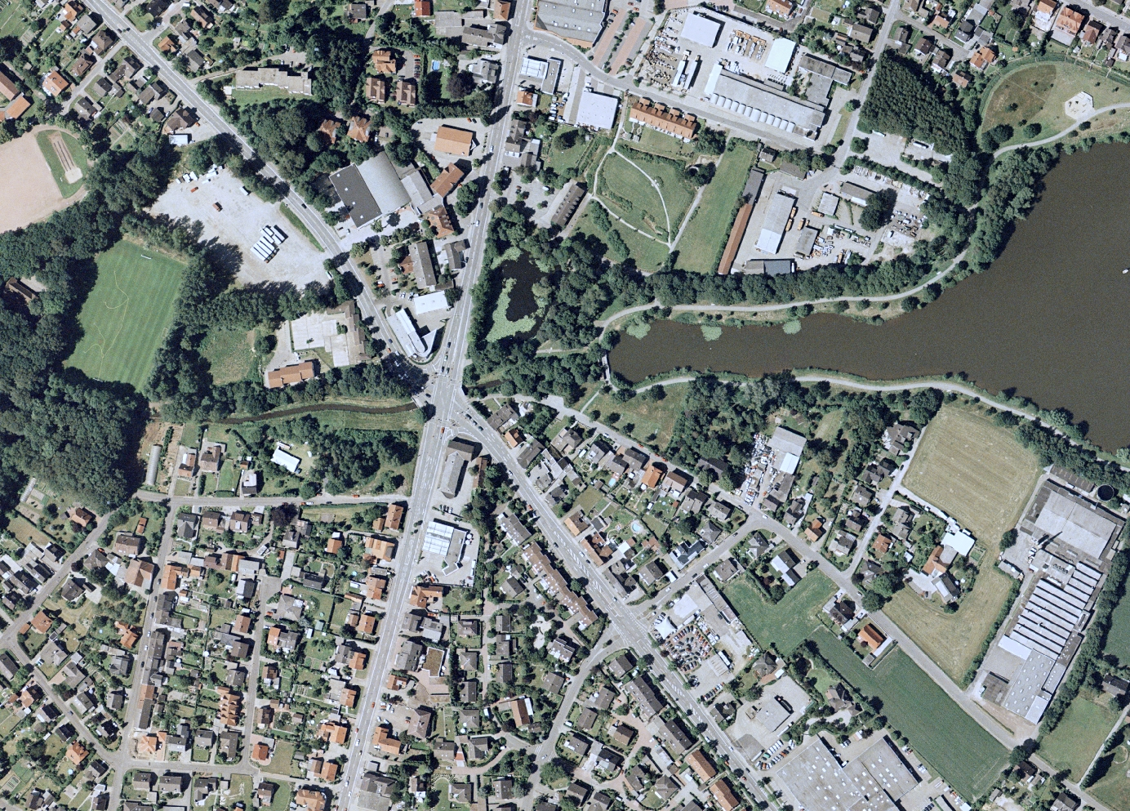
ISPRS goes geospatial: Imagery is core to GIS
GIS brings value
Contextual
relationships
Visual
integration
Data
management
Spatial analysis
Communication
Timely, rich
information
Measurements
and analysis
Authoritative
source
GIS
Imagery
Imagery brings value

Slide 15
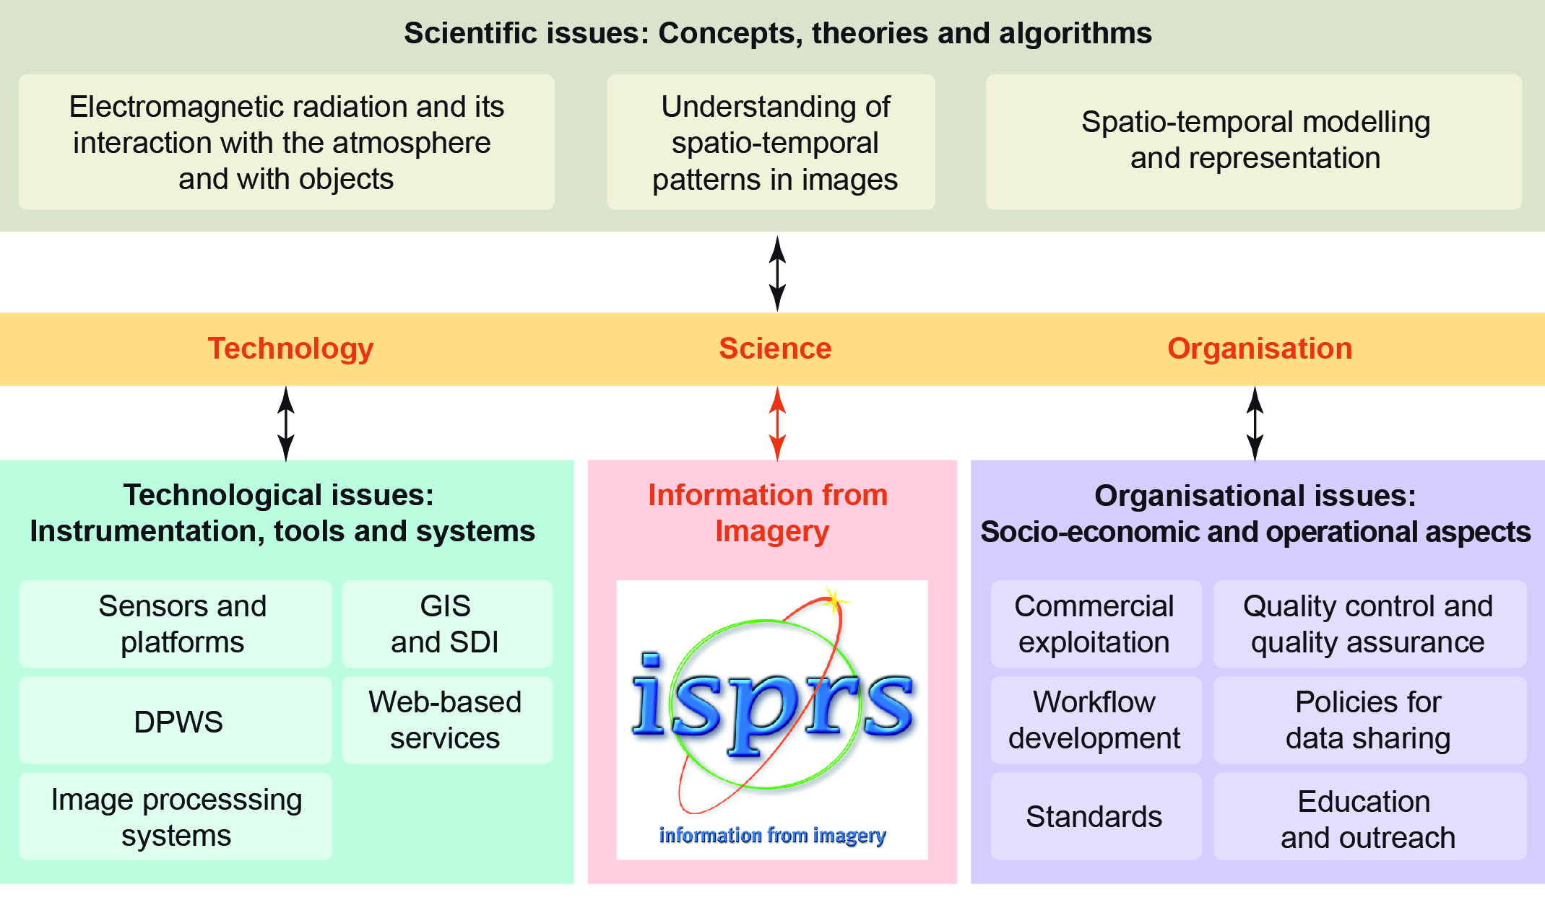
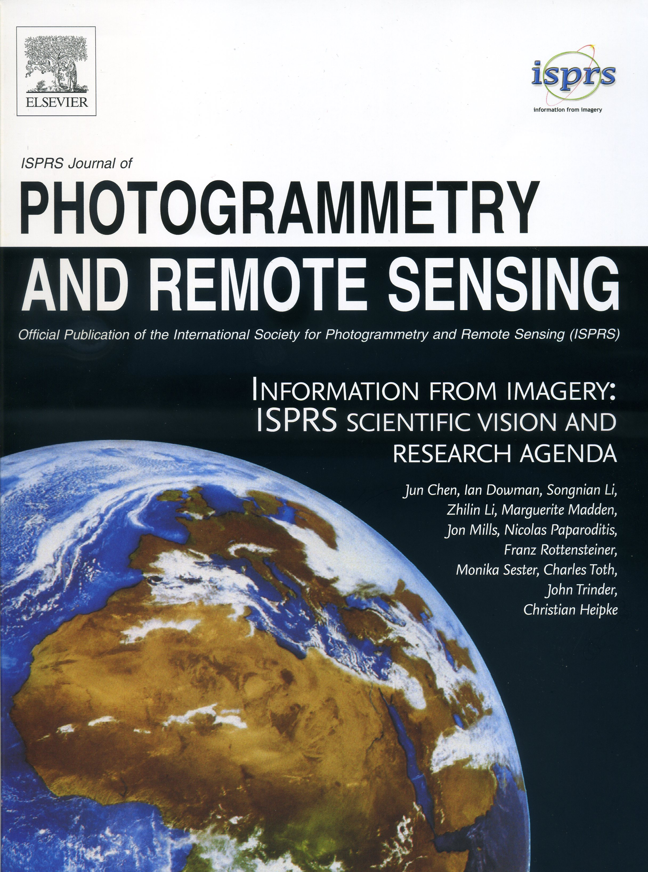
ISPRS – XXIII Congress, Prague 2016
a new research agenda (vision paper)* + 10 review/overview papers
* J. Chen, I. Dowman, S. Li, Z. Li, M. Madden, J. Mills, N. Paparoditis, F. Rottensteiner, M. Sester, C. Toth, J. Trinder, C. Heipke: Information from imagery: ISPRS scientific vision and research agenda

Slide 16
Membership

Slide 17
ISPRS Membership
Ordinary members (92)
representing a country or region as a whole
Associate members (16)
representing a community not represented by the Ordinary Member organization
Regional members (15)
multi-national association promoting regional cooperation
Sustaining members (58)
connection to the commercial world
Individual members (increasing daily)

Slide 18
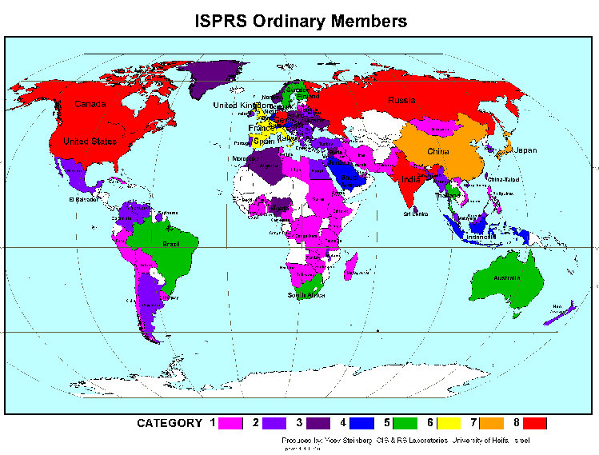
ISPRS a global society of organisations

Slide 19
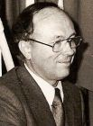
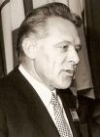
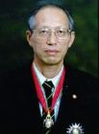
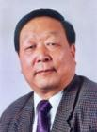
ISPRS Honorary Members
Aino Savolainen (SF), 1988
Gottfried Konecny (D), 1992
Fritz Ackermann (D), 1996
Shunji Murai (JPN), 2000
Larry Fritz (USA), 2004
Armin Grün (CH), 2008
John Trinder (AUS), 2008
Ian Dowman (UK), 2012
Li Deren (China), 2012
Orhan Altan (TUR), 2016

Slide 20
Individual membership
Annual
renewal
363 IdM,
as of July
12, 2016
Largest
groups:
- India
- US
- Nigeria
- Turkey

Slide 21
Internal structure

Slide 22
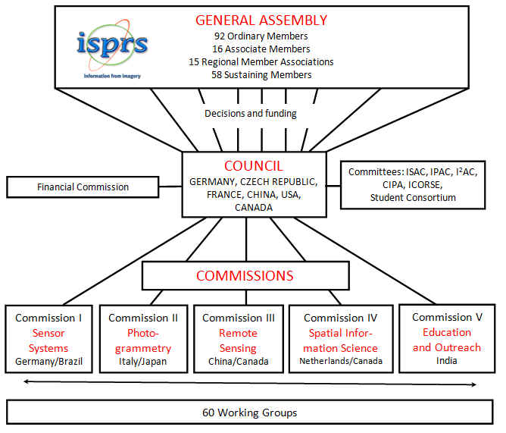
ISRPS Structure (2016 – 2020)

Slide 23
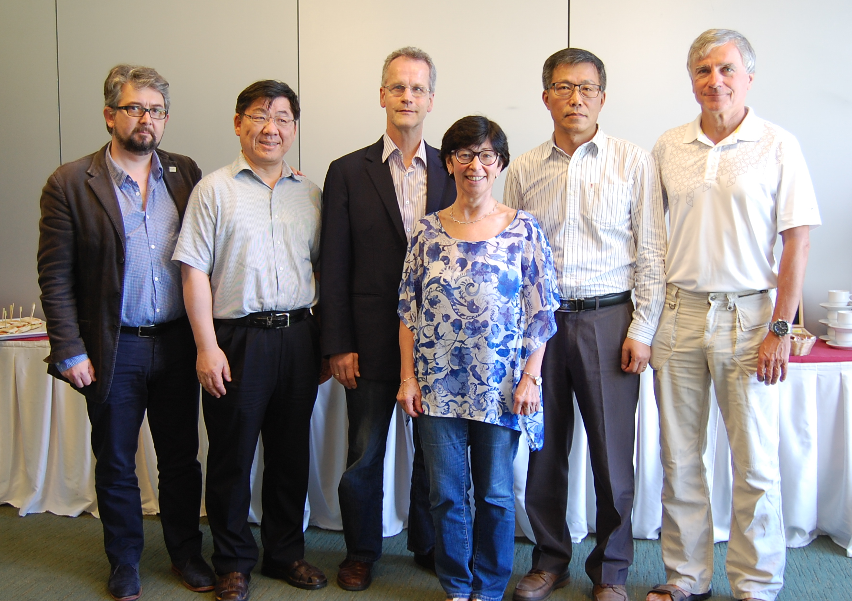
ISPRS Council (2016 – 20)
Prague 2016

Slide 24
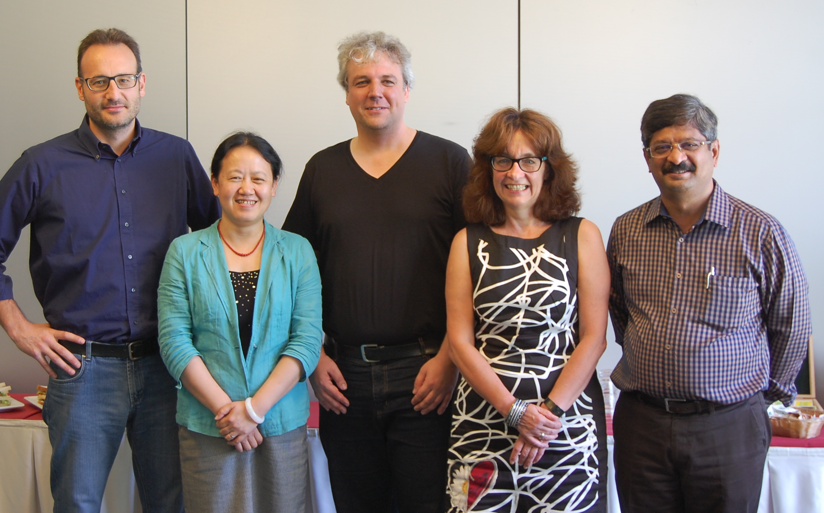
Technical Commission Presidents (2016 – 20)
Prague 2016

Slide 25
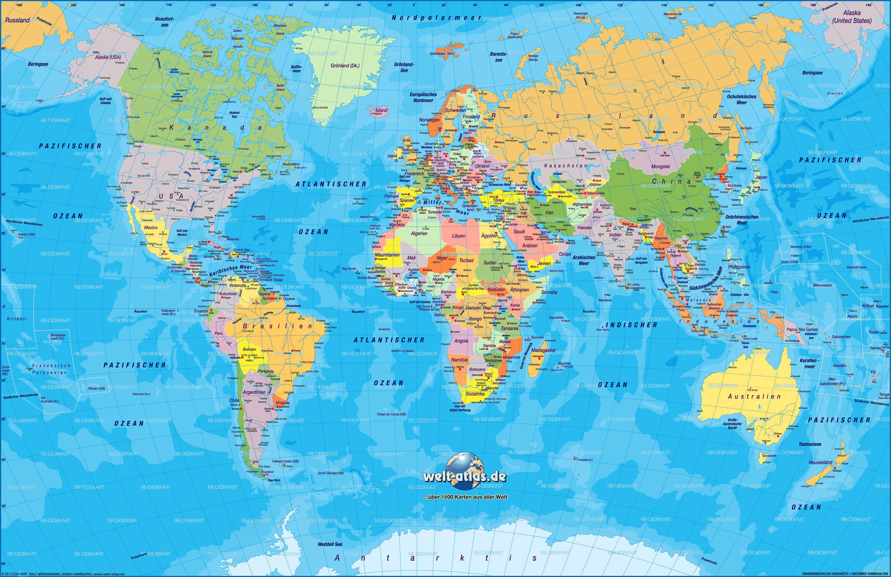
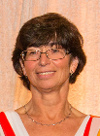
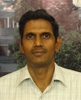

Slide 26
Technical Commissions (2016 – 20)
No. | Commission title | President / Vice-president
I | Sensor systems | Stefan Hinz (Germany) / Raul Feitosa (Brazil)
 | Photogrammetry | Fabio Remondino (Italy) / Takashi Fuse (Japan)
III | Remote sensing | Jiang Jie (China) / Ahmed Shaker (Canada)
IV | Spatial information science | Sisi Zlatanova (Netherlands) / Suzana Dragićević (Canada)
V | Education and outreach | A. Senthil Kumar (India) / P.L.N. Raju (India)

Slide 27
Commissions and Working Groups
each Commission is responsible for approx. 10 working groups (approx. 60 in total)
WGs cover dedicated topics
“this is where the actual work is done”, e. g.
benchmarks
common theoretical and experimental investigations
editing of special journal issues
organisation of focussed workshops, tutorials, seminars
Intercommission WGs ensure collaboration
new WG setup every 4 years

Slide 28
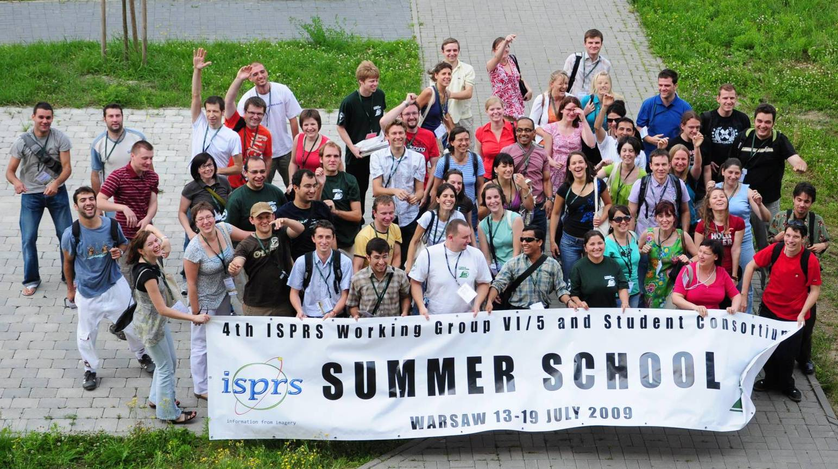
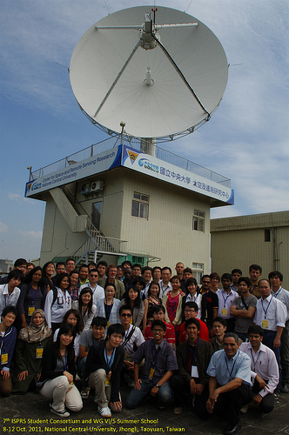
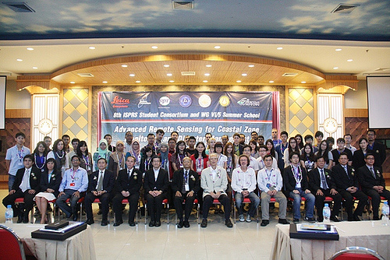
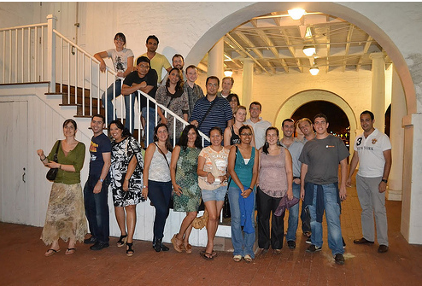
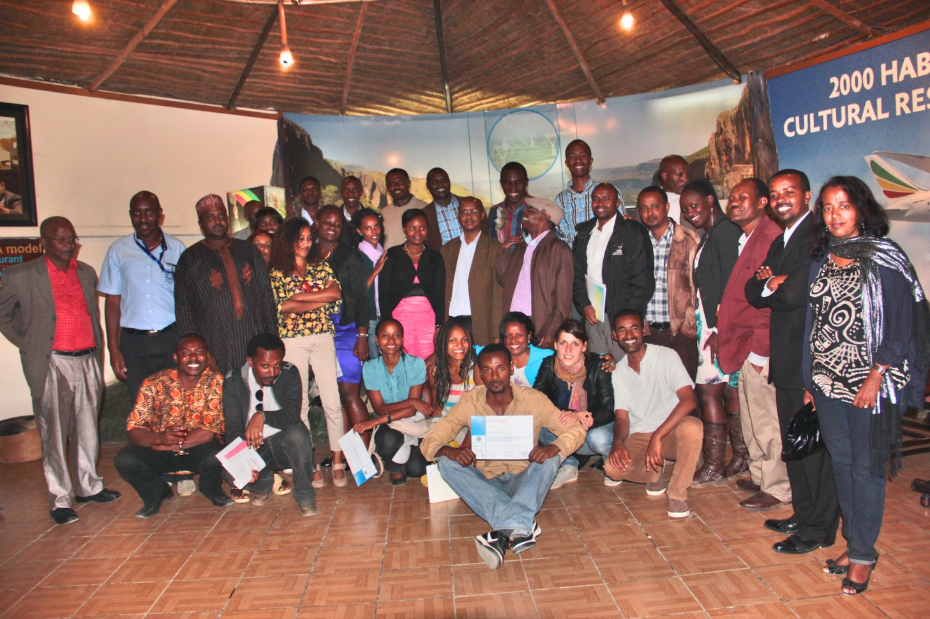
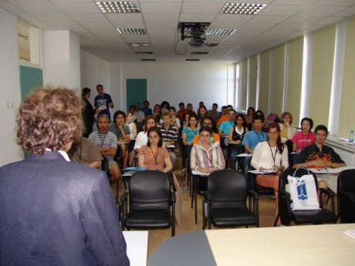
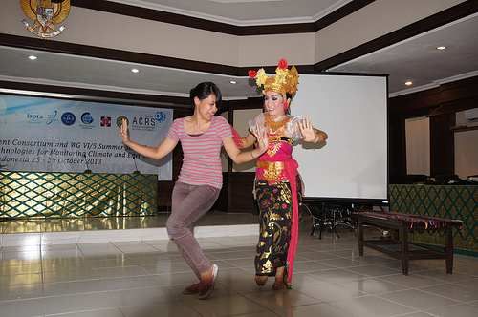
ISPRS Student Consortium
… the next generation leaders of ISPRS
students and young professionals
SC founded in 2004,
Chair: Sheryl Rose Reyes (Philippines)

Slide 29
The ISPRS Foundation
... organizes fund raising to help support the activities and to reach the goals of ISPRS
… provides grants, scholarships, awards, training supplies etc. to qualified individuals and organizations, especially those in developing countries

Slide 30
General meeting schedule
ISPRS Congress for all in „Summer Olympic years” (2000 – 3000 participants)
ISPRS Geospatial Week in odd years
approx. 500 participants
One Symposium per Commission in “Soccer World Cup Years” (approx. 300 participants each)
Smaller Workshops, organised by WGs
2016 | 2017 | 2018 | 2019 | 2020
Congress Prague | GSW Wuhan | Symposia | GSW, tbd | Congress Nice

Slide 31
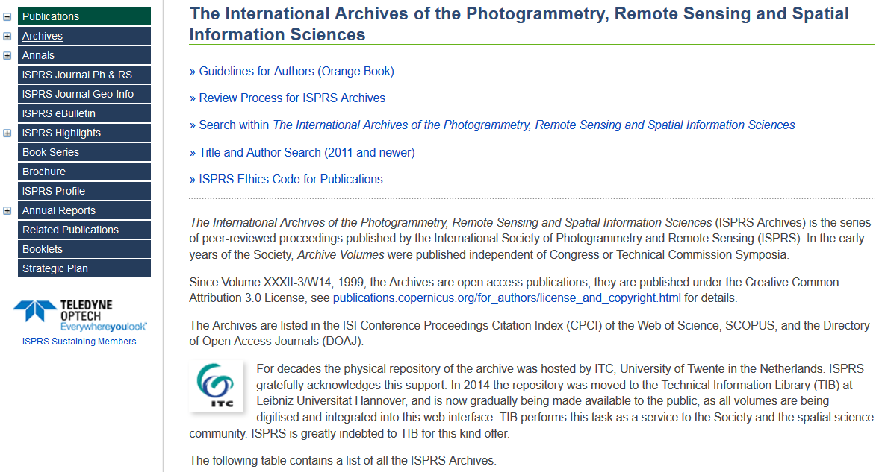
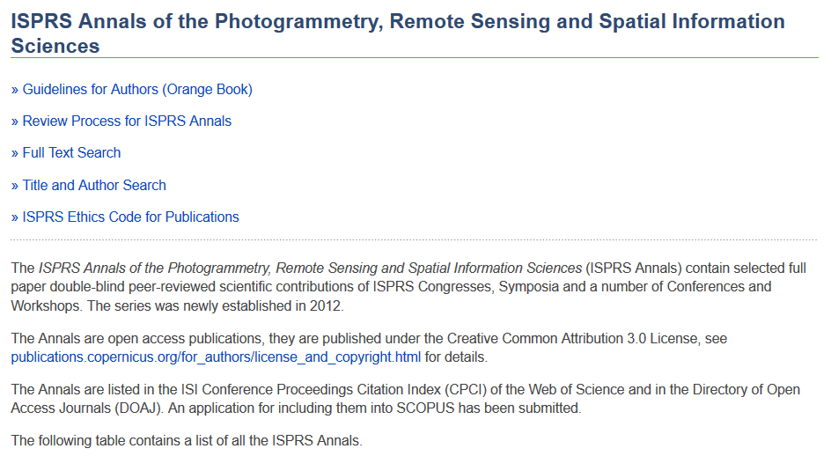
ISPRS proceedings: Annals and Archives
Archives and Annals included in Web of Science, DOAJ –
Archives also in SCOPUS, EI
Annals: double blind peer-reviewed full paper proceedings
Archives: proceedings based on abstract review

Slide 32
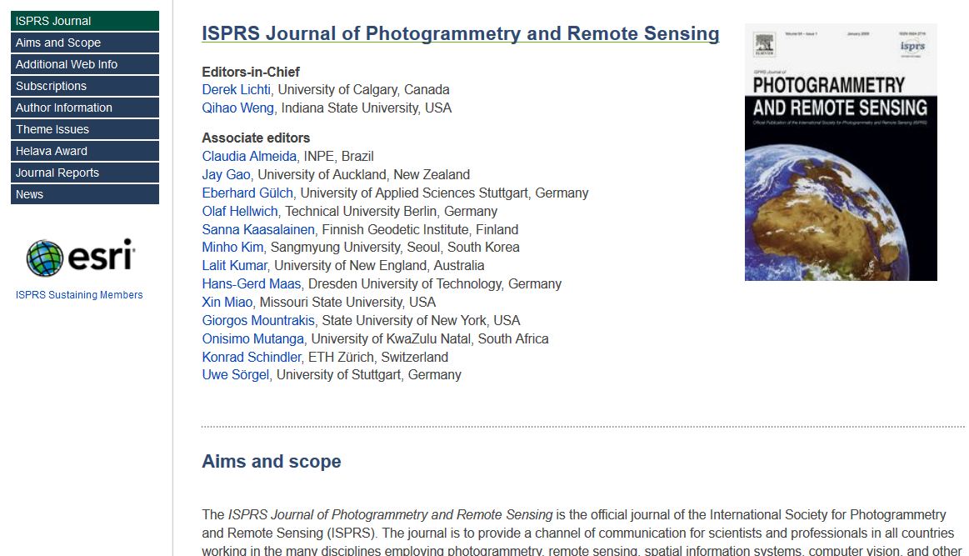
ISPRS publications: The flag ship
... one of the top journals in
remote sensing and
photogrammetry worldwide,
impact factor 2015: 4,188

Slide 33
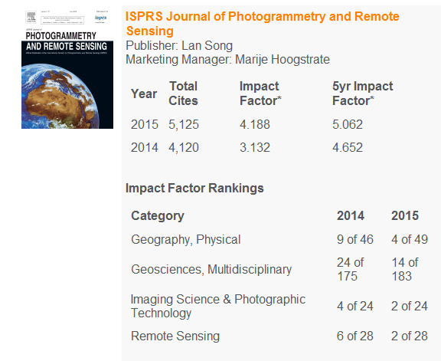
ISPRS publications: The flag ship
ELSEVIER 2015 Journal Metrics

Slide 34
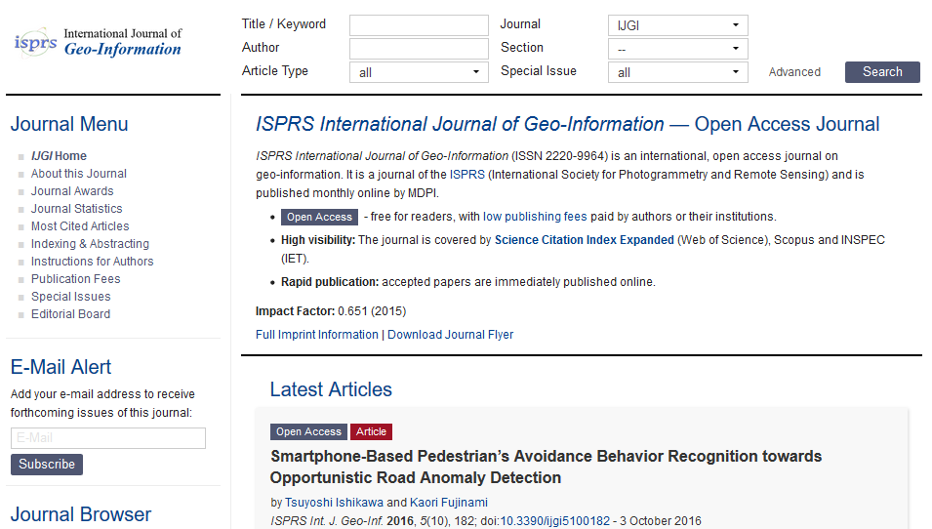
ISPRS publications: Open-access journal in GI
… also part of Web of Science

Slide 35
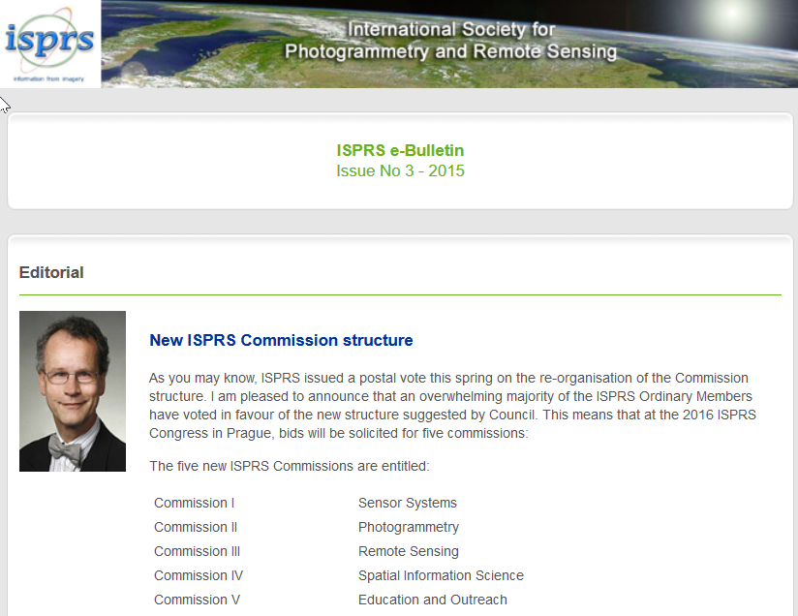
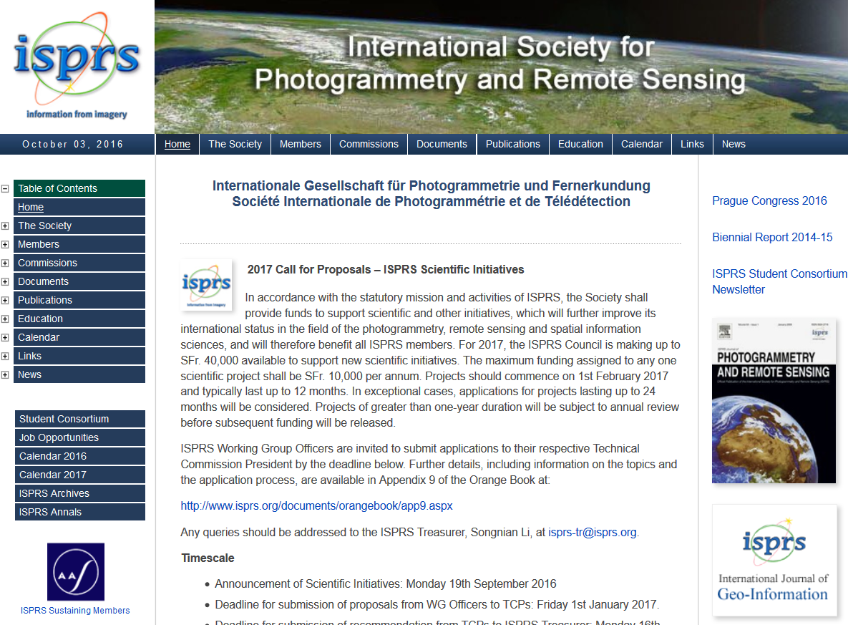
ISPRS publications: Web site and eBulletin
www.isprs.org

Slide 36
Activities

Slide 37
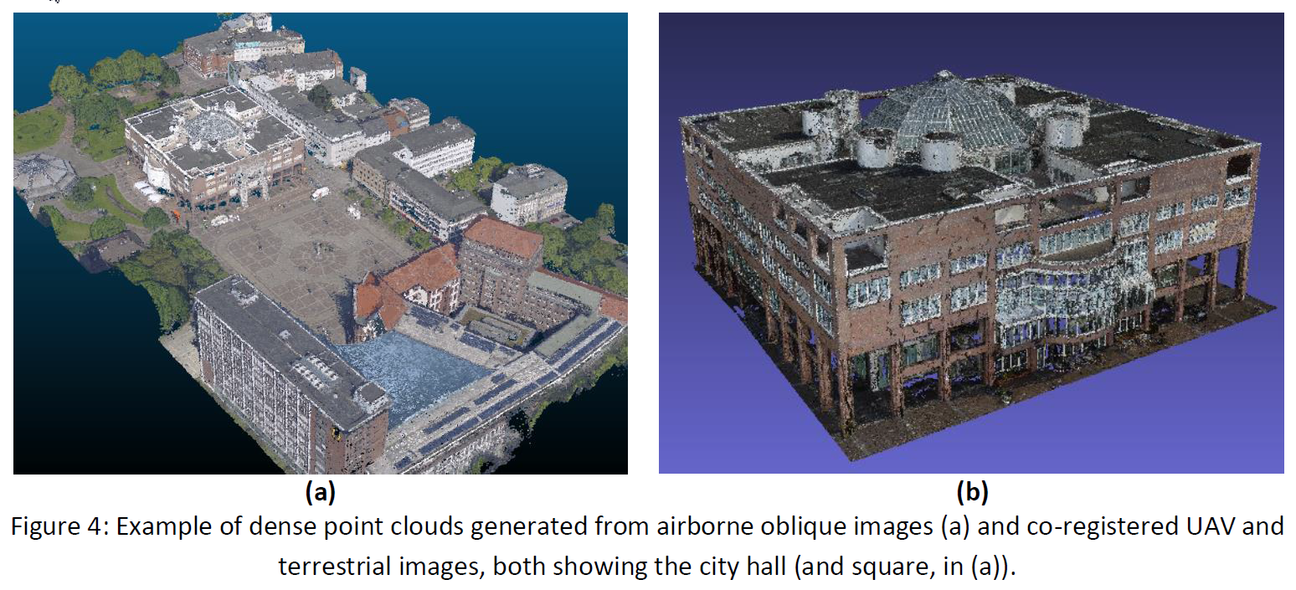
Scientific Initiative: Multi-platform benchmark
Nex et al. 2014

Slide 38
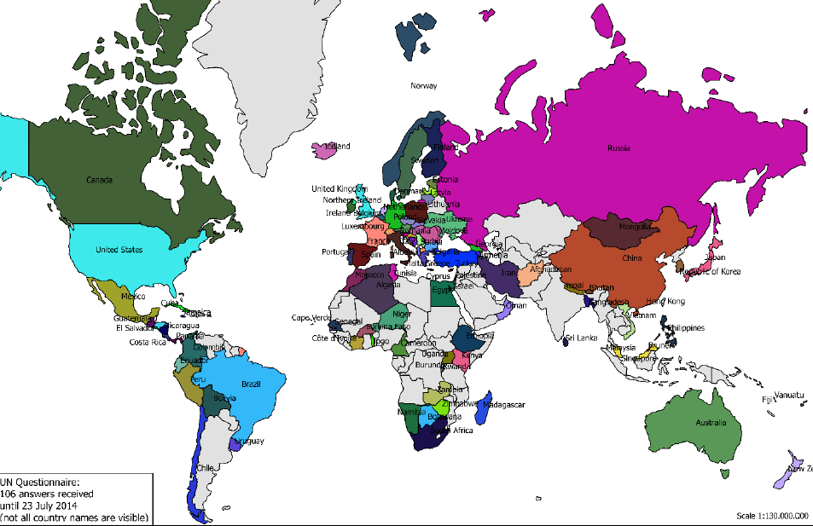
Scientific Initiative: Status of World Mapping

Slide 39
ISPRS Geospatial Week 2017 18-22 September 2017, Wuhan, China
State Key Laboratory of Information Engineering in Surveying, Mapping and Remote Sensing (LIESMARS), Wuhan University
Notes:
Thank Christian Hepke, thank Nicolus, thanks ISPRS for their great decision to let Wuhan to organize Geospatial Week 2017. Two years is not long, it is only 24 months, 100 weeks. So, my team in Wuhan University will work hard and make all potential to make Geospatial week 2017 a great success, at least as successful as this one.

Slide 40
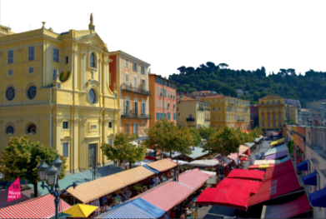
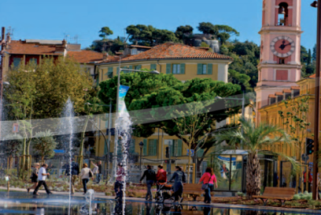
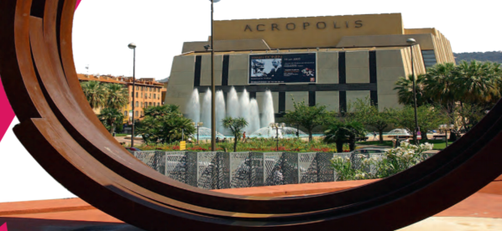
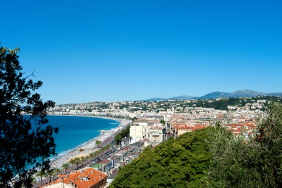
Invitation to ISPRS 2020 in Nice, France Imaging today, foreseeing tomorrow
www.isprs2020-nice.com
June 28 – July 4, 2020
Notes:
I am Nicolas Paparoditis and I am the new congress director. In my non ISPRS life, I am head or Research & Education at IGN, the french national mapping agency and head of the engineering school ENSG-Geomatics
On behalf of the french community of Photogrammetry, Remote Sensing and Geospatial Sciences, it is with great honour that I am inviting you to attend the 24th ISPRS Congress in 2020 in Nice.
This congress is supported by most of the french major players in the field and will be enlarged during the 4 years to gather all the french players. These players all together have a very large number of researchers working worlwide with universities and foreign institutions in the field of ISPRS and also the neighbouring fields (such as computer vision, image processing, ellectronics, robotics, etc.). This congress in France, will as a consequence bring a large number of new scientists within ISPRS.

Slide 41
Summary:
benefits to members

Slide 42
Benefits of ISPRS membership
Access to international scientific network
Right to host Commissions and Congress and vote in GA
Free electronic subscription of ISPRS Journal (for sustaining members)
Online publications and other web-resources, in particular educational material
eBulletin and other information
Support from ISPRS Foundation
… and many more …

Slide 43
ISRPS
106 years of serving society with
information from imagery …
… and still going strong

Slide 44
Thank you ...
See you in Wuhan for the
Geospatial Week 2017
See you in Nice for the
XXIV ISPRS Congress 2020

