Slide 1
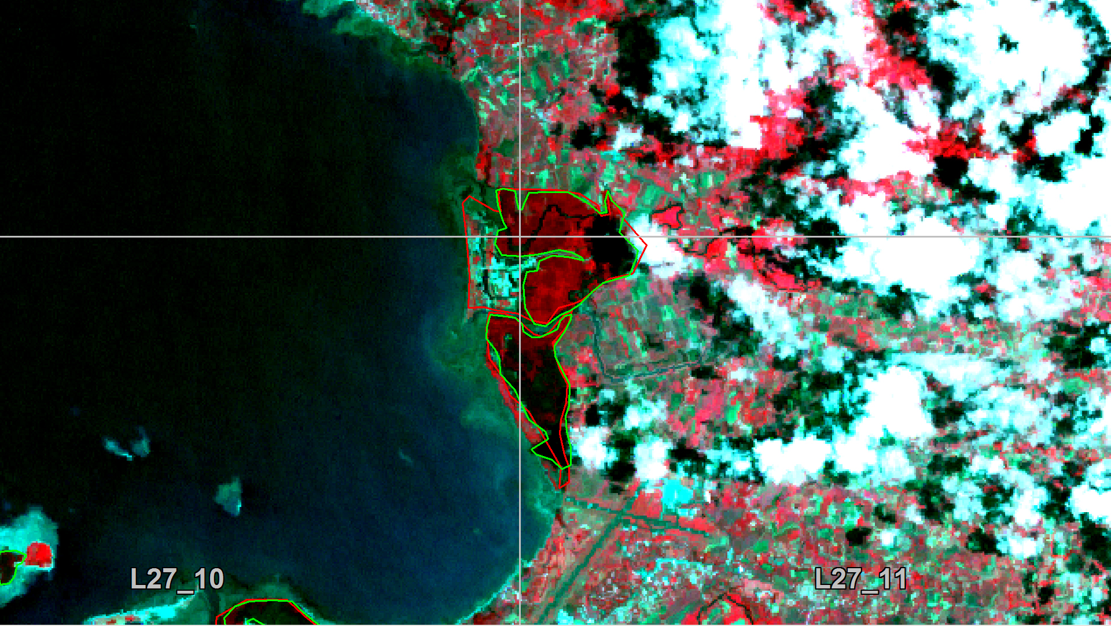
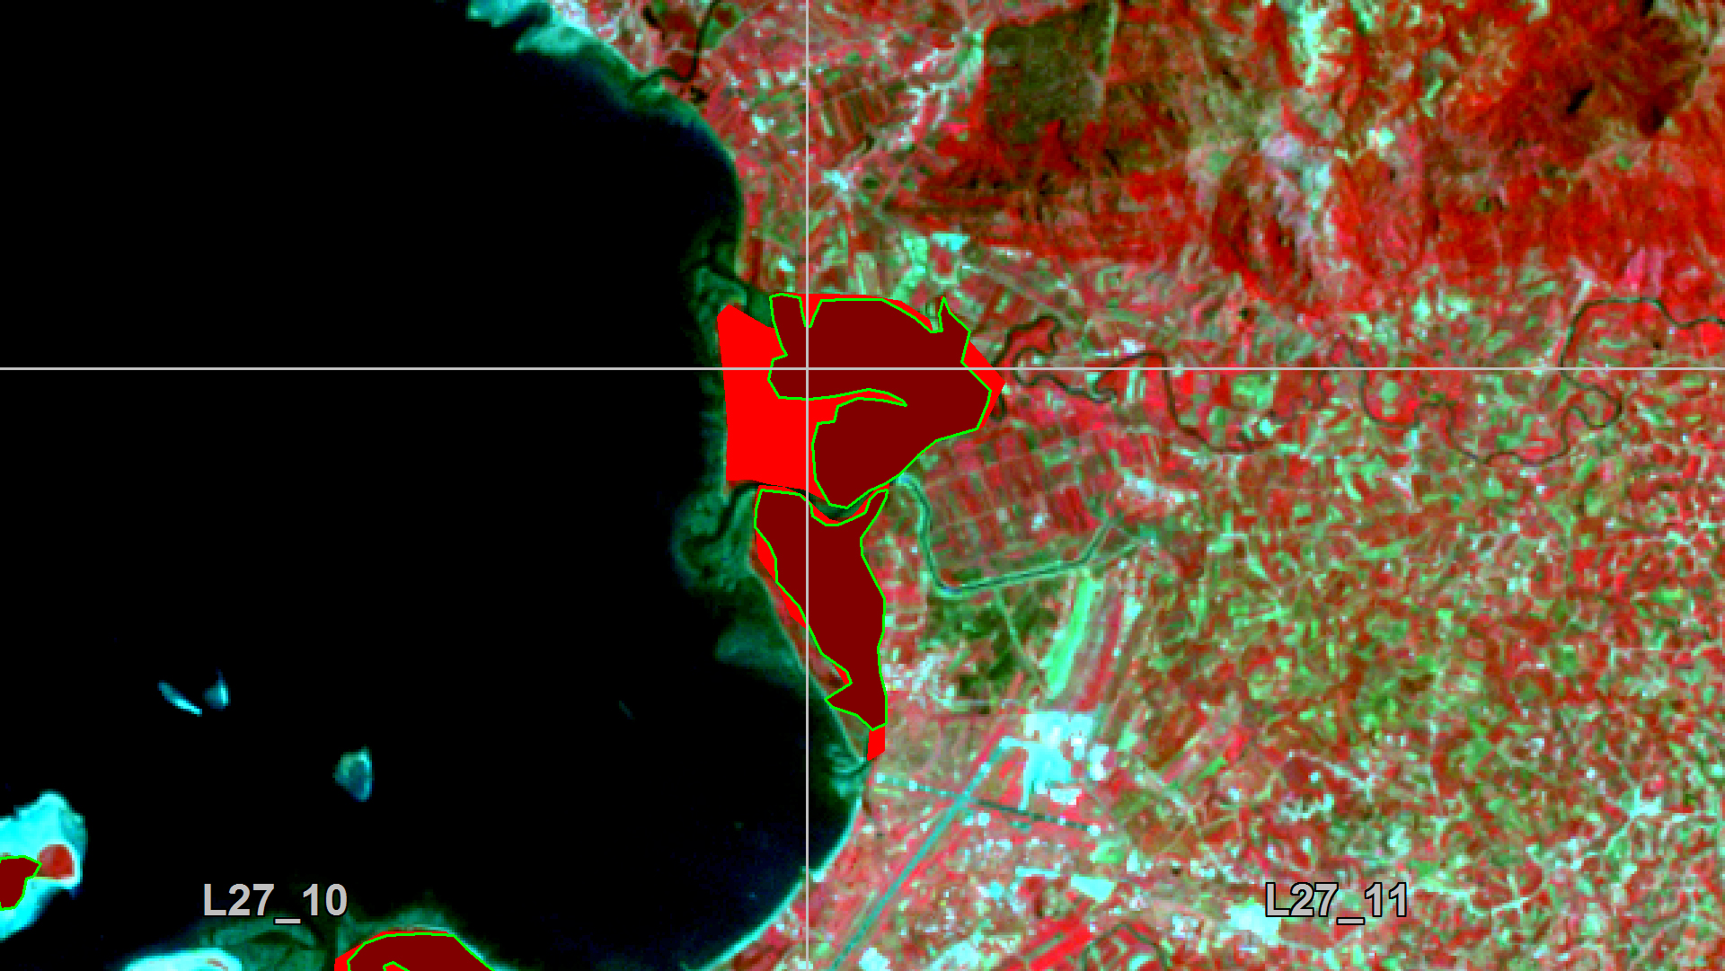
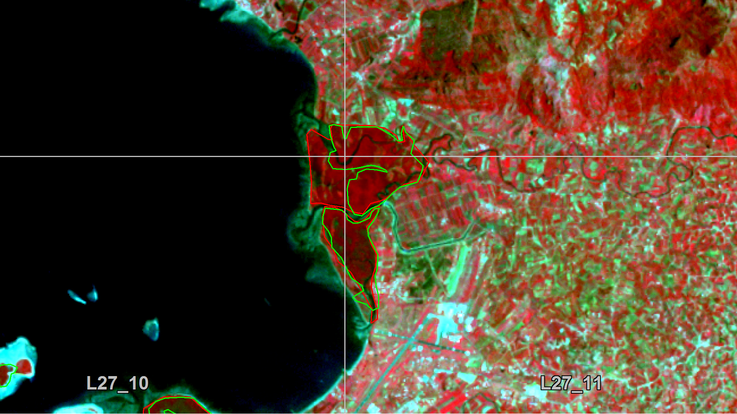
Deforestation

Slide 2
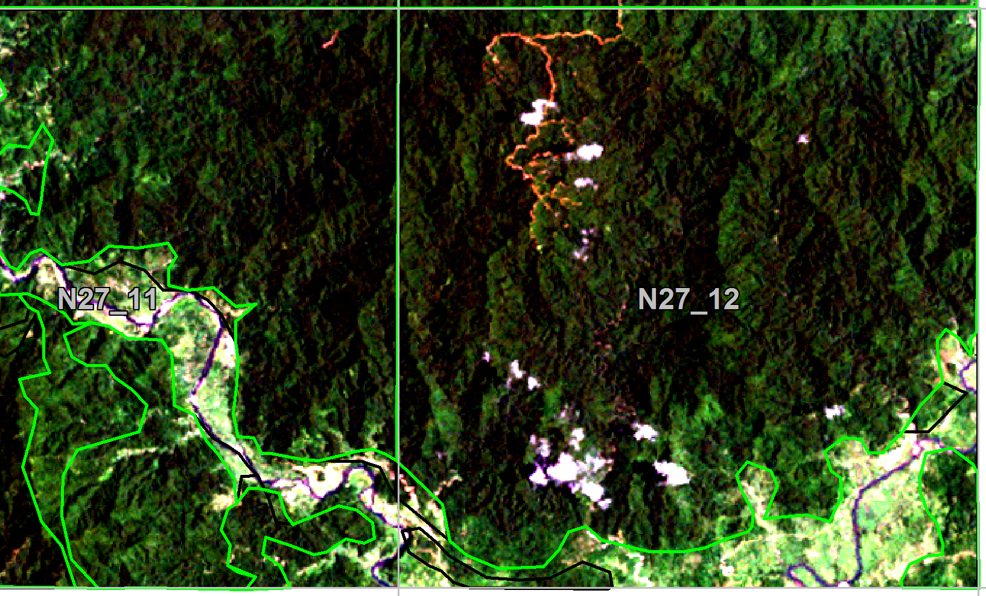
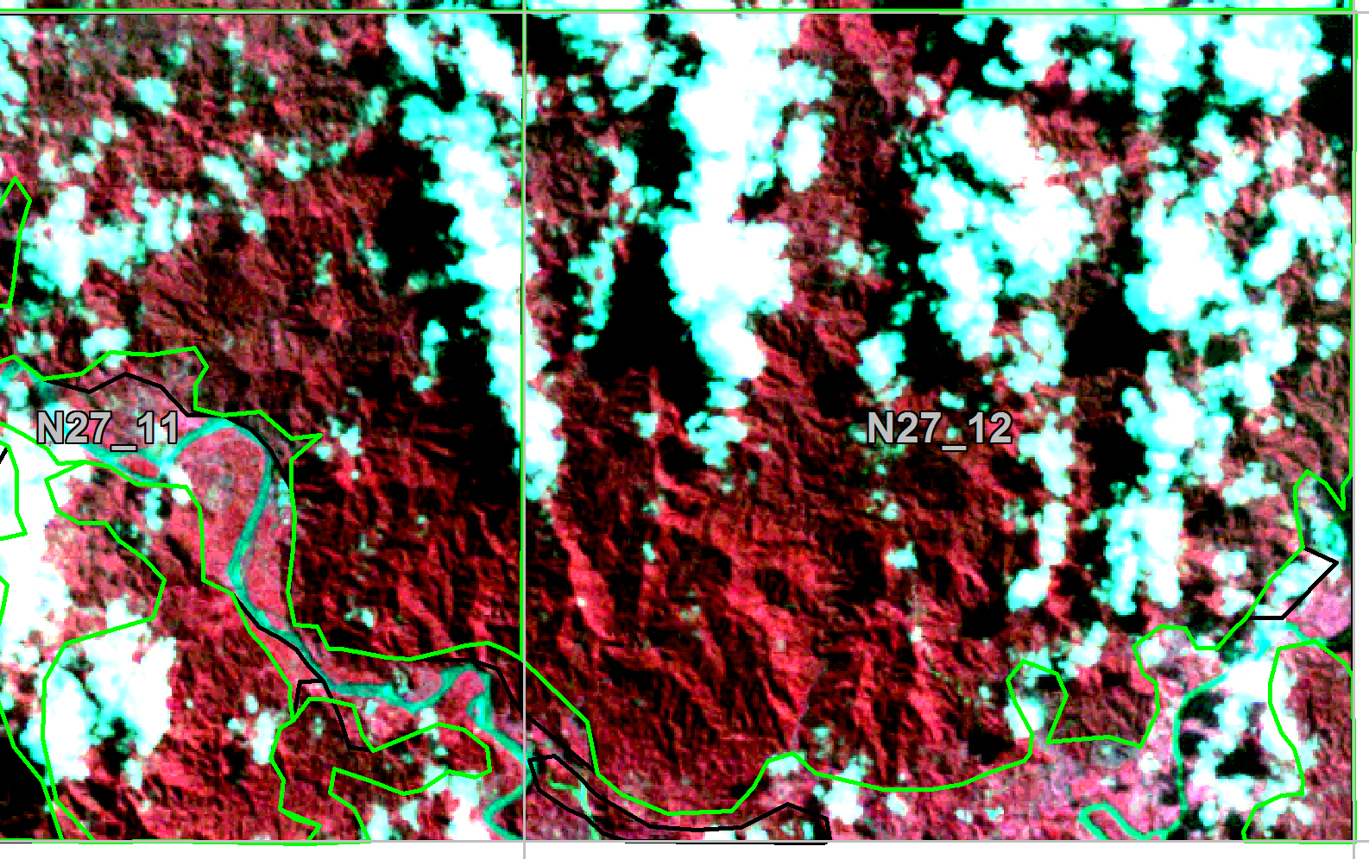
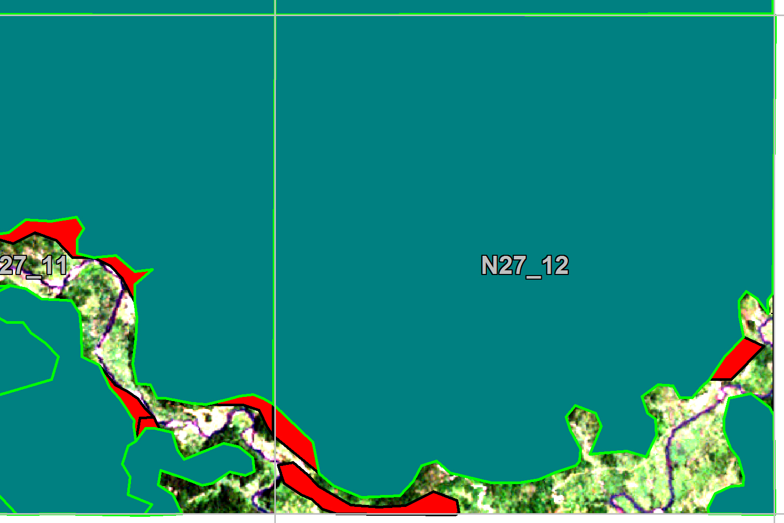
Forest (Area) Change

Slide 3
Problem
Deforestation rate is low but removal of carbon stock takes place!
Canopy cover looks like unlogged forest (selective logging)
Logging roads are only visible for about 3 months

