Slide 1
Niue Tide Gauge and GNSS station
By Hubert M Kalauni
Division : Lands and Survey
Department of Justice, Land & Survey and Community Services
Ministry of Social Services

Slide 2
Overview
General country information
Pacific Sea Level Monitoring Project (PSLMP)
GNSS
Levelling traverse

Slide 3
Where in the Pacific is

Slide 4
More or less between Samoa, Tonga and Rarotonga (Cooks)

Slide 5
How to get to Niue?
The only way anybody can get to the Rock is through NZ and by Air NZ
One flight a week service late November to March
Two flights per week from March to November

Slide 6
Niue Country Information
Location : 19°03'S 169°55'W
Capital: Alofi
A raised atoll consist of three terraces
Highest point at about 70 metres
Niue Total land area is 260 sq km
Population: 1 800 (June 2016 Niue Govt)

Slide 7
Pacific Sea Level Monitoring Project

Slide 8
Background Pacific Sea Level Monitoring Project
Due to the concerns voiced by Pacific Forum leaders about the potential impact of changing climate and sea levels, the Australian Government in the early 1990s established a network of tide gauges to collect sea level and weather data in thirteen Pacific locations.
The project is now called the
Pacific Sea Level Monitoring Project (PSLMP)

Slide 9
Project Overview
Provide continuous, high-quality sea level, climate, and geodetic data for the Pacific Islands.
They provide an indispensable record for meteorological agencies, emergency services, shipping operators, and a huge range of industries across the Pacific Ocean.

Slide 10
From 2010 to 2015, the tide gauges have been progressively refurbished and upgraded, and their number has grown to fourteen.

Slide 11
13 Pacific locations and Niue in 2015

Slide 12
Niue Tide Gauge and GNSS station
The Niue tide gauge is the newest and most technologically advanced addition to the network.
Open in November 2015
The tide gauge was formally launched by the Premier of Niue, the Hon. Toke Talagi; the Australian Government Minister for International Development and the Pacific,Hon. Steven Ciobo MP; and the Director-General of the Pacific Community, Dr Colin Tukuitonga.

Slide 13
The tide gauge comes in three main parts, all connected by underground cabling:

Slide 14
The tide gauge comes in three main parts, all connected by underground cabling:
Niue Tide Gauge – Brief Notes
M. Foo, Australian Bureau of Meteorology, 03 Nov 2015
The tide gauge comes in three main parts, all connected by underground cabling:
The main electronic systems in the weatherproof hut – on the South side of the road going down to the wharf.
The tide gauge sensor platform – on the South side of the wharf.
The wind sensor mast – on the West side of the wharf.
1. The main electronics systems in the weatherproof hut
The hut is made of fibreglass and is a weatherproof enclosure for the main electronics systems.
The hut is strengthened by a stainless steel support structure around it (like a ‘skeleton’), to resist wind and some wave action during storms.
The main electronics systems are:
The datalogging equipment – where the sea level and weather information is recorded, processed and stored.
The data communications equipment – that send the sea level and weather information to the Niue Government and to Australia for further processing.
The Geoscience Australia earth-monitoring receiver systems - that determine the vertical motion of the tide gauge sensor platform and send this information to Australia for further processing.
Supported at the top of the hut are two satellite communications antennas (two different satellite services for increased data communications reliability) and a small GPS antenna (for synchronising the tide gauge time to the global time).
2. The tide gauge sensor platform
Built from stainless steel and is about 3m high.
Supports two radar water level sensors positioned at an optimum height above the water. These are the main water level sensors, and two identical sensors are used for increased reliability.
Supports a water pressure sensor (depth sensor) to get additional information about water level and to crosscheck the information from the two radar water level sensors.
Supports the Geoscience Australia antenna for the built-in earth-monitoring system. This uses the Global Navigation Satellite System (GPS and other satellite positioning systems) to measure the vertical movement of the platform and the attached wharf land.
Supports the water temperature sensor (unfortunately currently needing repair – failures are fortunately rare!).
3. The wind sensor mast
This is a typical 10m stainless steel mast used for a weather station.
The mast supports a wind sensor (‘anemometer’), held at 10m high for a good indication of local wind speed and direction at the wharf site.

Slide 15
2. 1. The main electronics systems in the weatherproof hut
The main electronics systems are:
The data logging equipment – where the sea level and weather information is recorded, processed and stored.
The data communications equipment – that send the sea level and weather information to the Niue Government and to Australia for further processing.
The Geoscience Australia earth-monitoring receiver systems - that determine the vertical motion of the tide gauge sensor platform and send this information to Australia for further processing.
Supported at the top of the hut are two satellite communications antennas (two different satellite services for increased data communications reliability) and a small GPS antenna (for synchronising the tide gauge time to the global time).

Slide 16
2. The tide gauge sensor platform
Built from stainless steel and is about 3m high.
Supports two radar water level sensors positioned at an optimum height above the water. These are the main water level sensors, and two identical sensors are used for increased reliability.
Supports a water pressure sensor (depth sensor) to get additional information about water level and to crosscheck the information from the two radar water level sensors.
Supports the Geoscience Australia antenna for the built-in earth-monitoring system. This uses the Global Navigation Satellite System (GPS and other satellite positioning systems) to measure the vertical movement of the platform and the attached wharf land.
Supports the water temperature sensor (unfortunately currently needing repair – failures are fortunately rare!).

Slide 17
3. The wind sensor mast
This is a typical 10m stainless steel mast used for a weather station.
The mast supports a wind sensor (‘anemometer’), held at 10m high for a good indication of local wind speed and direction at the wharf site.

Slide 18
1. The tide gauge sensor platform
2. The main electronics systems in the weatherproof hut
3. The wind sensor mast
GNSS Station

Slide 19
1. Tide Gauge platform

Slide 21
2. The main electronic systems in the weatherproof hut.

Slide 22
3. The wind sensor mast – on the West side of the wharf.

Slide 23
The GNSS Station Located some 3 km at the Metrological Office

Slide 24
And Continuous Operating Reference Stations (CORS)

Slide 25
Levelling Traverse

Slide 26
Niue Datum : Tomb Point 18.86 m above MSL

Slide 28
Benefit to Niue
Information on tide prediction for local fishermen
Weather related data for the local weather station
Improved weather forecasting
Improved Height and MSL re-determination

Slide 29
To the Region
Participate with other Pacific Countries on the PSLMP
Dr Tukuitonga at the opening
“It's going to provide information that is valuable to the whole region, not just Niue."

Slide 30
Issues after opening
Wind sensor not working
Sea water sensor needs repair
Height information such as MSL from the tide gauge is not yet available to the local surveying authority.
Limited data available from the COSPPAC site

Slide 31
Acknowledgement
B R Thomas - Geoscience Australia
and A Lal – Geoscience Division, SPC with their report.
“Height Traverse Levelling & GNSS Monitoring Survey Report.
Alofi, August 2014”
Niue Meterogical Dept Niue
Geoscience Division, SPC

Slide 32
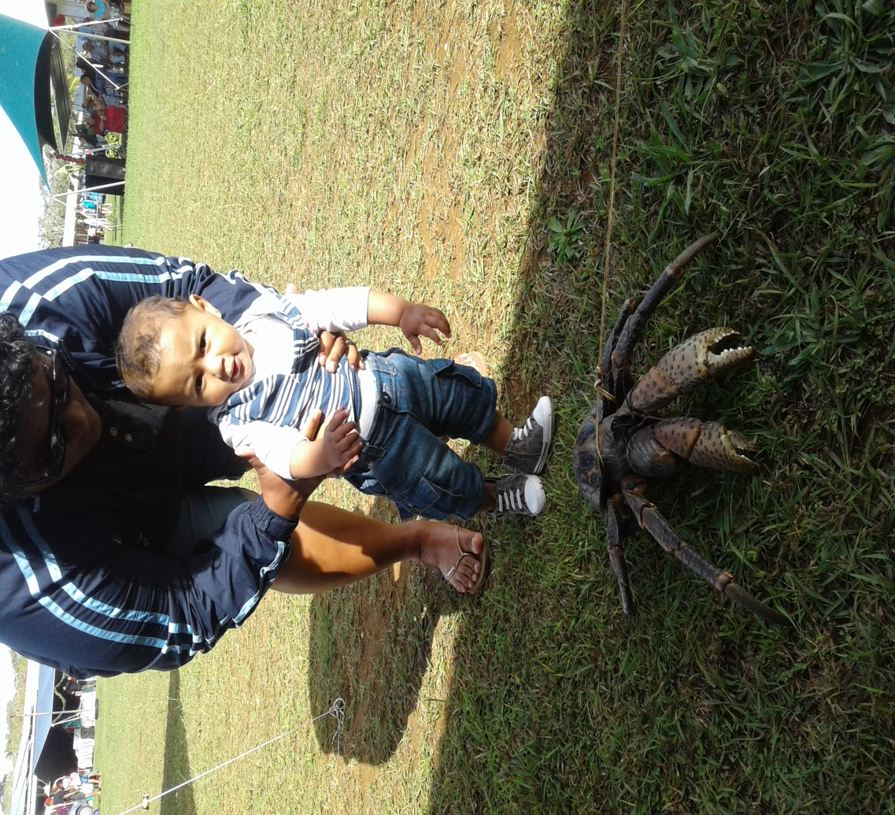
Thank you

