Slide 1
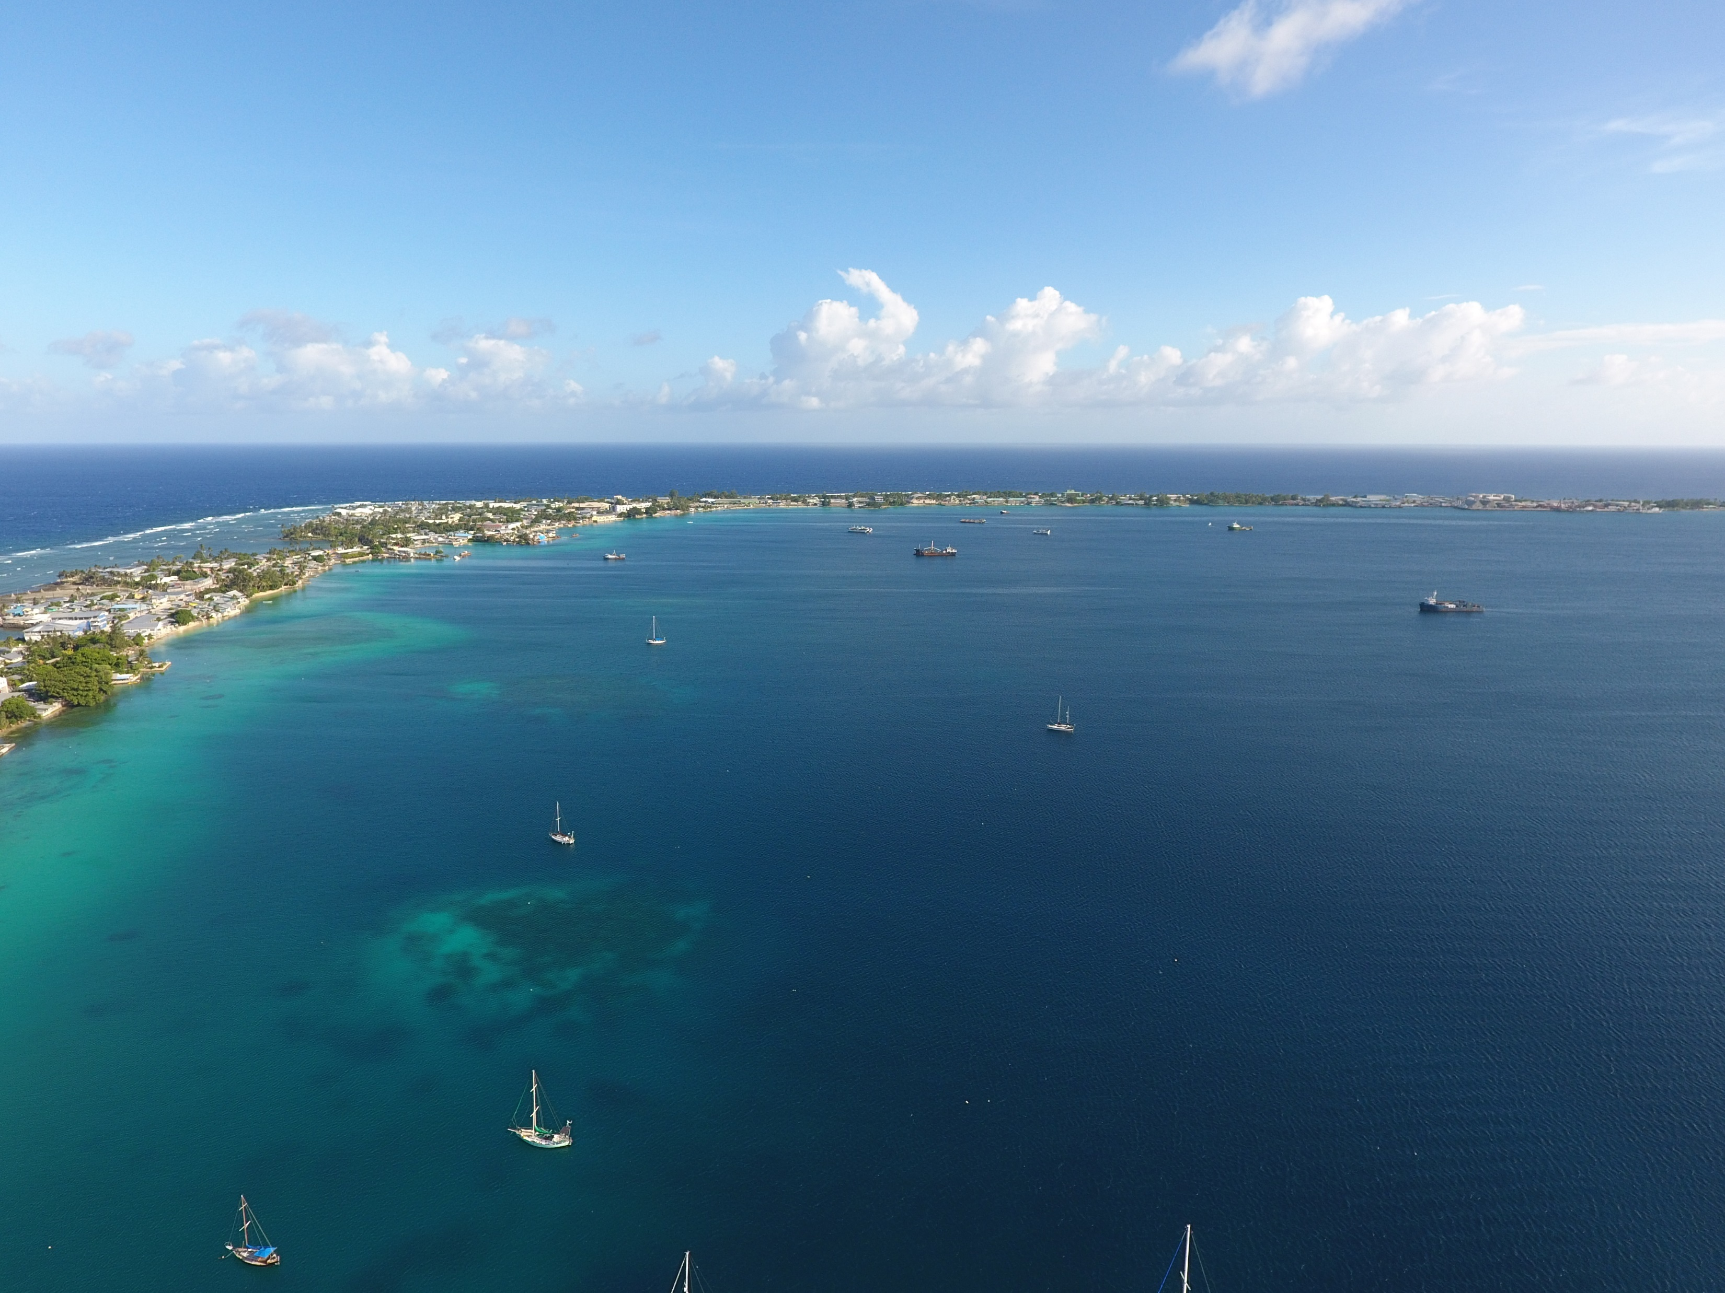
Mapping of Majuro Atoll using a low-cost UAV
Maria Kottermair
University of Guam
Andrea Jalandoni
Griffith University
Pacific Islands GIS&RS User Conference
November 30, 2016

Slide 3
Big picture: 1-meter DEM from Majuro to Laura
Our Goal: Map using low-cost UAV
In 10 days!
Laura
Majuro
8.8 km²
Notes:
2185 acres

Slide 4
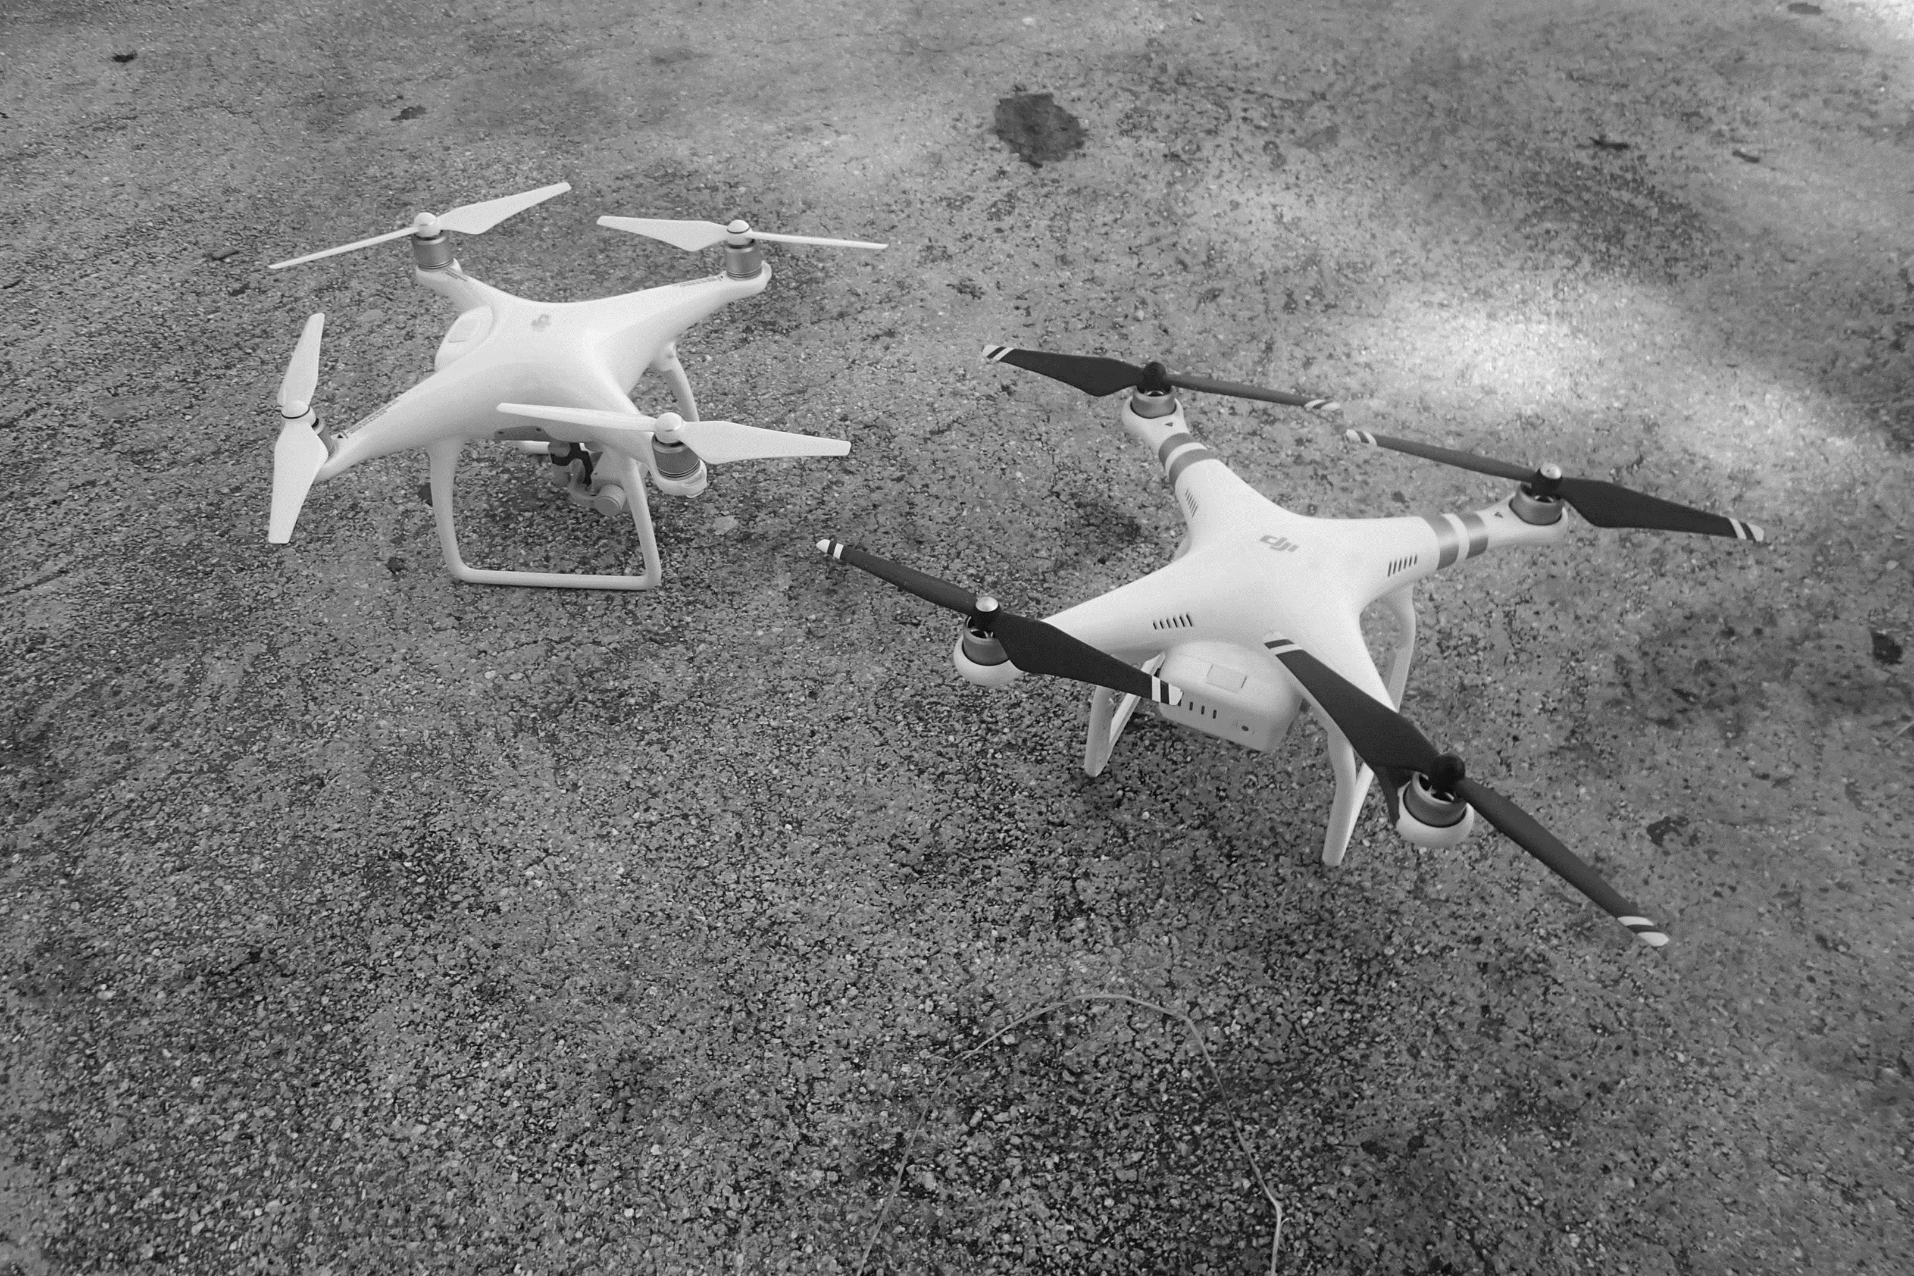
DJI Phantom 4
28’ max flight time
3+ miles-range
Better camera
DJI Phantom 3 Pro
23’ max flight time
~1 miles-range

Slide 5
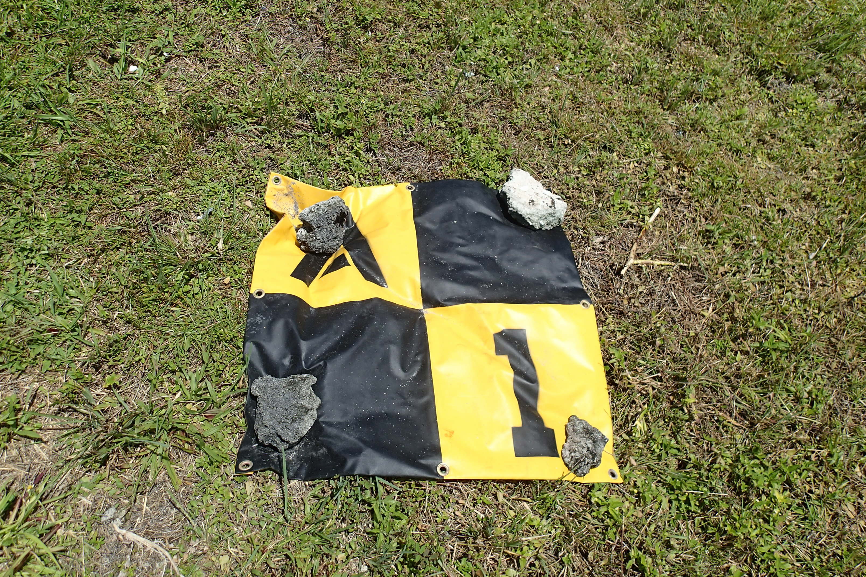
Survey Parameters
40-meter buffer around shoreline increased size by 57 %
(8.8 km² => 13.8 km²)
Altitude 125 m
Photograph resolution = 2.3 cm/pix
Post-processed resolution = 5.4 cm/pix
75% Side and Front Overlap
Vertical and oblique data sets

Slide 6
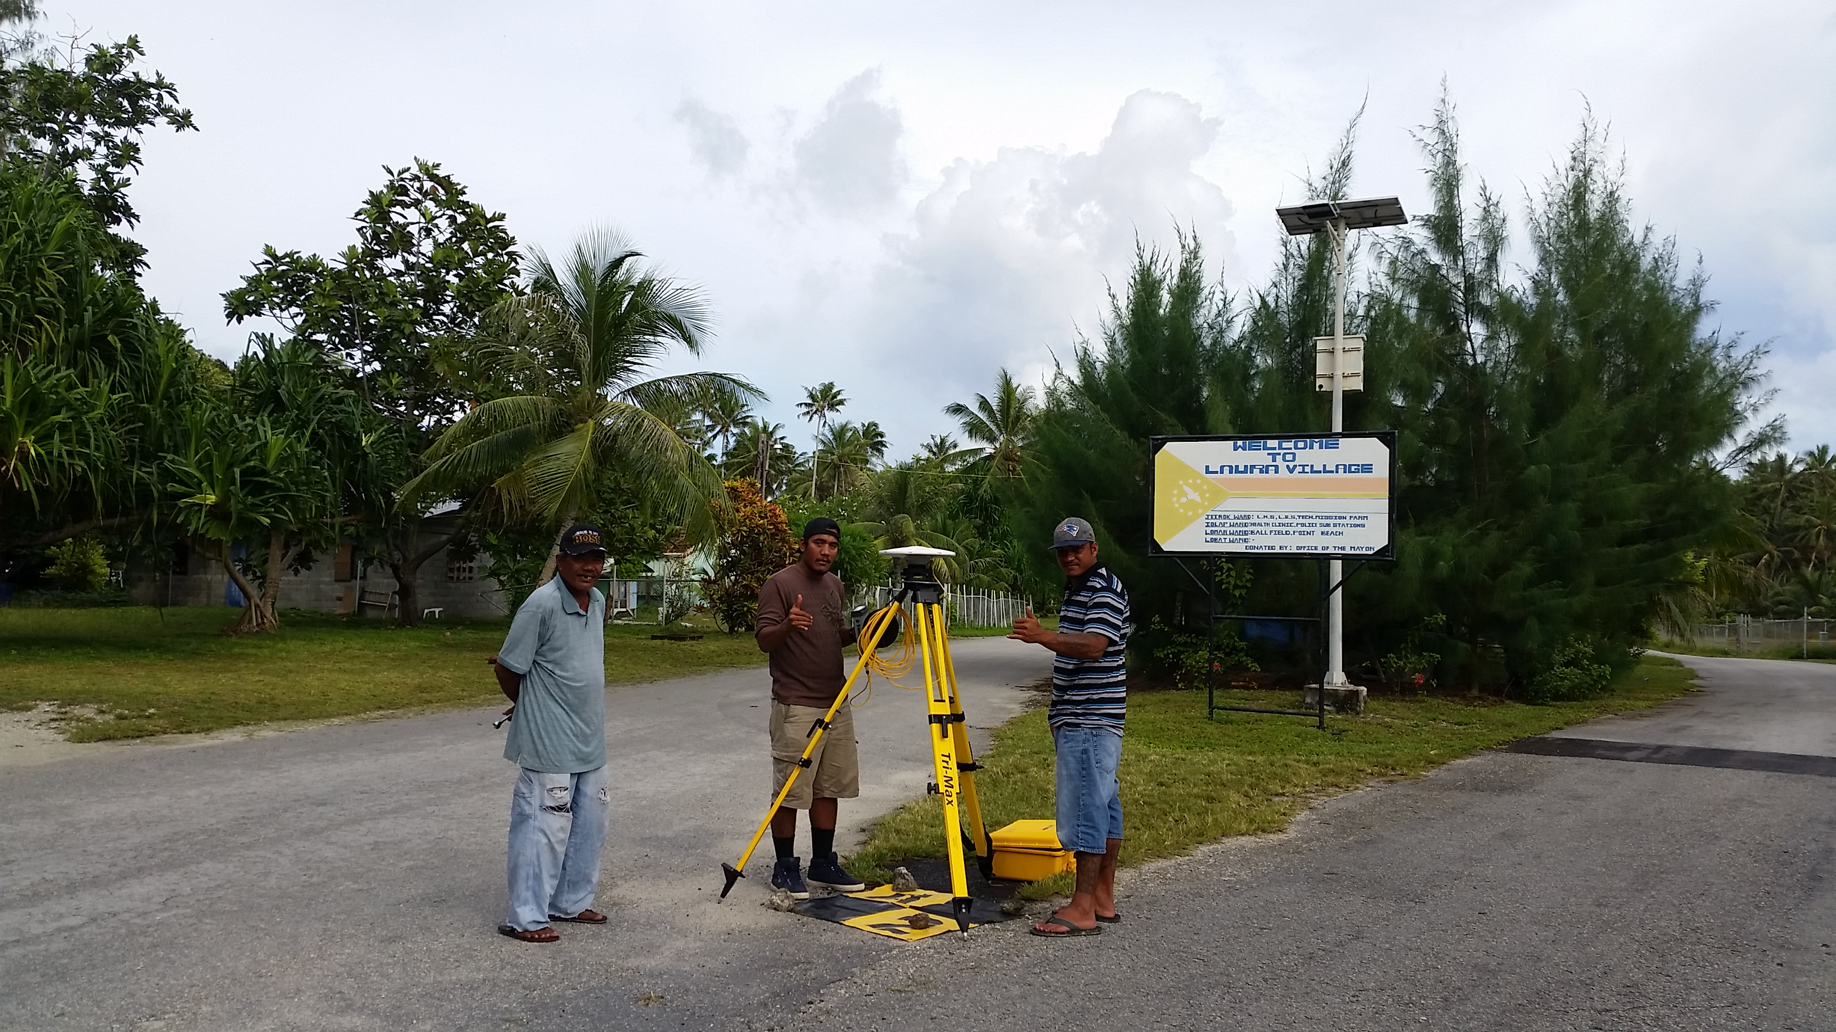
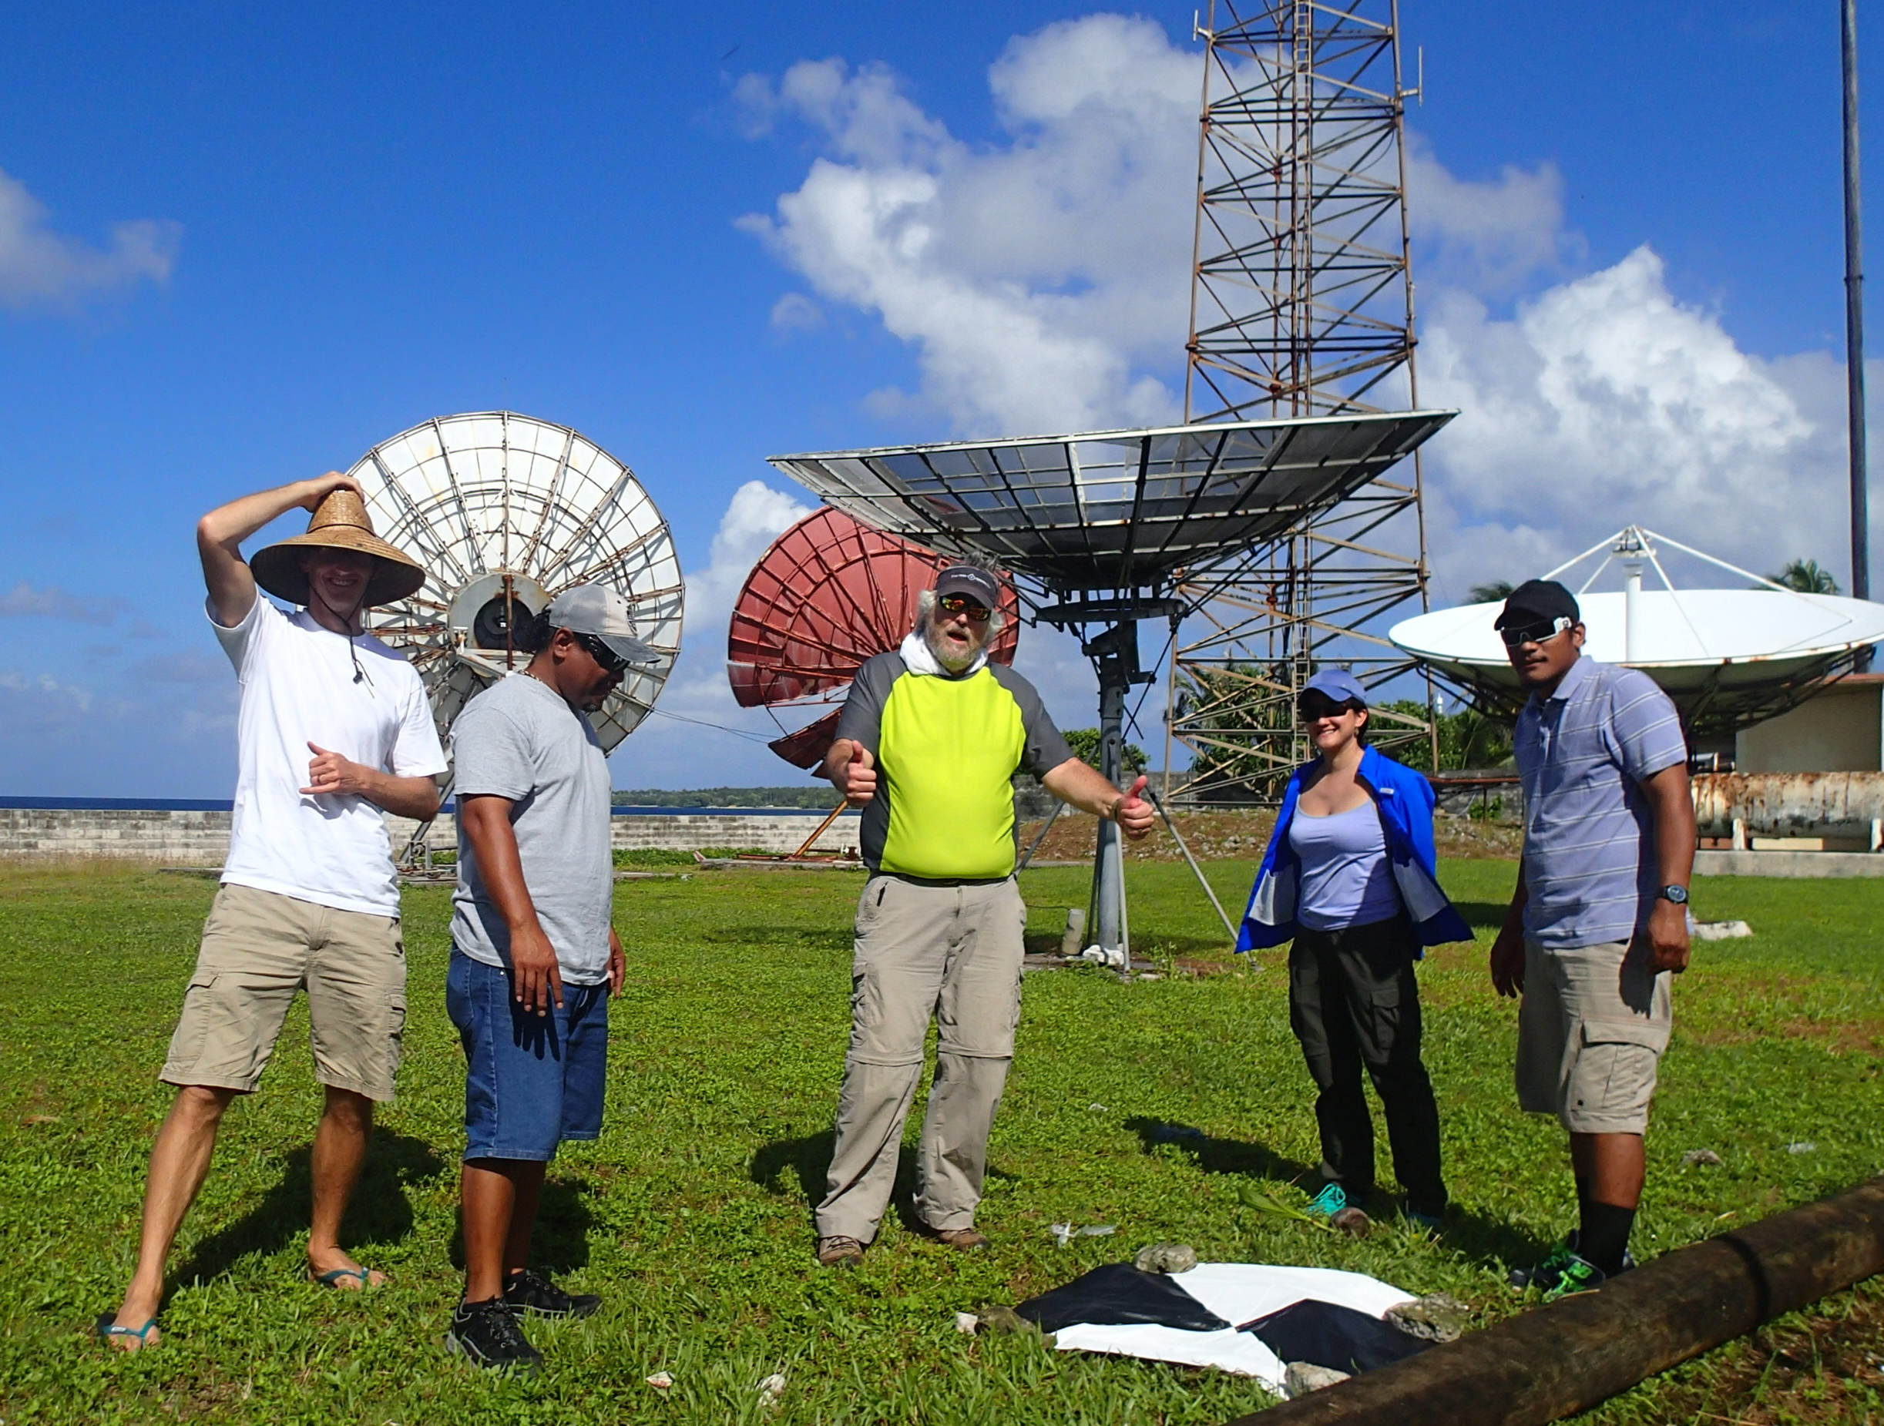
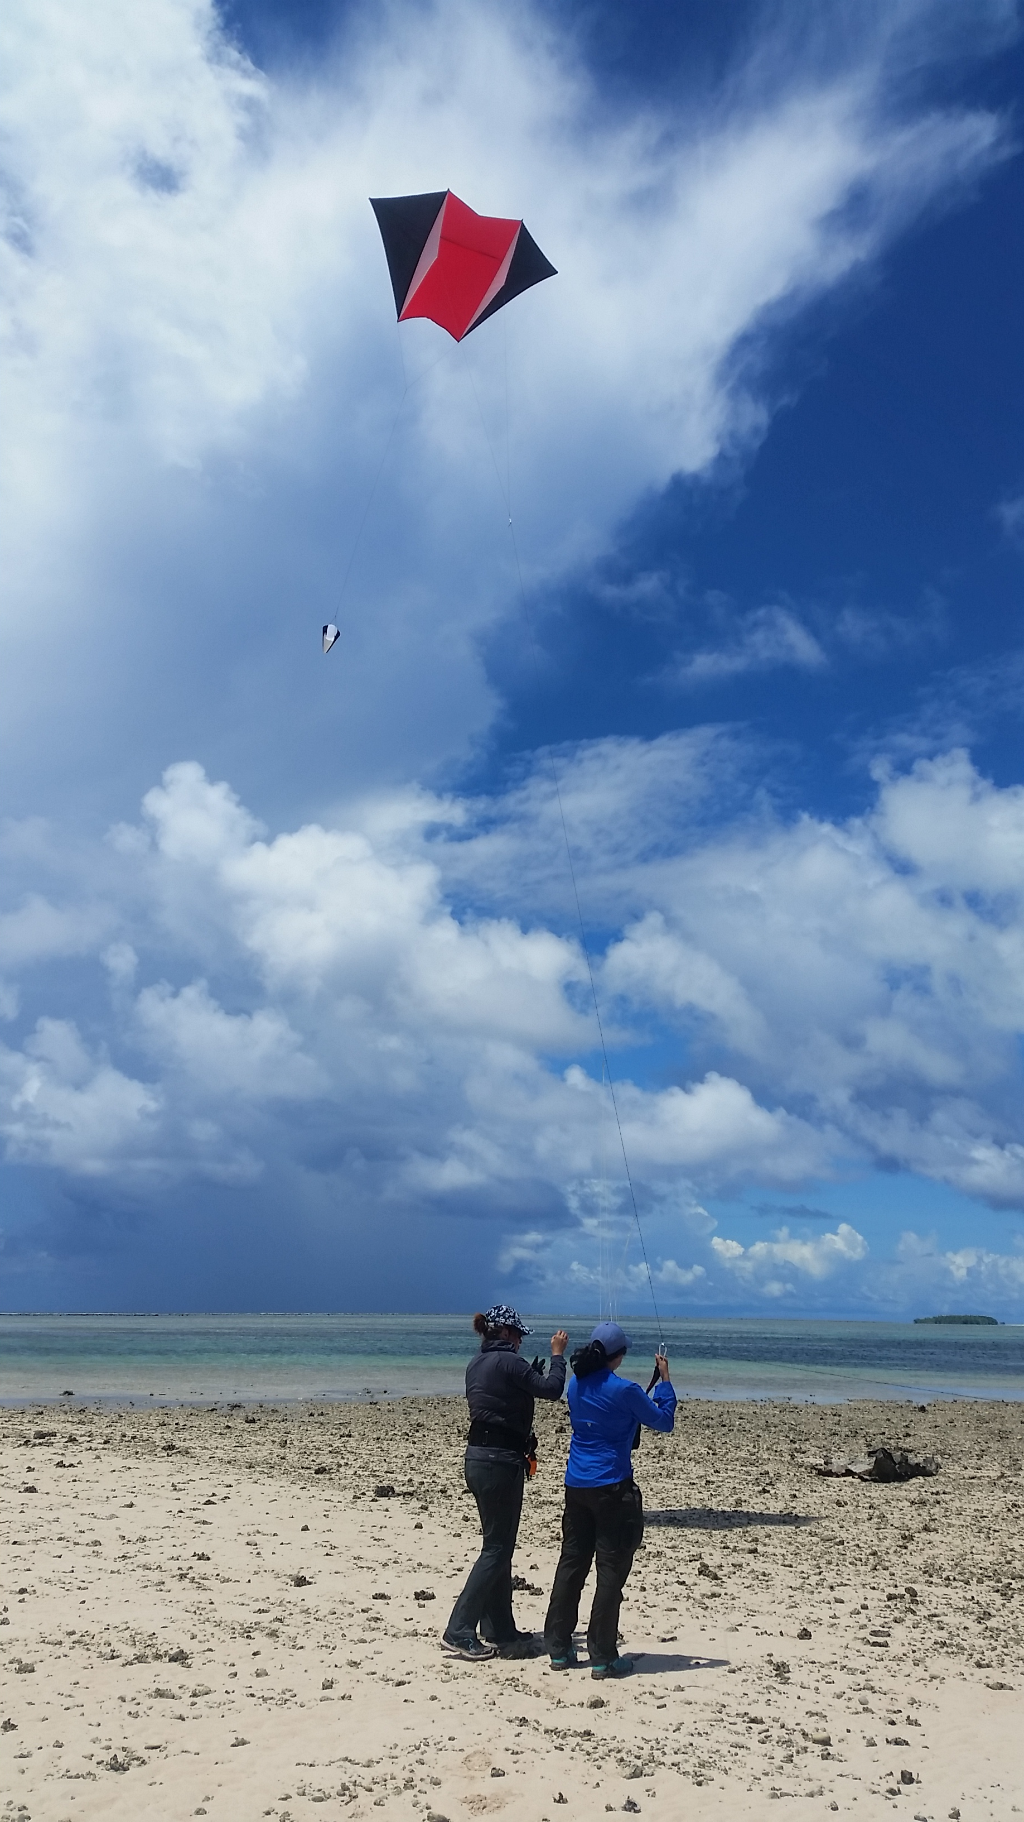
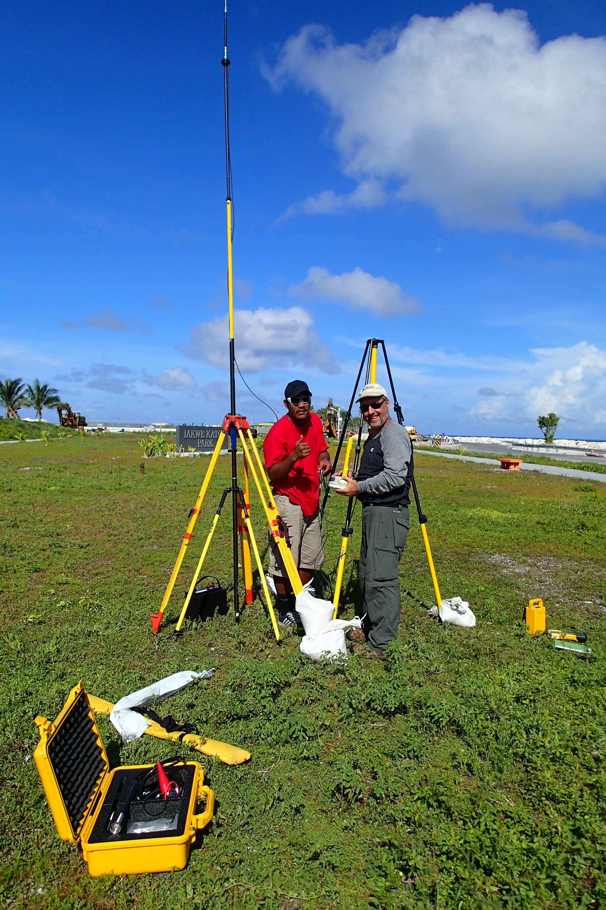
Concurrent surveys
Survey-grade GPS receivers & total station

Slide 7
Concurrent surveys
Survey-grade GPS receivers & total station

Slide 10
Flight path & Camera locations

Slide 11
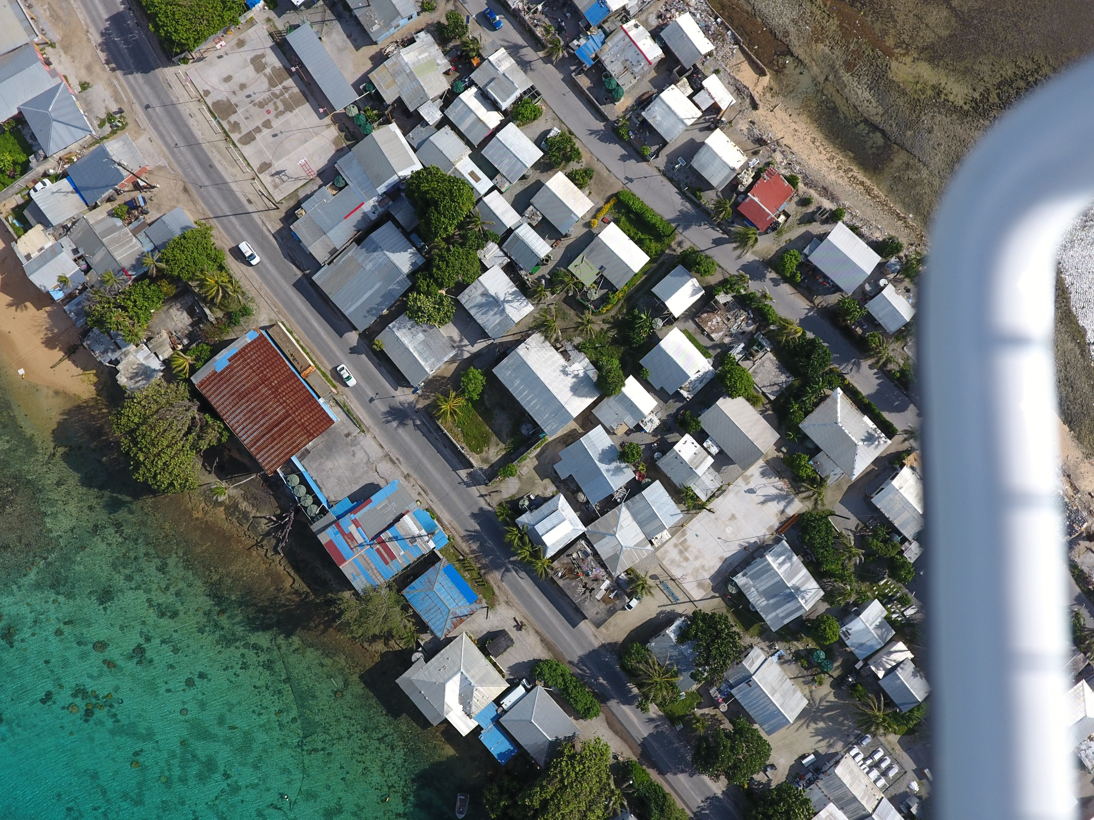
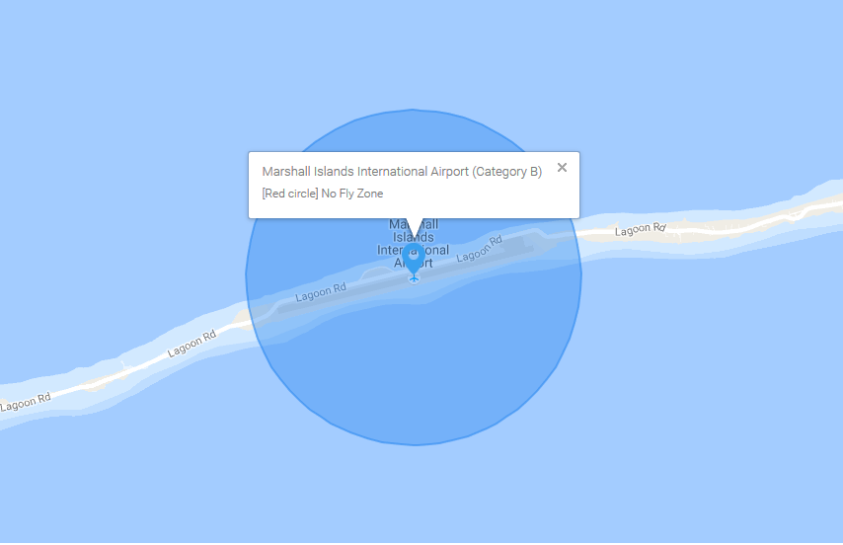
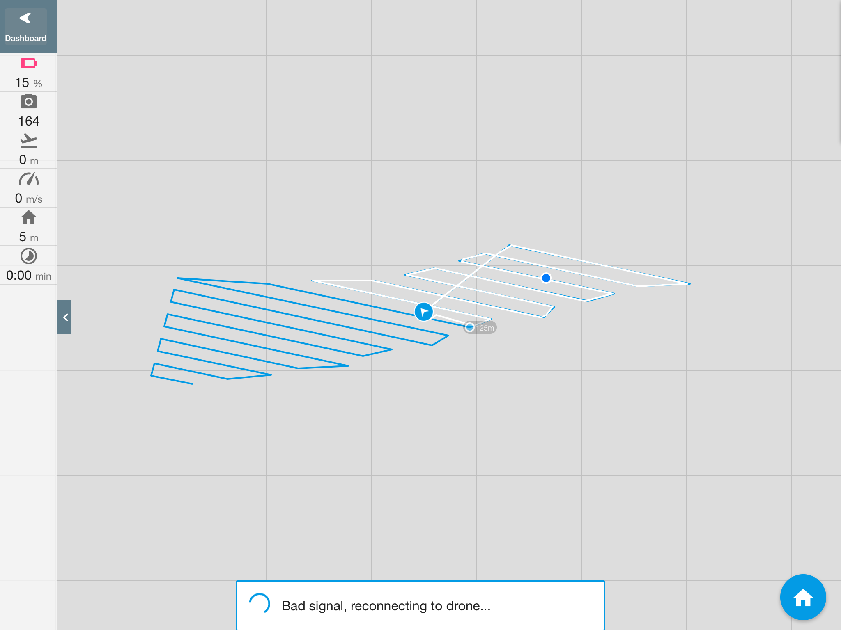
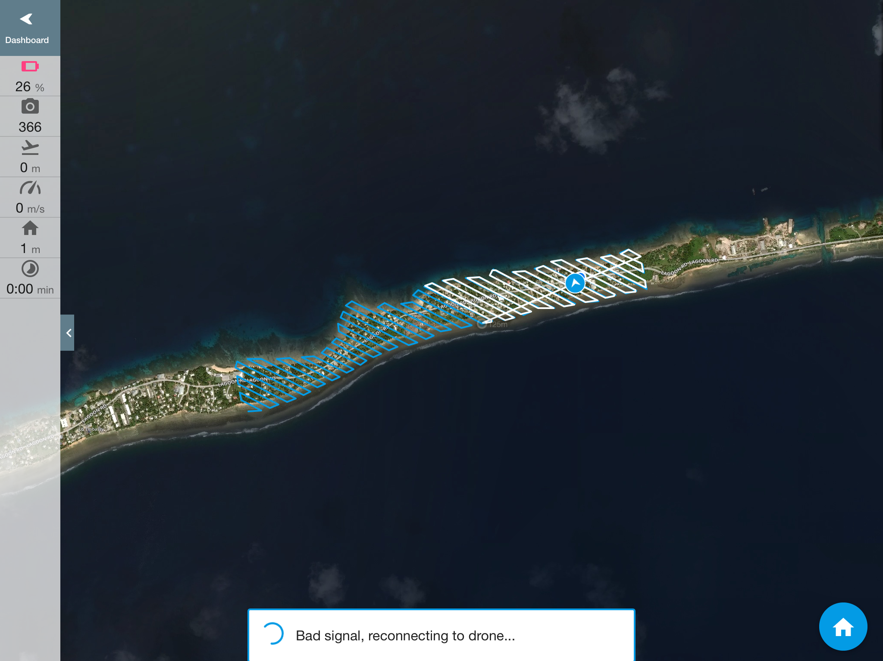
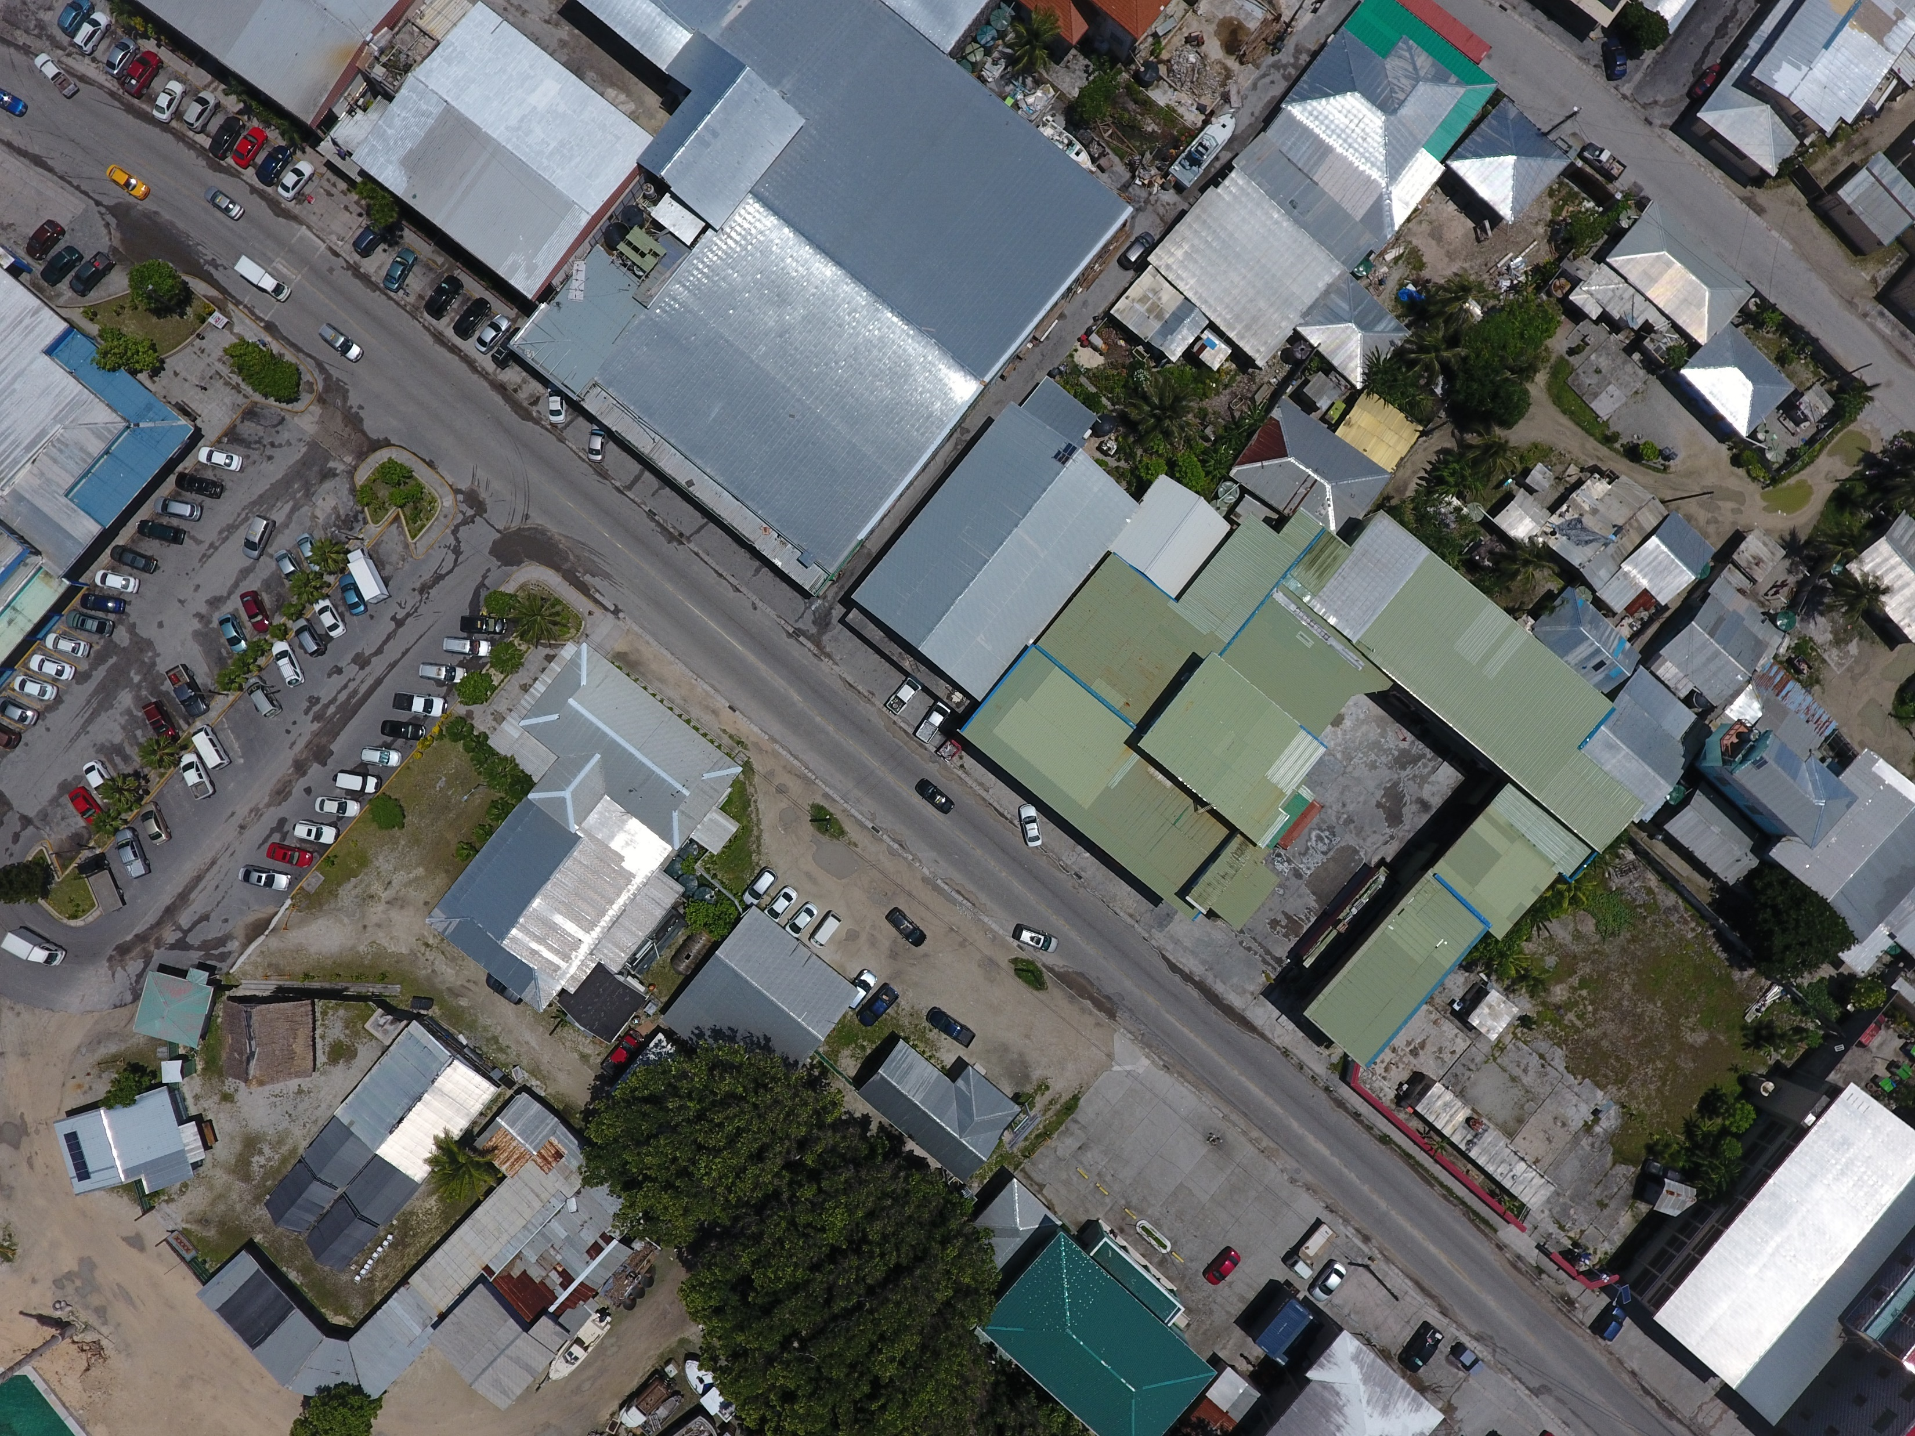
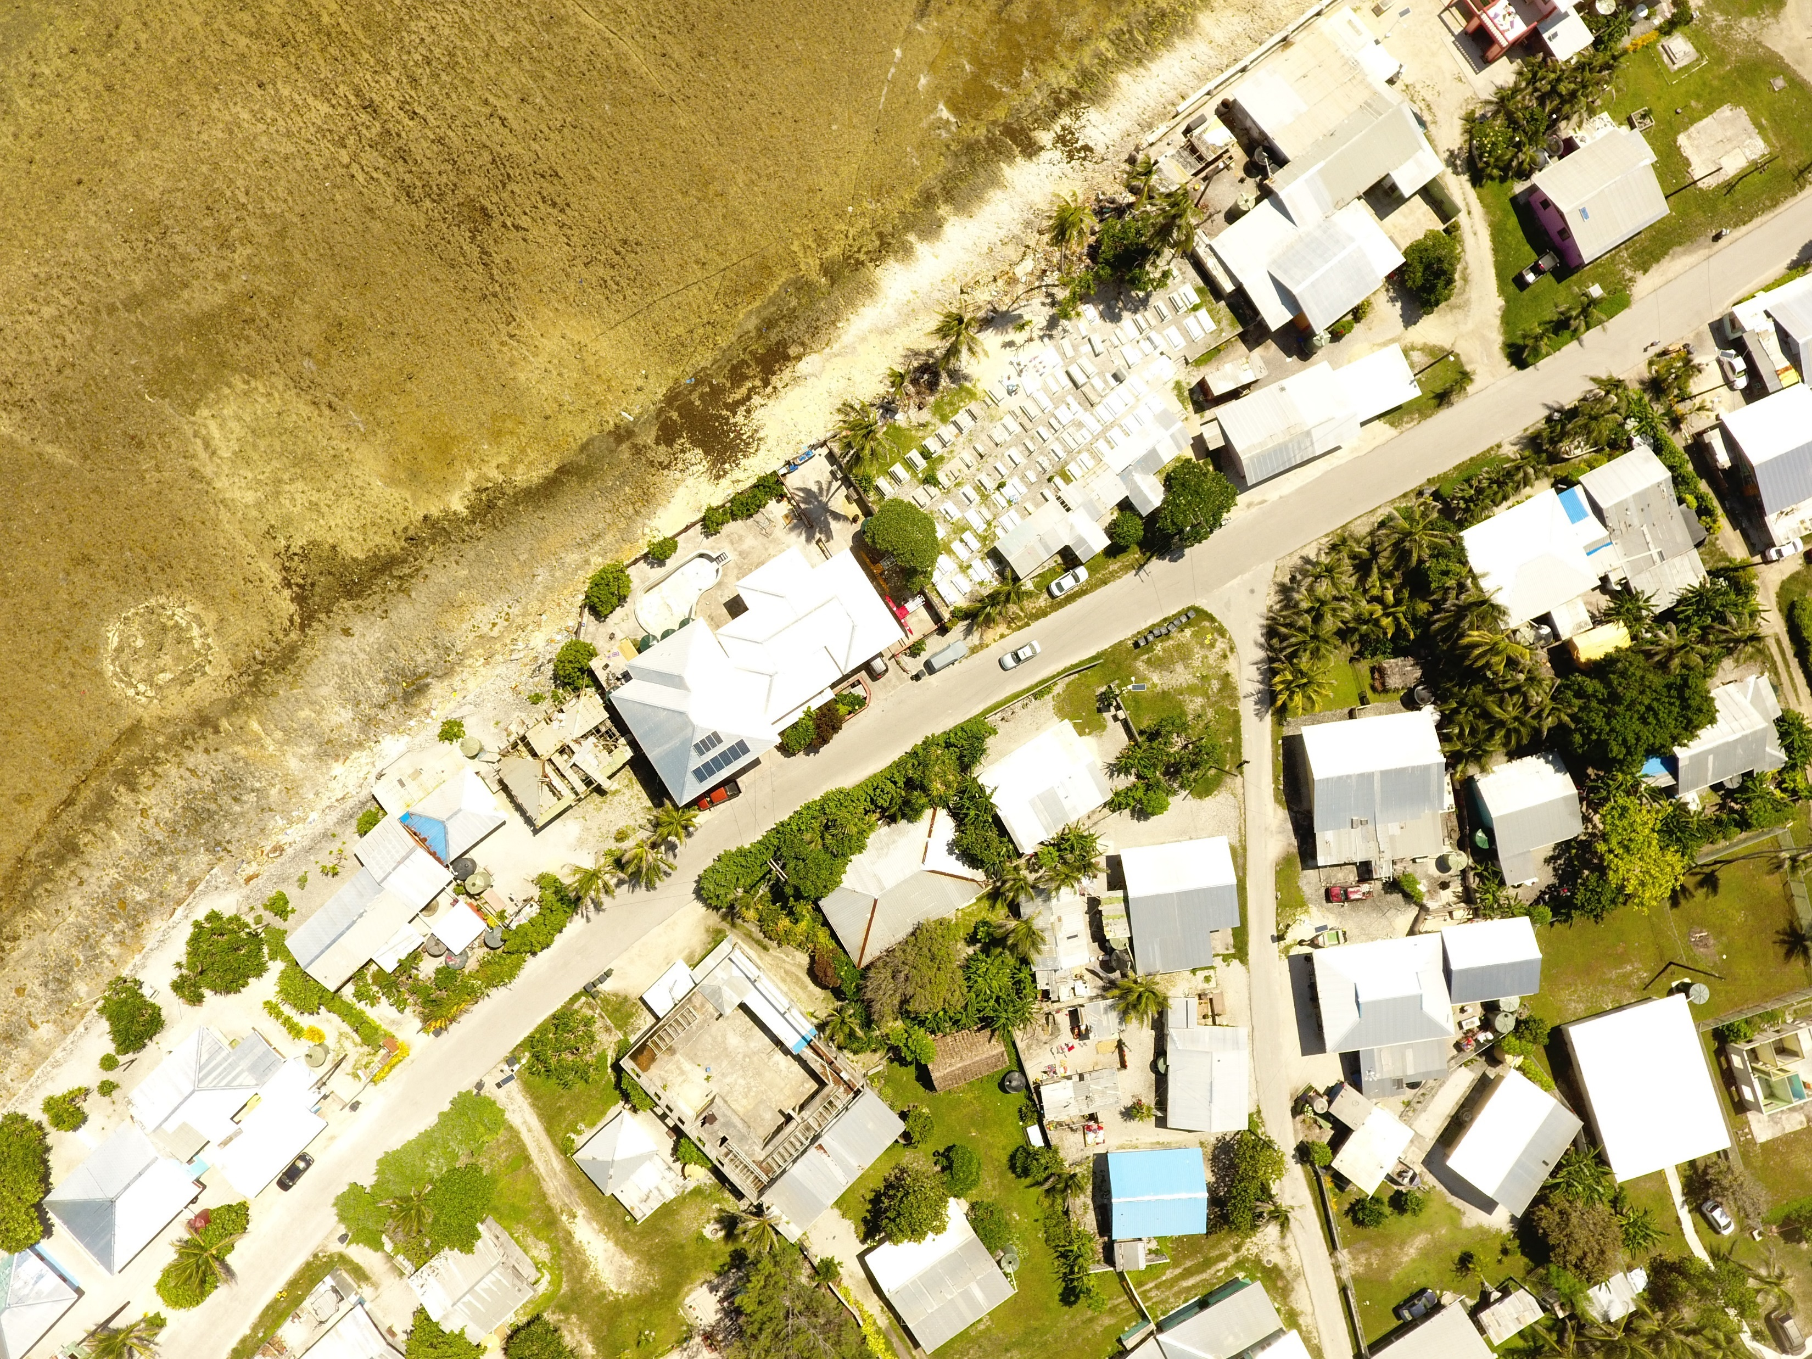
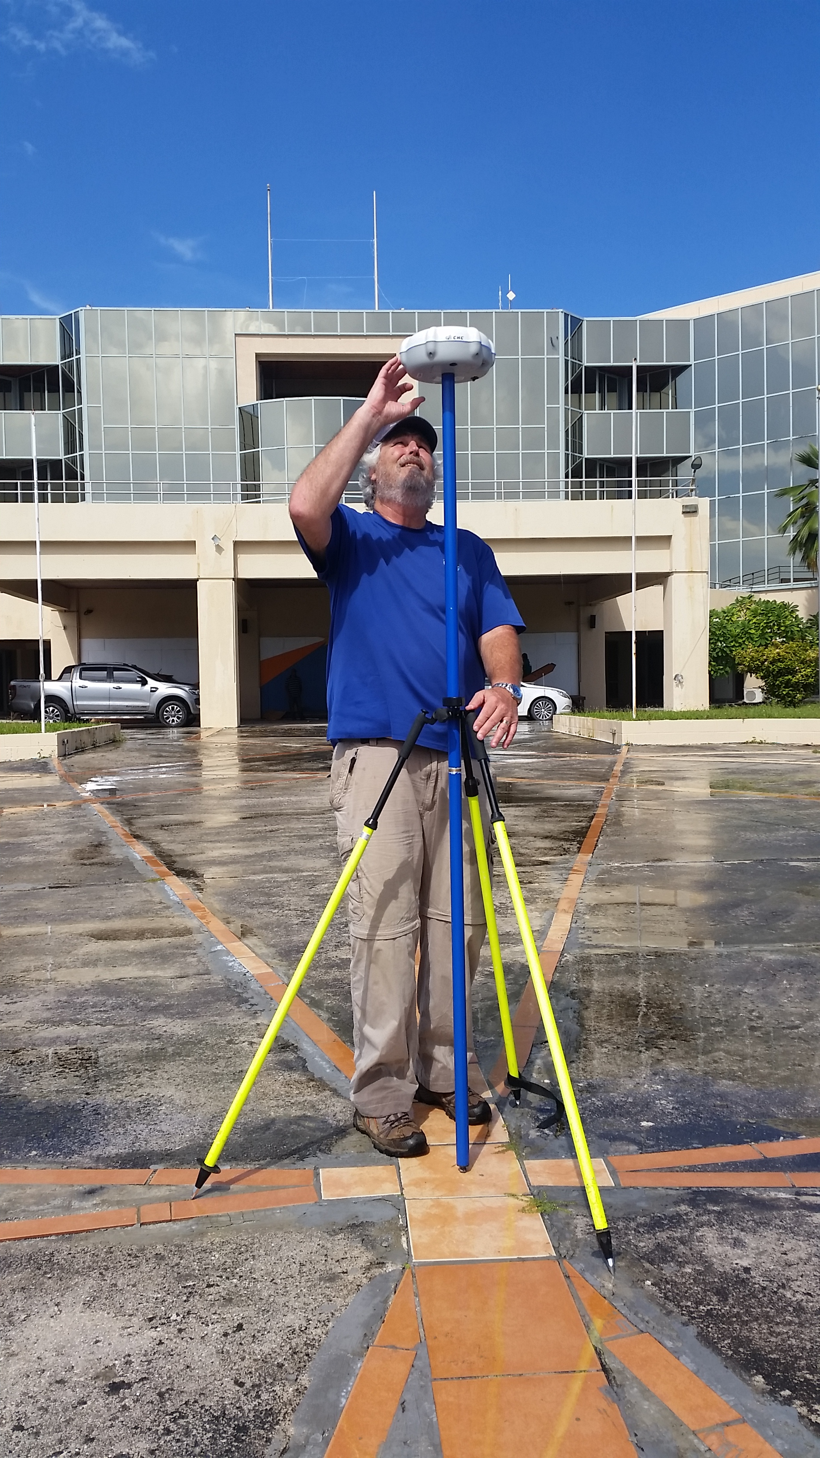
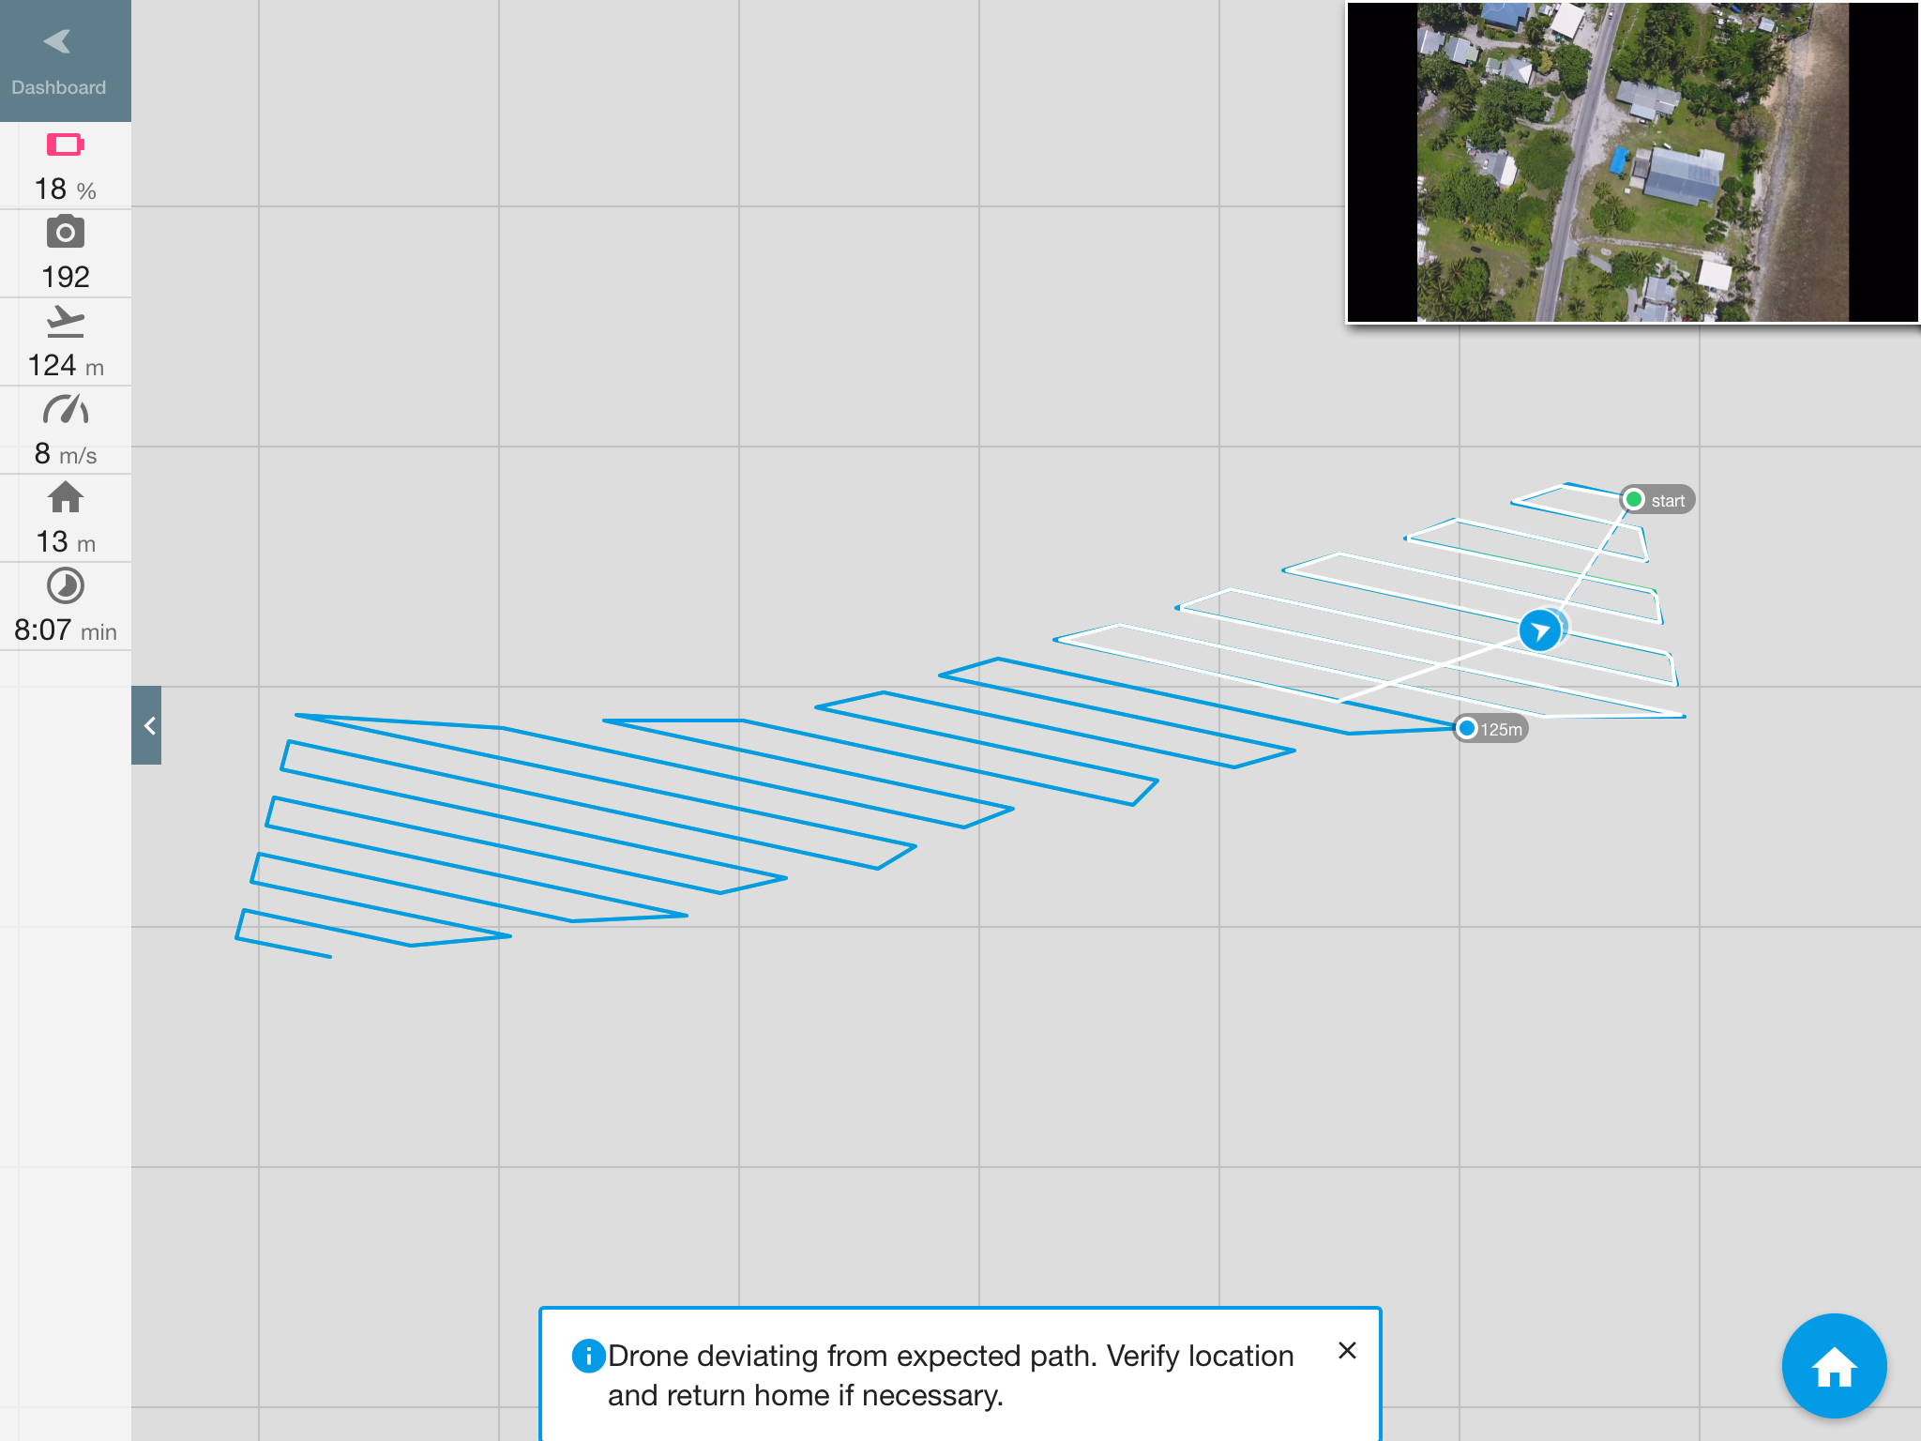
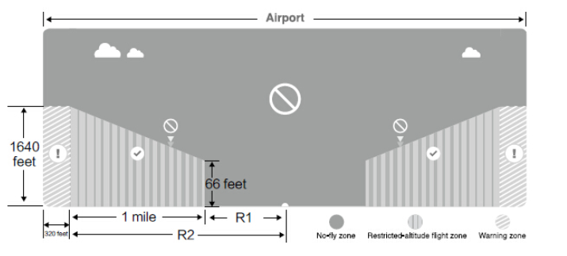
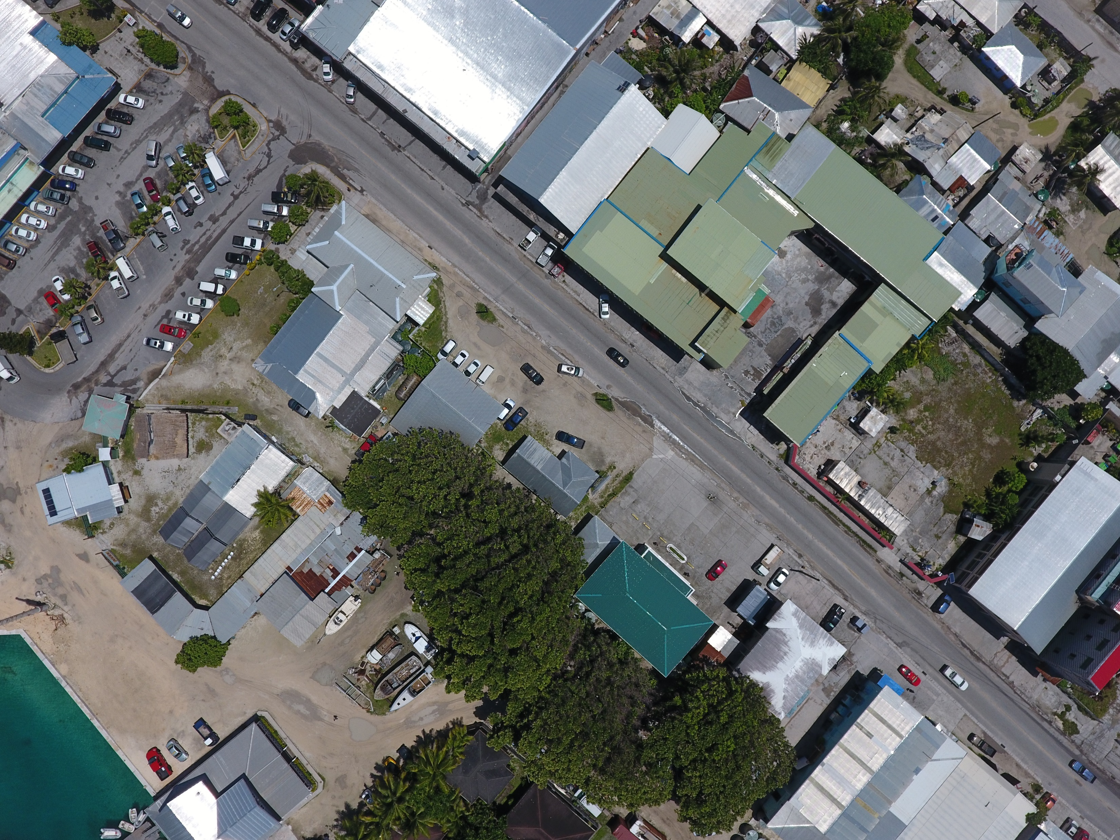
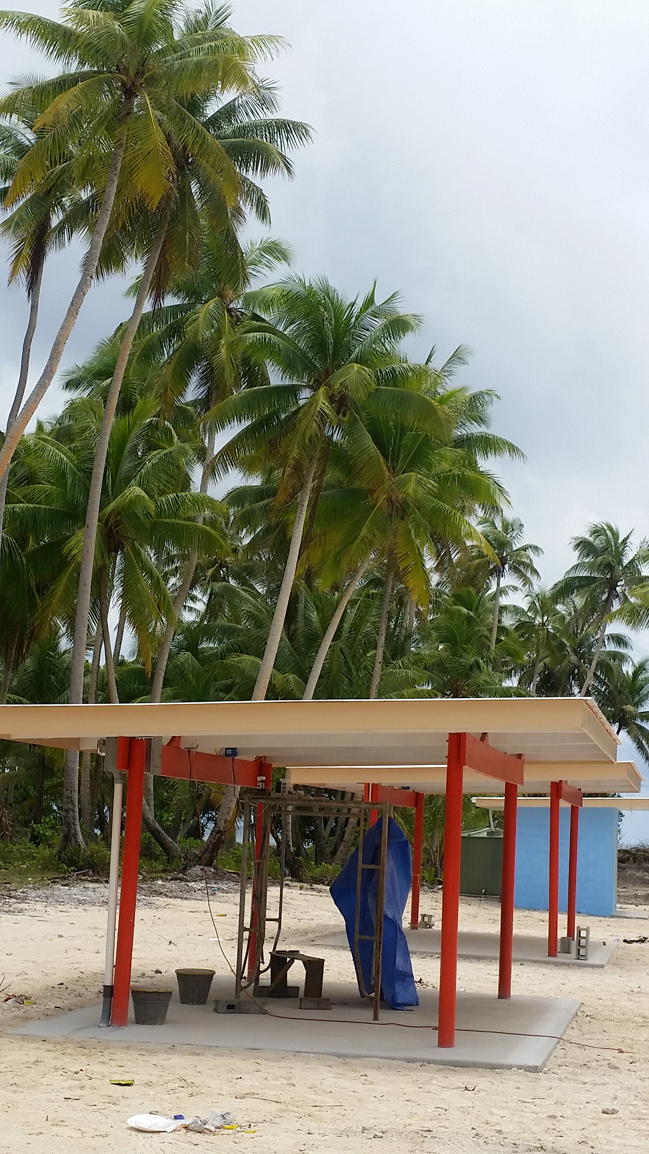
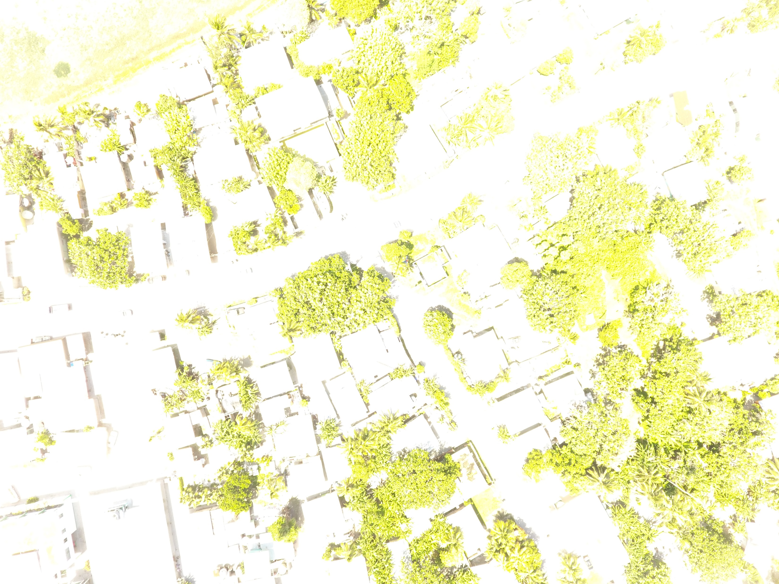
Challenges
HARDWARE
Failure – RF interference??
Overheating
SOFTWARE
No-fly zones
App restrictions

Slide 12
Challenges
ENVIRONMENT
Weather
Glare
Tides
Takeoff location
LOGISTICS
Charging battery
Transportation
Targets
HUMAN ERROR
Wrong settings

Slide 13
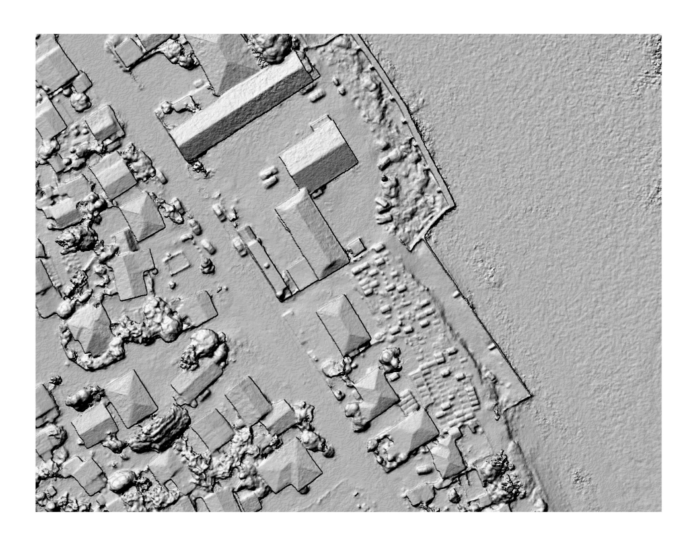
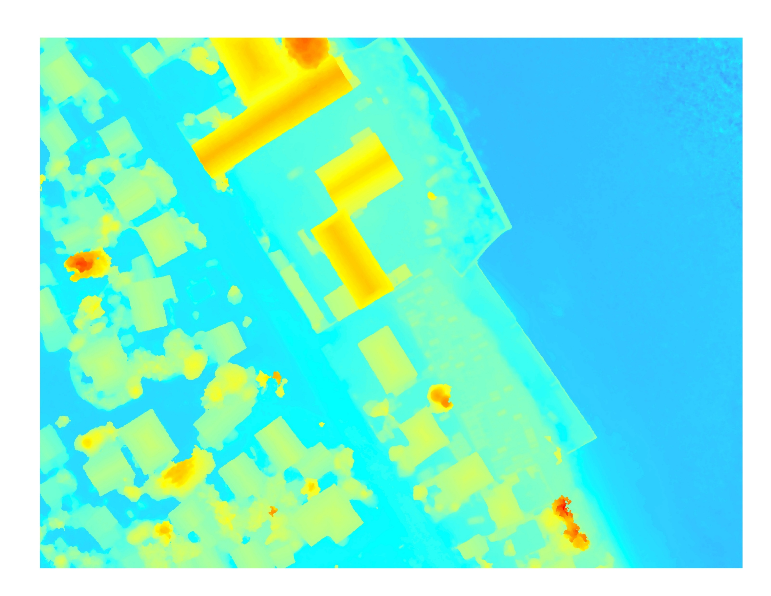
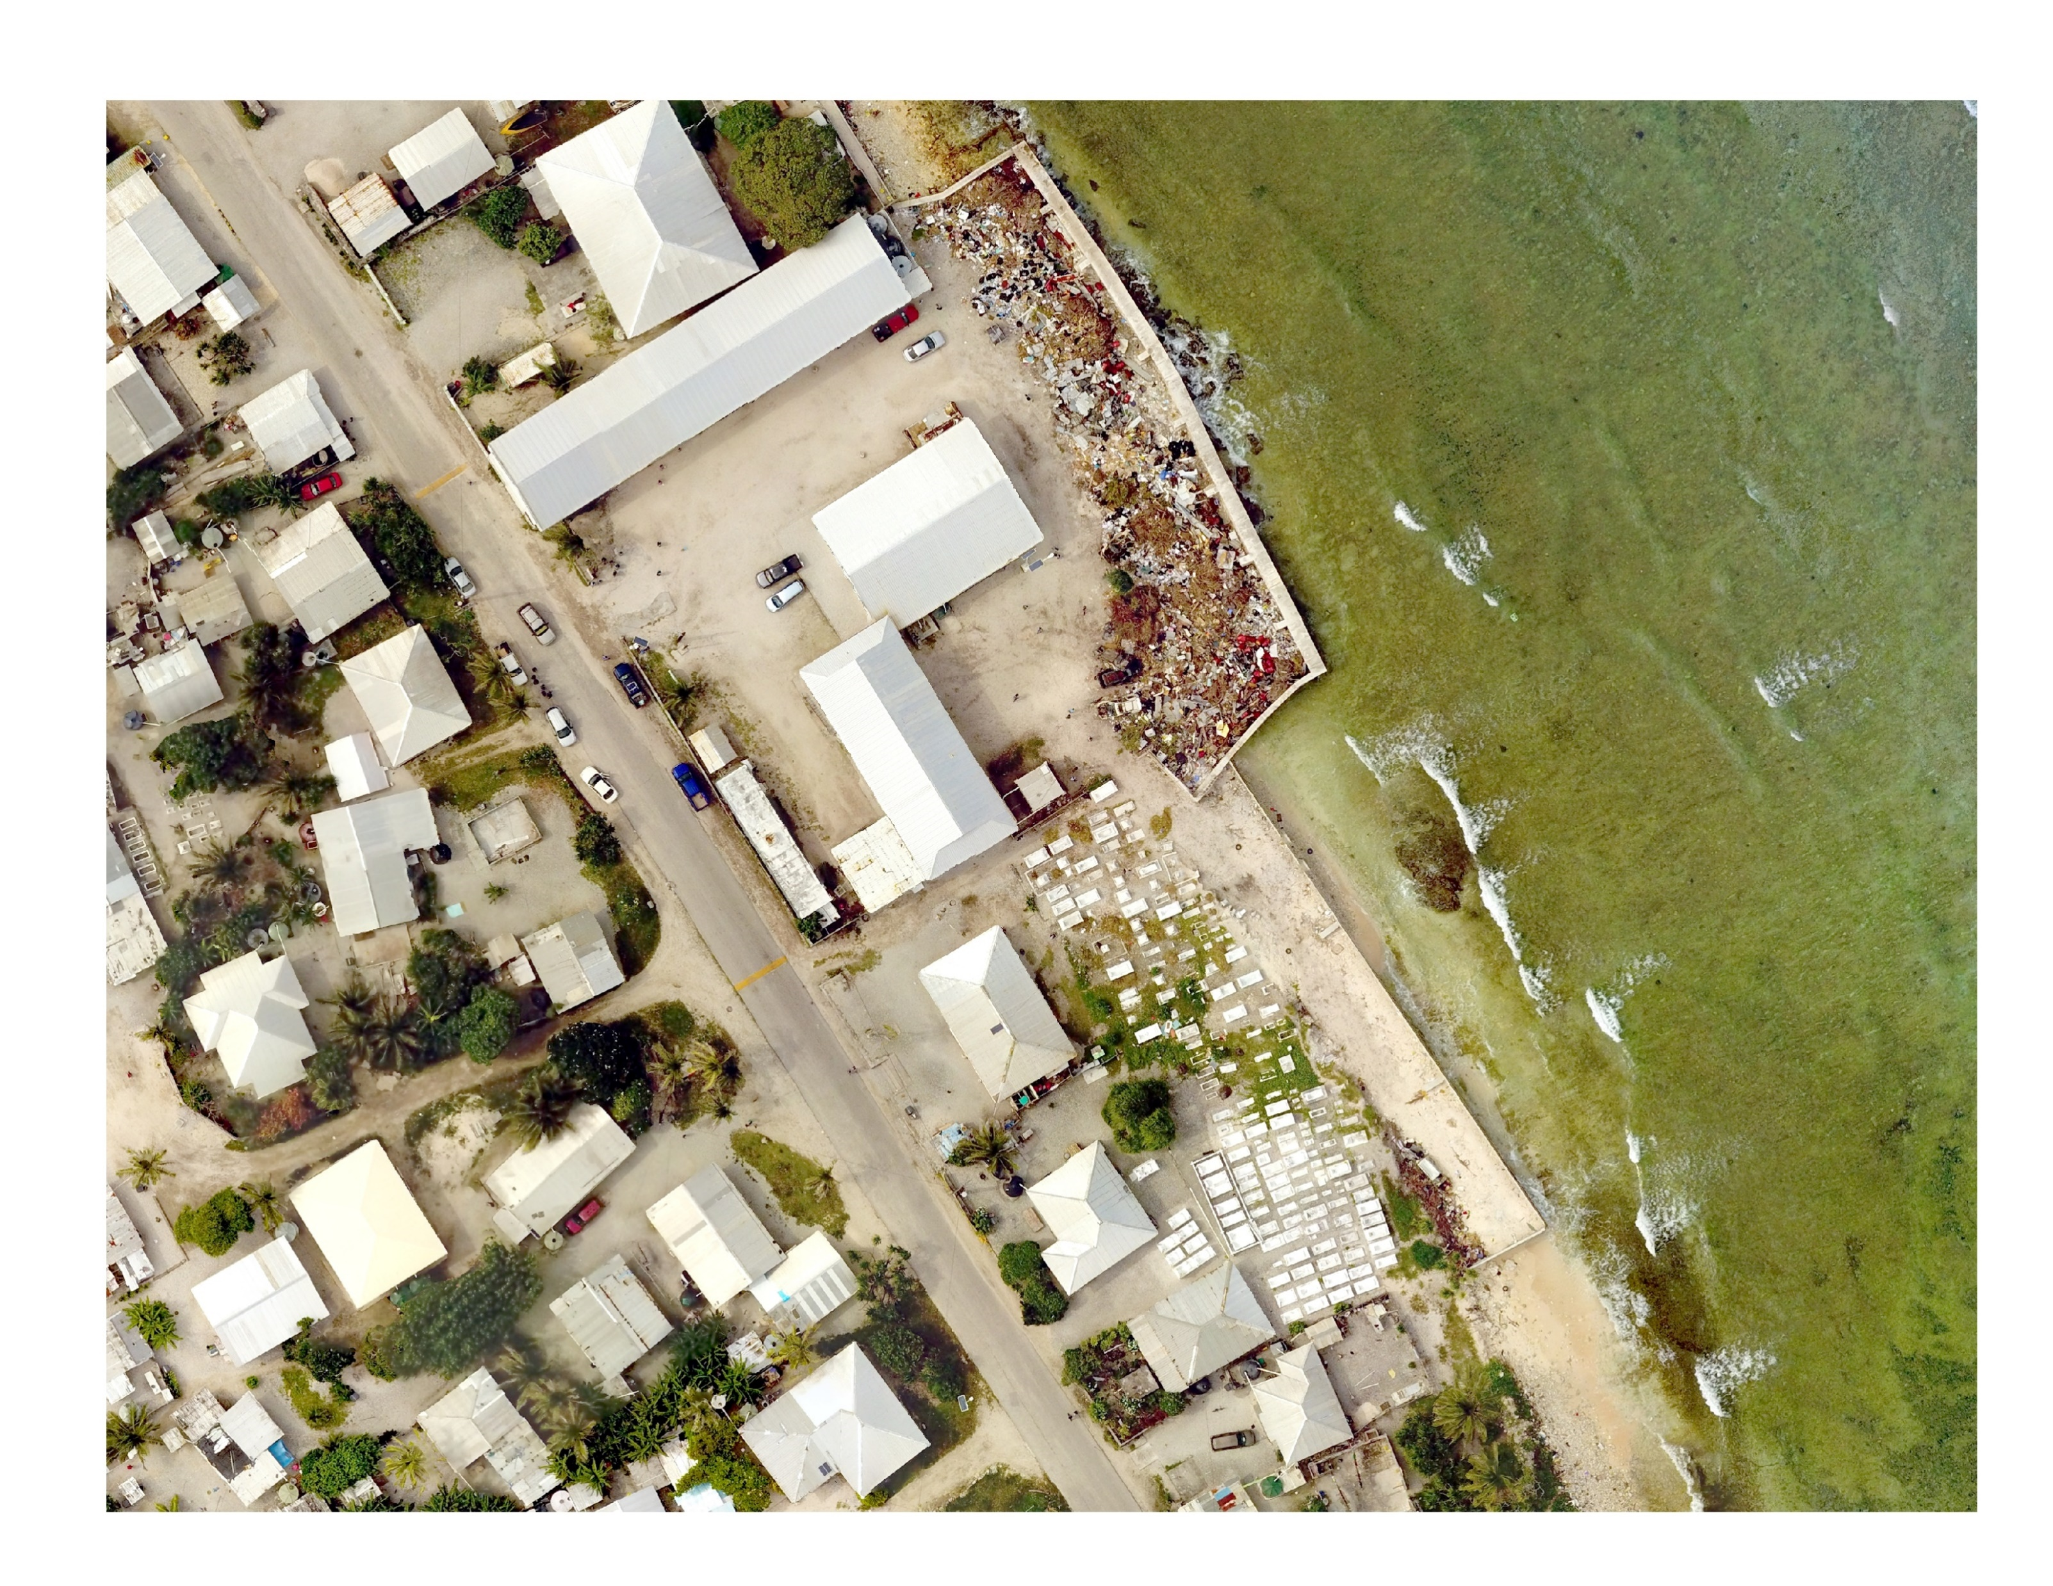
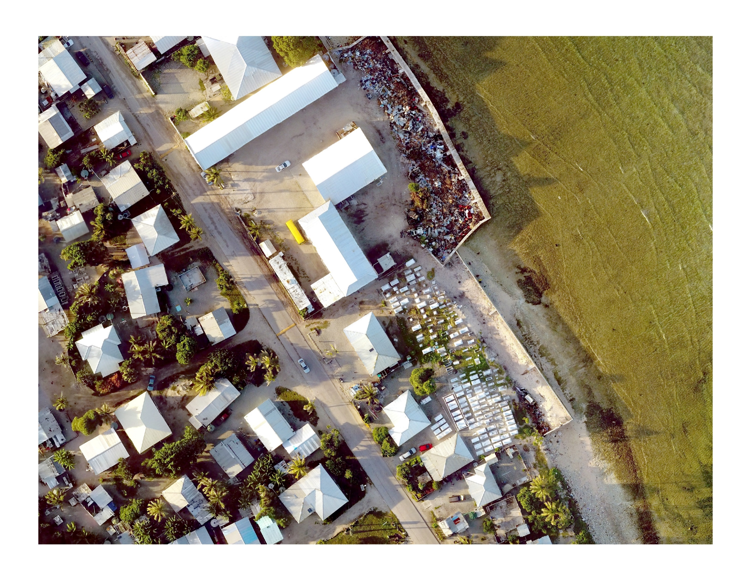
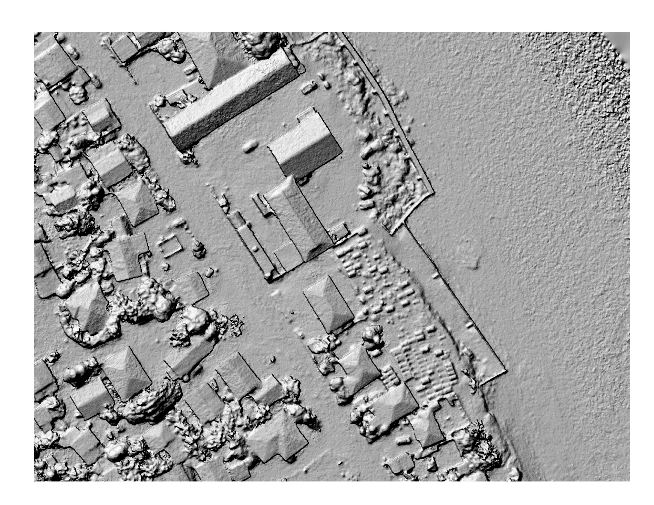
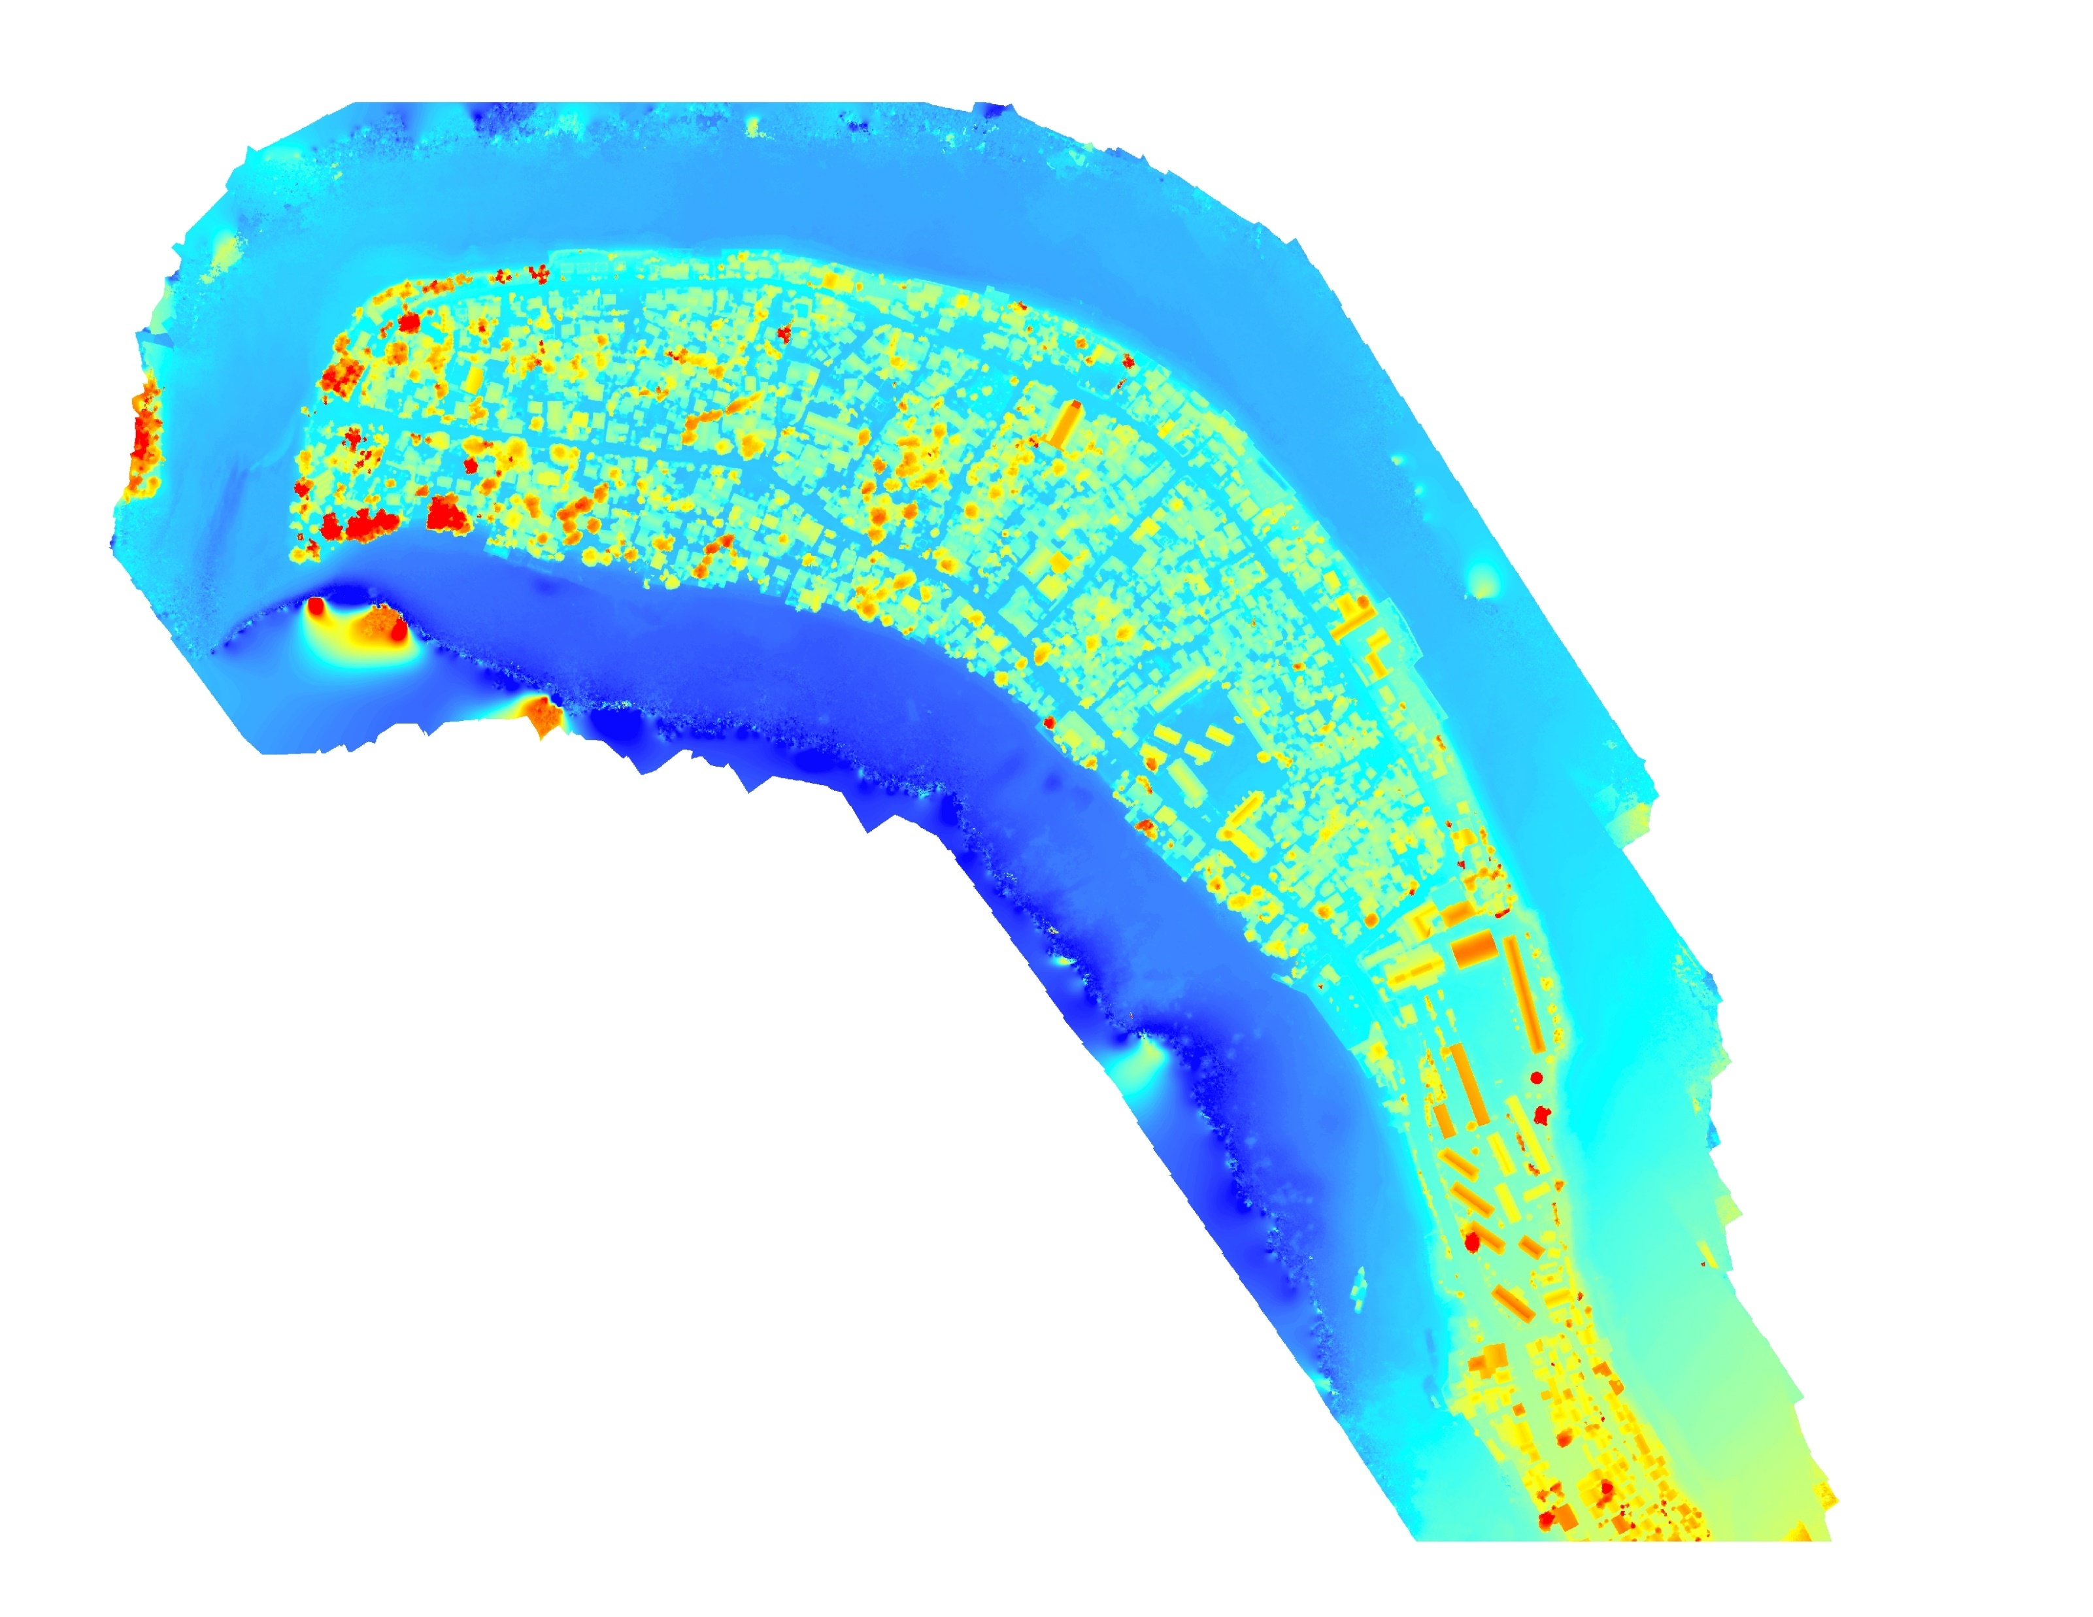
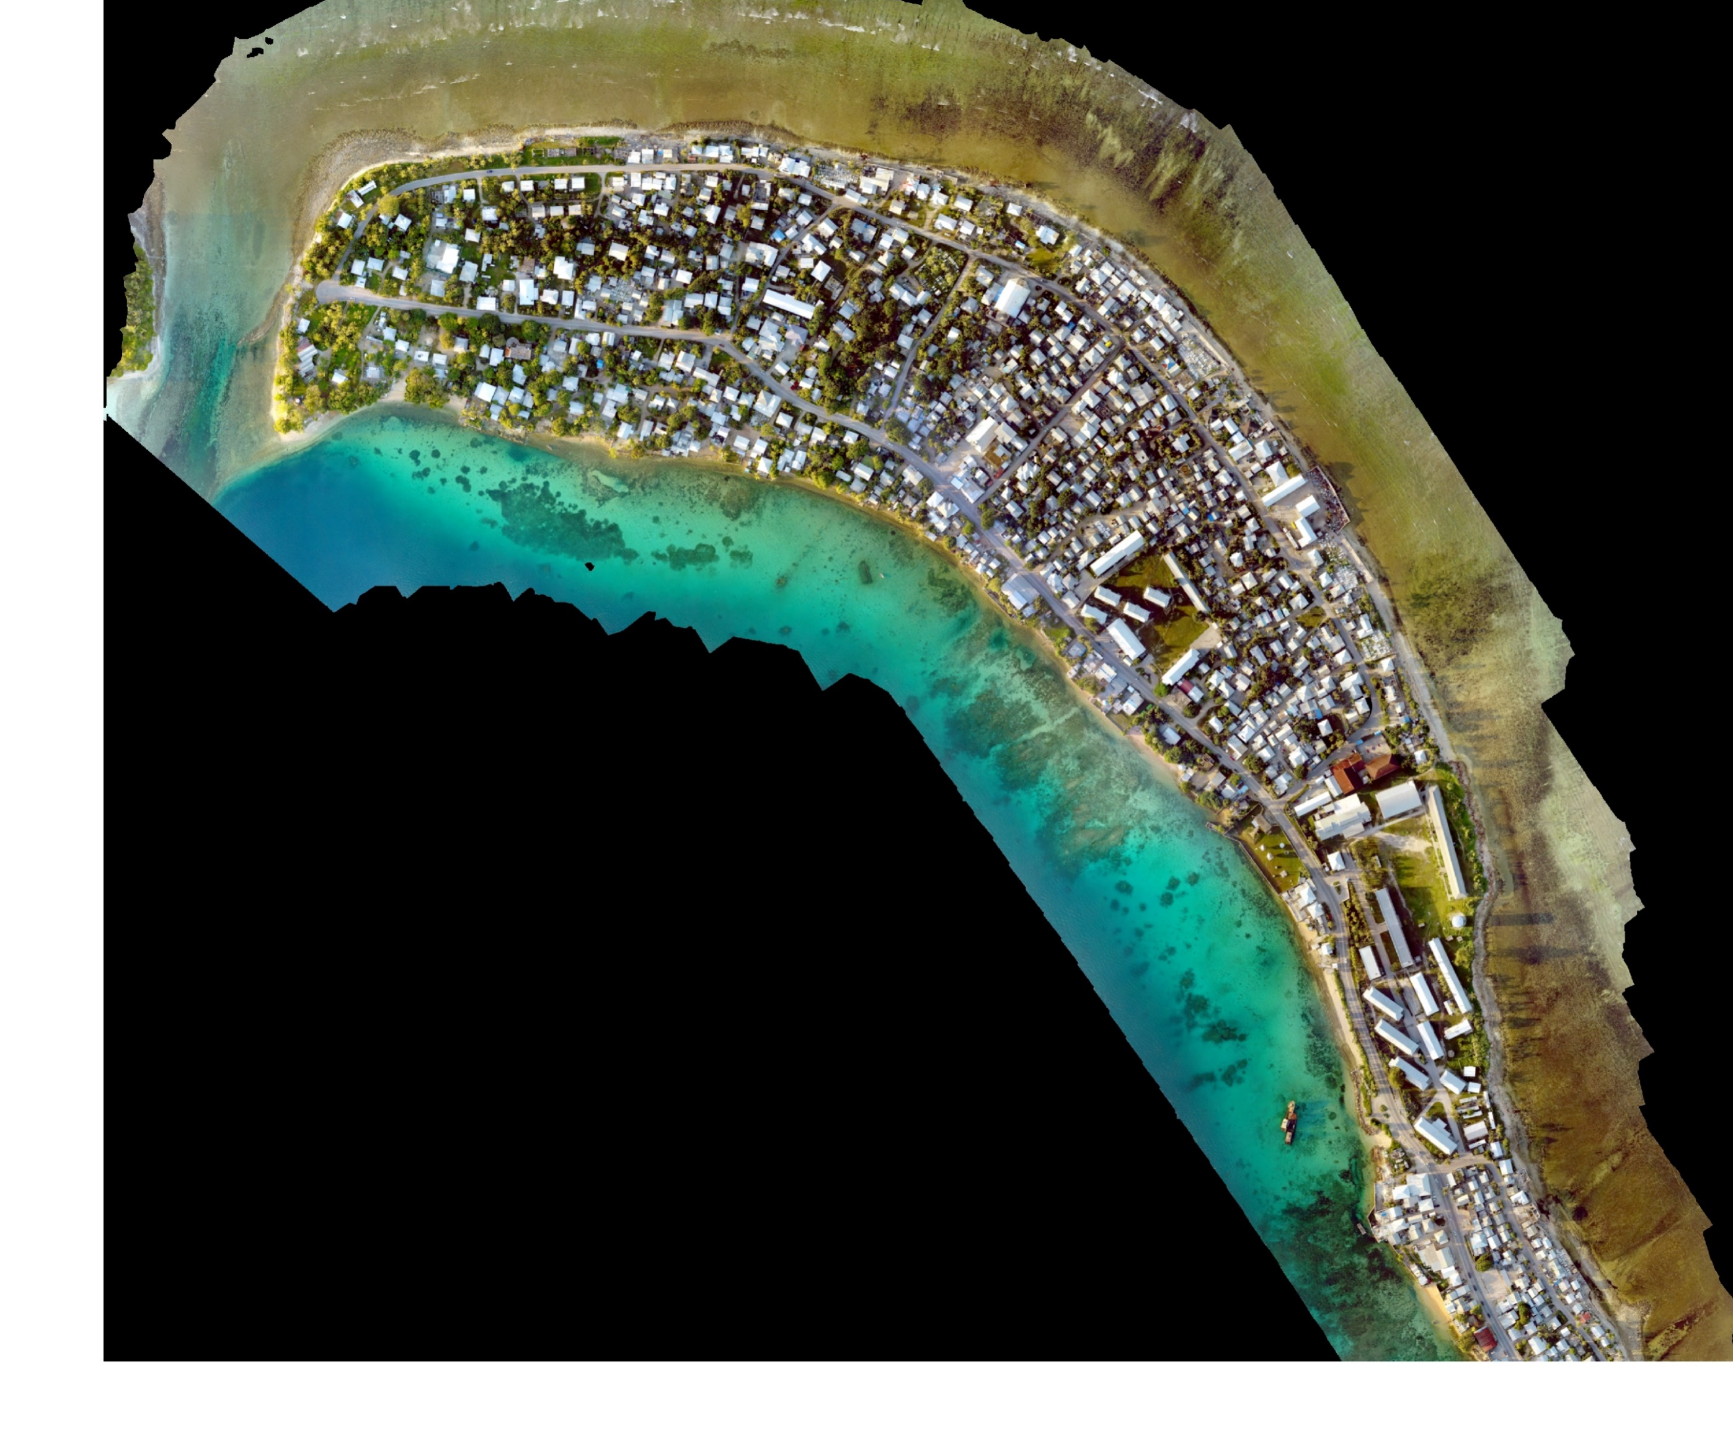
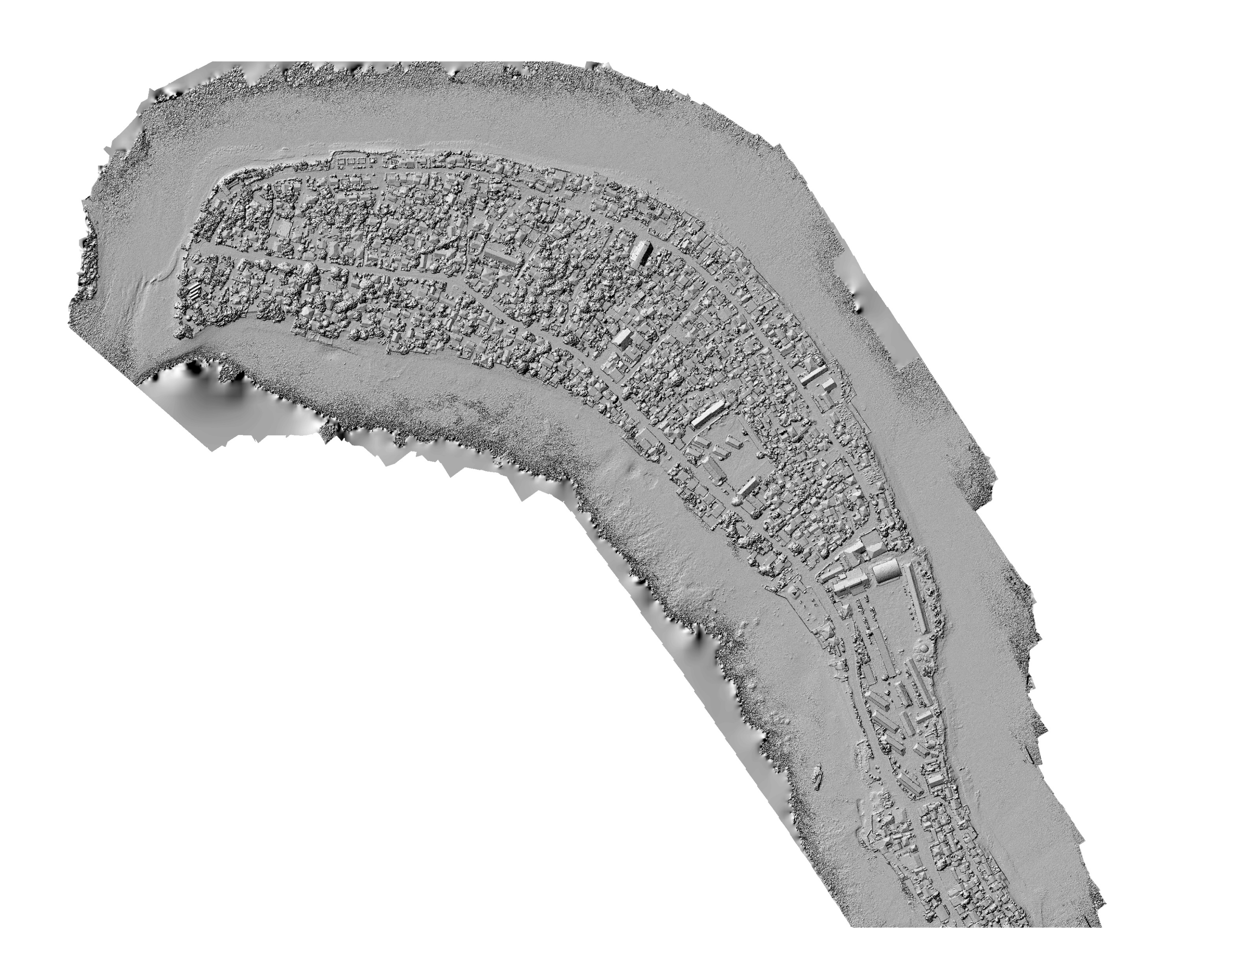
Preliminary Results/ Post-Processing (SfM) using Agisoft PhotoScan

Slide 14
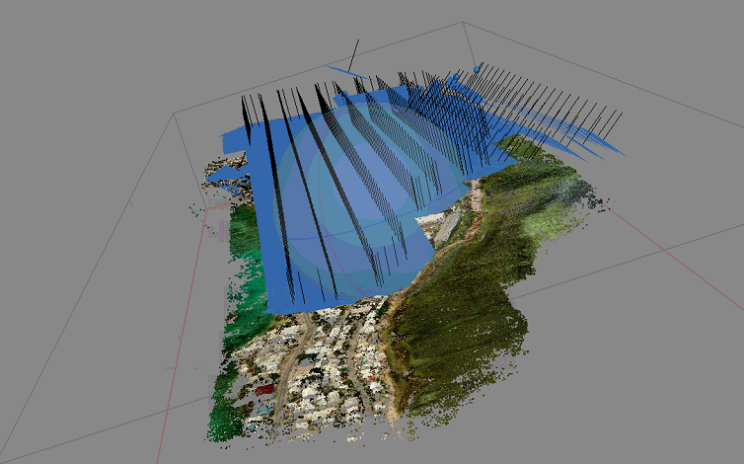
Conclusions
Results
44 missions
Over 36,000 pictures
Preliminary results promising
Combining vertical and oblique requires more flights and photogrammetry processing but better results
Consumer-level UAV (<2k USD) can be used for high-resolution mapping
Promising tool for Pacific Islands

Slide 15
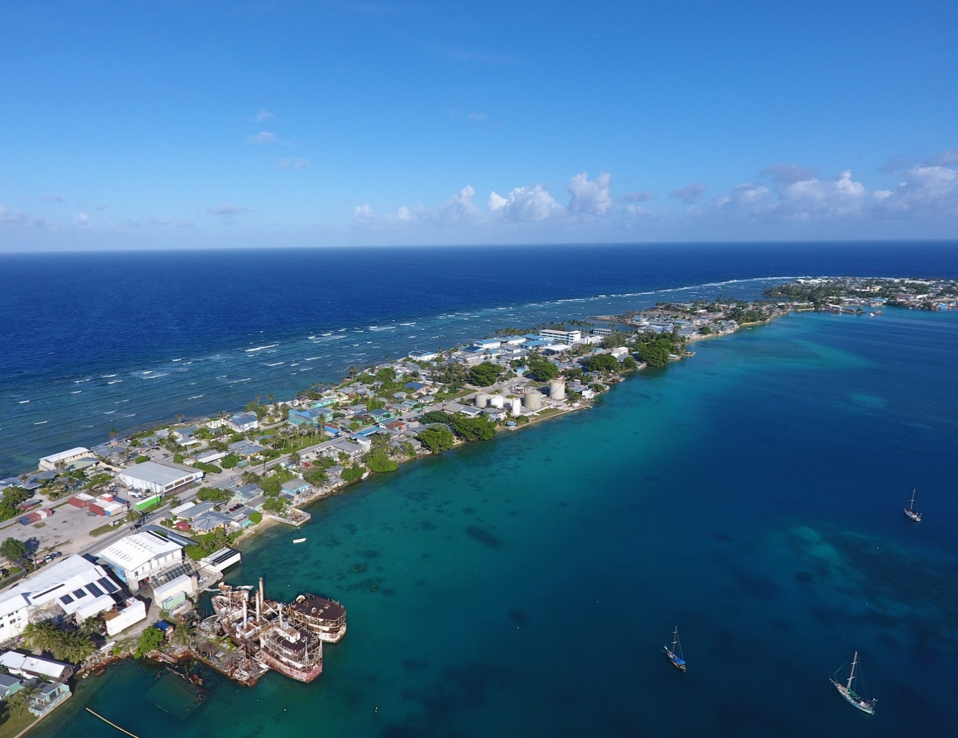
Next steps…
Continuous Orthomosaic
1-meter resolution DEM

Slide 16
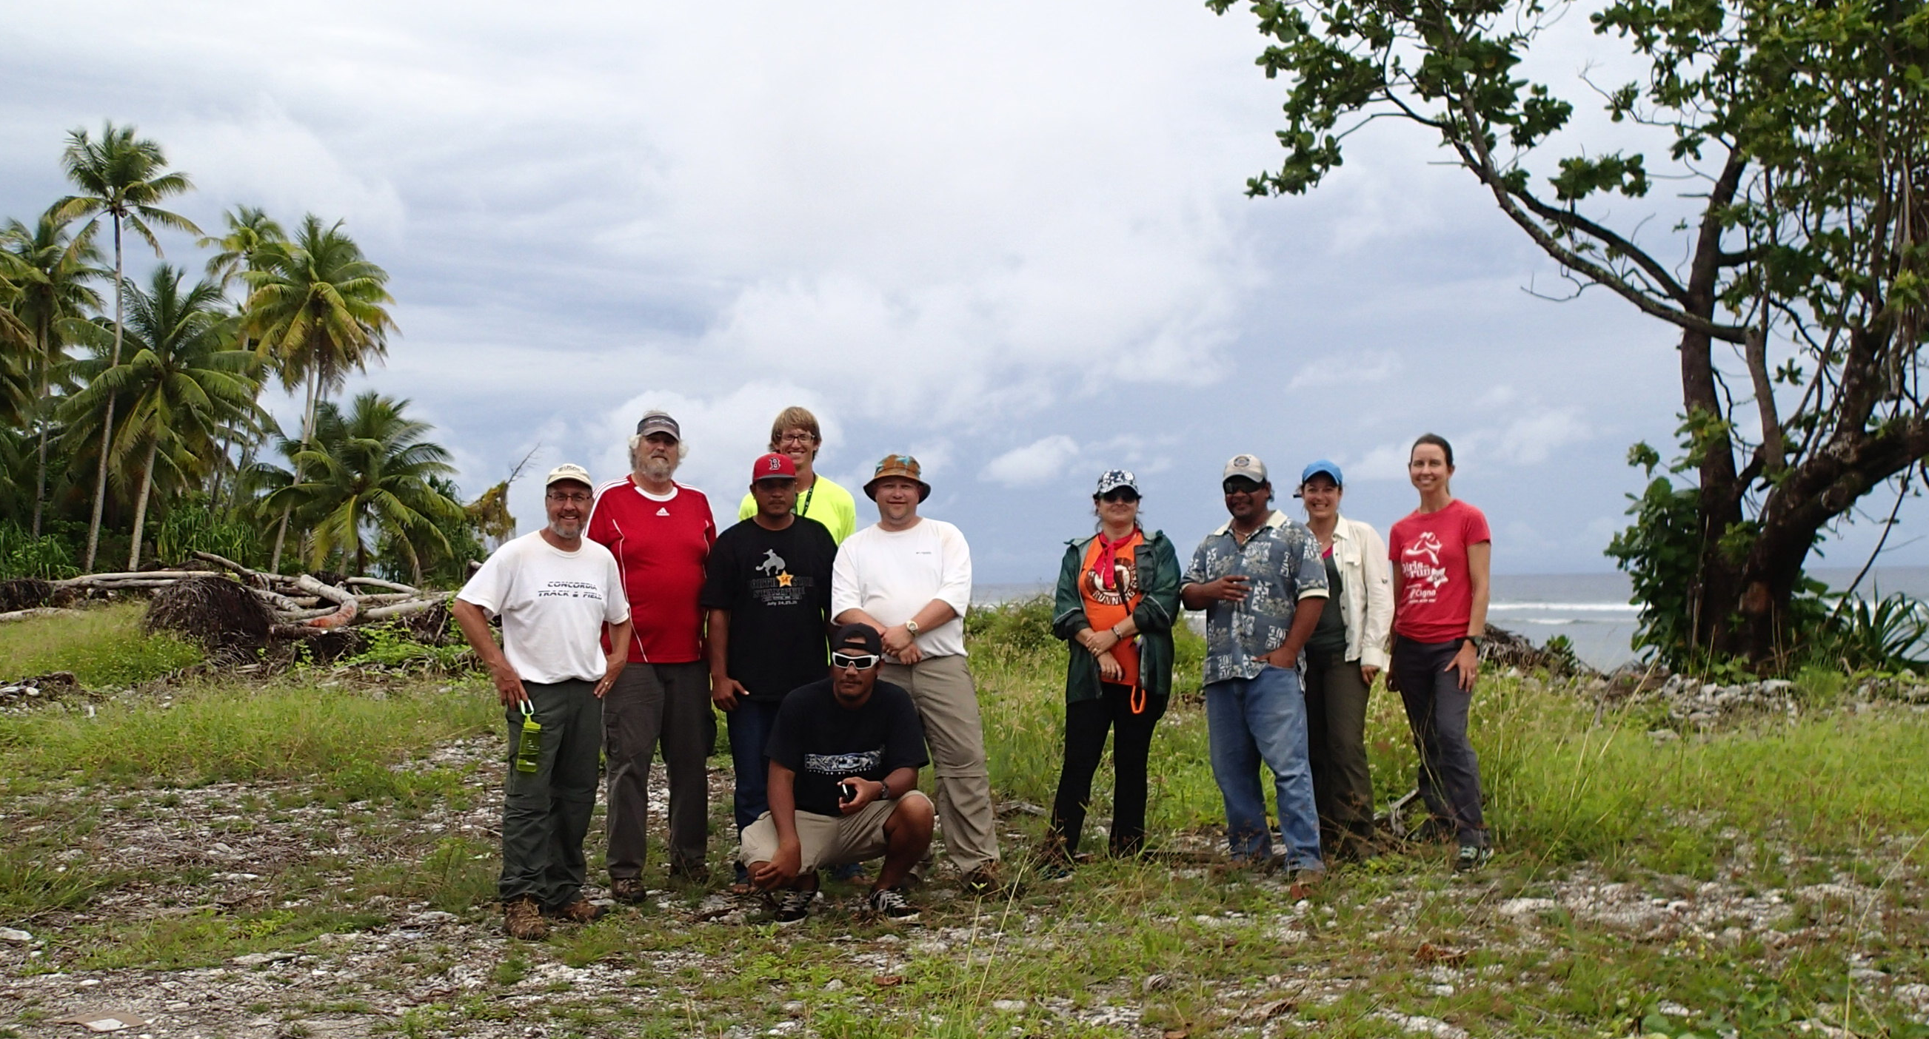
Acknowledgements
USGS Pacific Islands Climate Science Center
USGS Coastal National Elevation Dataset
NOAA National Geodetic Survey
University of Hawaii
University of Guam
RMI Lands & Survey
Directorate of Civil Aviation
MI Conservation Society
SeaGrant

Slide 17
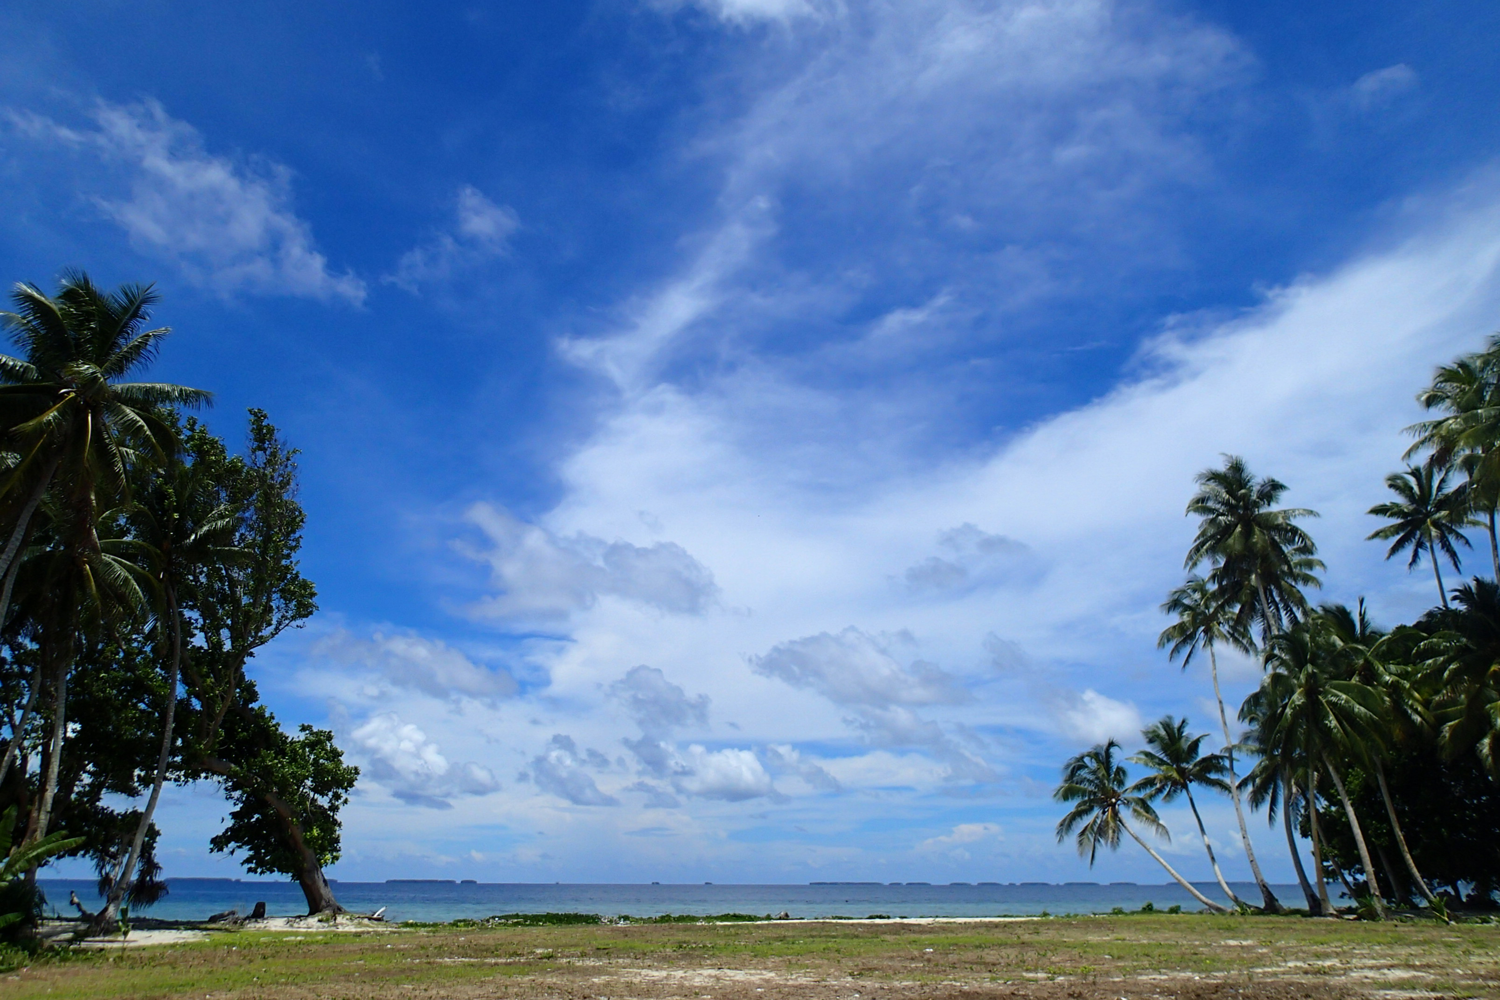
Vinaka!

