Slide 1




Pacific Island GIS & RS User Conference
USP Japan ICT Auditorium, Suva Fiji Islands
28 Nov – 1 Dec 2016

Slide 2

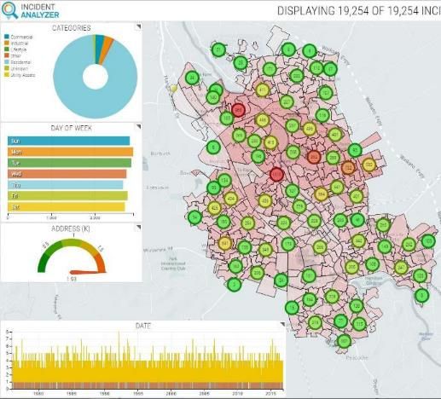
Powerful Web Based Analytics
Ken Mathers – Senior Consultant
Nov 2016

Slide 3



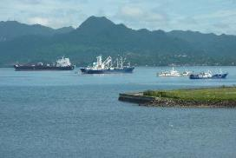
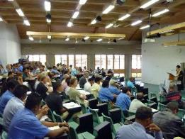


Visitor to Fiji since 1994

Slide 4



Agenda
Smart M.Apps
  Introduction
  Architecture
  Strategy
Incident Analyser
  What is Incident Analyser?
  A bit about the data
  Some preparation
  Live demo of the results

Slide 5
Smart M.Apps

Slide 6
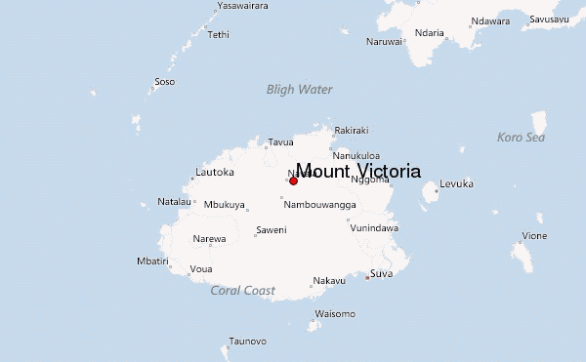
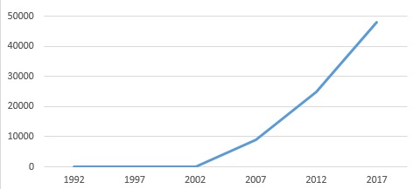


Some trends to consider
2,500,000,000,000,000,000
(2.5 Quintillion)
Bytes of new data every day. And accelerating exponentially
GB of new data created per SECOND
Mount Tomanivi
Height 1324m
Data for last 4 days written to blue ray disk and stacked would be higher than Mount Tomanivi
90% of that data is unstructured…

Slide 7

However, most of us struggle to understand it all

Slide 8







What everyone wants
Make Sense of Raw Data
Harness the Power of Change
Transform Geospatial Content
into Information
Create Meaningful Solutions
with Answers
Streamline Decision Making
Quickly Take Action

Slide 9
What is Smart M.Apps
Hexagon Geospatial’s cloud-based platform for building and using geospatial applications
Users can build their own customized, tailored applications to solve specific business problems
Apps can be sold on the M.App Exchange or delivered internally to an Organization
No programming experience required
Targeted
Lightweight
Dynamic

Slide 10


Traditional Geospatial Analysis Systems
Large Central Storage
100s or 1000s of Workstations to be managed.
  Large Local Storage
  Updates on each machine
  Each must be high end machine

Slide 11






Cloud Based Geospatial Processing
Centralized Storage and Computation
All code managed in one place
Version management greatly simplified
Can be deployed on premise (private cloud) or on a public cloud.
Workstations can range from desktop to laptop to tablet.
Supports Modern Browsers

Slide 12
Moving from tools to Dynamic Information Services
Producers
of Data
Analysis &
Exploration
of Data
Industry
Focused
Tools Using
Data
Dynamic
Information
Services
Solutions
Focused
Number
of Users
Functional
Complexity
Desktop
Cloud
Deep + Broad
Focused + Simple

Slide 13
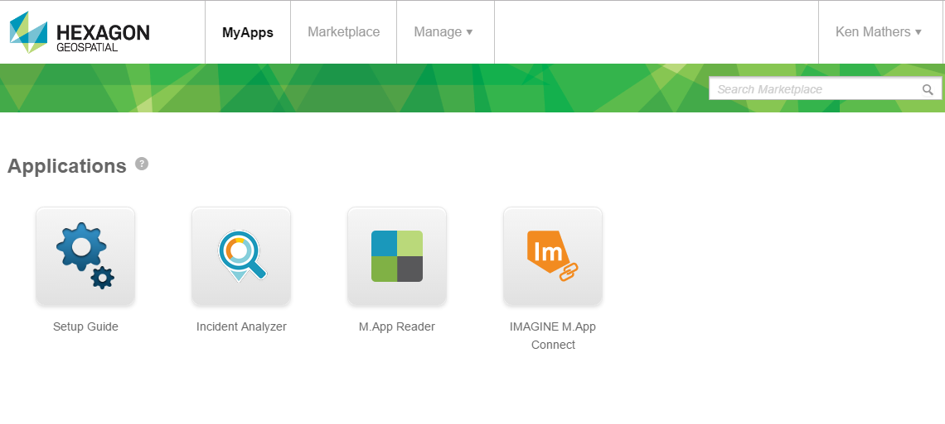

Hexagon Geospatial Smart M.Apps Subscriptions
Hosting platform for Hexagon Smart M.Apps, and core web services for building geospatial cloud applications

Slide 14
Incident Analyser

Slide 15
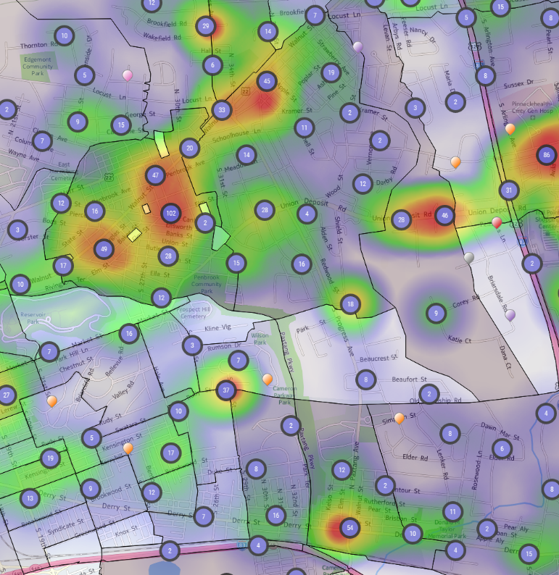
Incident Analyzer Smart M.App
Intuitively Analyze the Location of Events over Time using a collection of Business Intelligence Widgets
Dynamically explore data to easily create and share intelligence reports that depict meaningful spatial patterns
Access Live and Historical Incident data in the cloud or accessed securely from your location
Reports provide tactical analysis, to target specific areas, and to effectively deploy resources or remediation efforts.
Create, Explore Update and Share meaningful spatial patterns to Understand, Plan and Respond

Slide 16
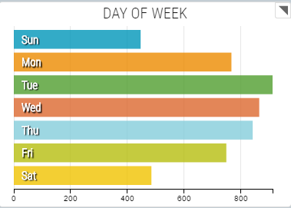
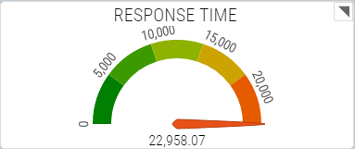
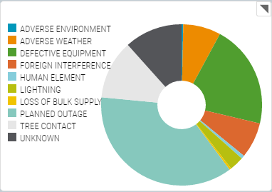
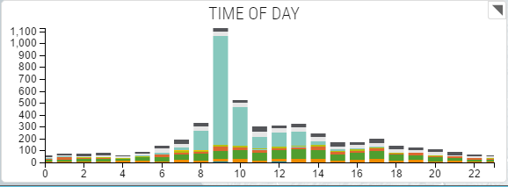
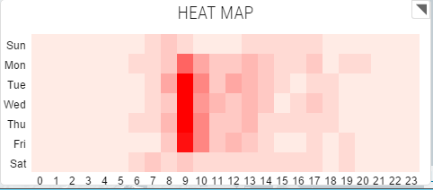
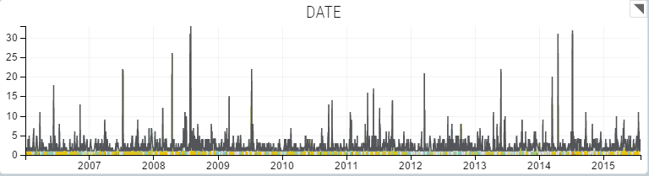
Some key objectives
Easily understood visualisation of the data
Simple
Intuitive
Clear
Precise

Slide 17
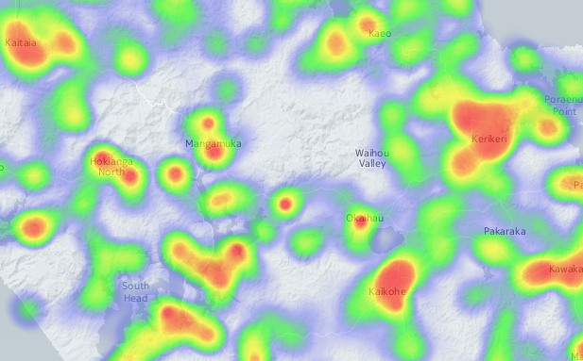
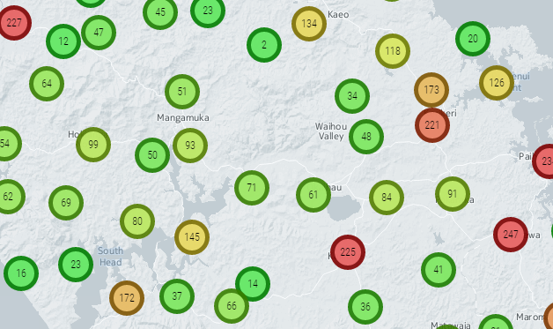
Some key objectives
Realtime Analysis
Incident Counts
Spatial Distribution
Identification of Duplicate records
Visualisation of Incident concentrations (Hotspots)

Slide 18
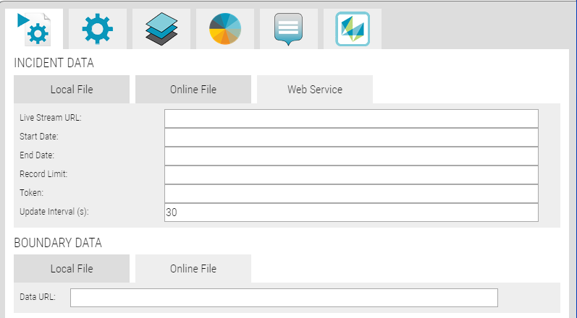
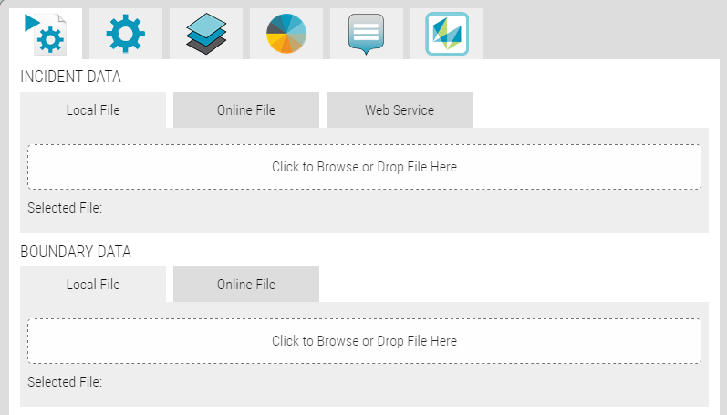
Some key objectives
Data source
Local Data uploaded to the Cloud
Live data via external Web Services
Point data and Shape data
Drag and Drop

Slide 19
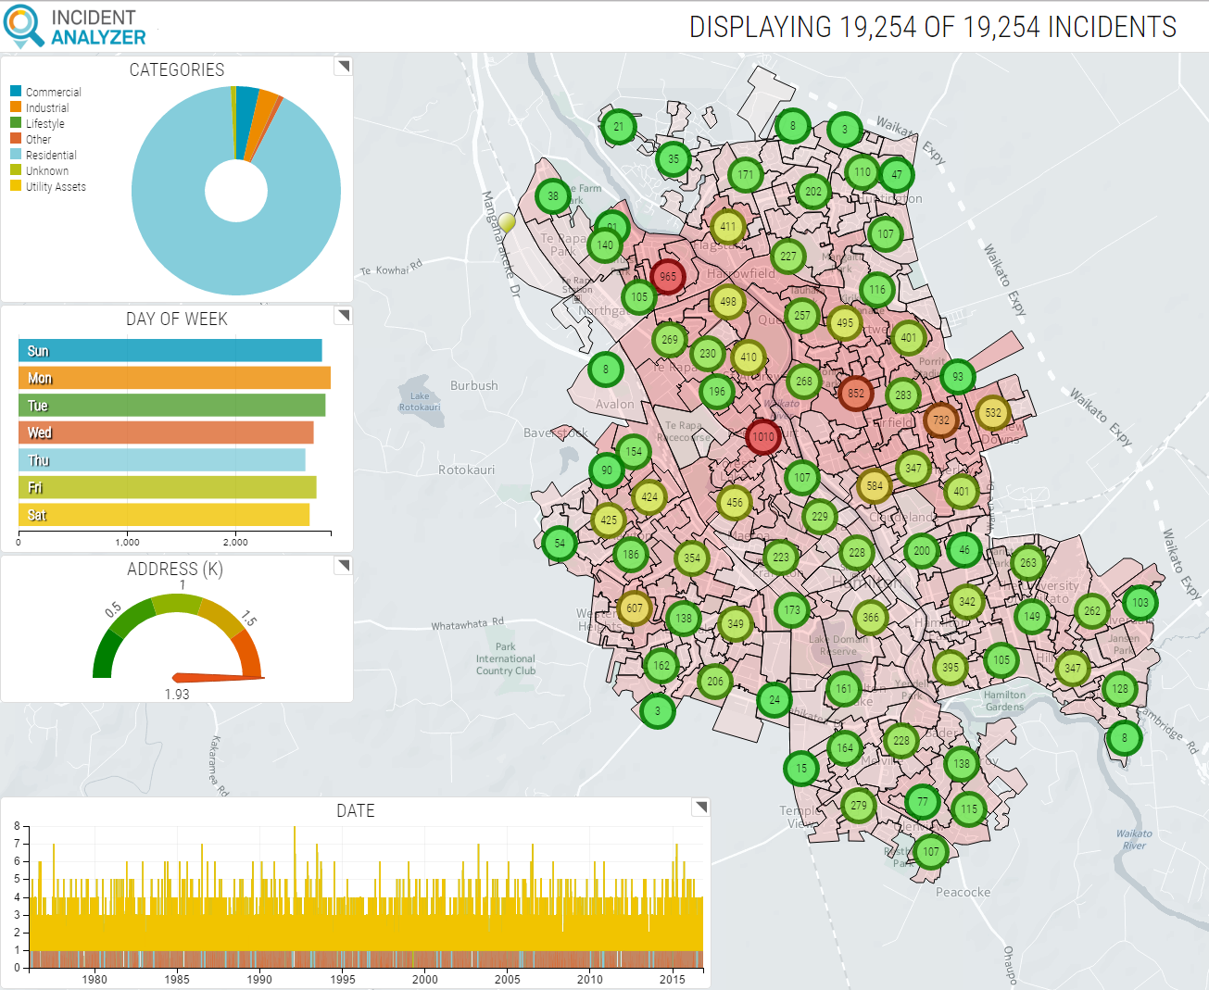
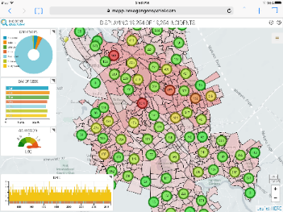
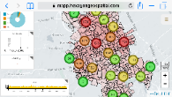
Some key objectives
Cloud Based Analysis
Runs in the Cloud
Subscription based access
Runs in any browser

Slide 20
Data Preparation
Prepare data by any means you like
Oracle SQL example
  Choose columns
  Include Date
  Include Classification (No more than 50 values)
  Include Lat/Long
  Reformat if desired (Substrings, Contatenation, Case, etc)
select A.LOCATION_ID, A.TUI, A.ADDRESS_STREET_NO||' '||A.ADDRESS_STREET_NAME||' '||A.ADDRESS_STREET_TYPE as ADDRESS,
INITCAP(A.CITY) as CITY, A.POSTCODE, to_char(A.RFS_DATE, 'MM/DD/YYYY') as RFS_DATE, to_char(NVL(A.INTACT_DATE, RFS_DATE), 'MM/DD/YYYY') as INTACT_DATE,
A.INTACT, A.ACTIVE, ROUND(t.x,5) longitude, ROUND(t.y,5) latitude
from intact_sites2 A, MA_ADDR_N N, MA_ADDR_PT P, table (sdo_util.getvertices(sdo_cs.Transform(P.g3e_geometry,4326))) t
where A.TUI= N.TUI and N.g3e_fid=P.g3e_fid
and ACTIVE=1;

Slide 21
Demonstration

Slide 22
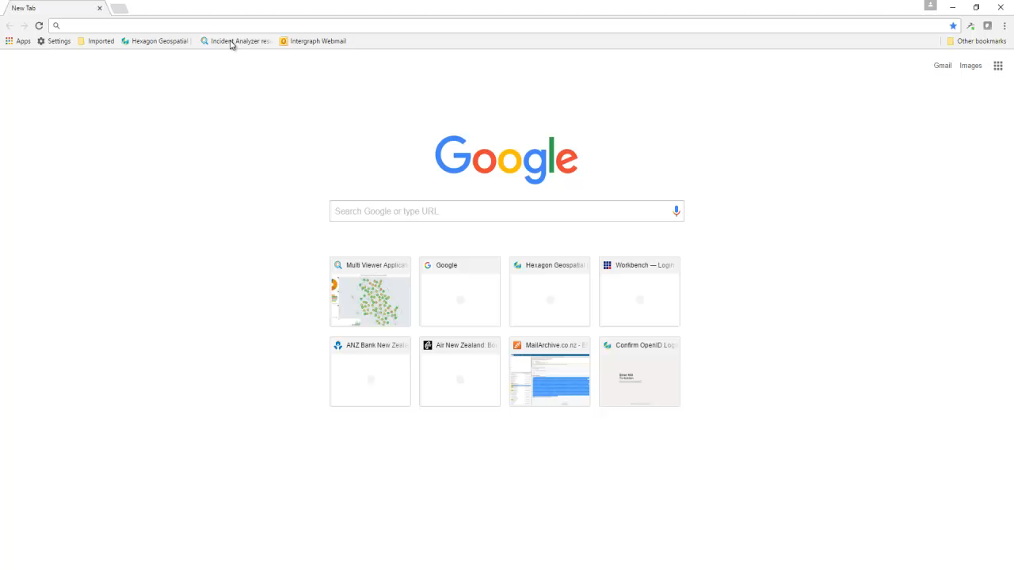

Slide 23
