Slide 1
Bachelor of Geospatial Science The University of the South Pacific
Geospatial Science Unit
School of Geography, Earth Science
and Environment
Aleen Elisha Prasad
Inesha Manzini
Semisi Ketenilagi

Slide 2
Geospatial Science at USP
Geospatial Developer Stream
“ I am interested in the data, how we capture it, how we assure its quality and in developing the databases and information systems we use to manage, manipulate and deliver it, both the data itself and as maps or visualisations”
Geospatial Analyst stream
"I am interested in applying geospatial science and technologies to perform geospatial analyses for problem-solving, capturing data and communicating information through geovisualizations including web-based maps."
Major in Geospatial Science
“I am interested in a career outside of geospatial science but I would like a good grounding in geospatial science to complement my chosen career.”
Bachelor Geospatial Science
Geospatial Analyst
Geospatial Developer
Major in Geospatial Science
Diploma Geospatial Science
Certificate Geospatial Science

Slide 3
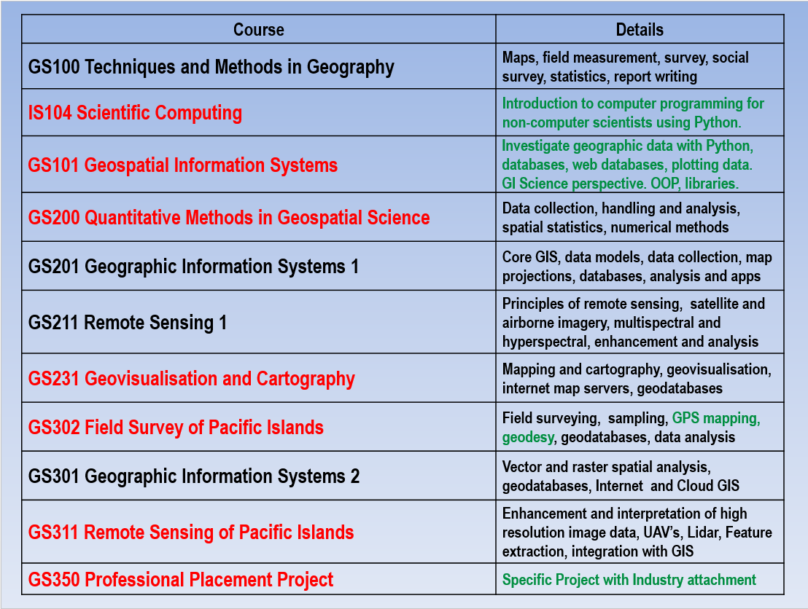

Slide 6
Professional Certification of Graduates
Geospatial Developer Stream & Geospatial Analyst stream
Both satisfy the educational requirements for Professional Certification under the Surveying and Spatial Sciences Institute of Australia (SSSI) GISP (AP) certification guidelines.
Major in Geospatial Science
May satisfy requirements depending on what electives students take

Slide 7
Staffing and Equipment
Associate Professor – Dr. Nick Rollings
Senior Lecturer – John Lowry
Lecturer – Nathan Wales
Professional Officer – Amrit Raj
Duplication of GIS Laboratory 2017
New equipment such as
DJI Phantom 4 Drone
DJI Phantom 3 Drone with Sequoia Sensor (4 bands)
Aerotestra Quadcopter Drone with Hyper spectral Sensor
OpenROV underwater drone

Slide 8
Geospatial Science at USP
2015 Approx. 70 students enrolled in geospatial awards
2016 Approx. 60 New students enrolled in Geospatial Awards
Total of 180 GS students

Slide 9
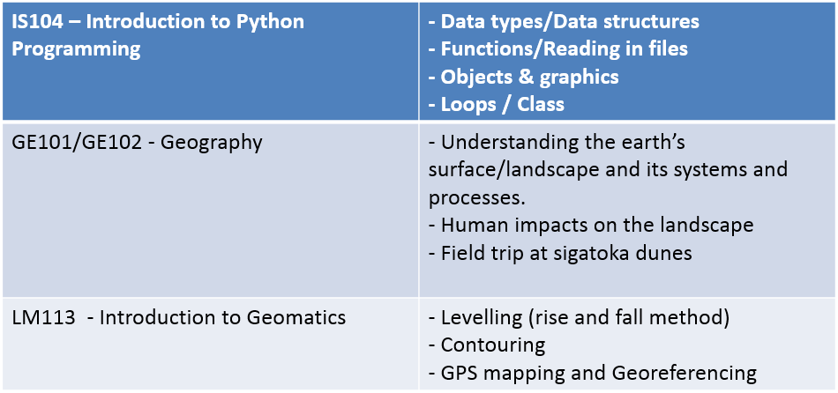
GS101 100 level units and coverage

Slide 10
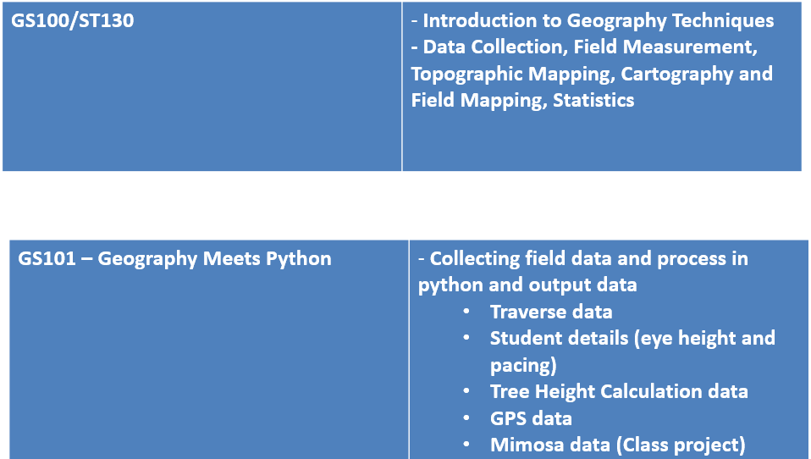

Slide 11
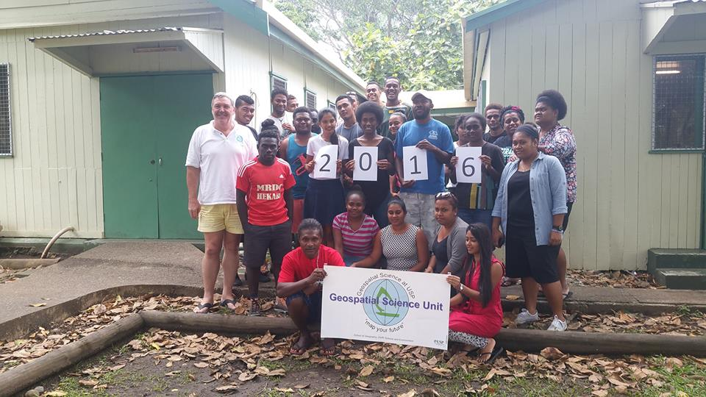
2016 Intake of GS Students

Slide 12
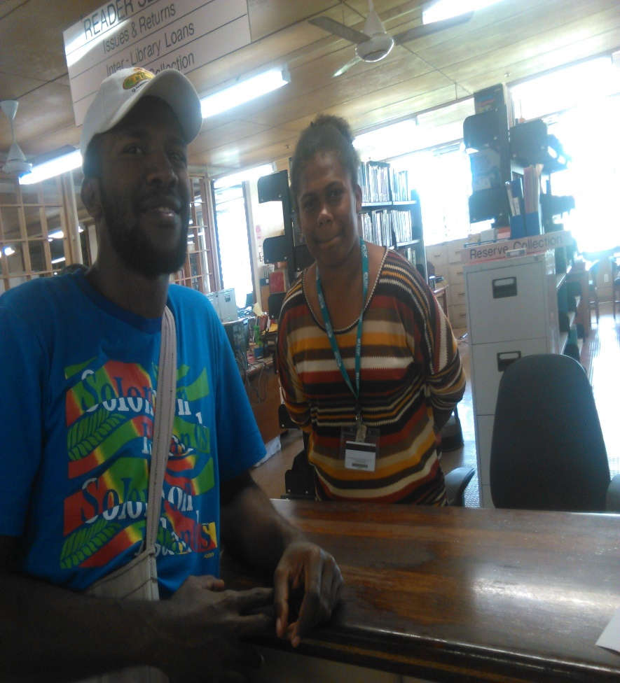
Selfie with librarian

Slide 13
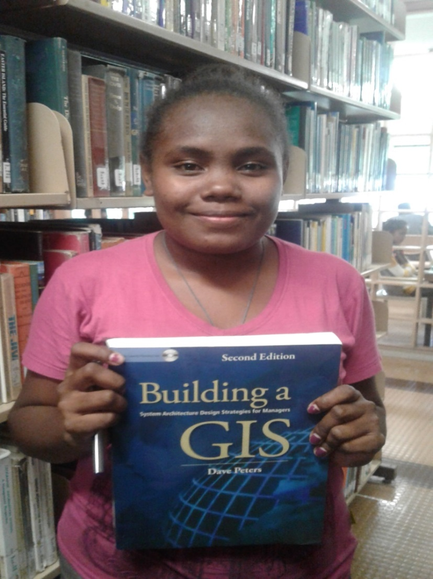
Selfie with a GIS book

Slide 14
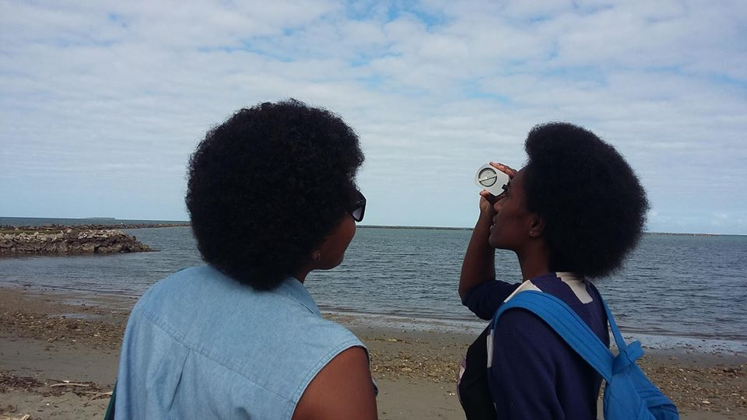
Collecting Traverse/Tree height data

Slide 15
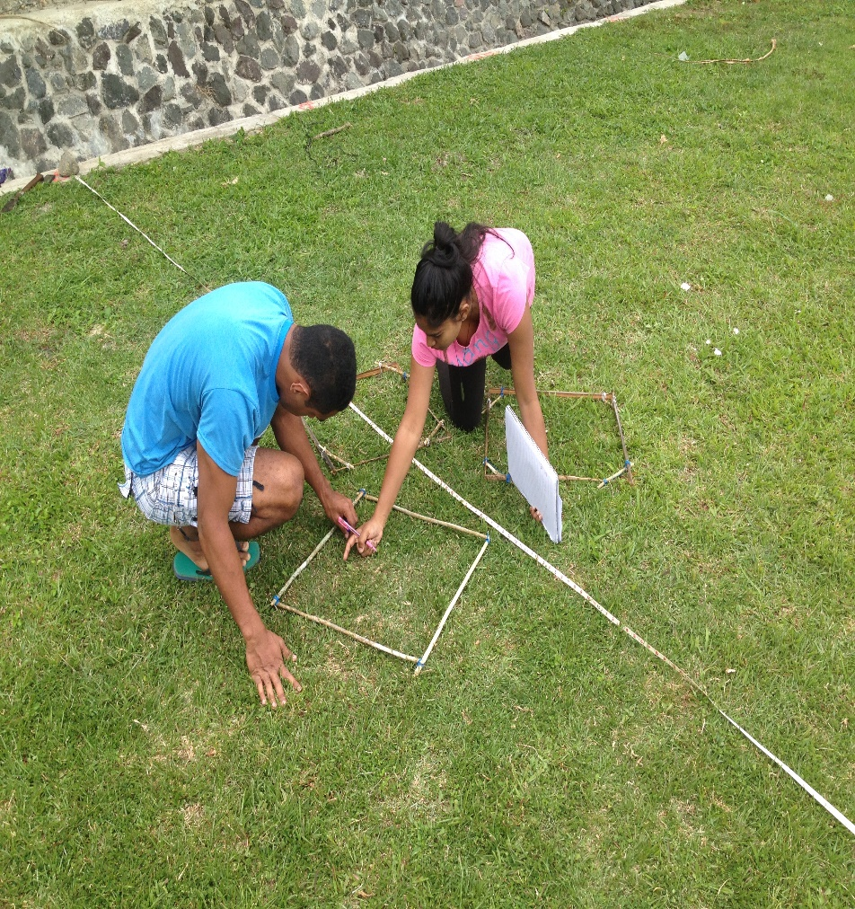
Field work – Counting mimosa plant

Slide 16
Processing data in the lab

Slide 17
Database SQLite

Slide 18
Modify Table information

Slide 19
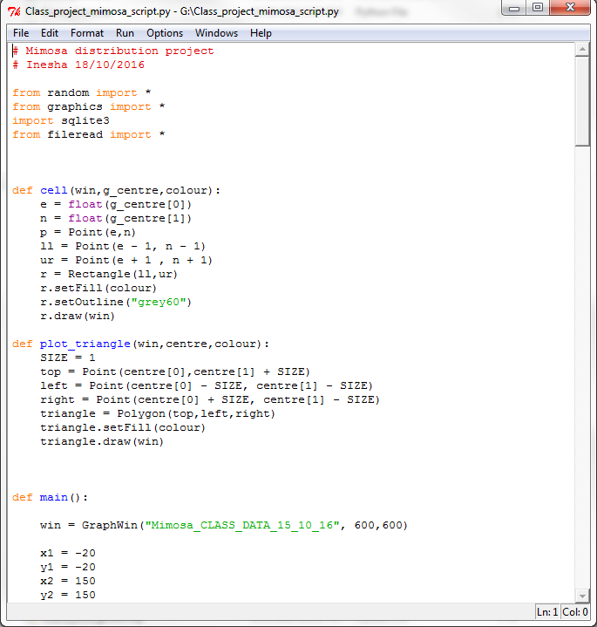
Python Scripts for each Activity

Slide 20
GPS Points Output - Proximity

Slide 21
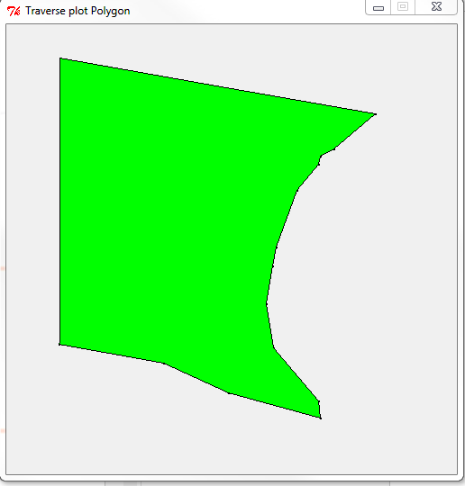
Traverse/ Plot Trees location Output

Slide 22
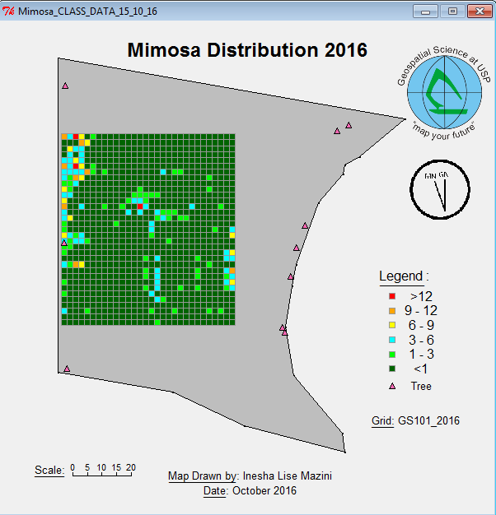
Class Project for GS101 2016

Slide 23
GS231 – Cartography and Geovisualisation
NEW COURSE
In this unit we learnt Modern Professional map making skills , fundamental principles of map design such as map layout, typography, generalization and projection and mapping skills
Skills acquired in critiquing other maps

Slide 28
GS211 : Remote Sensing 1
Provides students with a foundation of basic remote sensing of the environment. Topics covered were satellite image and aerial photo acquisition, principles of electromagnetic radiation, aerial photography and photogrammetry, geometric and atmospheric correction, image enhancement with band ratio’s and digital image processing and classification.
Students acquired a hands on learning experience through a variety of exercise conducted in the GIS lab

Slide 30
GS200 : Quantitative Methods
New Course
GS200 provides students with a foundation in numerical data analysis and problem-solving specific to quantitative research in geography and related disciplines. Building on classical descriptive and inferential statistics the course introduces the student to statistical data analysis in the geographic context

Slide 31
GS200 Field Work

Slide 32
GS200 ( R software usage in projects)

Slide 33
R software
Notes:
## Not normal, but the Central Limit Theorem suggests it is okay given that
# the Central Limit Theorem suggests that over the long-run a distribution of means
# would be normal, and this is what the t-distribution is based on.

Slide 34
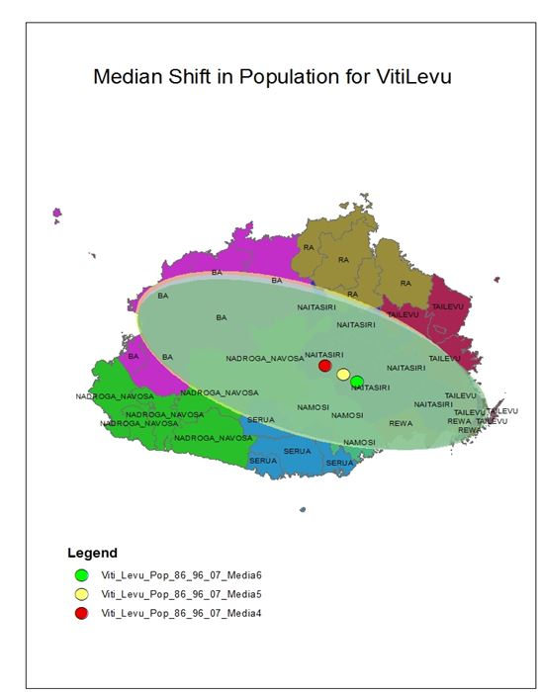
R software

Slide 35
GS 302 : Field survey of Pacific Islands
New Course offered 2017
Environments unique to the Pacific
P3DM (Participatory 3-Dimensional Modelling)
Pre and post disaster Mapping
Coastal Profiling
GNSS Mapping
Mangroves, Forest, Plantations and sampling strategies
Geodesy – dynamic datum, projections and vertical datum

Slide 36
GS 311: Remote Sensing of Pacific Islands
New Course
High Resolution Imagery
Satellite Imagery , UAV, Aerial Photography
On screen 3D Interpretation
Object Orientated Classification
3D Point Cloud
Hyperspectral Imaging

Slide 37
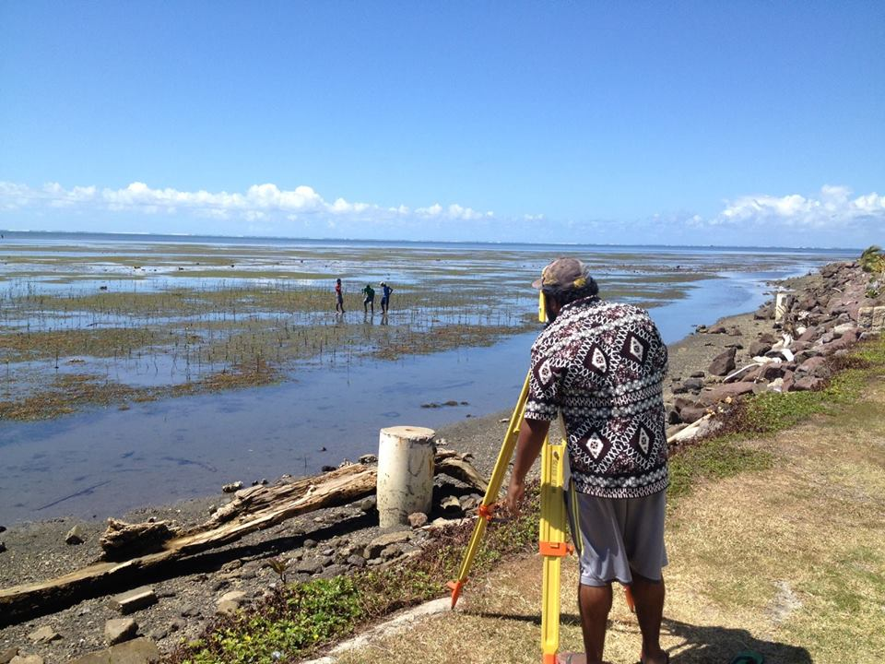
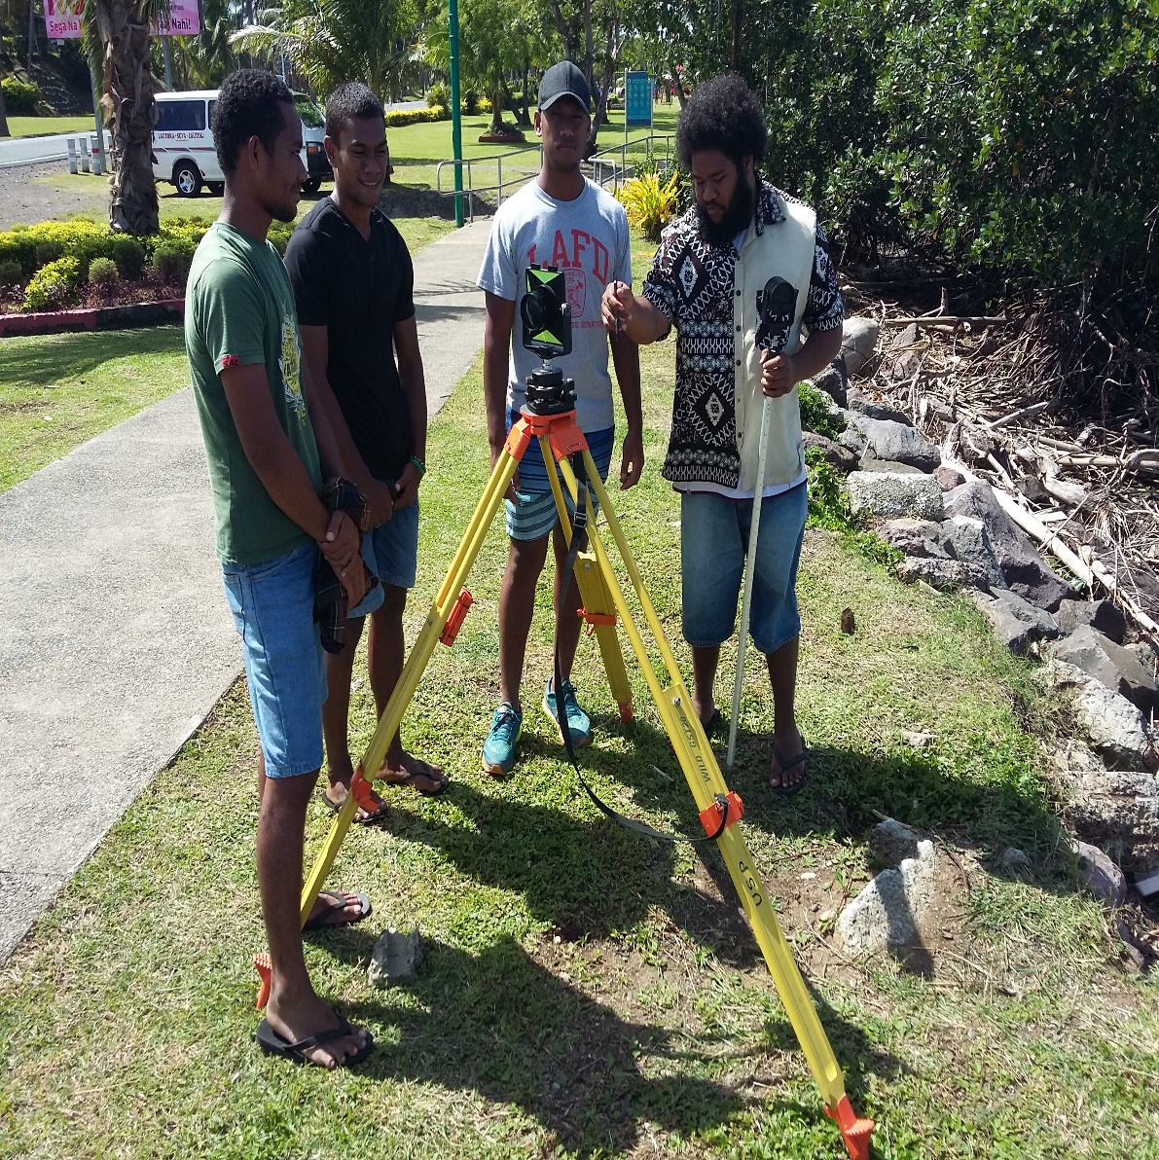
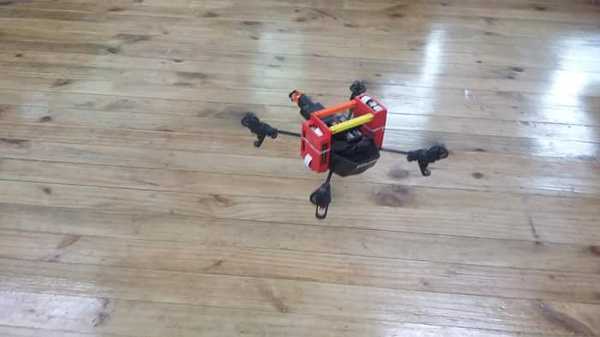
Mangrove project

Slide 38
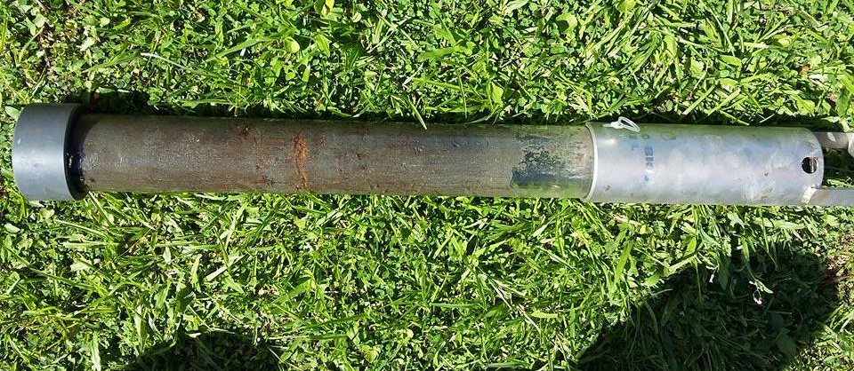
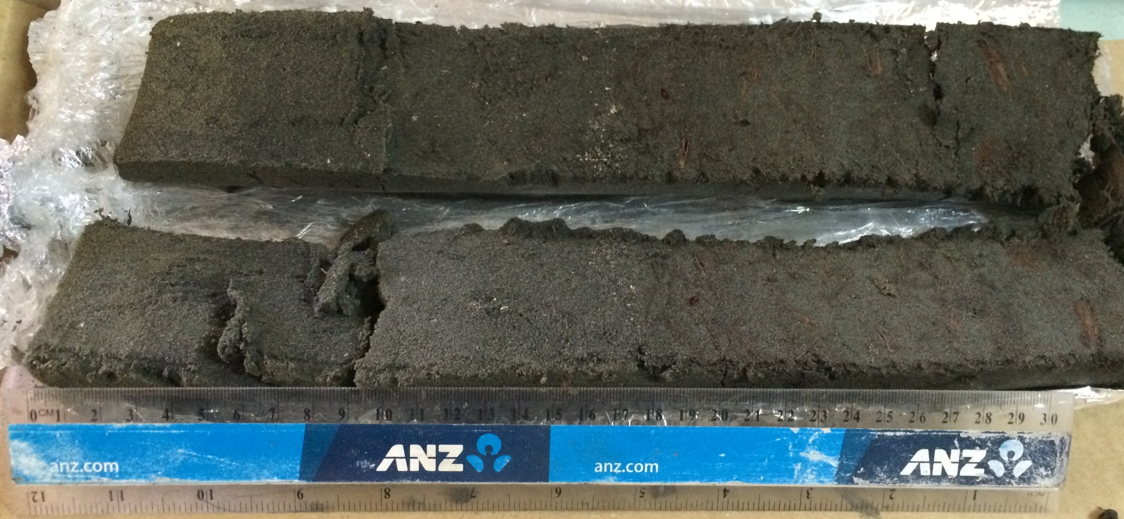
Mangrove Coring for Carbon Estimation

Slide 40
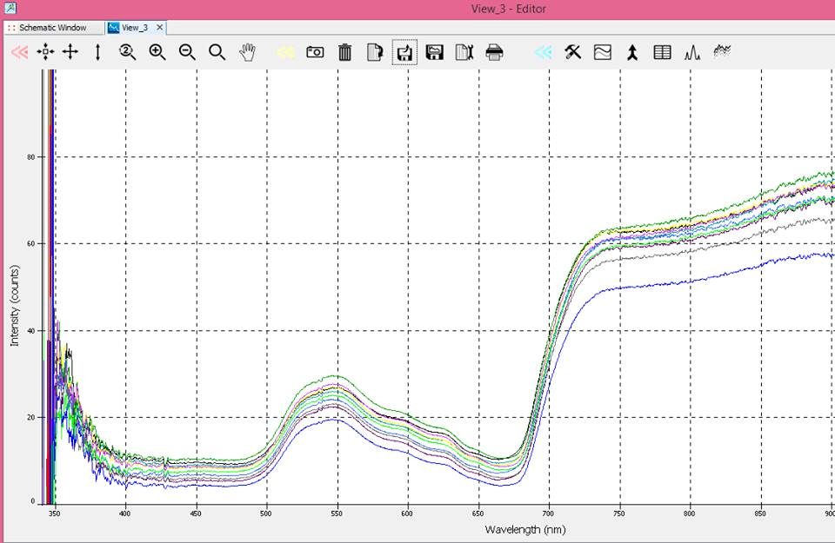
Mangrove Spectral Library

Slide 41
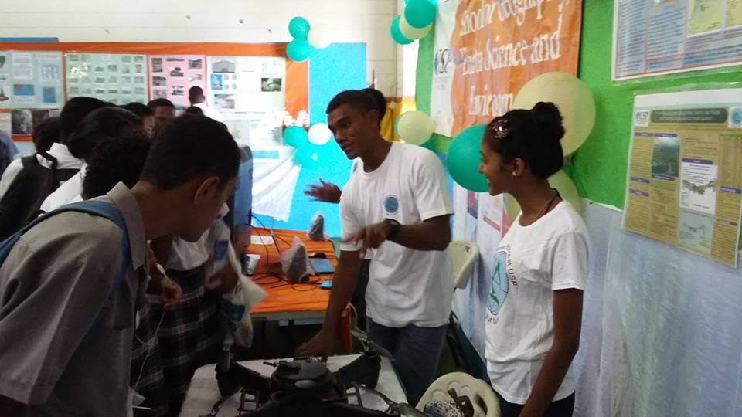
USP Open Day
Recruiting the next generation of Geospatial Science

Slide 42
Thank You

Slide 43
Please Don't forget to Vote for
Best Map
Best Poster

