Slide 1
The Pacific Geospatial and Surveying Council Strategy
Paserio Samisoni, PGSC Vice-Chair
29 November 2016

Slide 2
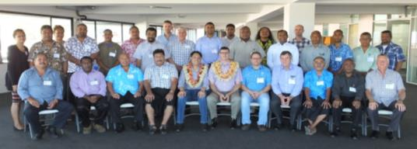
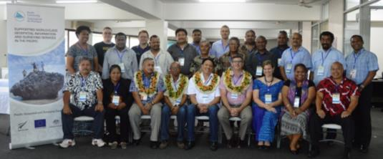
What is the PGSC?
Independent regional body advancing geospatial and surveying standards and capacity
Established in the margins of the 2014 GIS/RS User Conference
Governed by the PGSC Charter endorsed by 11 Pacific Island governments
Supported by PGSC Partnership Desk (SPC)
For more info, visit: http://gsd.spc.int/pgsc/

Slide 3
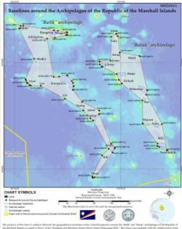
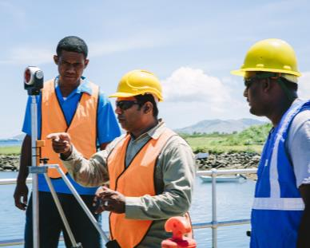
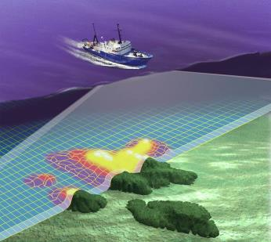
PGSC Vision
Sustainable development in the Pacific enabled by world class geospatial information and surveying services.

Slide 4
PGSC Strategy
10-year regional plan for developing geospatial and surveying capacity
Collaborative process
Member ownership

Slide 5
Purpose
1. To demonstrate the critical nature of geospatial and surveying information and services and the development and maintenance of these services in the Pacific region;
2. To articulate the collaborative aspirations of the region’s geospatial and surveying professionals in advancing capacity;
3. To guide the development of sustainable geospatial and surveying information and services in Pacific Island Countries and Territories, and;
4. To serve as an entry point for engagement with internal and external partners.

Slide 6
PGSC Strategy Goals
1. Leadership and Visibility
2. Standards and Technology
3. Sustainability
4. Capacity Building
Countries across the region adopt a modern Geodetic Reference Frame (GRF) and improved technology underpinning geospatial systems and applications.
Geospatial and surveying activities at the national and regional level are supported by a diverse and sustainable resource base.
The geospatial and surveying community is self-reliant with a culture supportive of learning innovation and gender equity.
The PGSC enables regional leadership, guidance and support for members to engage stakeholders and the community on geospatial and surveying activities.

Slide 7
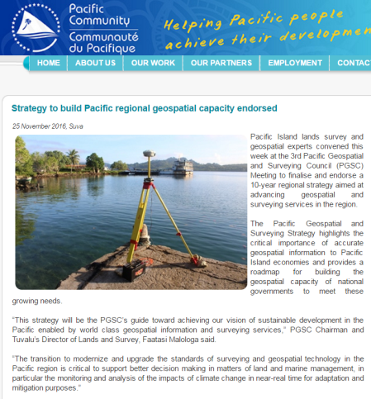
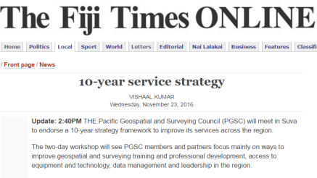
Endorsement
Members endorsed the strategy on 25 Nov
Plan to publish and launch by 2nd quarter 2017

Slide 8
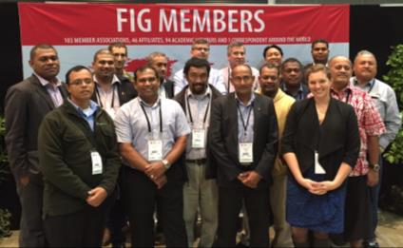
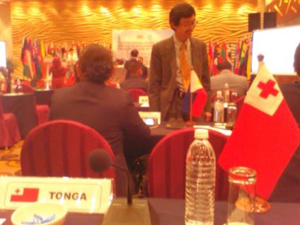
What is already happening?
May 2016- PGSC mentioned in FIG Christchurch Declaration
Aug 2016- Baseline capacity assessments begun
Oct 2016- PGSC represented and support for PGSC recommended at UN-GGIM AP Plenary
Nov 2016- 1st PGSC hosted workshop on Vertical Datums
Notes:
In support of the Strategy…

Slide 9
Many thanks for the support to date!

Slide 10
What comes next?
Complete baseline capacity assessments and country development plans
PGSC Working Groups to drive work on the 4 Goals
More regional training opportunities
PGSC Partnership desk to support and develop communications plan for the Strategy
Public and private sector partnerships
Continued implementation, monitoring, evaluation and learning…

Slide 11
Vinaka vakalevu Many thanks
QUESTIONS?

