Slide 1
Simple Stratification of African Tulip (Spathodea campanulata Beauv) through image enhancement
Romulose RaJale
Forestry
Notes:
Bula vinaka, I will be showing simple feature extraction from WorldView -3
data using your choice of software. In this research, ERDAS Imagine was used.
Please don’t leave the room just yet because its another African Tulip presentation.

Slide 2
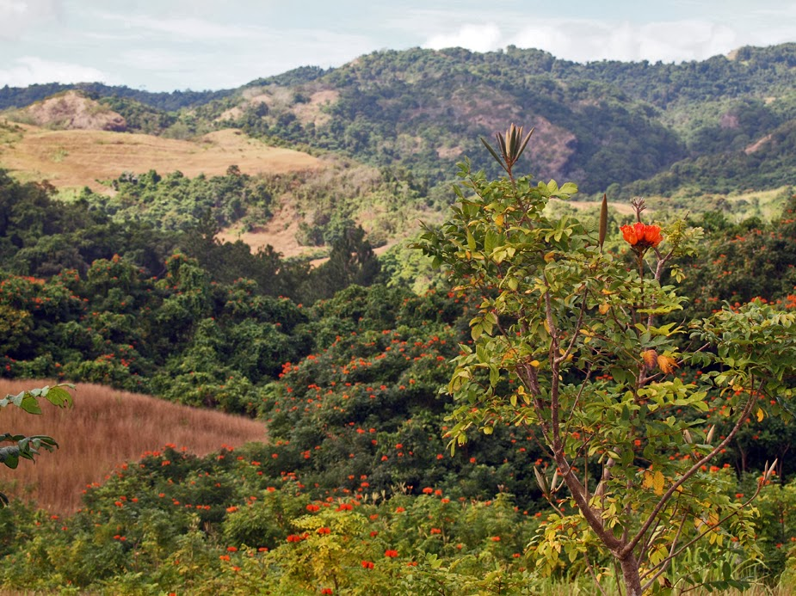
Native trees of Africa
?
Notes:
Alright, since its introduction in the 1930’s to prettify the streets of Suva as
an ornamental tree, African Tulip has made its way up as one of the worlds, top 100 most invasive plant.
Now what is the big fuss about that and Why we need to map it??

Slide 3
Regrow easily after a disaster.
Negative impact on local agriculture and forestry
Can wipe out the native species
Notes:
Now, for those of you that don’t know, these are the first few
trees that colonise an area after a cyclone.
It is also very difficult to remove from land because of
regrowth from broken root pieces and reinfestation from seedlings.

Slide 4
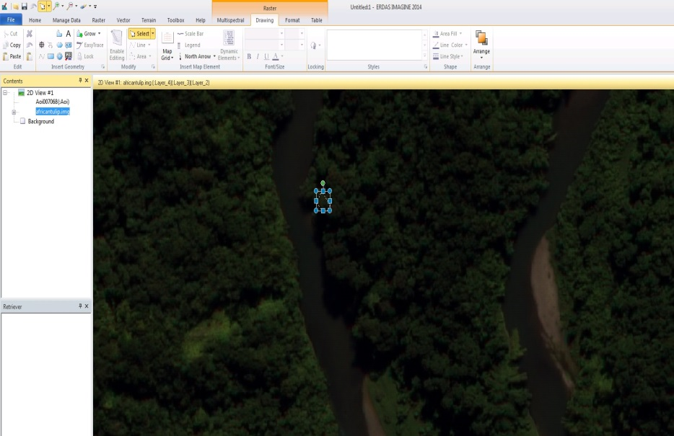
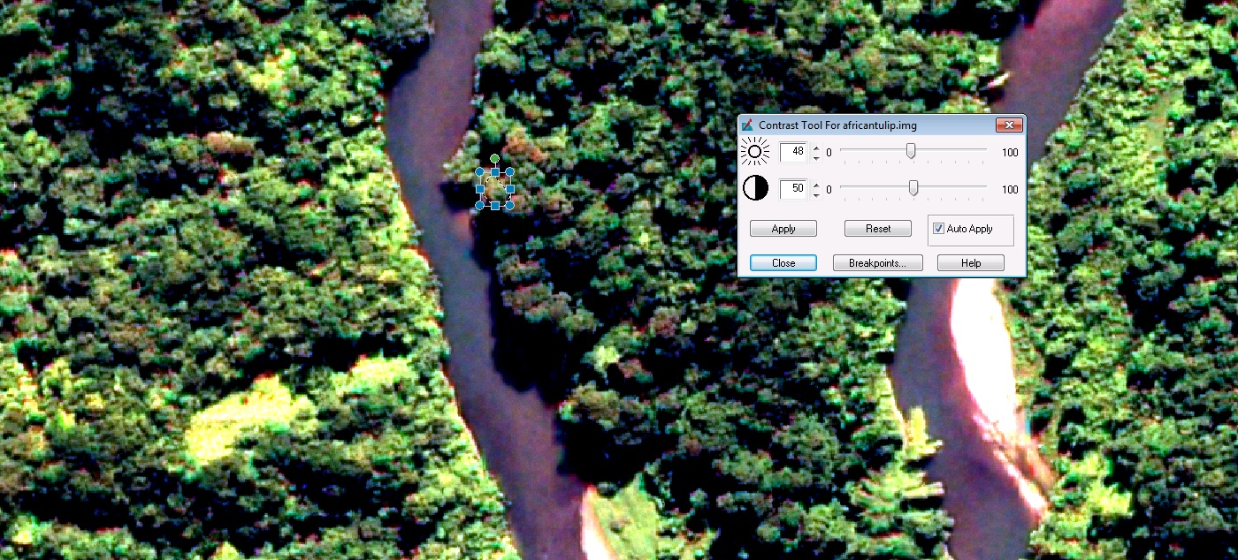
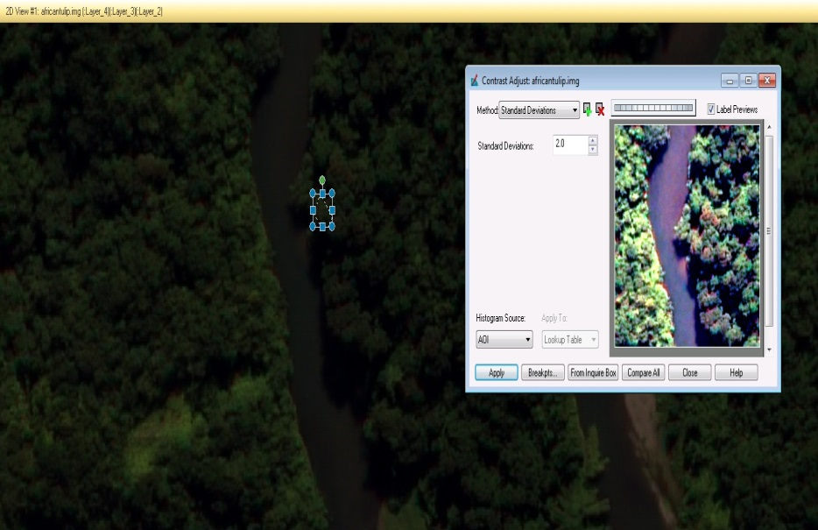
Image Enhancement
Notes:
We needed a method that was readily available and user friendly. So we kerekere to Peter for
some sample WV-3 data and technical support from SOPAC.
if you have a set of WorldView dataset, you can just highlight your feature of interest and play
around with the contrast adjustments bearing in mind the absorption and reflection properties of your feature.

Slide 5
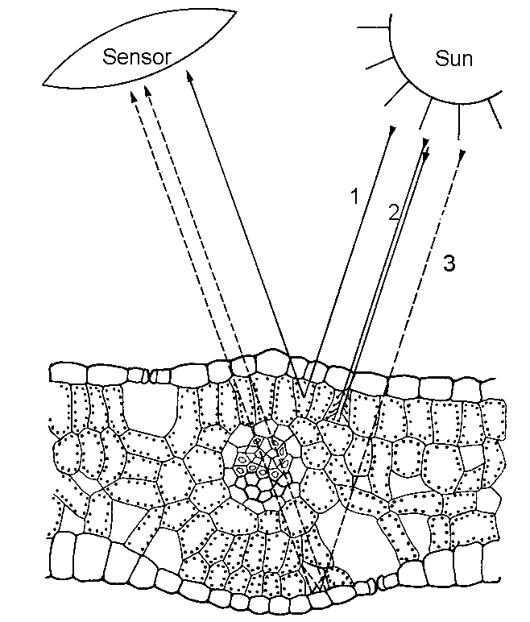
Absorption and Reflection of Leaves
1 green light
2 blue light and
red light
3 near infrared
Notes:
All this determines a features spectral abilities and the way we interpret them

Slide 6
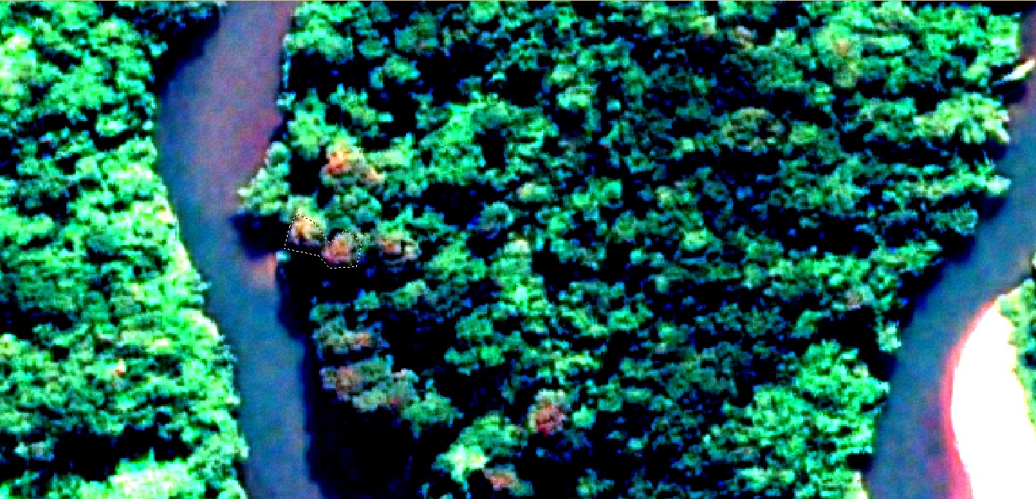
Natural Colour
Bands: 5,3,2 Enhanced
Notes:
During the flowering season, AF can be observed clearly.

Slide 7
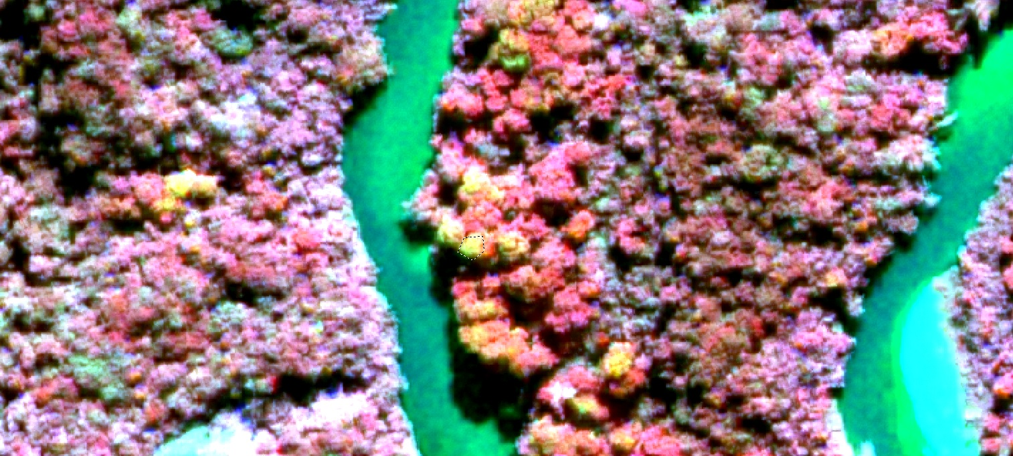
Infra - Red
Bands: 7,5,3 Enhanced
Notes:
And this is in the near infra red range. Still in the flowering season.
But most interestingly is the significant reflection in the Red Edge band when it’s not flowering season.

Slide 8
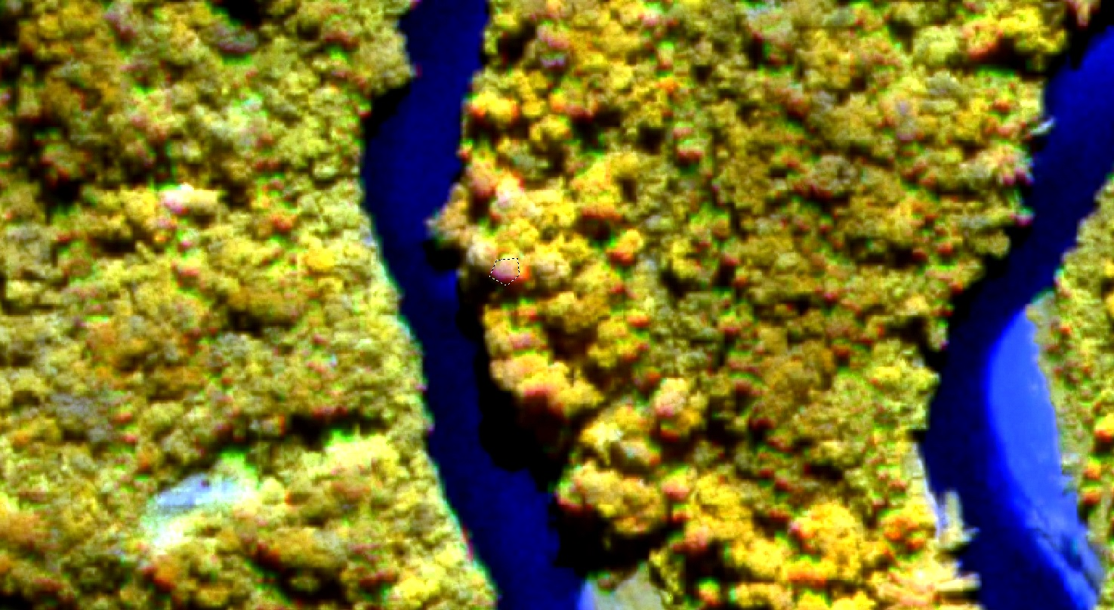
Red Edge
Near Infra-Red 1, Red Edge and Red
Bands: 8,6,5 Enhanced
Notes:
And you can see it here, and research is still on going to verify this results.

Slide 9
Spectral Plot
Notes:
Spectral Plot just to show the comparison with forest cover as it was initially included in this class.

Slide 10
Economical and non RS people can use
Eradication strategy put in place
Better Monitoring and Control
Notes:
With these method, farmers can be better informed where the African Tulips are growing and eradication methods can be planned and assist forestry field people location of these group of trees.
Please note This method can be used also for habitat mapping, mining and other applications.

Slide 11
Thanks

