Slide 1
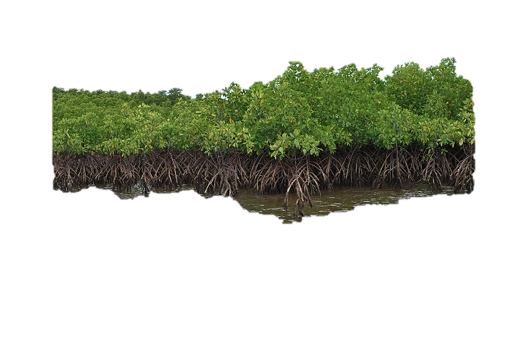
Using Sentinel Imagery in Modelling the Aboveground Biomass of Mangrove Forest and their Competing Land Uses
Jose Alan Castillo*, Armando Apan, Tek Maraseni and Severino Salmo III
*School of Civil Engineering and Surveying;
Institute for Agriculture and the Environment
University of Southern Queensland, Australia
Pacific Islands GIS/RS User Conference 2016
28 November – 01 December, Suva, Fiji

Slide 2
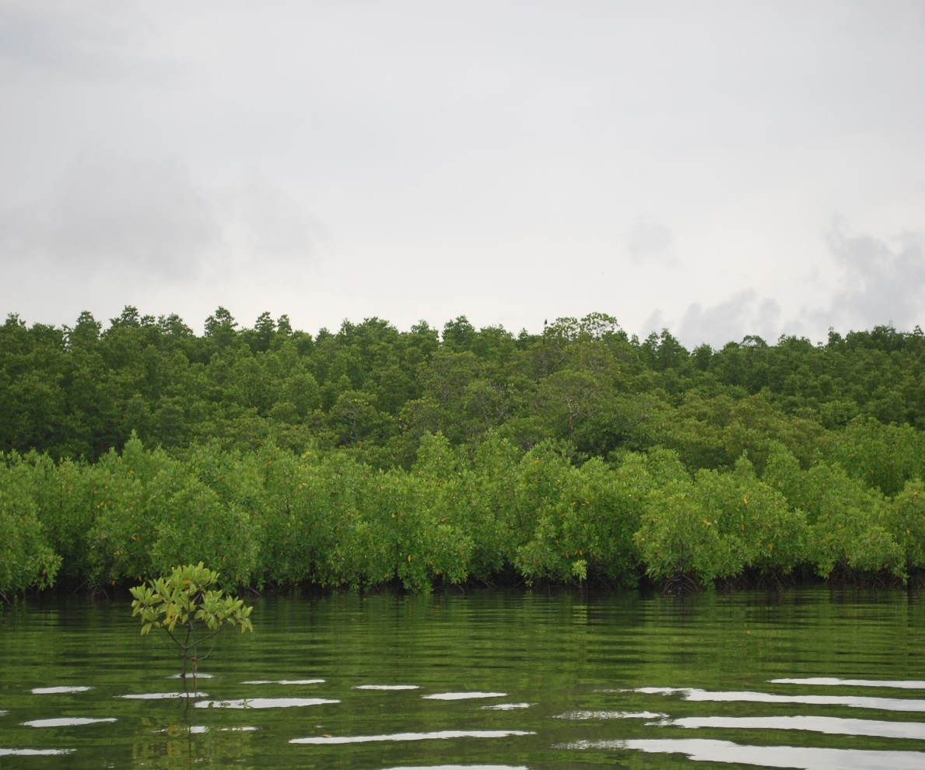
Outline of Presentation
Mangrove forest and land use conversion
Methods
  Field data
  Remote Sensing data
  Modelling and Mapping
Results
  Sentinel 1 (SAR)-based biomass map
  Sentinel 2 (Optical)-based map
Conclusion

Slide 3
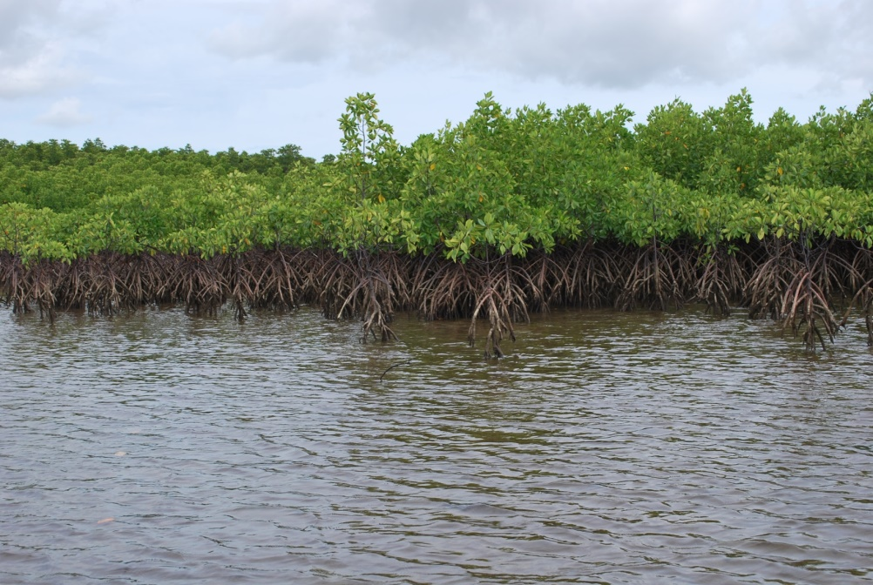
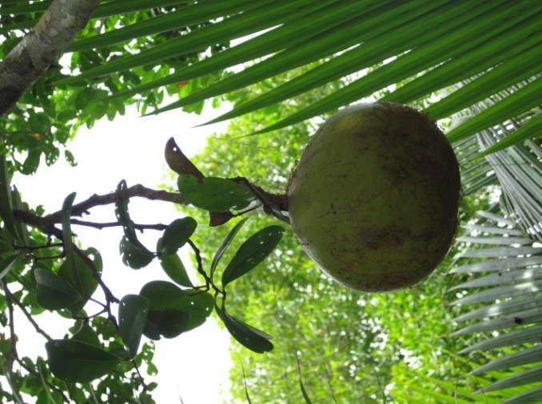
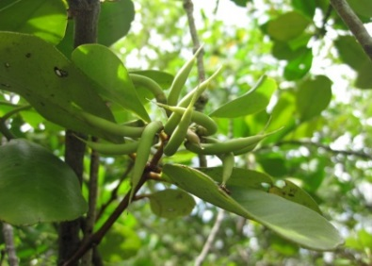
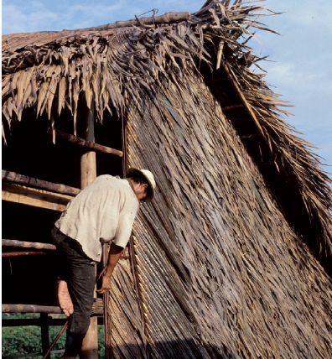
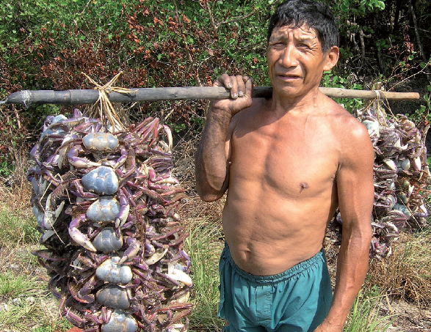
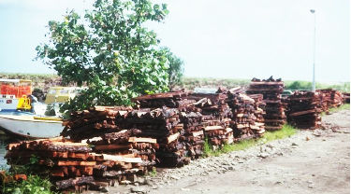
Background
Mangroves
  “Forest of the sea”, interface of land and sea
  Provide many ecosystem services including huge Carbon reservoir
Source: ITTO Tropical Forest Update (2012)

Slide 4
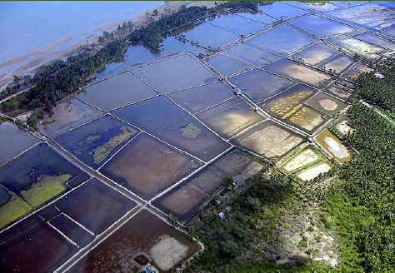
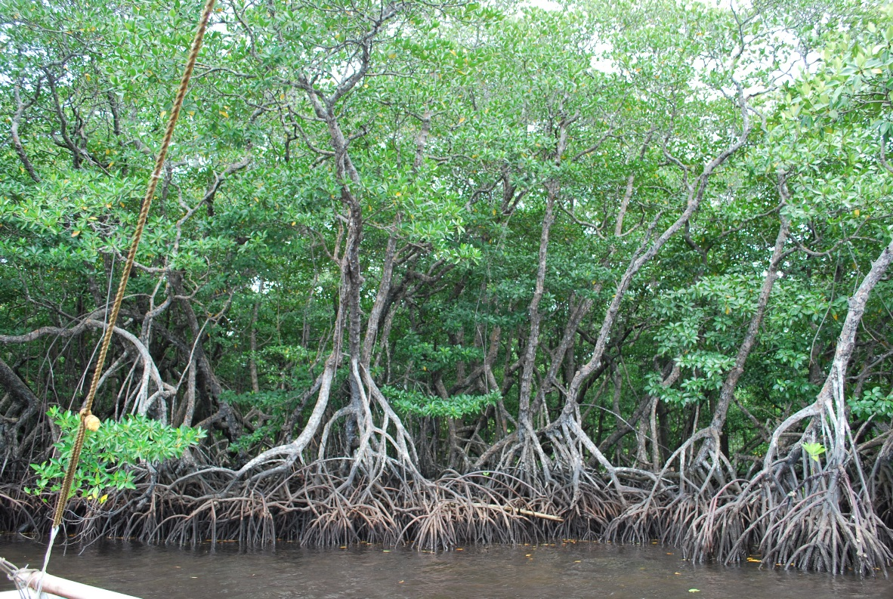
Background
Potentially large C emissions from biomass and soil due to mangrove conversion
Mapping and monitoring of biomass is important
Sentinel imagery is new and free of charge but not yet fully evaluated in mangrove biomass modelling and mapping

Slide 5
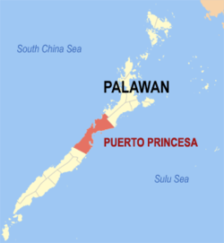
Method
Honda Bay
West Pacific
Tropical climate
1,527 mm rainfall

Slide 6
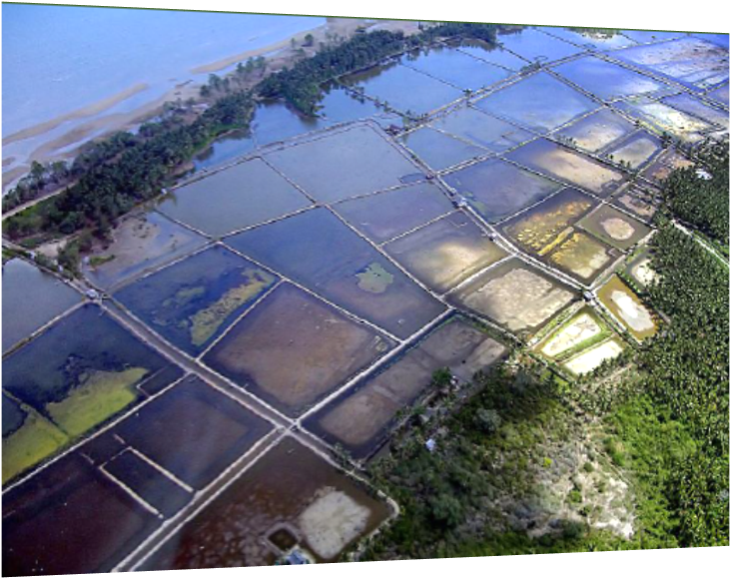
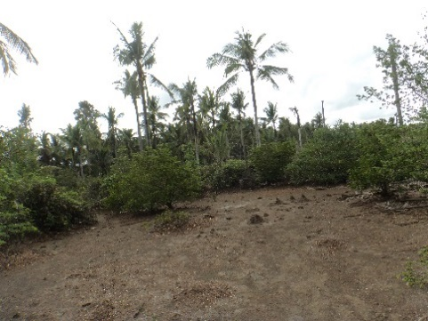
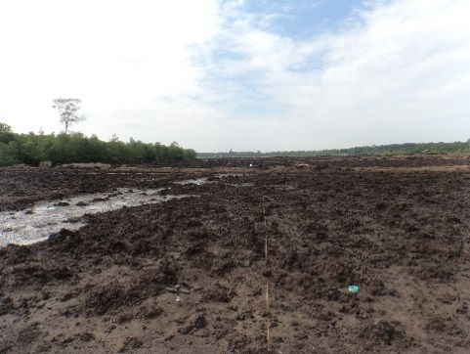
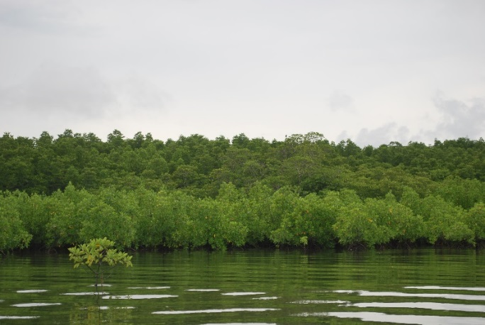
Method
Coastal land uses/land cover studied:
  Mangrove Forests
  Non-forest land uses in mangrove soil:
    Aquaculture pond (abandoned)
    Coconut plantation
    Salt pond (abandoned)
    Cleared mangrove

Slide 7
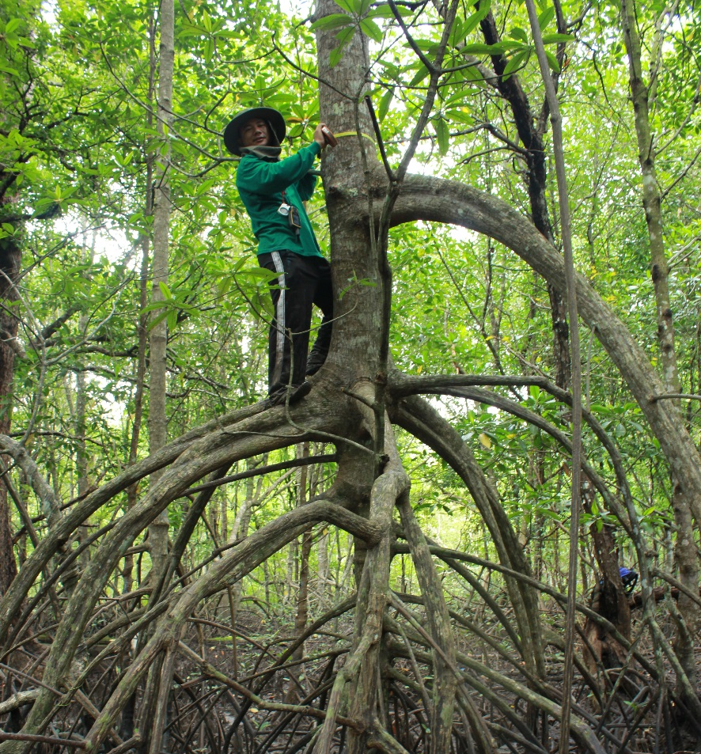
Method: Field Data
Plots (7-m radius) to collect field data (species, DBH, etc)
90 plots total (51- mangrove)
Plot coordinates – GPS
Published allometric models for mangrove biomass

Slide 8
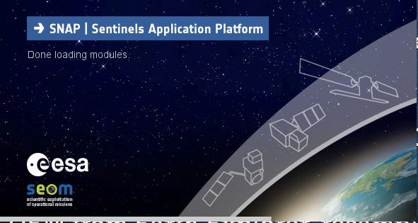
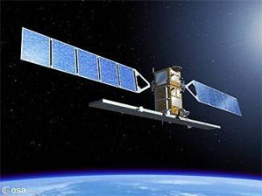
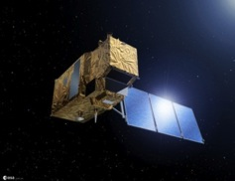
Method: Remote Sensing data
Sentinel 1 (SAR) and Sentinel 2 (Multispectral)
SNAP (Sentinels Application Platform) software (Open Source)
Sentinel 1 (IW-GRD product): 3 dates
Sentinel 2 (L1C product): processed to L2A (BOA reflectance) using Sen2Cor plug-in
SRTM 30-m DEM

Slide 9
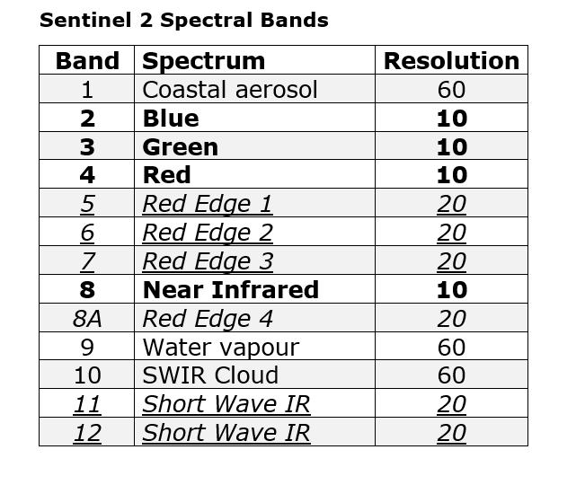
Sentinel 2
Spectral Band Resolutions (m)
Sentinel 1
IW-GRD High Resolution: 10m

Slide 10
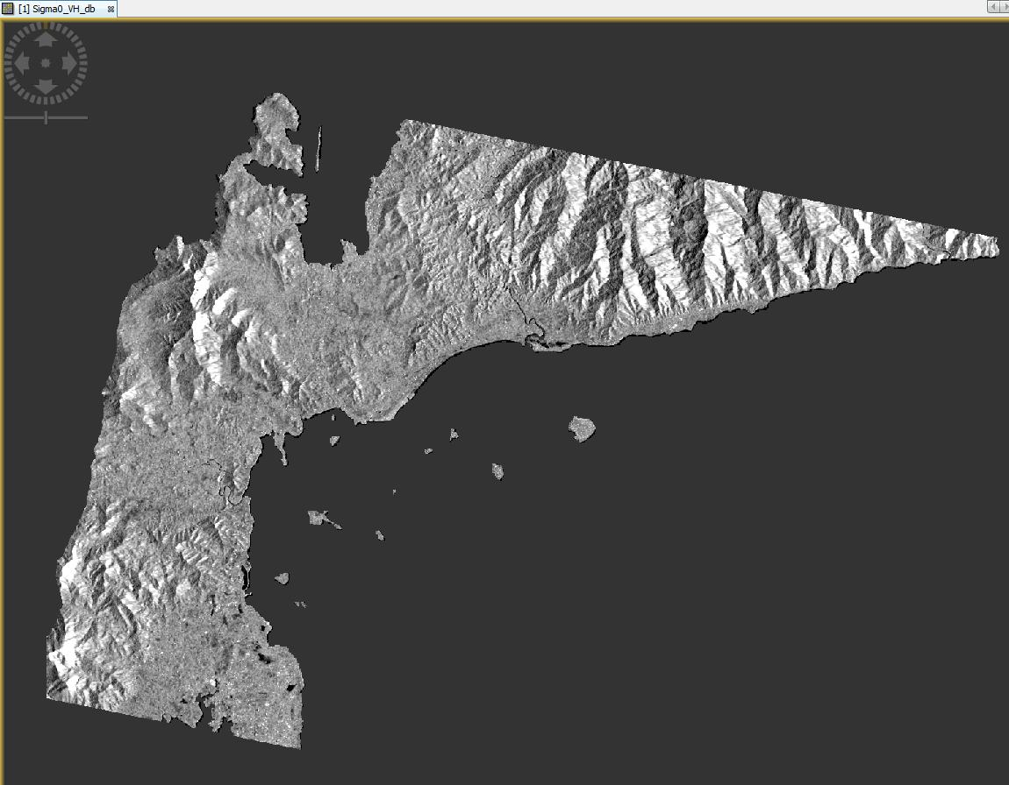
Sentinel 1 SAR Image (VH Polarisation)

Slide 11
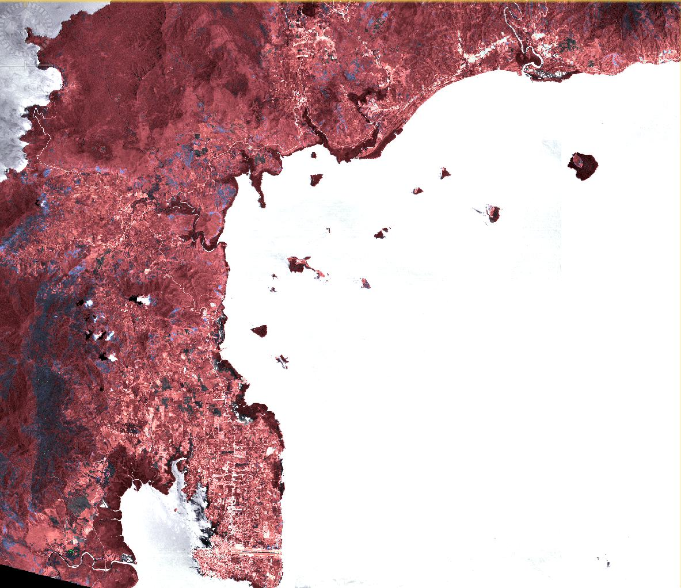
Sentinel 2 (MS) False Color Infrared HSV

Slide 12

Method: Biomass Modelling and Mapping
Modelling the linear relationships done in Weka machine learning software
Model building: 75% of field plots; validation: 25%
Best biomass model (highest r, lowest RMSE) then used in ArcGIS to develop biomass maps
Prediction Map validation: 25% of plots + 10 plots more (i.e. 32 plots, 19 mangrove): - RMSE, %Prediction Accuracy
12

Slide 13
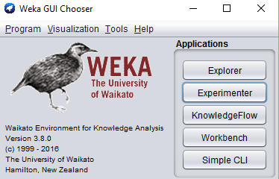
Weka machine learning software: Open source

Slide 14
Results
Field data: Aboveground biomass were variable and highest in mangrove forest
Land Use | Mean aboveground biomass (Mg ha⁻¹) | Biomass range (Mg ha⁻¹)
Mangrove Forest | 65.11 | 1.06 - 210.14
Non-mangrove
Abandoned aquaculture pond | 0.04 | 0 - 0.40
Coconut plantation | 11.36 | 0.20 – 19.74
Salt pond | 0 | 0
Cleared mangrove | 0 | 0

Slide 15
Results a
Sentinel 1 VV and VH polarisations moderately correlate with biomass; adding elevation data greatly improved the prediction
AGB = -37.702 + 4.3591*VVOCT - 3.2955*VHJAN + 12.6209*Elevation

Slide 16
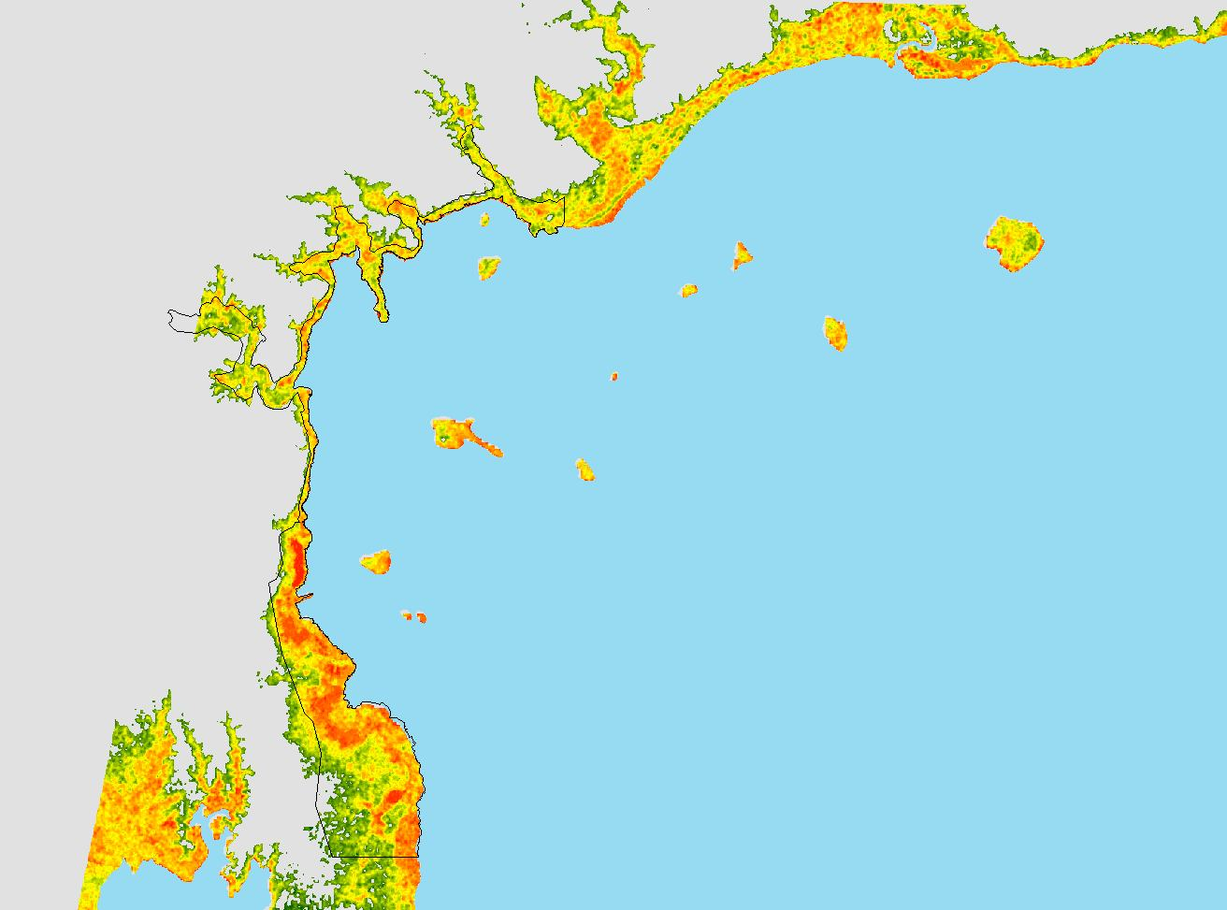
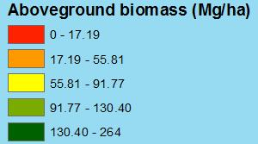
Sentinel 1-based Aboveground biomass Map
Honda Bay
RMSE: 25.5 Mg/ha
Prediction Accuracy: 83.8 %

Slide 17
Results
A
Sentinel 2 Red Edge 1 and Red Edge 2 bands combination provided better correlation and prediction; adding elevation data improved prediction
AGB = -3.2269 + 885.8416*Red – 1422.9515*Red Edge1 + 1320.47*Red Edge 2 – 751.8883*NIR + 9.9243*Elevation

Slide 18
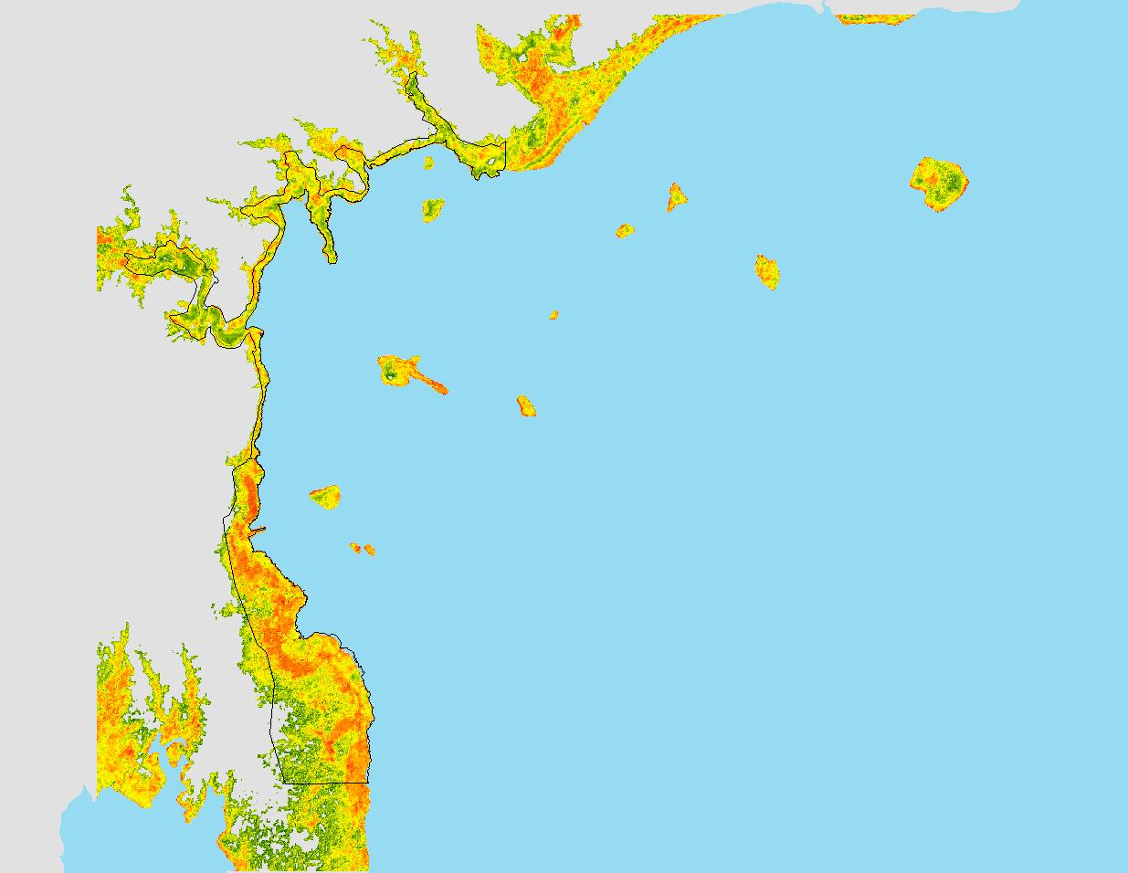
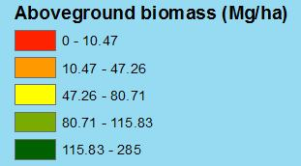
Sentinel 2-based Aboveground biomass Map
Sentinel 2-based Aboveground biomass Map
Honda Bay
RMSE: 26.9 Mg/ha
Prediction Accuracy : 83.2 %

Slide 19
Results a
Sentinel 2 NDI45 vegetation index gave better correlation and prediction with biomass
NDI45 = Normalised Diff. Index 4 and 5 (Red Edge 1 – Red) / (Red Edge 1 + Red)
IRECI = Inverted Red Edge Chlorophyll Index (Red Edge 3 - Red)/(R. Edge 1- R. Edge 2)
AGB = 150.0705*NDI45

Slide 20
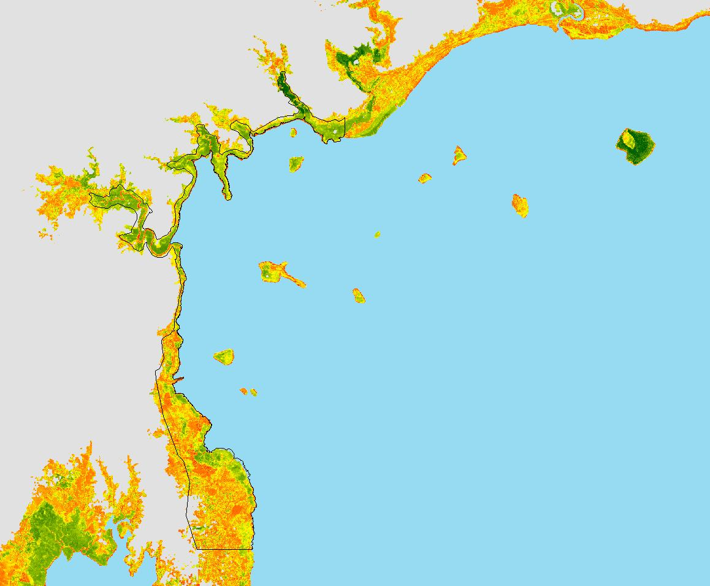
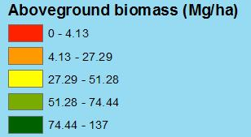
Sentinel 2 NDI45-based Aboveground biomass Map
Sentinel 2 NDI45-based Aboveground biomass Map
Honda Bay
RMSE: 27.9 Mg/ha
Prediction Accuracy: 82.2 %

Slide 21
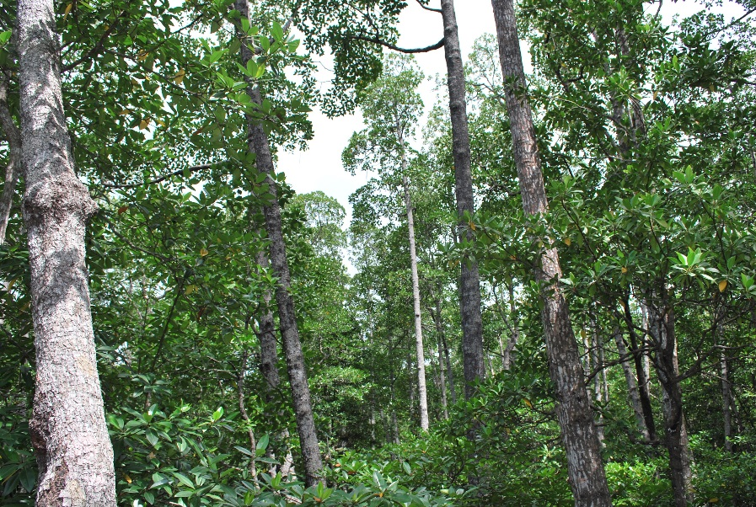
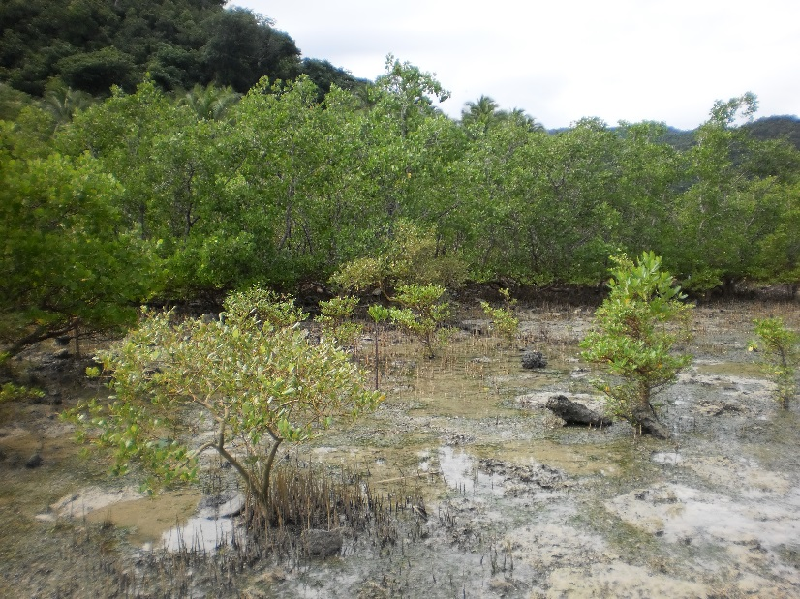
Conclusion
Sentinel 1 and 2 data, with SRTM elevation, useful in mapping aboveground biomass of mangrove in the coast of southern Honda Bay
Derived maps for pinpointing high biomass areas for policy and management attention

Slide 22

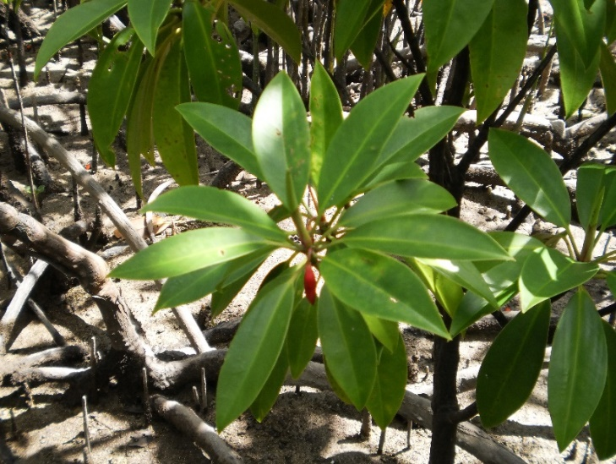
Conclusion
Where clouds are persistent, Sentinel 1 SAR imagery is a useful option to map coastal biomass as SAR are not weather-dependent
RS/GIS users from developing countries would benefit from Sentinel imagery as they are high resolution (10-20m), available for free and with support user-friendly open source software (i.e. SNAP)

Slide 23
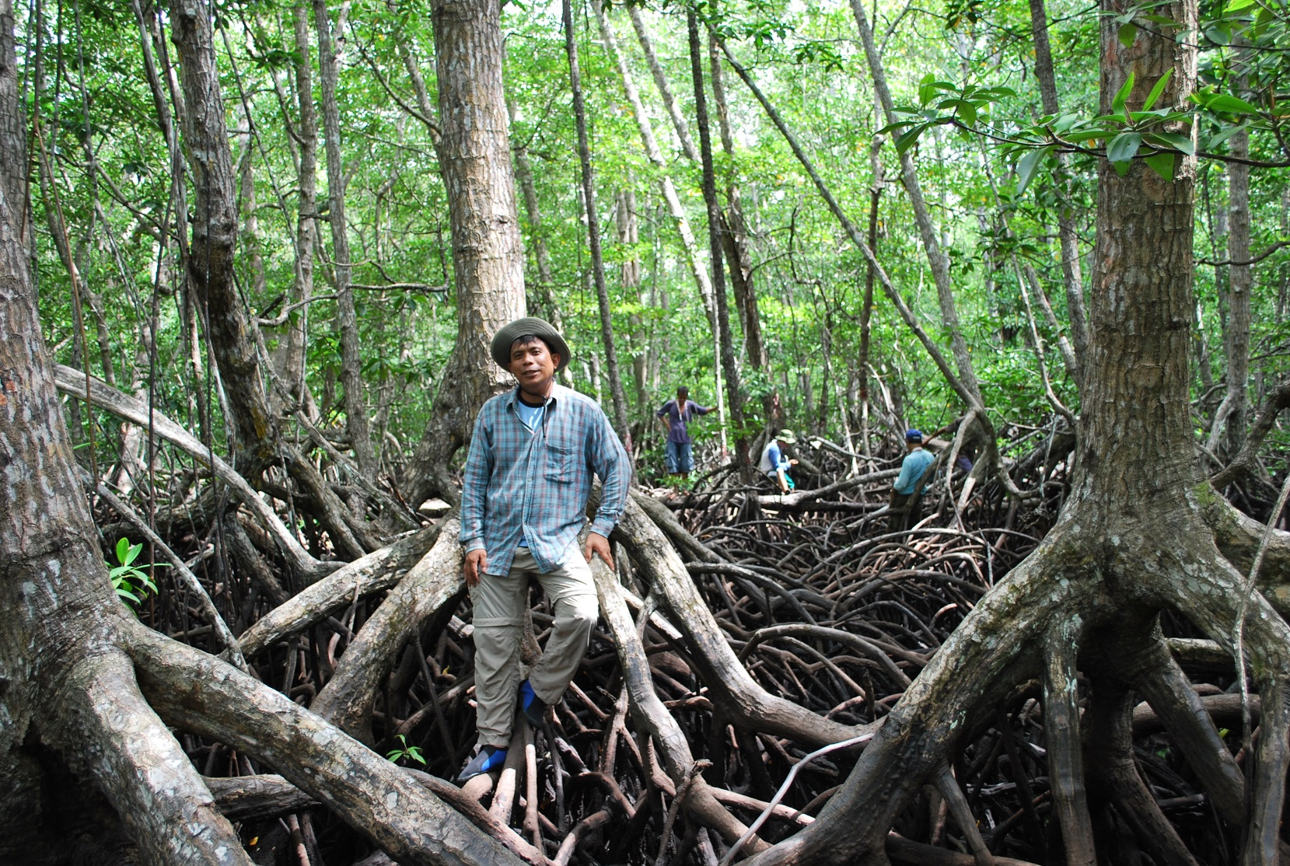
Thank You Very Much!

