Slide 1
Forest Change Detection Fiji 1991, 2001, 2007 and 2012, as Wall to Wall Mapping
Vilisi Tokalauvere,
Pacific GIS/RS User Conference,
November 28th - December 1st, 2016
Notes:
The calculation of the rate of deforestation is required by the Fiji Forestry Department as a part of REDD initiatives. The mapping part including new satellite image data, software and manpower was financed by GIZ.

Slide 2
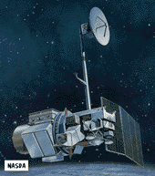
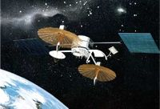
Forest Inventory Fiji 1991
Tracking and Data Relay Satellite System TDRSS
First Pacific Island Country covered with satellite images
Notes:
The forest layer showing the forest cover of Fiji’s National Forest Inventory conducted with Landsat TM image data recorded in 1991 and 1992 by satellite Landsat 4.
TDRSS = Tracking and Data Relay Satellite System TDRSS allowed to record and transmit image data from Fiji

Slide 3
Forest Inventory 2006
Conducted with image data recorded 2001/2002
Mask building
Maximum likelihood classification with maximum visual interaction
Notes:
The national forest was carried out in 2006 with image data captured in 2001. It was a condition of the donor to use maximum likelihood image classification and not visual image interpretation and an unsupervised classification was chosen as method most linked to manual steering. Consequently, it was impossible to establish a database showing the spectral signatures for each forest type.

Slide 4
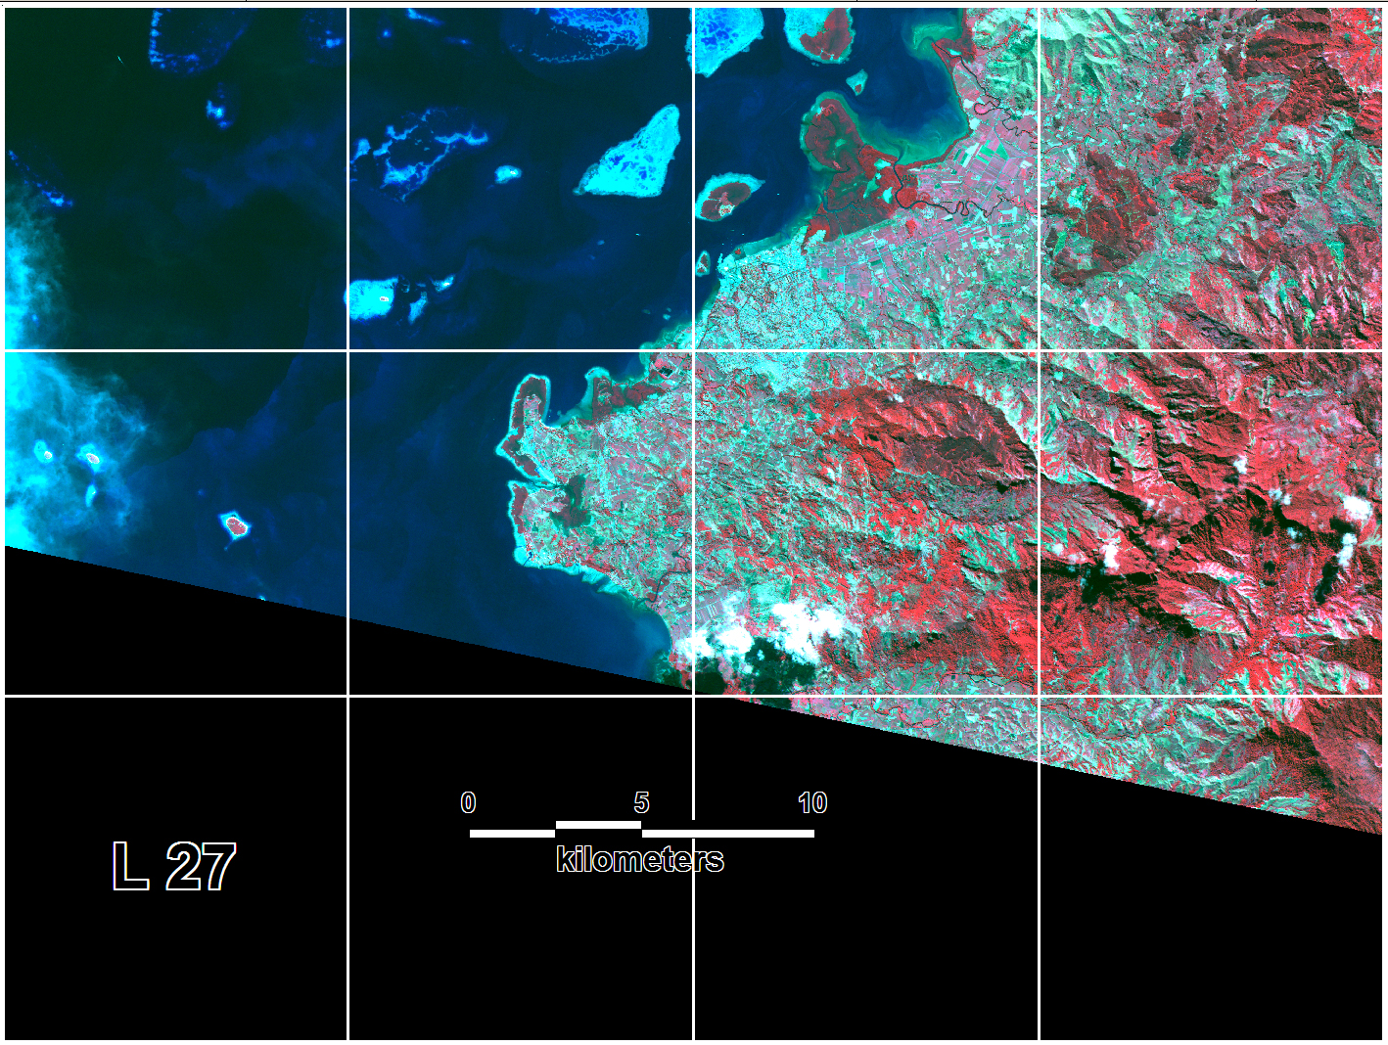
ALOS Satellite 2007

Slide 5
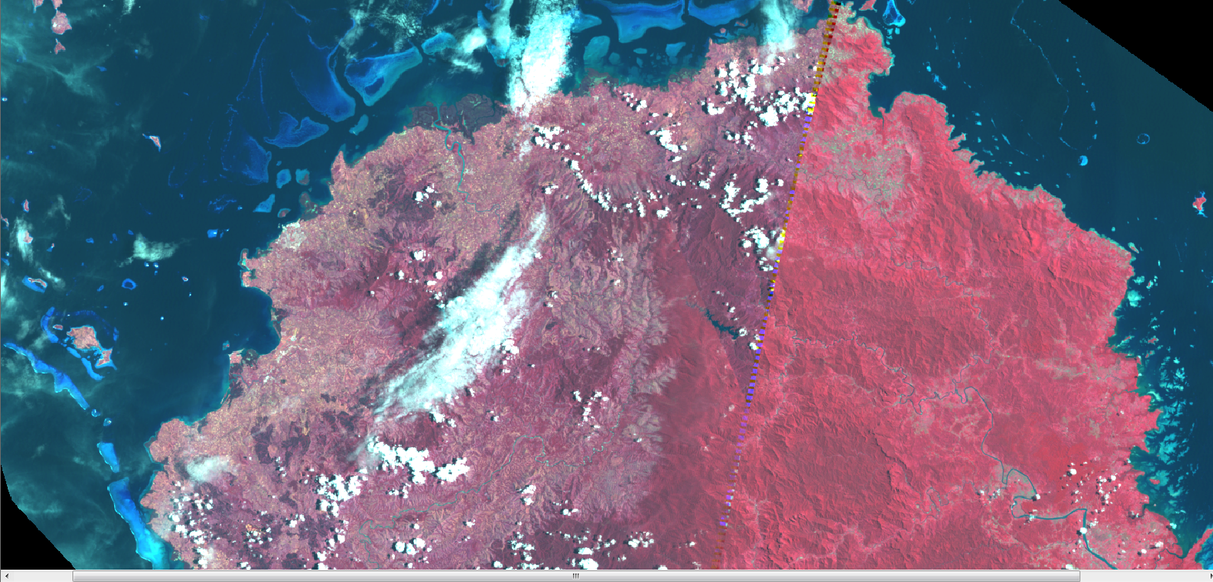
2012 Landsat 7 Image Data

Slide 6
Digitising 2012 Forest Layer

Slide 7
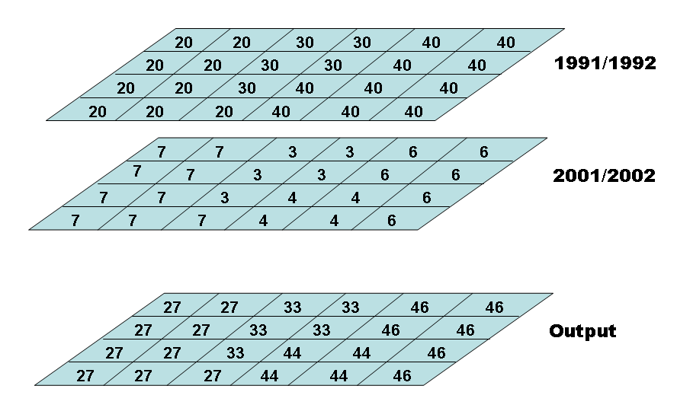
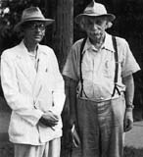
Overlay Analysis 1:50,000
Notes:
Kurt Gödel a friend of Albert Einstein developed methods to link to different information to a new one without loosing the track to the origin. However this only works smoothly in raster data environment. The digitising in vector GIS environment had to be transferred to raster data environment. By multiplying one layer by ten and then adding corresponding pixels it is known which class is converted to which new land cover or forest type class.

Slide 8
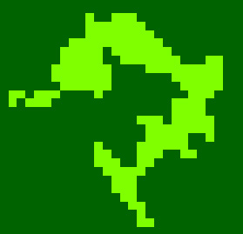
Reducing to Mappable Area Size
Clump
Cluster No. 2384
1.2 ha
All clusters < 1 hectare are joined with the next biggest neighbour class
Eliminate
Notes:
ERDAS provides a module (Clump) which analyses all clusters of pixels and archives them where an address of the cluster and the size (number of pixels) is stored as well.
ERDAS module (Eliminate) allows eliminating all clusters below 1 hectare size, where the pixels of these clusters are recoded and added to next biggest neighbour class. To reduce noise it was agreed to filter areas smaller than 1 hectares.

Slide 9
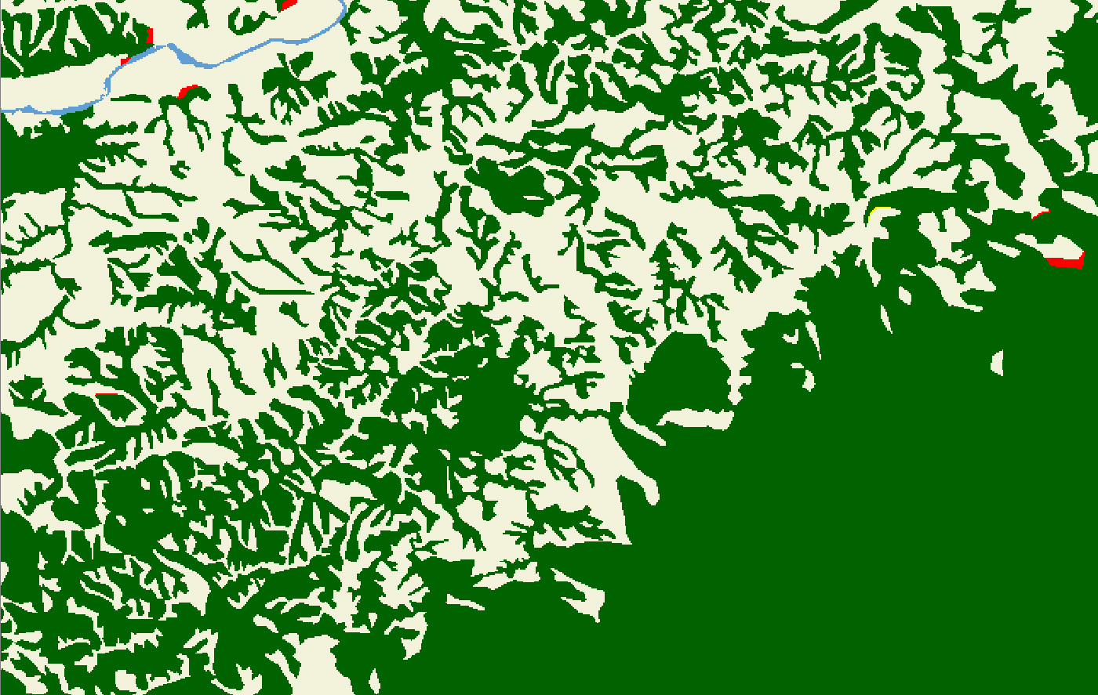
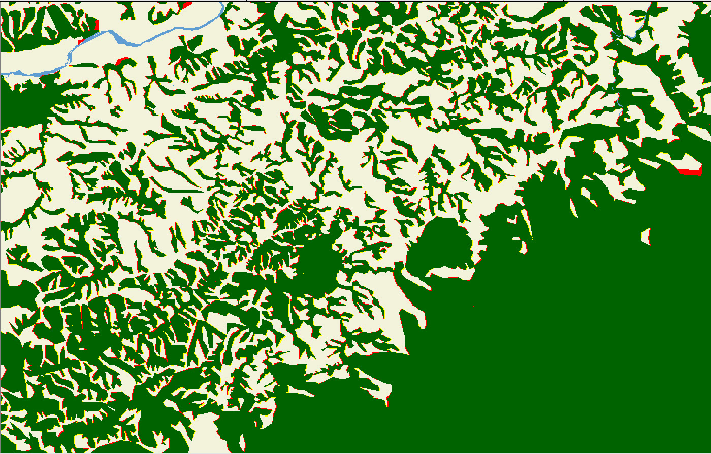
1Hectare Accumulation

Slide 10
Output from Access Database
ID | Hectare | Legend
R22 |  | -----------------------------------------------------------------------------------------
 |  | 1 Stable Natural Forest
22 | 2,739 | Mangrove in 1991 and mangrove in 2001
11 | 49,791 | Natural forest in 1991 and natural forest in 2001
SUM | 52,530
 |  | 2 Reforestation Natural Forest
71 | 12 | Water body in 1991 and natural forest in 2001
61 | 2 | Non forest in 1991 and natural forest in 2001
72 | 364 | Water body in 1991 and mangrove in 2001
SUM | 378
 |  | 3 Deforestation Natural Forest
25 | 166 | Mangrove in 1991 and coconut cover in 2001
15 | 212 | Natural forest in 1991 and coconut cover in 2001
16 | 231 | Natural forest in 1991 and non forest in 2001
Notes:
The area database can summarise all 16 tables (of the 16 map sheets covering Viti Levu) into one table (D). Also this procedure is now code written and works semi automatically. The database converts the results into hectare figures by dividing the summarised number of pixels for every class by 16. To fully work in integer values and avoid real numbers the areas are rounded to full hectare by this process. This explains that the numbers for one map sheet can differ up to 2 hectares.

Slide 11
Rate of Deforestation
Area /Time Period | STFO | REFO | DEFO | STFOPL | CHFOPL | REFOPL | DEFOPL | NOFO | SUM
Viti Levu 1991 - 2001 | 554,961 | 9,953 | 12,725 | 72,388 | 22,946 | 4,421 | 4,761 | 1,237,850 | 1,920,005
Vanua Levu 1991 - 2001 | 363,253 | 4,757 | 19,449 | 25,135 | 19,623 | 7,107 | 2,896 | 1,357,780 | 1,800,000
Outer Islands 1991 - 2001 | 58,045 | 774 | 746 | 37,690 | 147 | 302 | 232 | 502,064 | 600,000
Sum | 976,259 | 15,484 | 32,920 | 135,213 | 42716 | 11830 | 7889 | 3,097,694 | 4,320,005
Area /Time Period | STFO | REFO | DEFO | STFOPL | CHFOPL | REFOPL | DEFOPL | NOFO | SUM
Viti Levu 2001-2007 | 582,892 | 94 | 424 | 81,349 | 0 | 0 | 0 | 1,255,242 | 1,920,001
Vanua Levu 2001 - 2007 | 377,287 | 38 | 561 | 42,015 | 0 | 0 | 11 | 1,380,087 | 1,799,999
Outer Islands 2001 - 2007 | 58,639 | 1,357 | 237 | 38,121 | 0 | 0 | 0 | 501,647 | 600,001
SUM | 1,018,818 | 1,489 | 1,222 | 161,485 | 0 | 0 | 11 | 3,136,976 | 4,320,001
3.37 %
3.32 %
Notes:
In Fiji African tulip can cover pasture land and build a dense canopy which then is interpreted as forest. The colour coding for reforestation is yellow in the detailed change detection reports.

Slide 12
Rate of Deforestation
Area /Time Period | STFO | REFO | DEFO | STFOPL | CHFOPL | REFOPL | DEFOPL | NOFO | SUM
Viti Levu 1991 - 2001 | 554,961 | 9,953 | 12,725 | 72,388 | 22,946 | 4,421 | 4,761 | 1,237,850 | 1,920,005
Vanua Levu 1991 - 2001 | 363,253 | 4,757 | 19,449 | 25,135 | 19,623 | 7,107 | 2,896 | 1,357,780 | 1,800,000
Outer Islands 1991 - 2001 | 58,045 | 774 | 746 | 37,690 | 147 | 302 | 232 | 502,064 | 600,000
Sum | 976,259 | 15,484 | 32,920 | 135,213 | 42716 | 11830 | 7889 | 3,097,694 | 4,320,005
Area /Time Period | STFO | REFO | DEFO | STFOPL | CHFOPL | REFOPL | DEFOPL | NOFO | SUM
Viti Levu 2001-2007 | 582,892 | 94 | 424 | 81,349 | 0 | 0 | 0 | 1,255,242 | 1,920,001
Vanua Levu 2001 - 2007 | 377,287 | 38 | 561 | 42,015 | 0 | 0 | 11 | 1,380,087 | 1,799,999
Outer Islands 2001 - 2007 | 58,639 | 1,357 | 237 | 38,121 | 0 | 0 | 0 | 501,647 | 600,001
SUM | 1,018,818 | 1,489 | 1,222 | 161,485 | 0 | 0 | 11 | 3,136,976 | 4,320,001
3.37 %
3.32 %
0.12 %

Slide 13
Rate of Deforestation
Area /Time Period | STFO | REFO | DEFO | STFOPL | CHFOPL | REFOPL | DEFOPL | NOFO | SUM
Viti Levu 1991 - 2001 | 554,961 | 9,953 | 12,725 | 72,388 | 22,946 | 4,421 | 4,761 | 1,237,850 | 1,920,005
Vanua Levu 1991 - 2001 | 363,253 | 4,757 | 19,449 | 25,135 | 19,623 | 7,107 | 2,896 | 1,357,780 | 1,800,000
Outer Islands 1991 - 2001 | 58,045 | 774 | 746 | 37,690 | 147 | 302 | 232 | 502,064 | 600,000
Sum | 976,259 | 15,484 | 32,920 | 135,213 | 42716 | 11830 | 7889 | 3,097,694 | 4,320,005
Area /Time Period | STFO | REFO | DEFO | STFOPL | CHFOPL | REFOPL | DEFOPL | NOFO | SUM
Viti Levu 2001-2007 | 582,892 | 94 | 424 | 81,349 | 0 | 0 | 0 | 1,255,242 | 1,920,001
Vanua Levu 2001 - 2007 | 377,287 | 38 | 561 | 42,015 | 0 | 0 | 11 | 1,380,087 | 1,799,999
Outer Islands 2001 - 2007 | 58,639 | 1,357 | 237 | 38,121 | 0 | 0 | 0 | 501,647 | 600,001
SUM | 1,018,818 | 1,489 | 1,222 | 161,485 | 0 | 0 | 11 | 3,136,976 | 4,320,001
976,259 hectares
1,018,818 hectares
Notes:
This deforestation can be related to clearing of forest or mangrove areas, however, even heavy logging is not counted as deforestation because there is still a canopy cover left which is interpreted as forest. It is visible that the forest boundary moves uphill in some valleys and small gallery forests or mangrove patches disappear, but it is impossible to remotely map the removal of forest biomass due to selective logging operation

Slide 14
Rate of Deforestation
2007 - 2012
Area /Time Period | STFO | REFO | DEFO | STFOPL | CHFOPL | REFOPL | DEFOPL | NOFO | SUM
Viti Levu 2001-2007 | 563,892 | 94 | 516 | 81,349 | 0 | 0 | 0 | 1,255,242 | 1,920,001
Vanua Levu 2001 - 2007 | 377,187 | 38 | 613 | 42,015 | 0 | 0 | 11 | 1,380,087 | 1,799,999
Outer Islands 2001 - 2007 | 58,539 | 1,357 | 217 | 38,121 | 0 | 0 | 0 | 501,647 | 600,001
SUM | 999,618 | 1,489 | 1,346 | 161,485 | 0 | 0 | 11 | 3,136,976 | 4,320,001
0.13 %

Slide 15
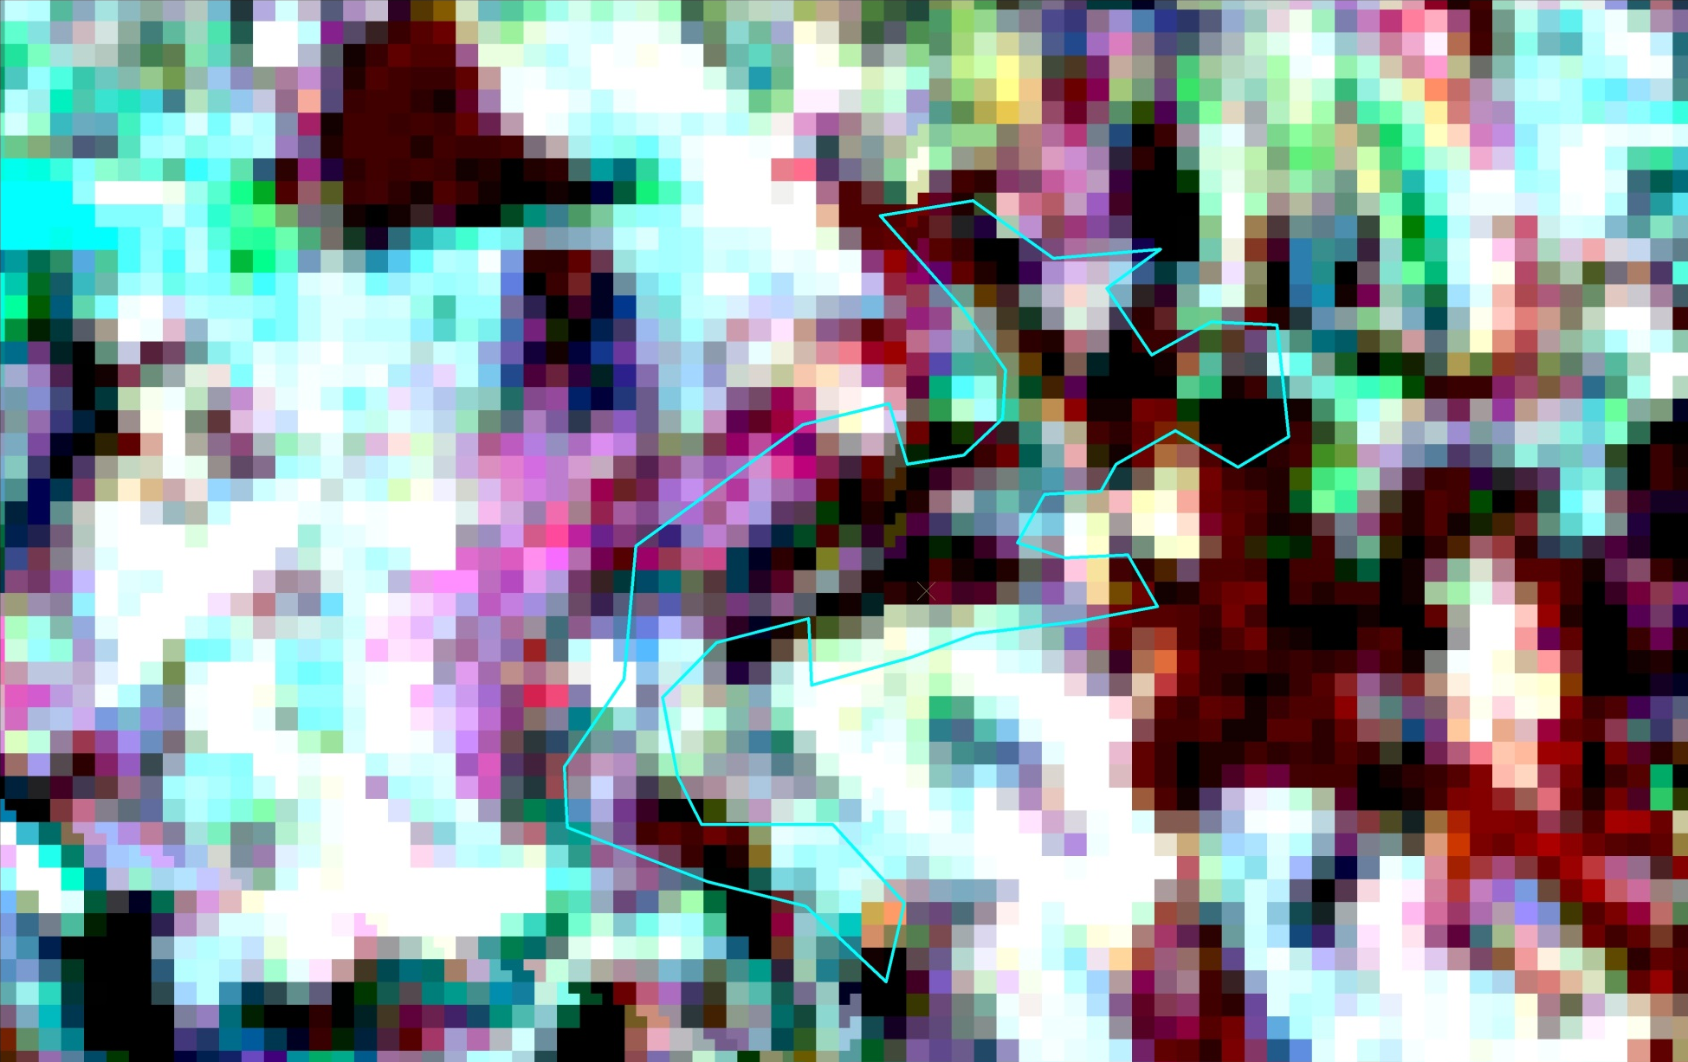
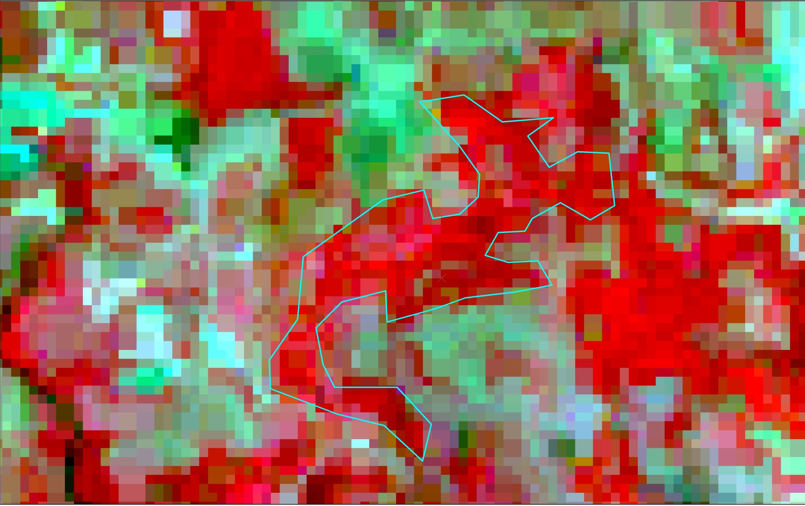
Deforestation

Slide 16
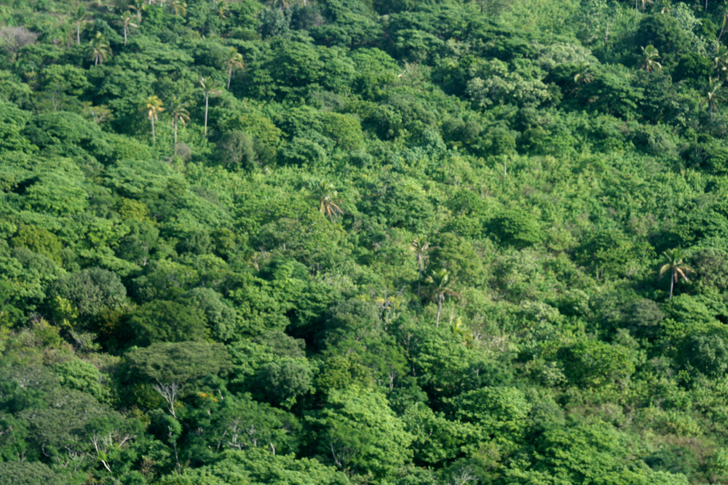
VINAKA

