Slide 1
Setup
Open http://arcg.is/2fwCjhC you should not need to sign-in
Open Story Map Series template page https://storymaps.arcgis.com/en/app-list/map-series/
Open the Map Tour (sometimes on smaller tablets it does not quite embed well) http://arcg.is/2fwDwFQ

Slide 2
Notes:
The 2016 Kaikoura earthquake was a magnitude7.8 (M_{w}) earthquake in the South Island of New Zealand that occurred two minutes after midnight on 14 November 2016 NZDT (11:02 on 13 November UTC). The epicentre was about 15 kilometres (9 mi) north-east of Culverden and 60 kilometres (37 mi) south-west of the tourist town of Kaikoura.
This map to the right is a Shakemap that is produced by the US Geological Survey. It provides an immediate source of information to estimate the potential human and economic impact.
This is a static map that can be printed, but next we will take a look at examples of web mapping applications that are dynamic and provide focused information depending on the audience. This is possible through geographic information systems on the internet, or Web GIS. The ability to deliver focused applications that anyone in the world can access is greatly enhancing situational awareness and revolutionizing the way we look at maps.

Slide 3
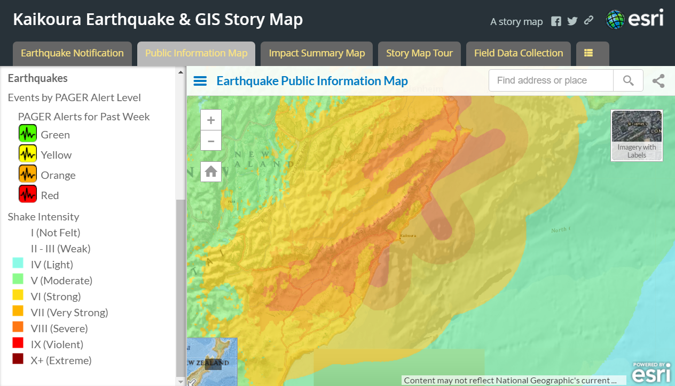
Notes:
Earthquake Public Information Map
This map displays continuously updated data from the USGS Earthquakes and Shakemaps. It also features feeds from geo-tagged social media and Webcams.
This is a live map! It updates when new earthquakes occur. I can zoom in…

Slide 4
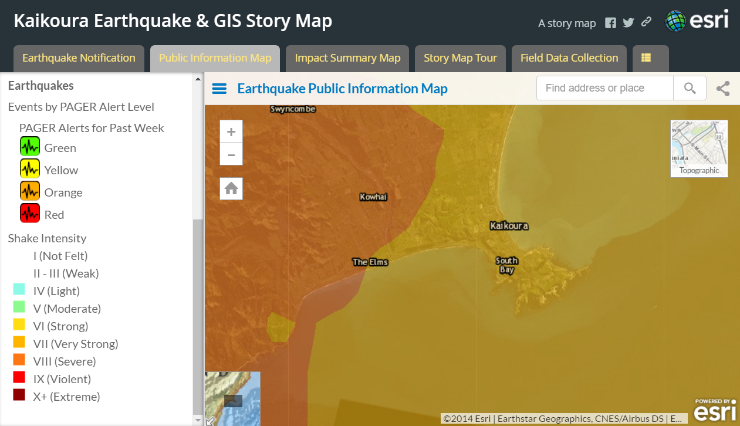
Notes:
Turn layers on and off, and get a more relevant sense of where the impact is.

Slide 5
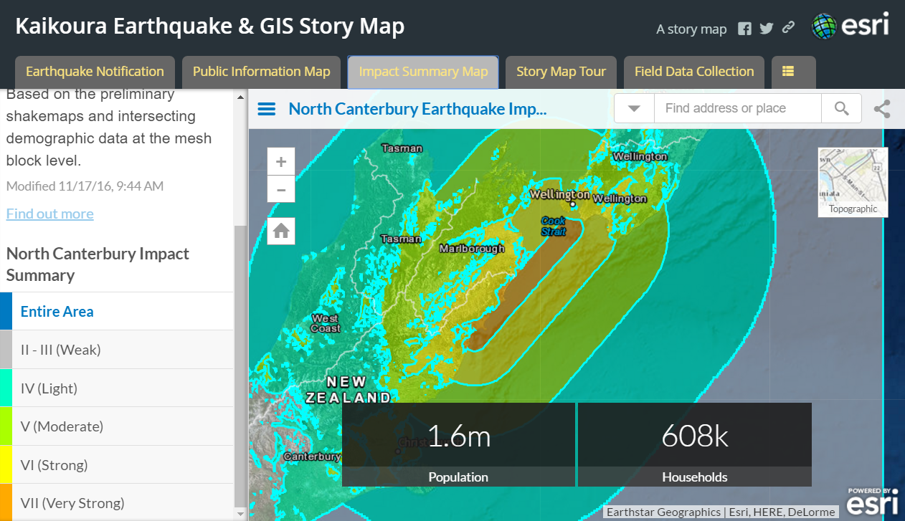
Notes:
Here is an impact summary map.
This map answers the questions - who and what has been impacted? The answers are based on the preliminary shakemaps and intersecting demographic data at the mesh block level.

Slide 6
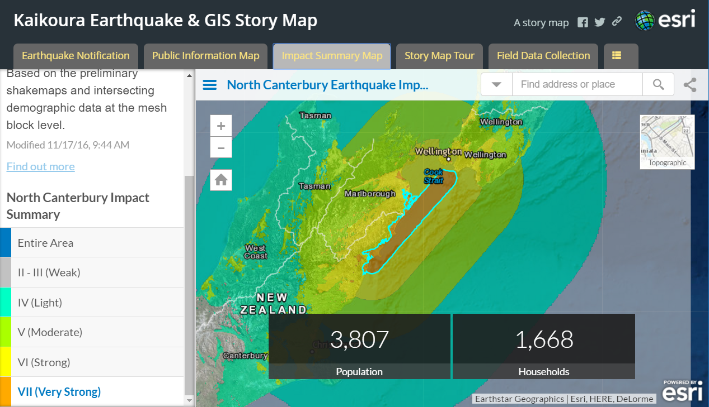
Notes:
I can focus on just the areas that were hardest hit, in this case the area that received Very Strong shaking – 3,807 people in 1,668 Households.

Slide 7
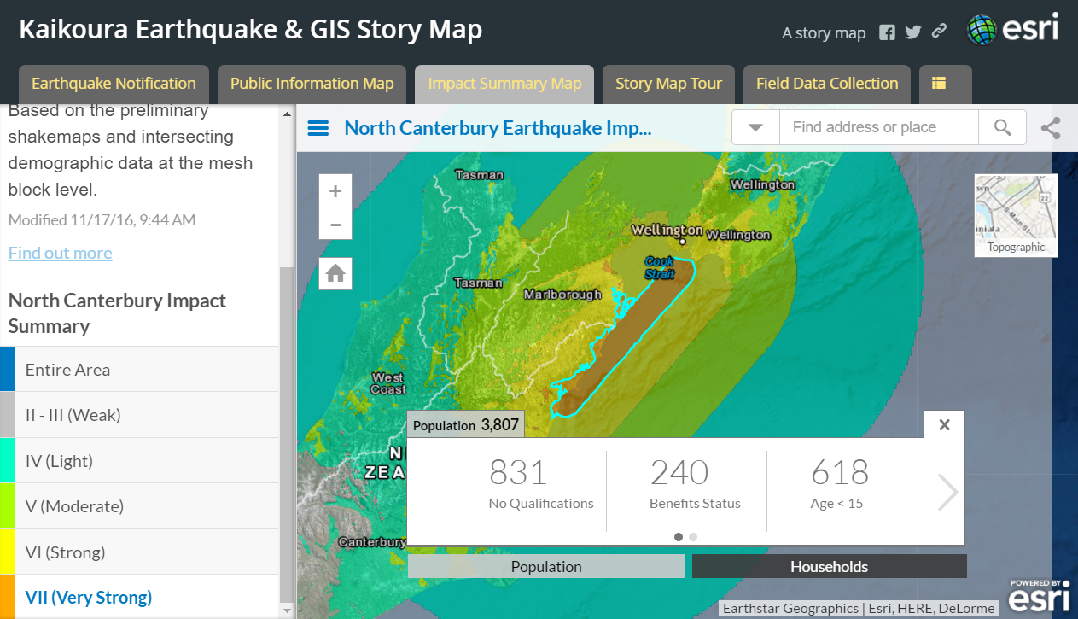
Notes:
If I want to dig a little deeper, I can find out more about those 3,807 people. For instance, their economic status and their age. Important variables in both response and recovery.

Slide 8
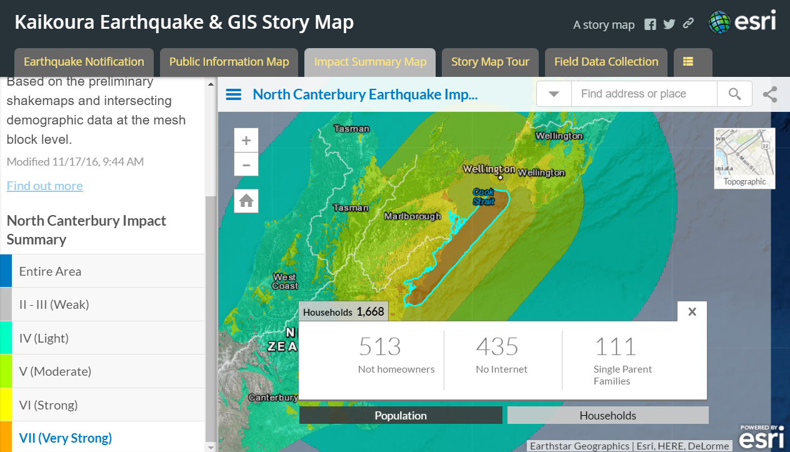
Notes:
OR which households are not homeowners, have no internet, or are single parents.

Slide 9
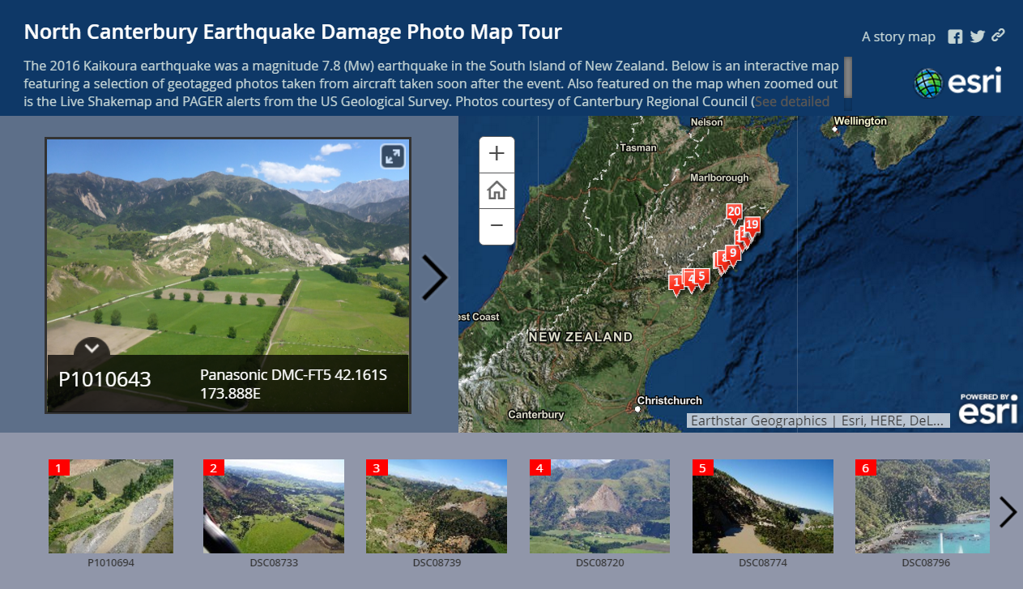
Notes:
This is an interactive map featuring a selection of geotagged photos taken from aircraft taken soon after the event. Photos courtesy of Canterbury Regional Council.

Slide 10
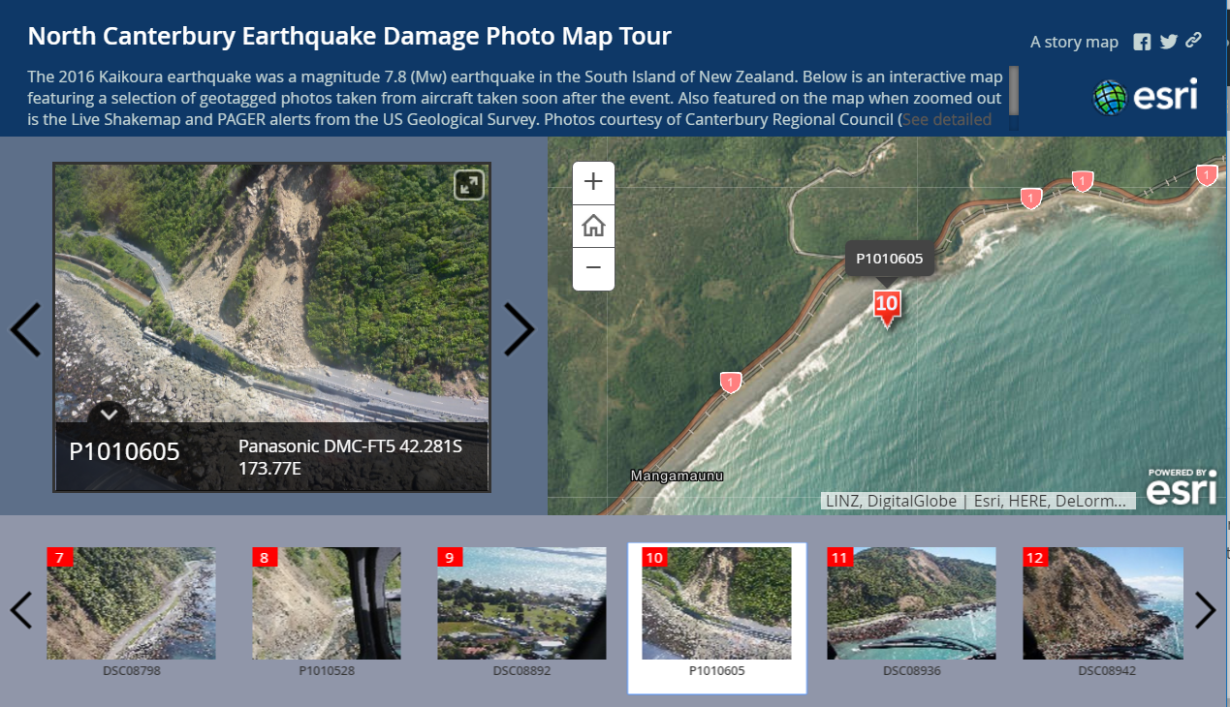

Slide 11
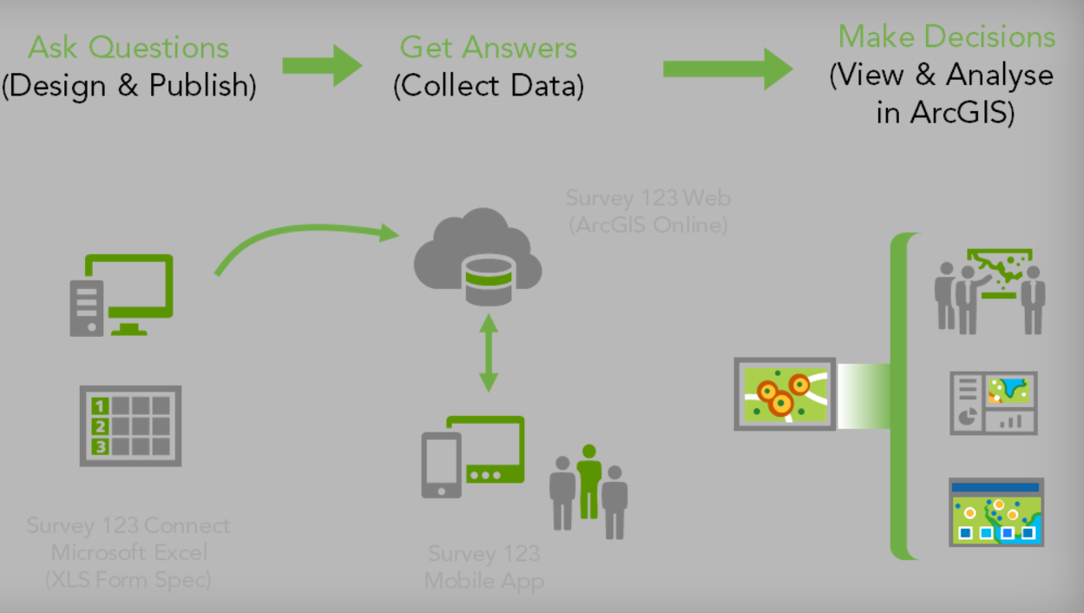
Notes:
GIS Analysts quickly producde maps used for field data collection using Web GIS. These maps were taken offline into disaster areas where internet is not yet available. Then their data wase shared with decision makers in the command post and with other agencies who will use that information to make decisions.
A variety of apps can be deployed for this purpose, click on the links to find more information.
Survey123 for collecting points (video)
Collector for ArcGIS for editing layers and using maps

Slide 12
Notes:
Geography really does matter during an emergency and maps can help change outcomes for survivors. GIS Staff are a critical team member of emergency management and their preparedness for disaster is extremely important.

Slide 13
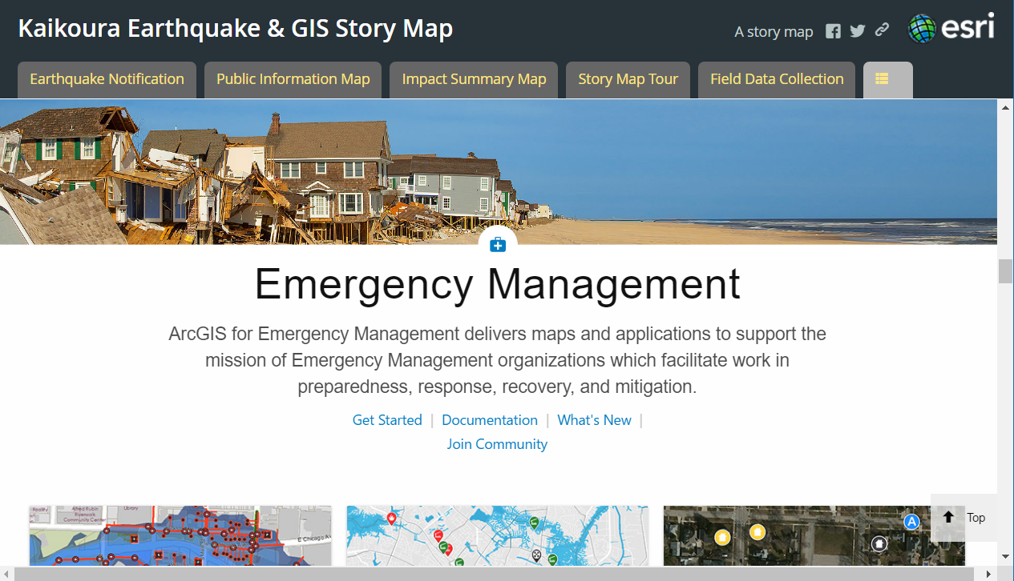
Notes:
So – what can you do to prepare? Visit this website (solutions.arcgis.com) and explore the templates for emergency management.
ArcGIS for Emergency Management delivers maps and applications to support the mission of Emergency Management organizations which facilitate work in preparedness, response, recovery, and mitigation.
Web maps and apps should be deployed ahead of disaster and used regularly for disaster planning. This way the apps are there and familiar when you need them.

Slide 14
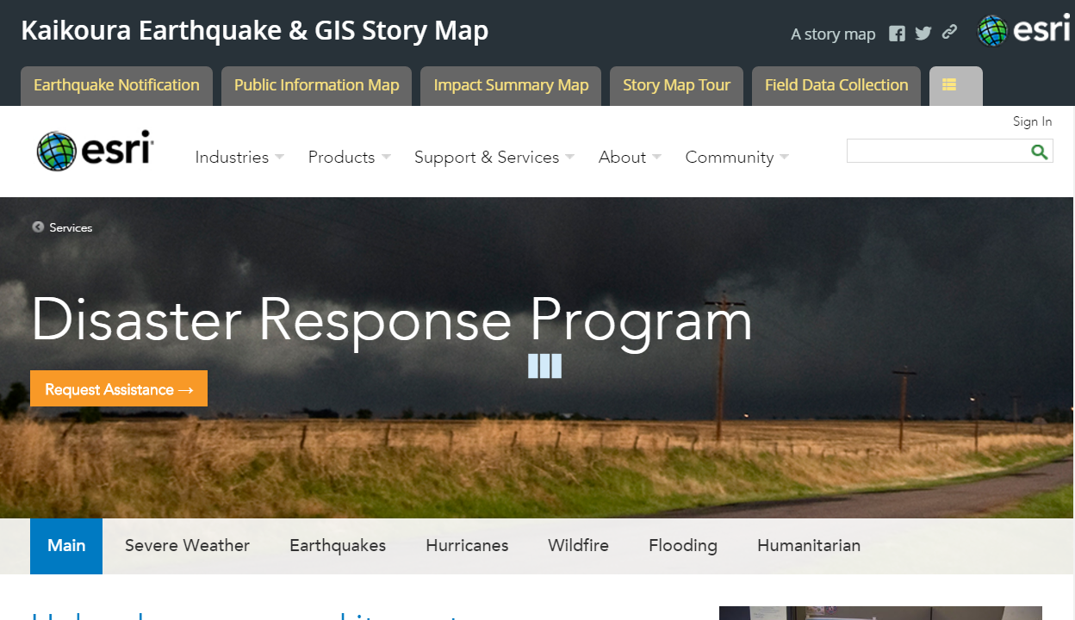
Notes:
Finally – if you have been making progress towards using GIS for disaster response, but still need our help, visit www.esri.com/disaster and make a request.
When disaster strikes, Esri’s Disaster Response Program (DRP) is here to support you around the clock, 24/7. Monitor events online, explore rich content, augment software, and request assistance from Esri experts as part of our corporate citizenship.
By the way – this presentation was created using the Story Map Series template – an ArcGIS Online configurable app that is becoming commonly used in Emergency Management for briefings.
The Story Map Series℠ app lets you present a series of maps via tabs, numbered bullets, or our expandable 'side accordion' control. In addition to maps, you can also include images, video and web content in your series to tell your story and engage your audience.

